Slide 1
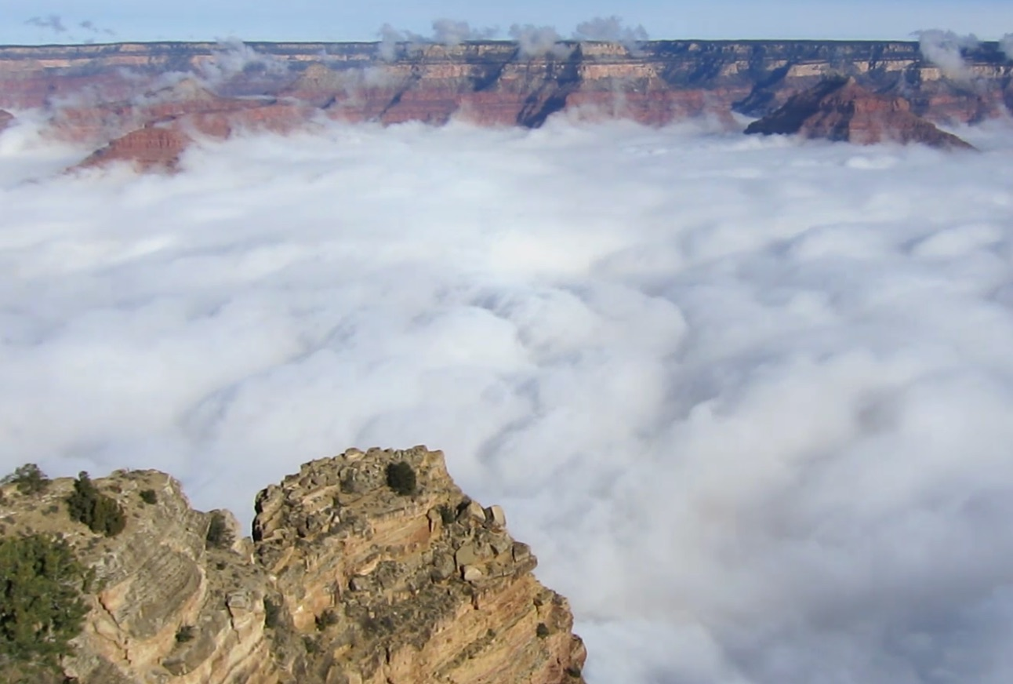
The Grand Canyon:
Exploring Connections between microclimate and vegetation

Slide 2
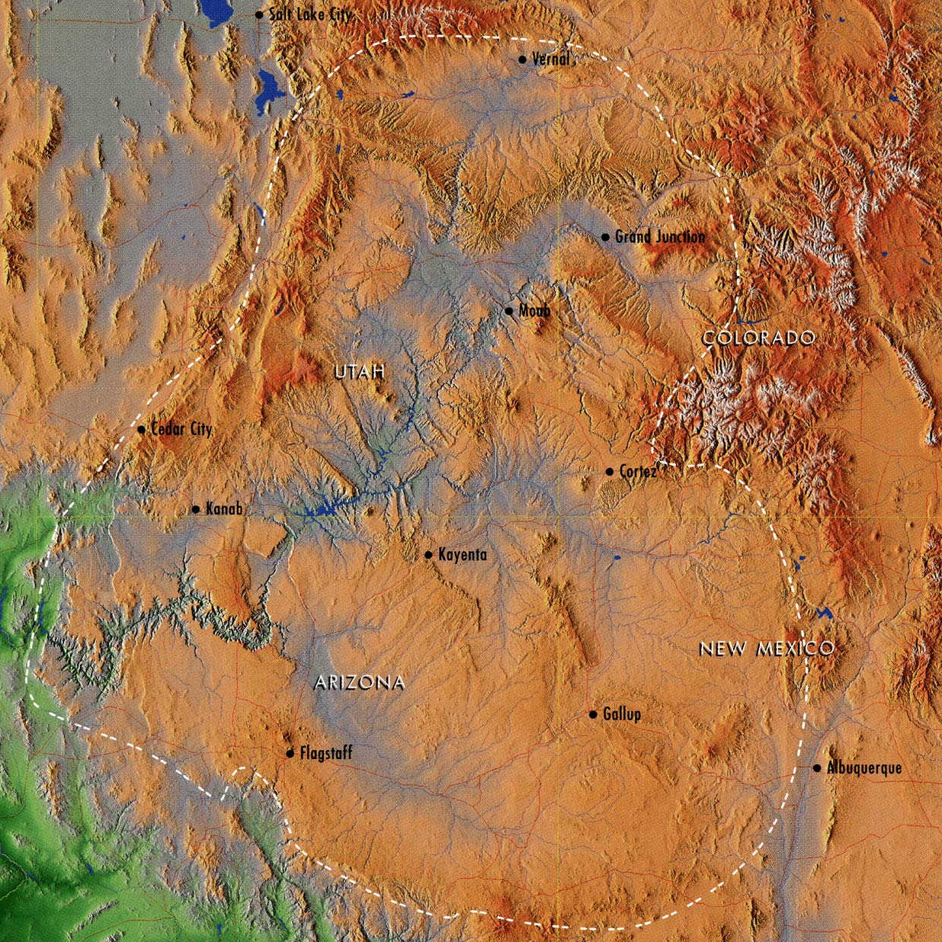
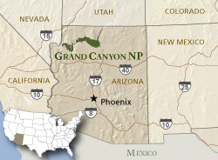
Grand Canyon Region
Colorado River Basin
Colorado Plateau
Source: nps.gov

Slide 3
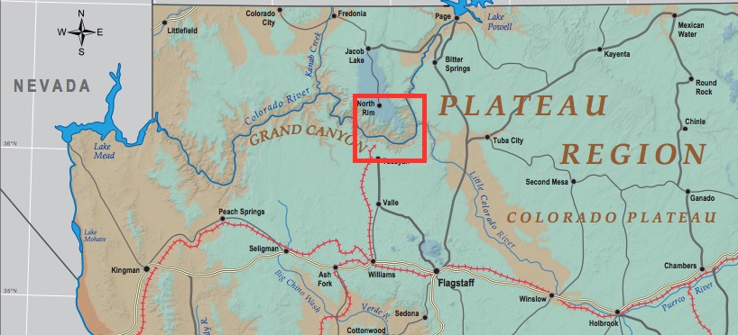
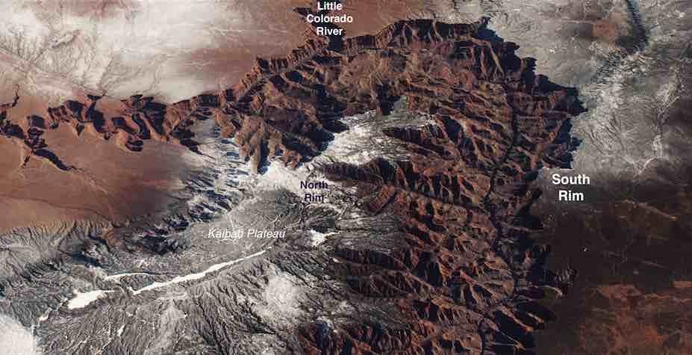
Study Site: Heart of the Grand Canyon
Source: NASA

Slide 4
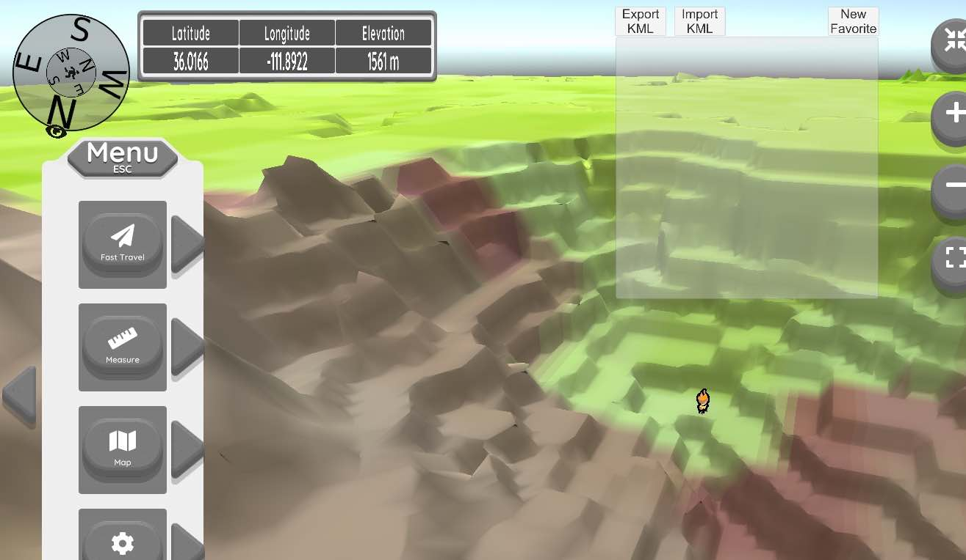
Lab focus on how physical geography landscapes of plants are influenced by microclimate
Exploration tasks in the lab
Reading/Presentation quiz on microclimate & plants basics
Detailed Analysis
Synthesis Essay

Slide 5
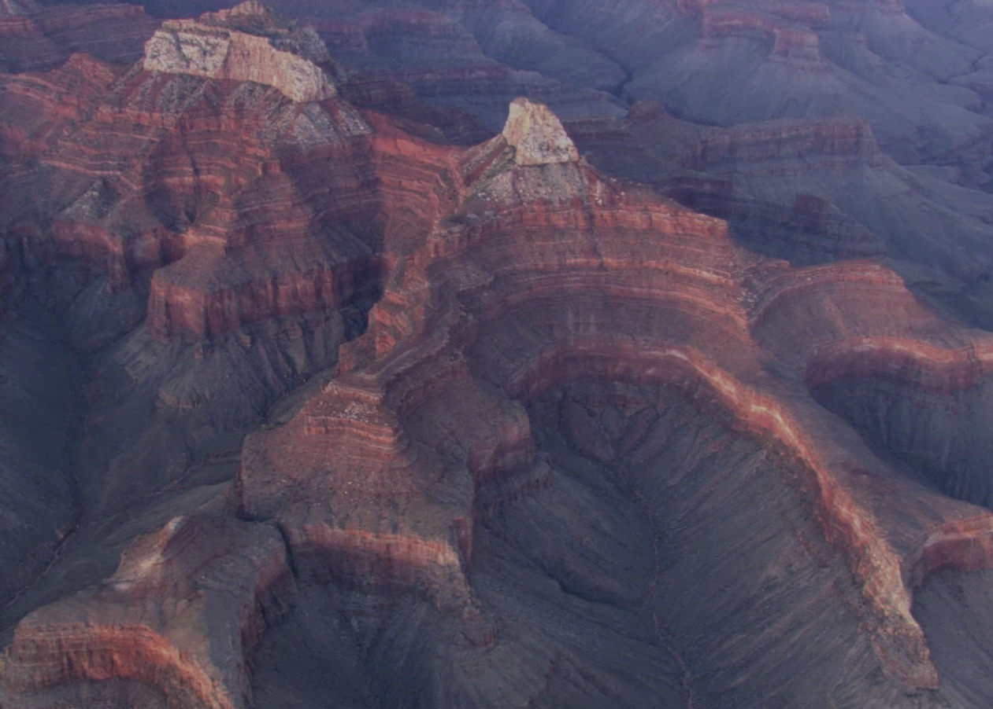
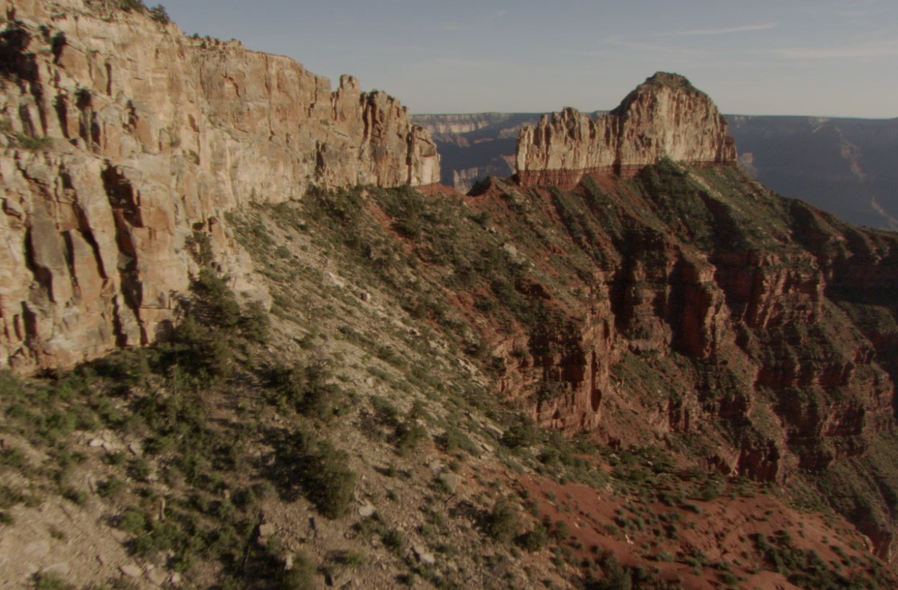
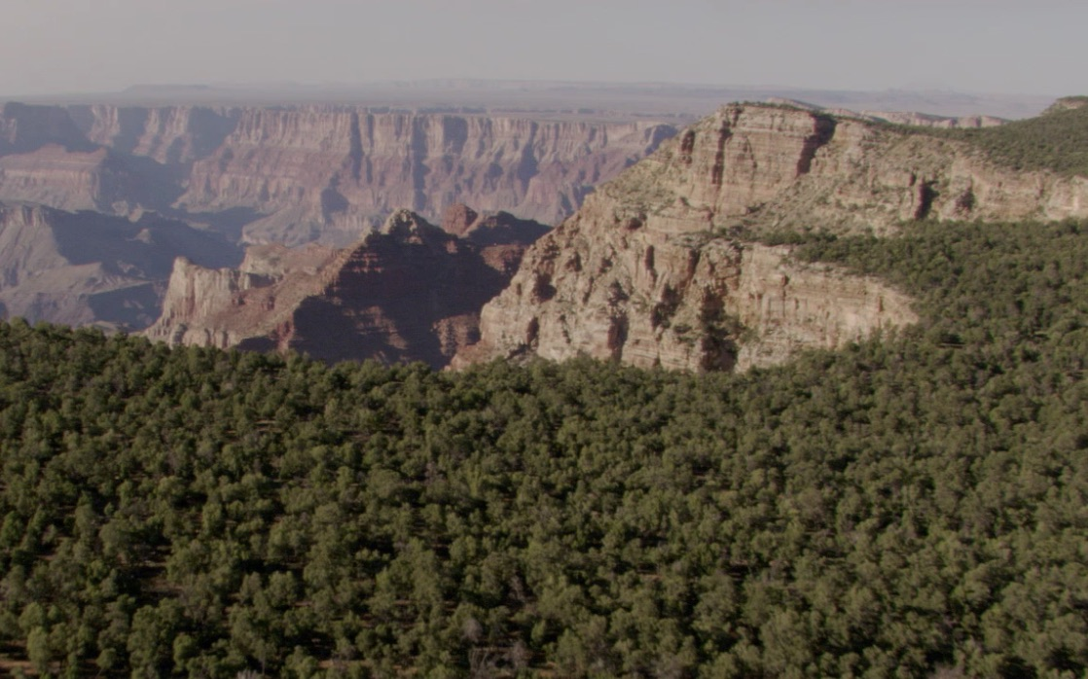
Incredibly rugged topography: months to explore connections, so you analyze in a geovisualization video game
Desert Plants
Dwarf Trees – Juniper,
Pinyon Pine & associated
shrubs
Ponderosa Pine Forest

Slide 6
PDF Instructions – very detailed
How to purchase, download & play videogame – canvas page in welcoming module
PDF file provides important and extra background information
Goes over all the questions in Stages A, B and C

Slide 7
Stage A Questions/Tasks
Sample the sorts of tasks & questions cover later in the lab .. But first, in case this is the first game you try … some hints
Escape key on your keyboard – (on/off) giving you access to the menu (via the left arrow) or Play the game.
Toggle between game and other programs:

Slide 8
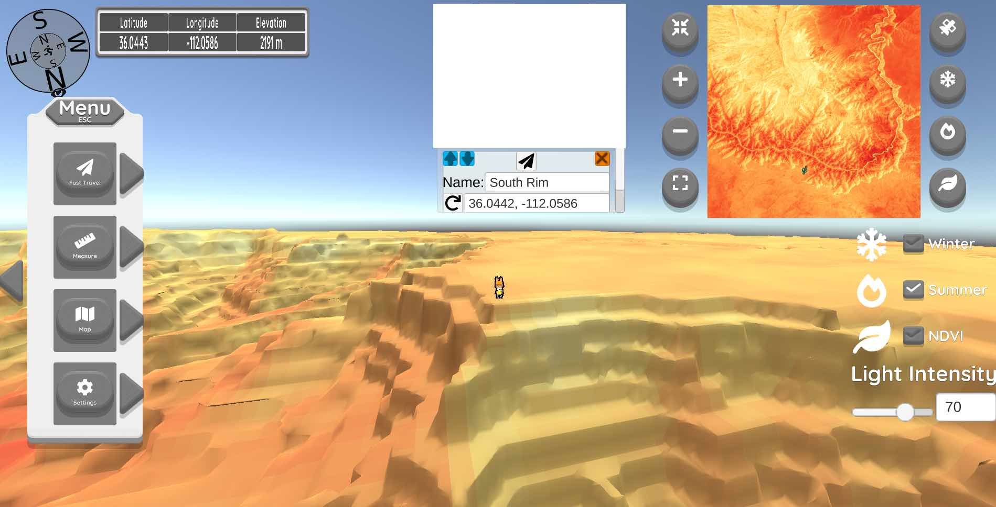
Stage A Questions/Tasks
1. Fast travel & look at east-facing and west-facing slopes. How do you explain the temperatures you see? Acquired at 10am

Slide 9
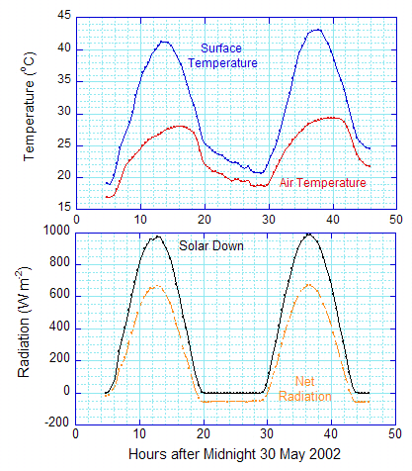
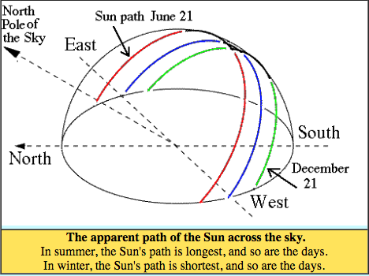
Question A1

Slide 10
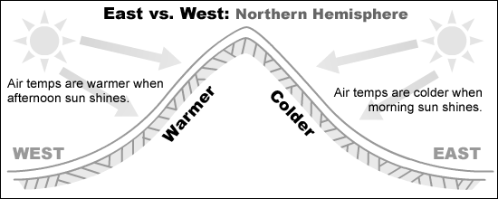
Question A1
East-Facing
West-Facing

Slide 11
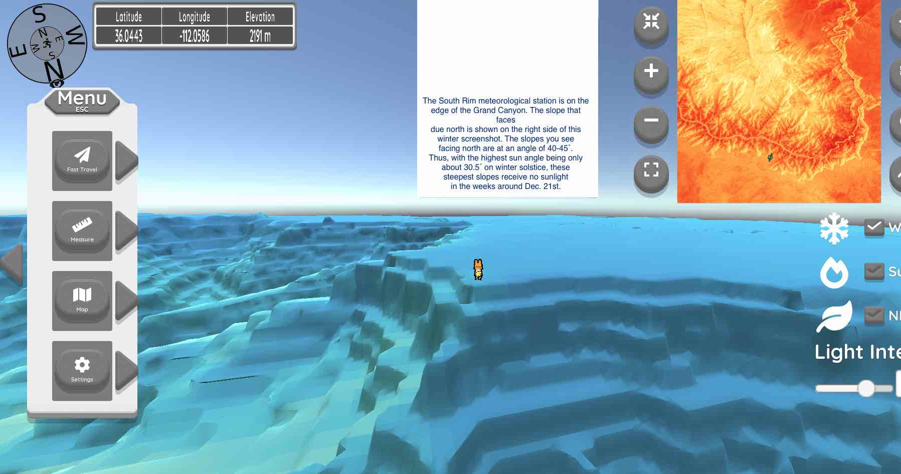
Stage A Questions/Tasks
2. Fast travel & look at south-facing and north-facing slopes. How do you explain the temperatures you see?

Slide 12
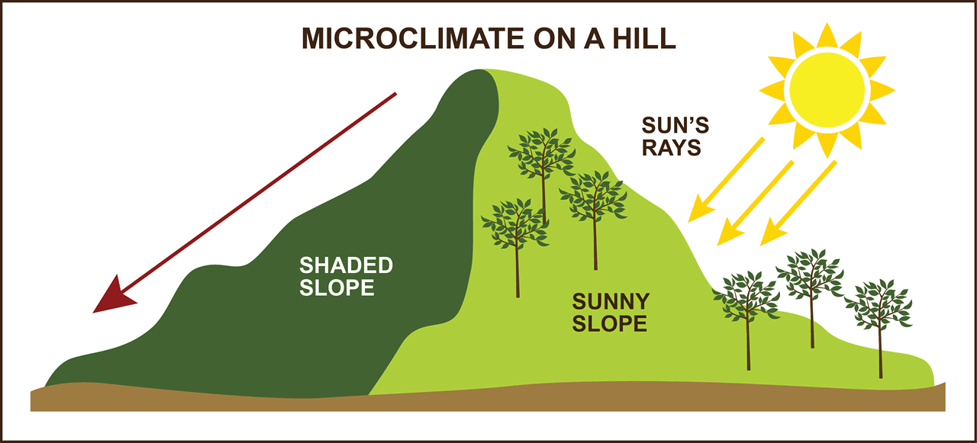
Question A2

Slide 13
A2 How do you explain the temperatures you see?
=

Slide 14
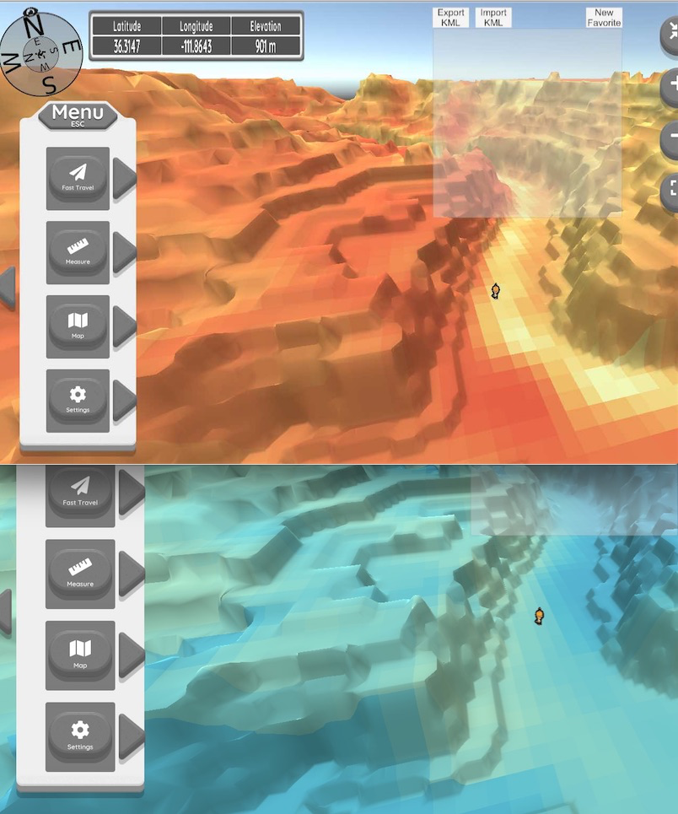
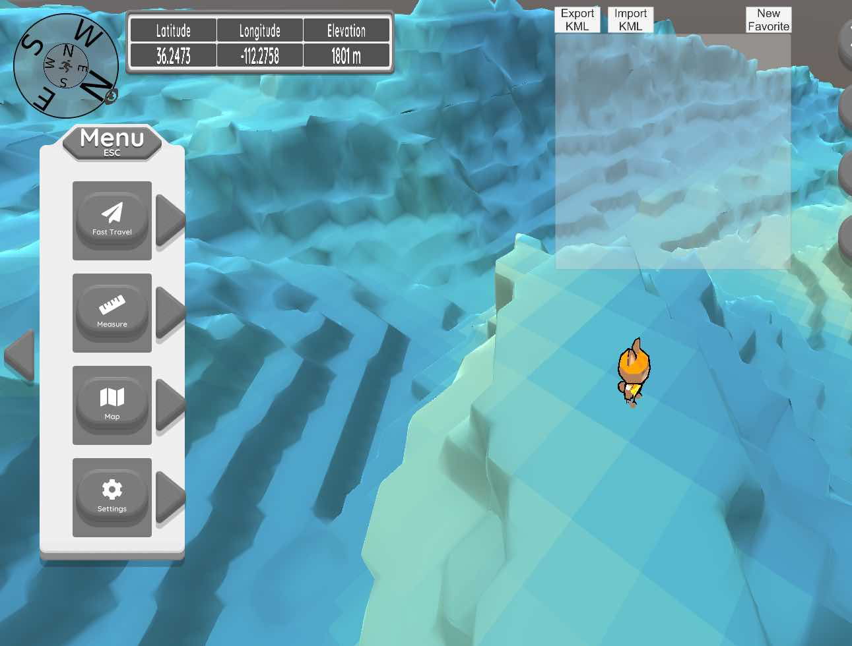
Note: you will not get these examples. Question pools – similar but different
North-
facing
East-Facing
West-
facing
South-
facing

Slide 15
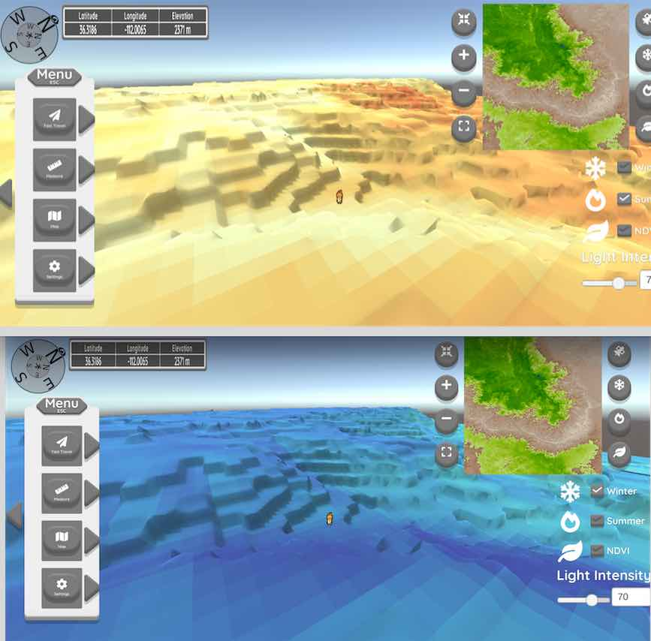
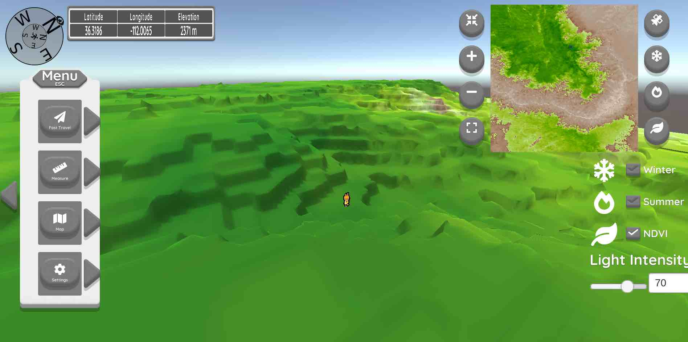
Stage A3: Questions/Tasks
Fast travel and using the temperature scale to interpret plant distribution you see
One of the highest elevations in the
Study Area on Kaibab Plateau, facing
Northeast – biomass (NDVI), summer & winter temps

Slide 16
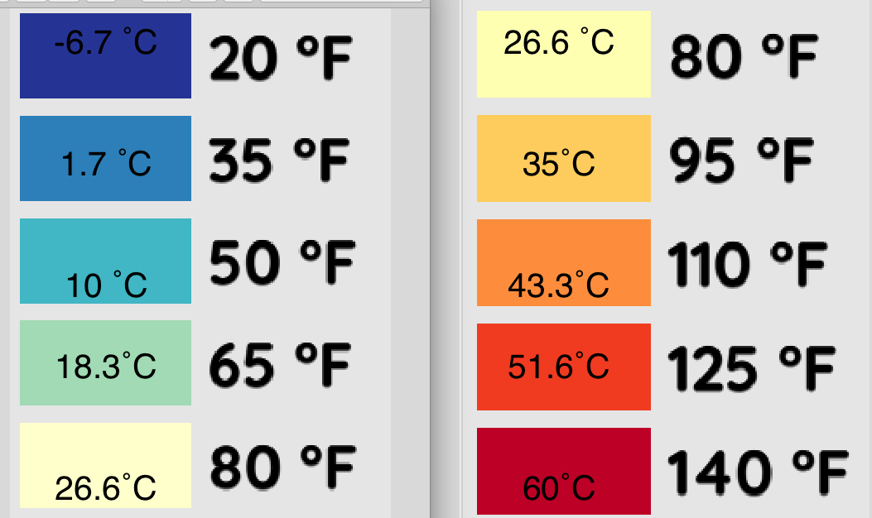
A3: Interpret biomass & temp

Slide 17
A3: Interpret biomass & temp
Example question: what are the winter and summer surface temperatures.
Answer: 20-35˚ F in winter, 80-95˚F in summer
Boreal forests need cooler summer and can tolerate quite cold winter temperatures

Slide 18
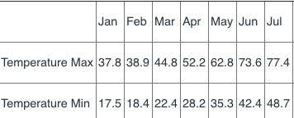
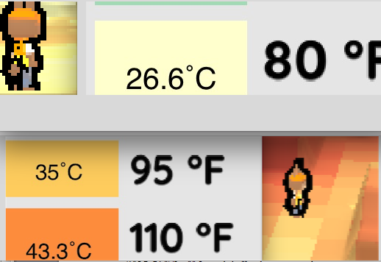
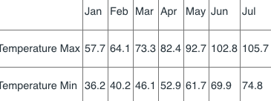
Stage A Questions/Tasks
Temp Change (Lapse Rate) Surface Change ˚C/1000m and air temp change
July Air Temp
Average max/min
North Rim 2611 m
Ave 63.1 or 17.3˚C
Colorado River 721 m
HOW TO THINK: CR - 17.3˚C / 1.89 thousand meters for July Air temperature LR
DO NOT WORRY ABOUT A FEW DECIMALS!!
Surface Temp change 35˚C-26˚C or ABOUT 9˚C /1.89 = 4.8˚ C/1000 m

Slide 19
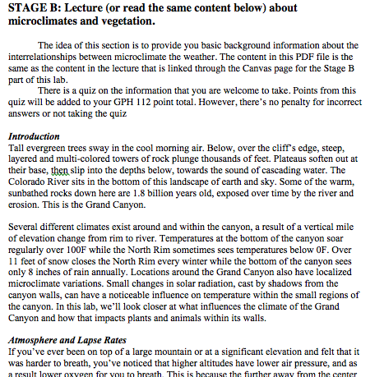
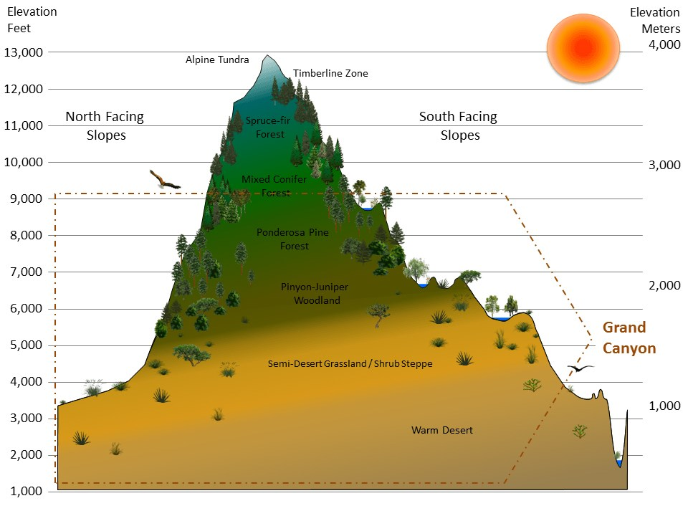
Stage B: Short Quiz on background material about microclimate & plants

Slide 20
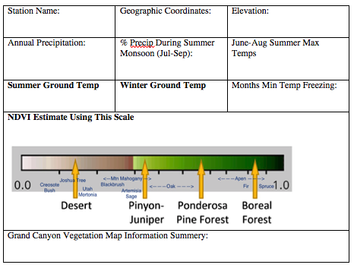
Stage C: More detailed investigation
Using meteorological stations data and the geovisualization, investigate the connections between precipitation, elevation in the canyon, and the types of plants that are growing

Slide 21
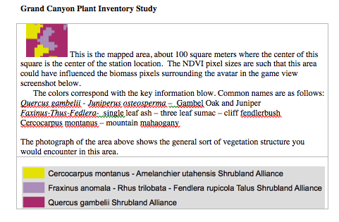
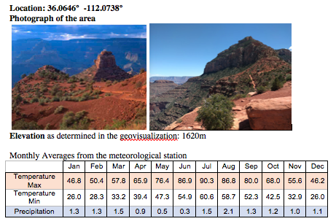

Slide 23
What are the basic climate-vegetation relationships that you can observe at the Cedar Ridge station from the geovisualization and information supplied in the question?
Incorrect choices would have
Wrong information mixed in. Not to trick you, but just get you to be careful

Slide 24
Another example: investigate temperature stresses to plants

Slide 25
Another example: investigate temperature stresses to plants

Slide 26
Example of Matching Format
----------------------------------------
----------------------------------------
Hotter south facing slopes

Slide 27
Other analyses such as juniper treeline in the Grand Canyon

Slide 28
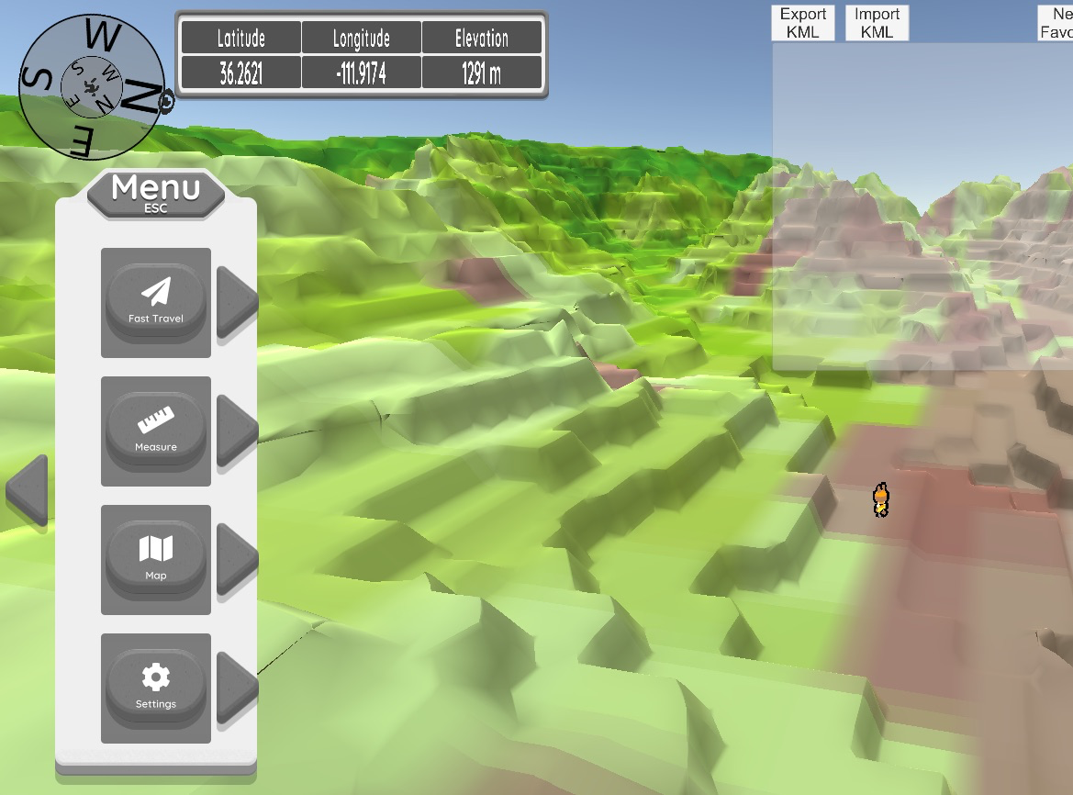
You decide if graph is basically correct or too simple?
This one site 1291 m treeline
nouth facing slope

Slide 29
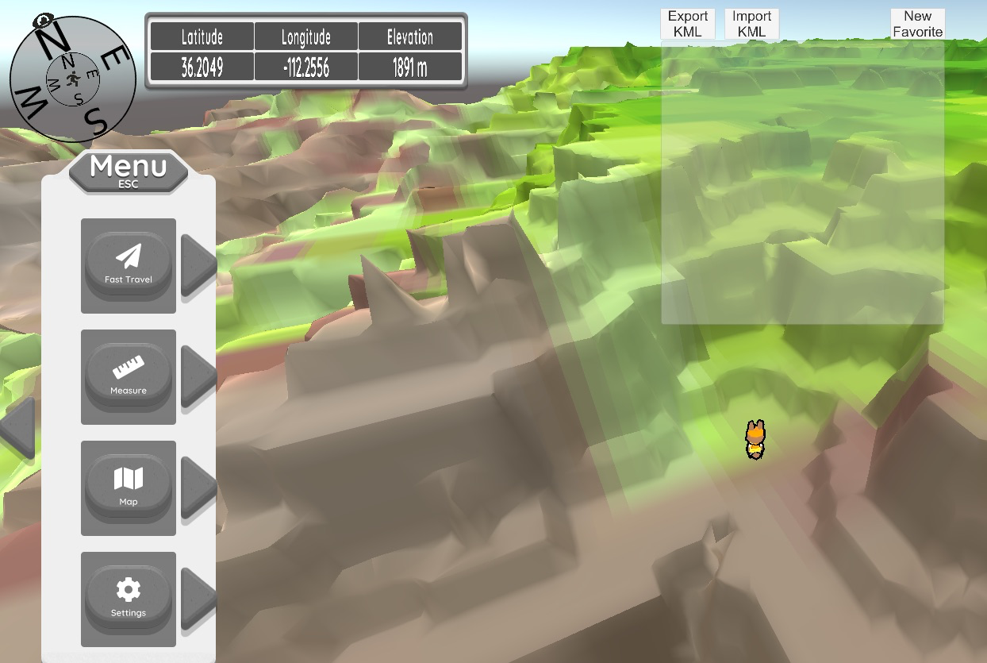
You decide if graph is basically correct or too simple?
This one site 1891 m treeline
South facing slope

Slide 30
Stage D Essay
Paragraph 1: What is the connection between altitude, microclimate, and vegetation in and around the Grand Canyon? Please give examples from the lab, and you can also include your own observations.
Paragraph 2: What is the connection between the direction a slope faces (aspect), microclimate, and vegetation in and around the Grand Canyon? Please give examples from the lab, and you can also include your own observations.
Paragraph 3: Was there anything in particular that struck you as particularly interesting about the connection between topography, microclimates, and vegetation? Please do not simply write down a sentence. Explain your idea, and elaborate with at least a few sentences.
Paragraph 4: Please provide you thoughts on this geovisualization as a tool to investigate connections between microclimate and the biomass (abundance) of vegetation. Please do not simply write down a sentence. Explain your idea, and elaborate with at least a few sentences.

