Slide 1
GPH 211 Fire and Ice Multistep lab FAQ presentation

Slide 2
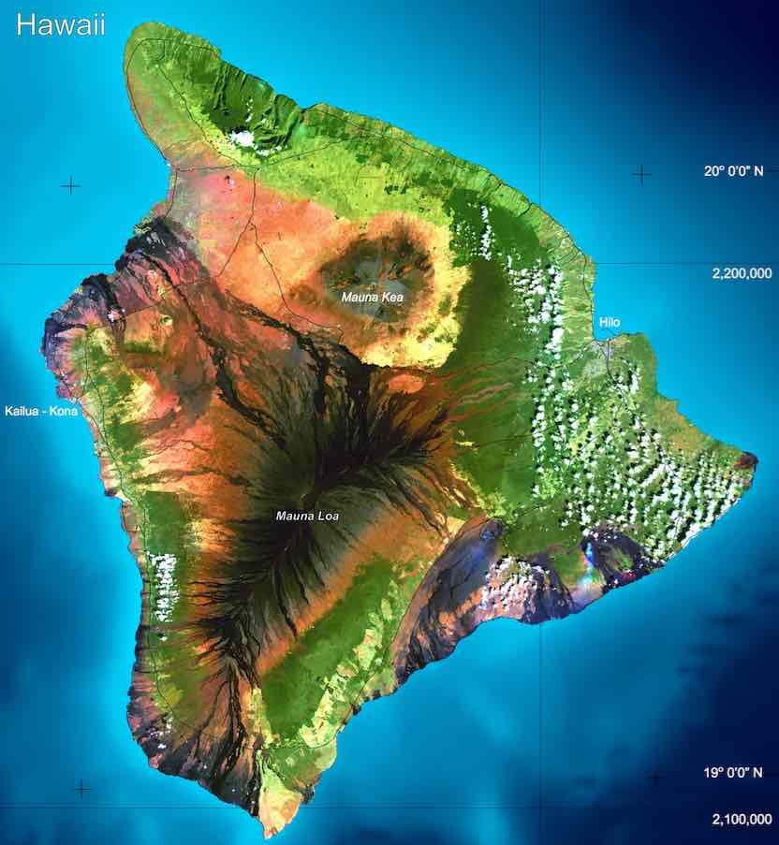
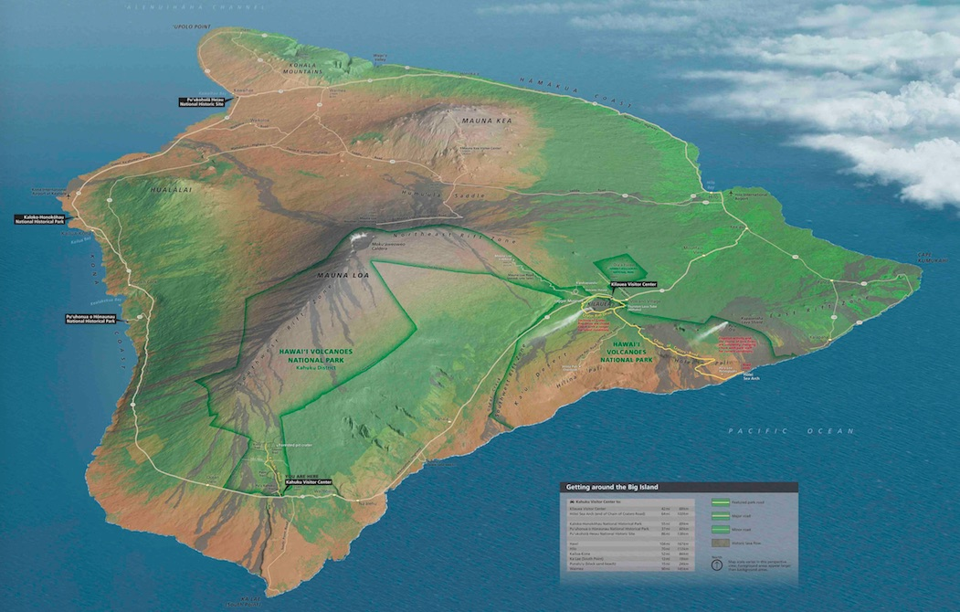
Big Island

Slide 3
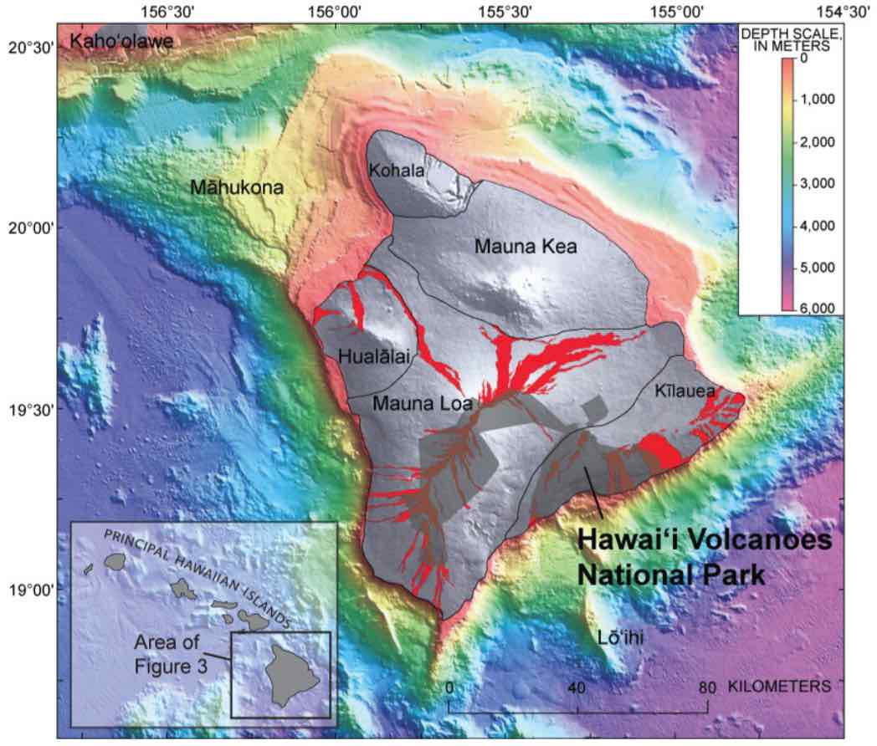
Five volcanoes

Slide 4
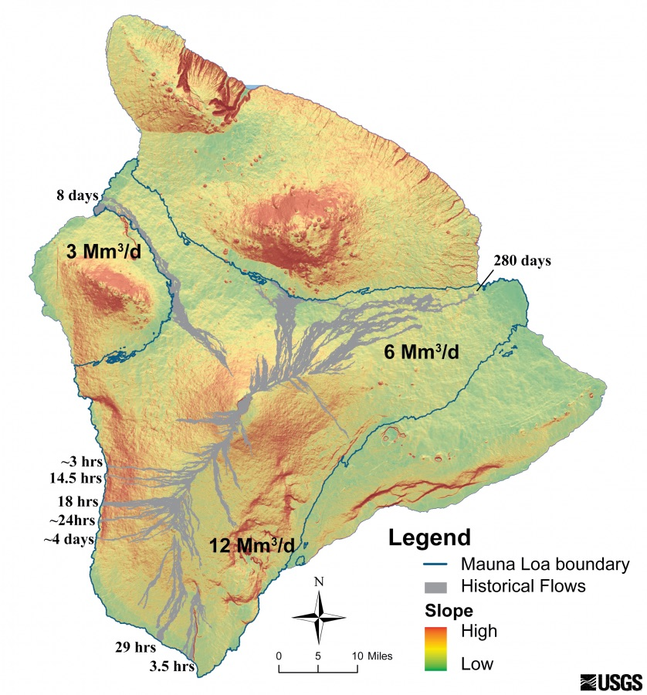
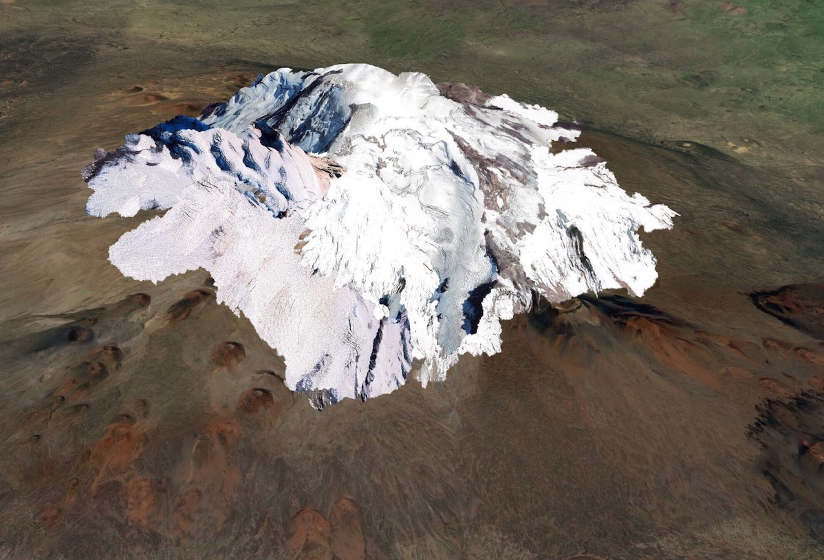
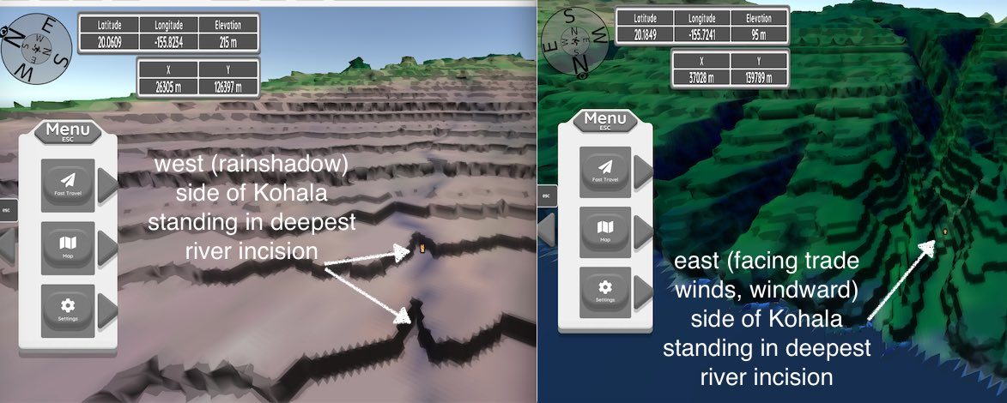
Lab Focus
Part 1: Big Island Volcanoes
Part 2. Volcanic Hazards science analysis
Part 3. Science & Society essay ~ volcanic hazards
Part 4. Will Mauna Kea ever be glaciated again?
Part 5. How fast does it take to erode a river valley in Hawai’i

Slide 5
Pieces of the lab
This presentation gives you an overview and tries to answer typical questions
PDF file goes over all of the questions you will be asked in canvas and how to answer them
Geovisualization “video game” – you purchase, download and play to obtain information (how to purchase – information on canvas page in module)
Canvas quiz – where the questions are graded

Slide 6
How to “do” the lab
Geovisualization plays on laptop/desktop with 4 GB RAM (at least)
Students tell me that they find it easiest to use another device (e.g. phone) to access the PDF file & canvas questions … taking physical notes on their observations in the game environment
You do not have to submit the lab right away. You can return after asking questions, after re-reading the PDF file.

Slide 7
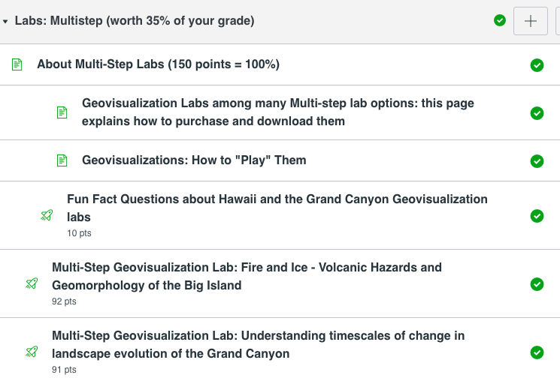
How to purchase game
SEPARATE PAGE ON CANVAS ON HOW TO PURCHASE

Slide 8
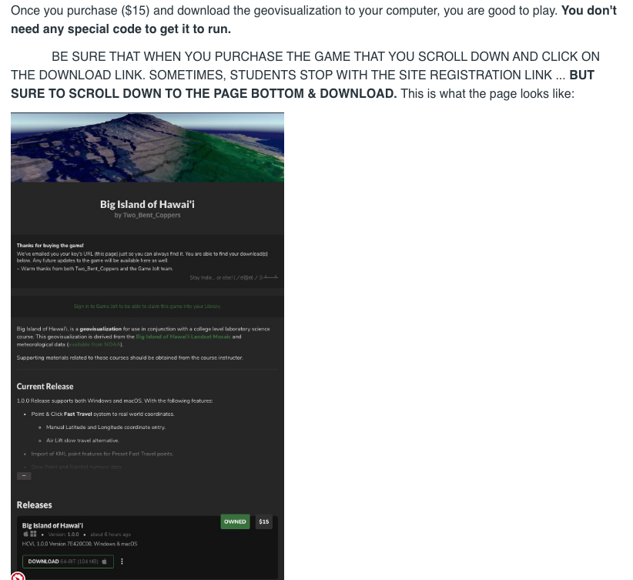
Heads up
Save zipped file!
Scroll to bottom & hit download
You do not have to do this lab. Other options

Slide 9
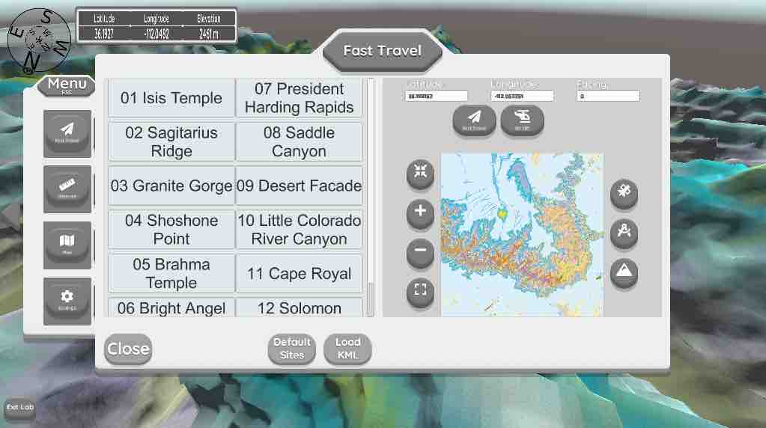
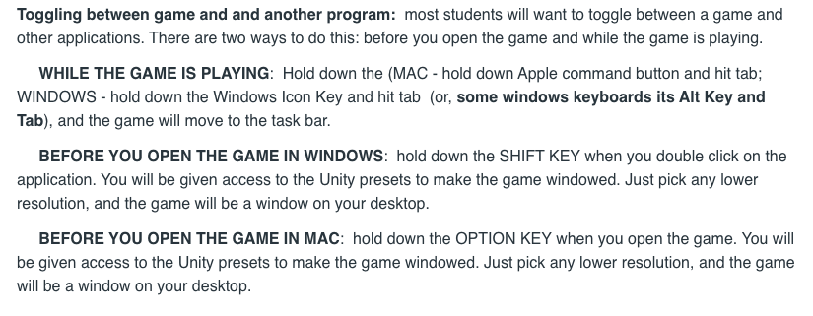
How to play the game
SEPARATE PAGE IN CANVAS ON HOW TO PLAY
Escape key on your keyboard – (on/off) giving you access to the menu (via the left arrow) or Play the game.
Fast travel – paste in or type
Latitude
Longitude from PDF file

Slide 10
Other hints

Slide 11
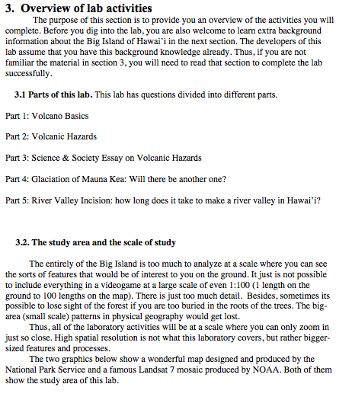
PDF File

Slide 12
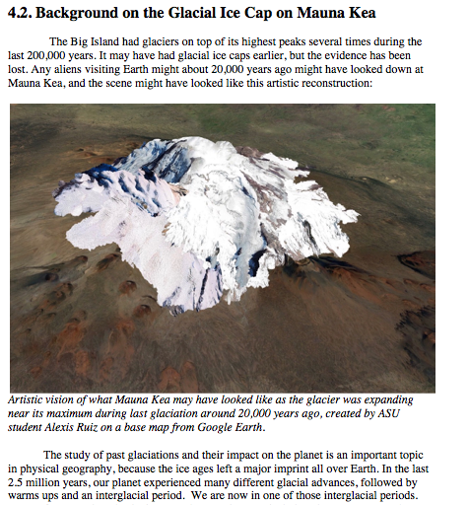
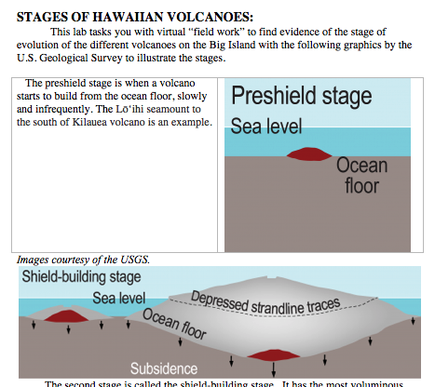
Background info

Slide 13
Part 1. Hawaiian Volcano questions

Slide 14
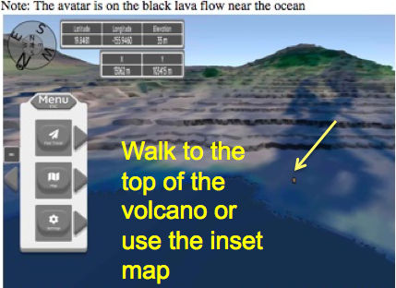
Part 1. Hawaiian Volcano questions

Slide 15
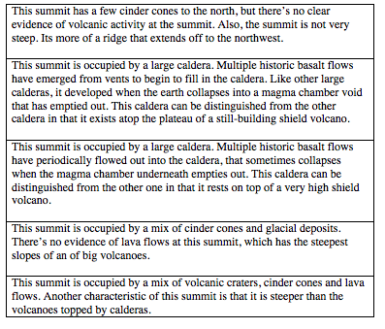
Question 2
Practice using fast travel to jump to the tops of the five volcanoes in pre-sets

Slide 16
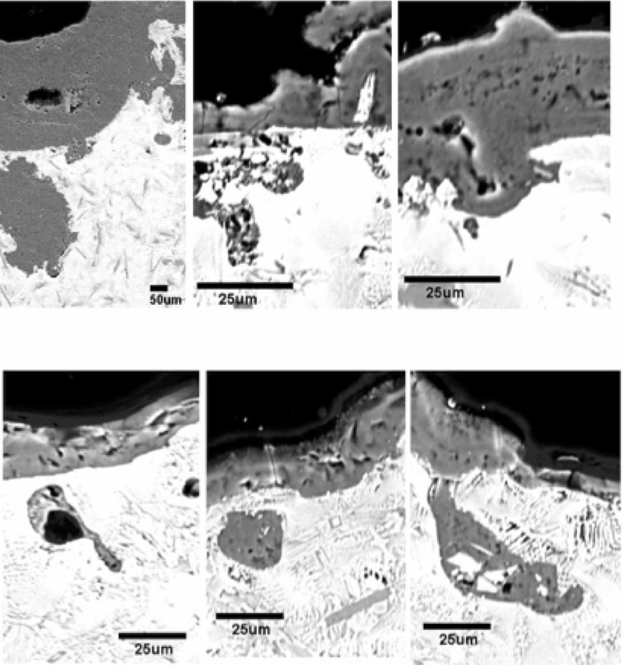
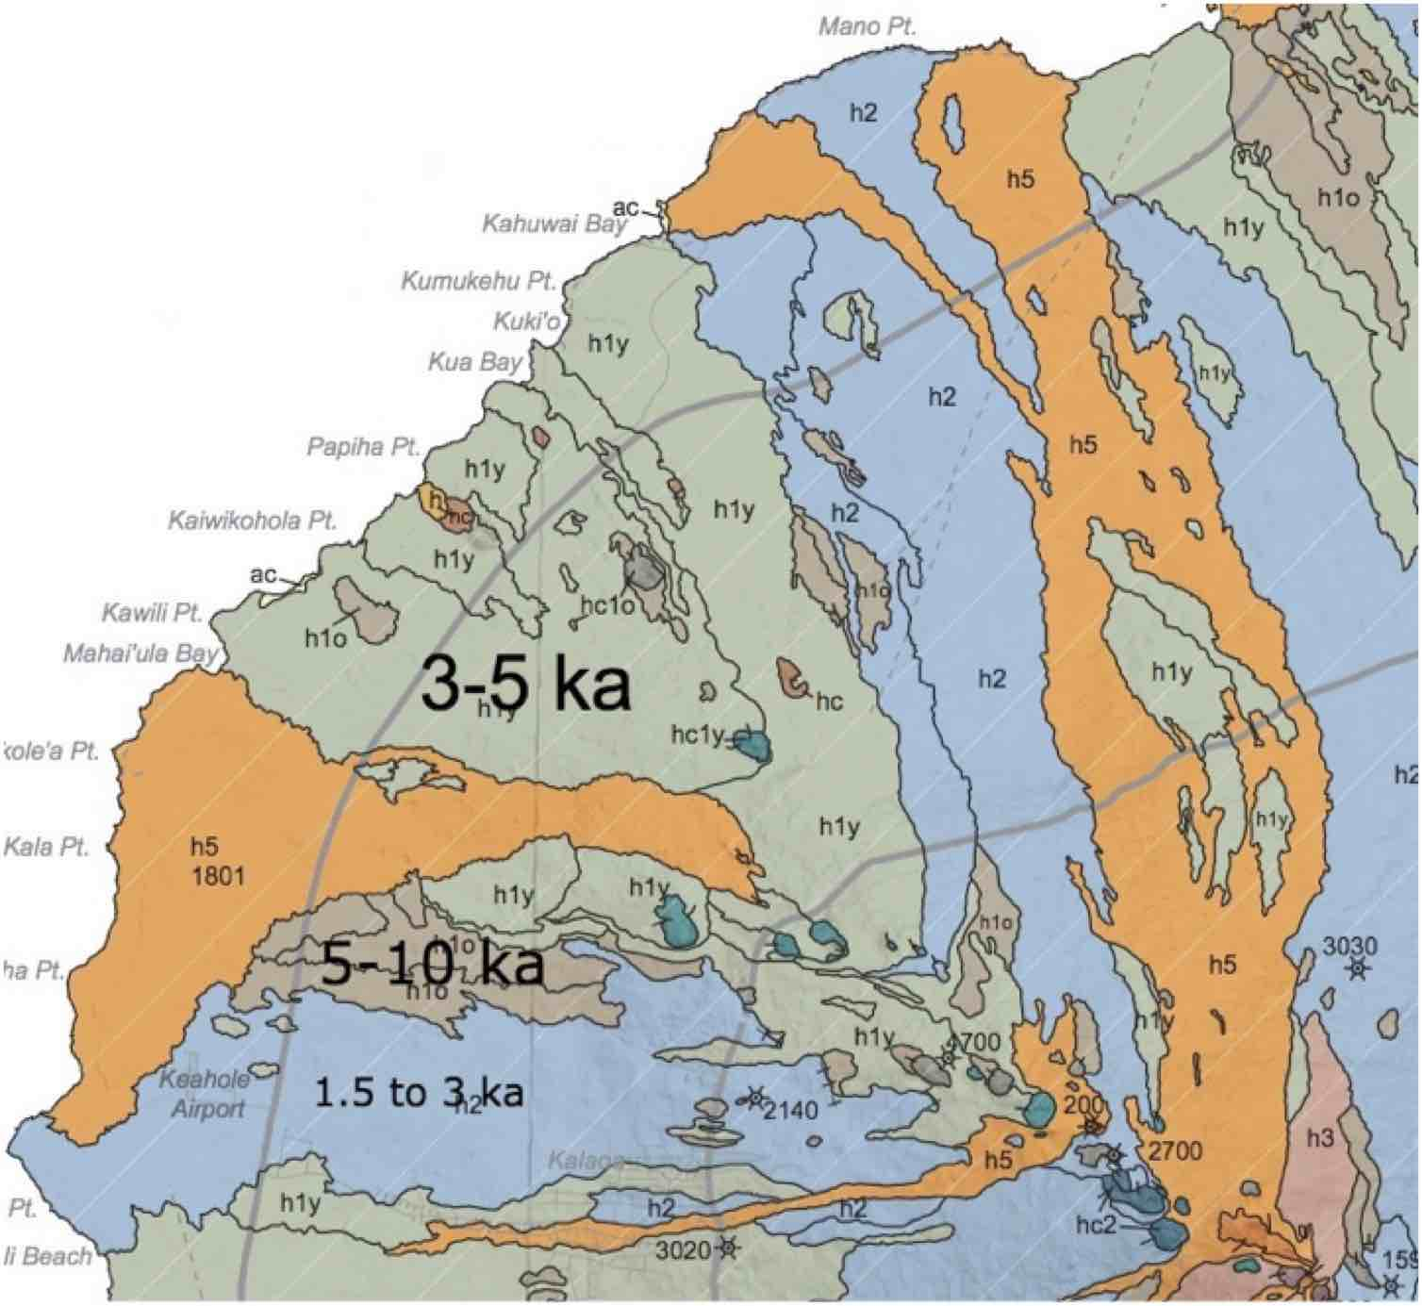
Question 3

Slide 17
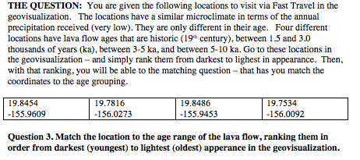
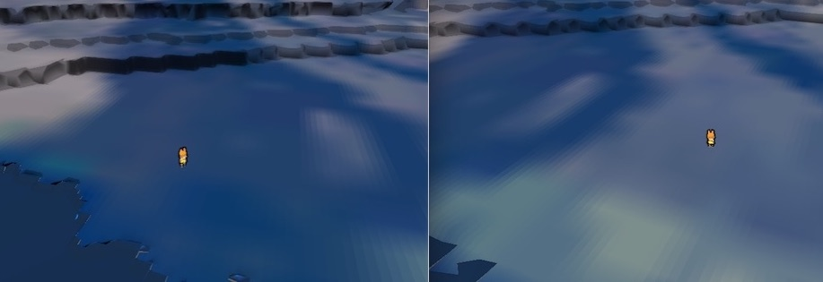
Question 3

Slide 18
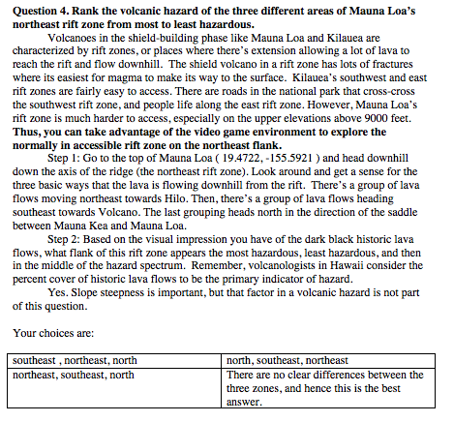
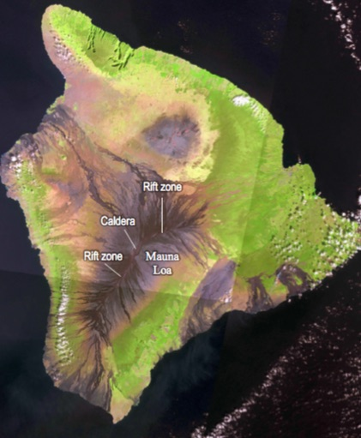
Question 4

Slide 19
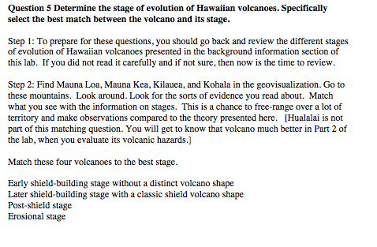
Question 5

Slide 20
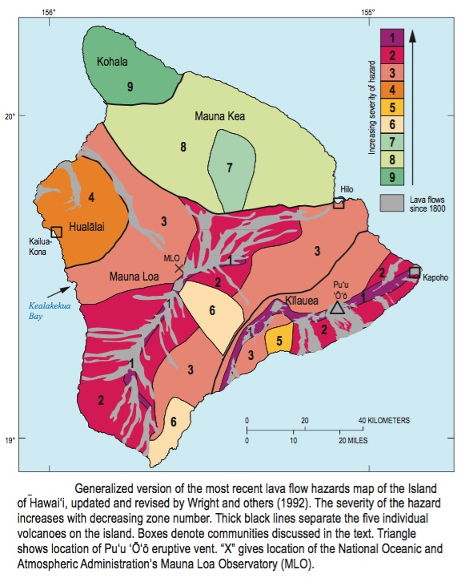
Part 2 & 3 Volcanic Hazards
Part 2 is a study of the volcanic hazards of Hualalai Volcano.
Part 3 is a Science & Society essay where you are tasked with a consulting project for a developer in the Kailua-Kona area

Slide 21
Part 2
Question 6 – stage of Hualalai Volcano
Question 7 – can you outrun a lava flow
Question 8 – download a KML file to the game and see locations of all radiocarbon ages & you analyze them via making a histogram

Slide 22
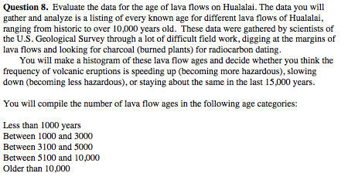
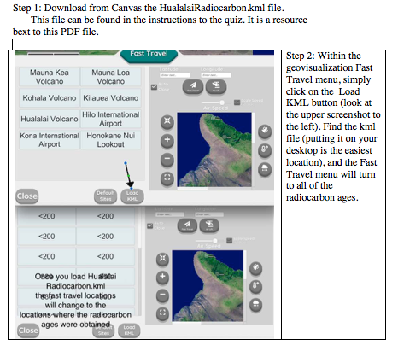
Question 8

Slide 23
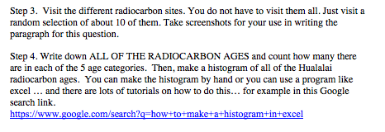
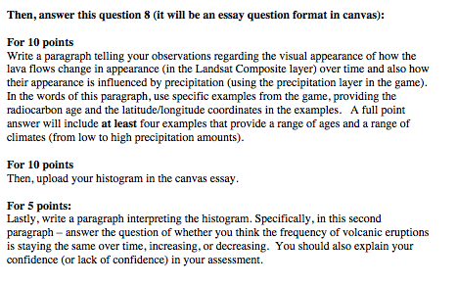
Question 8

Slide 24
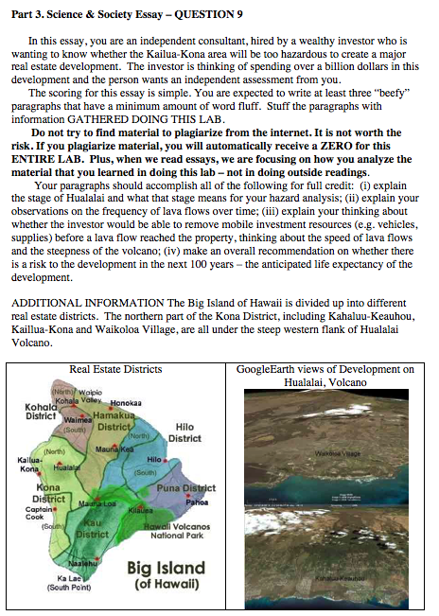
Question 9

Slide 25
Part 4 Will Mauna Kea be glaciated again?

Slide 26
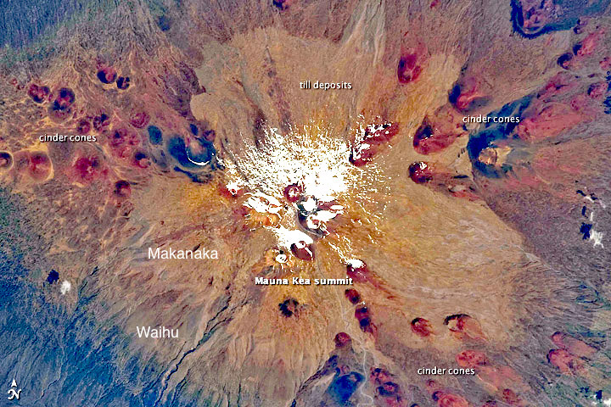
Question 10

Slide 27
Question 11

Slide 28
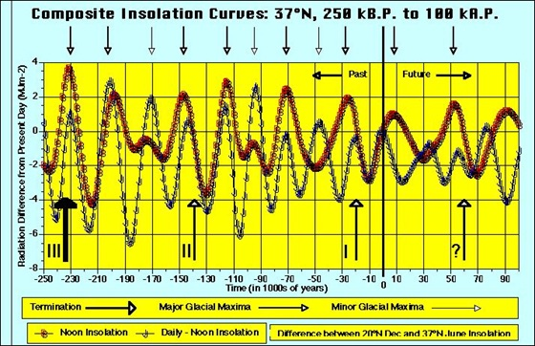
Question 12

Slide 29
Question 13: will there be a future glaciation of Mauna Kea

Slide 30
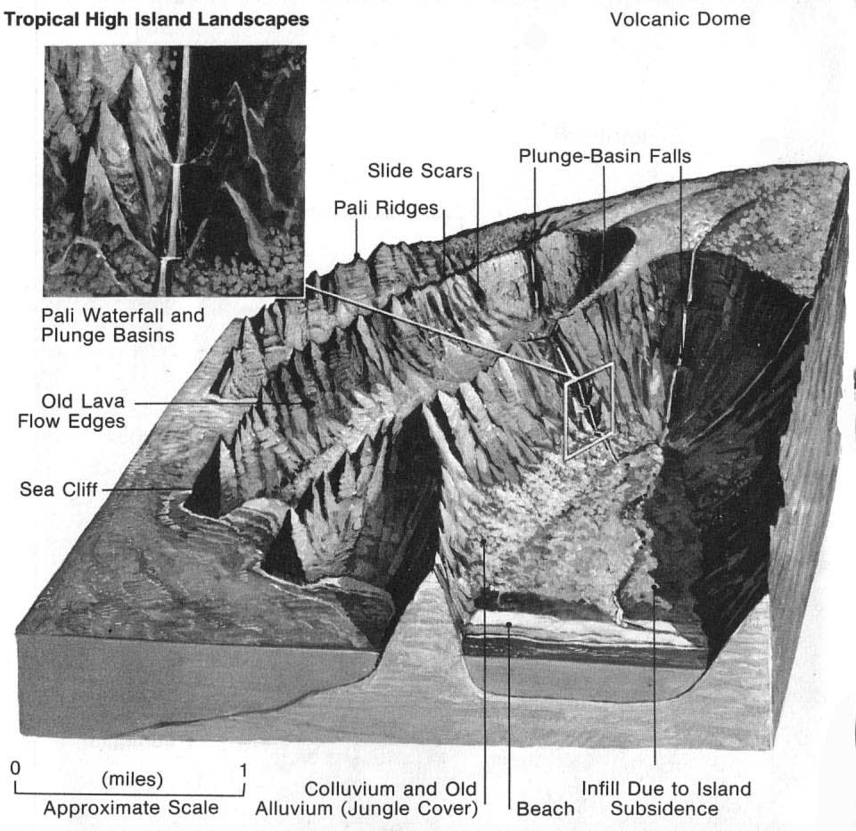
Part 5: How fast does it take to make a river valley?

Slide 31
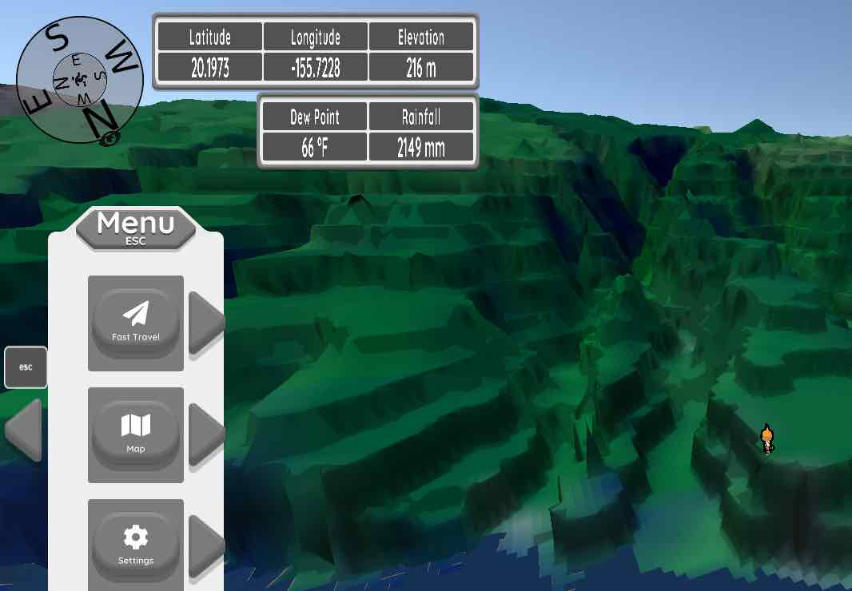
Questions 14, 15, 16
216-35= ~180 m deep valley

Slide 32
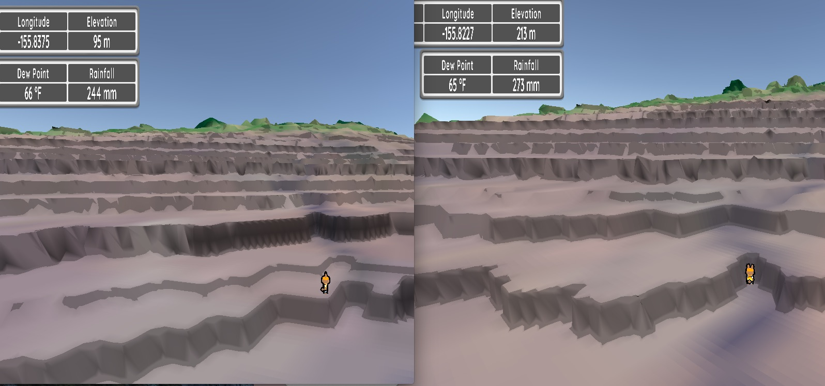
Don’t be obsessed with precision. You cannot be precise. The averaging will blend differences & answer choices are VERY far apart
213-95= ~120 m deep
valley

Slide 33
Questions 16 & 17

Slide 34
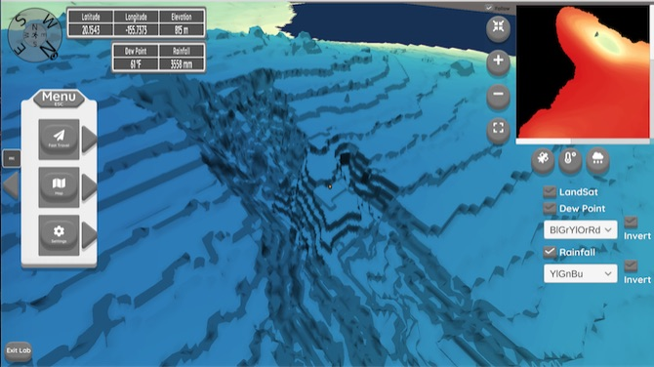
Isohyet layer & readout

Slide 35
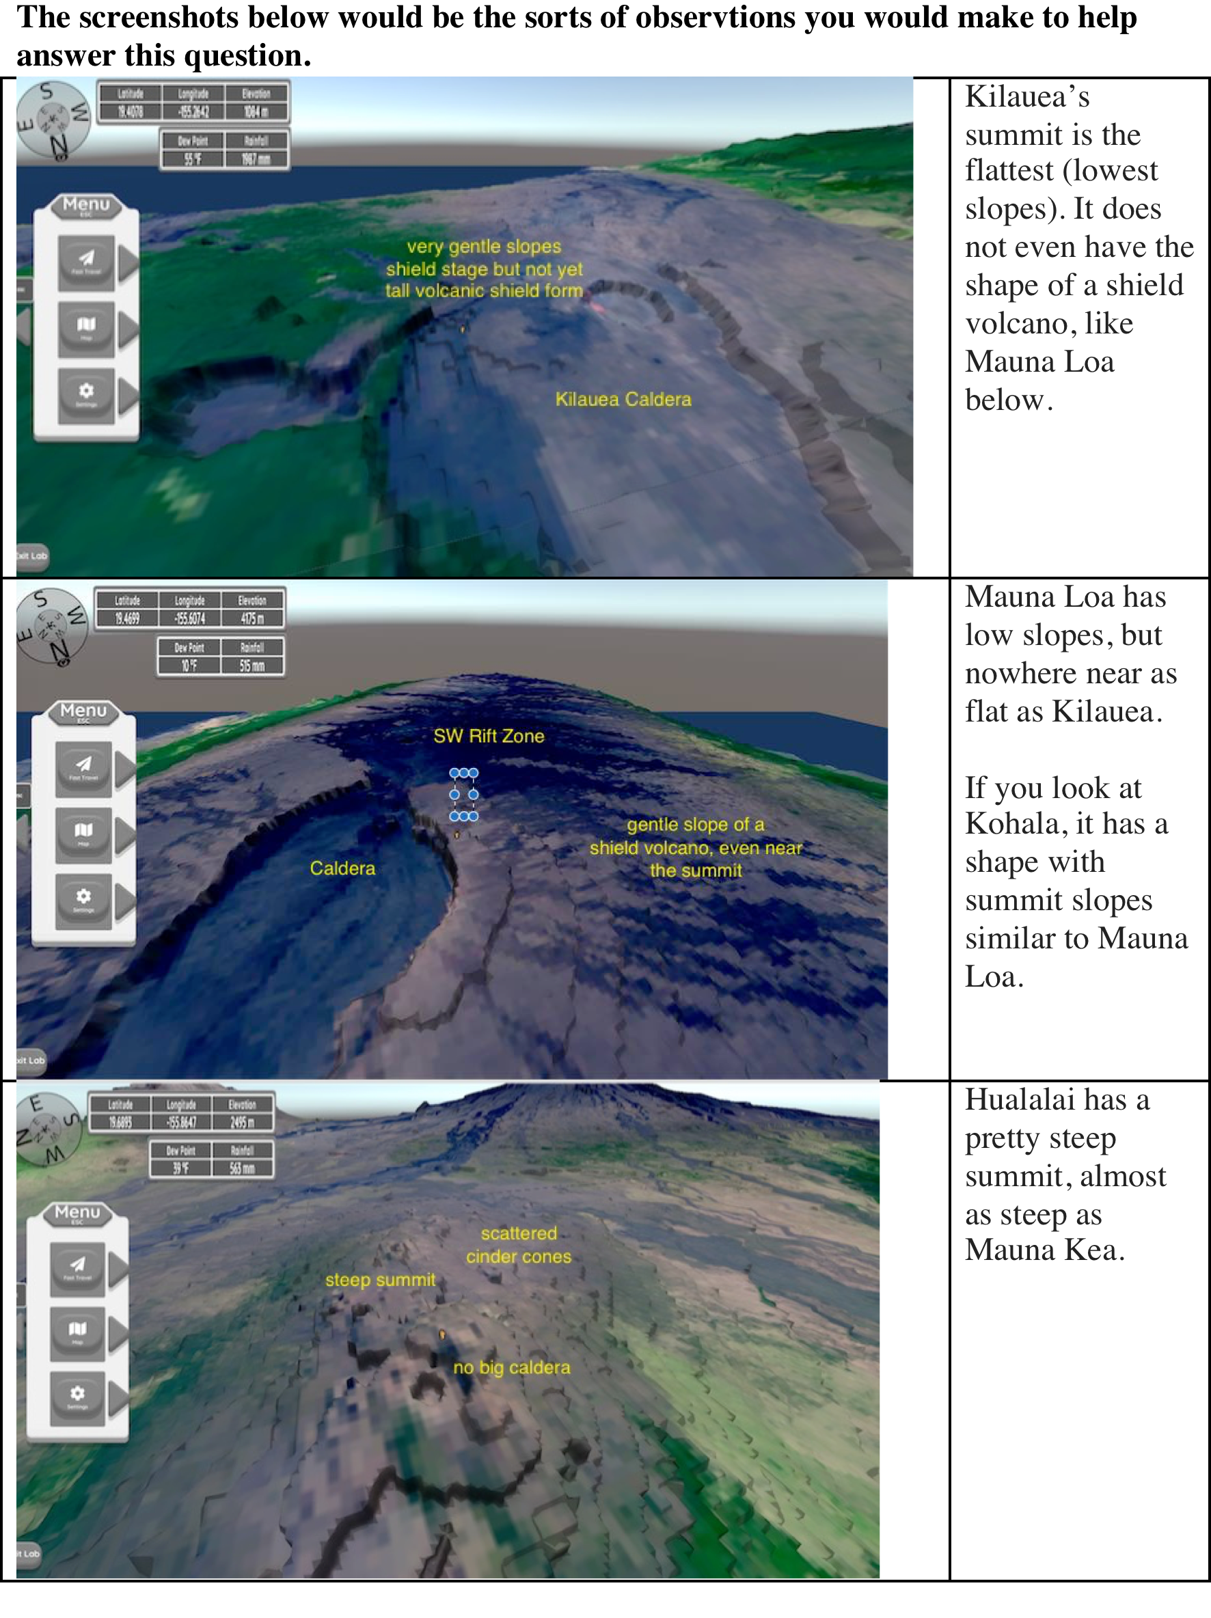
Have fun exploring the Big Island!

