Slide 1
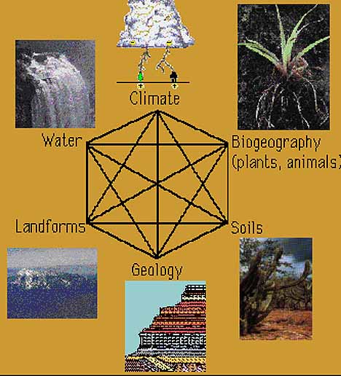
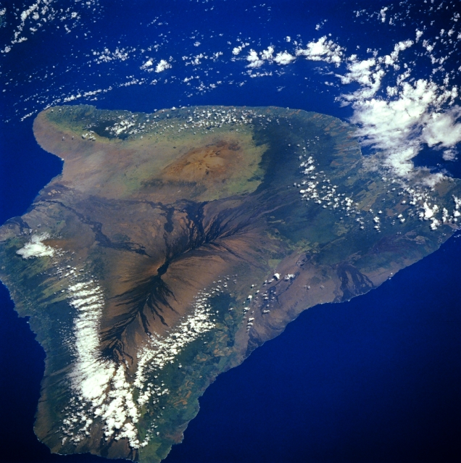
Physical Geography of the Big Island of Hawai’i
Physical Geography of the Big Island of Hawai’i

Slide 2
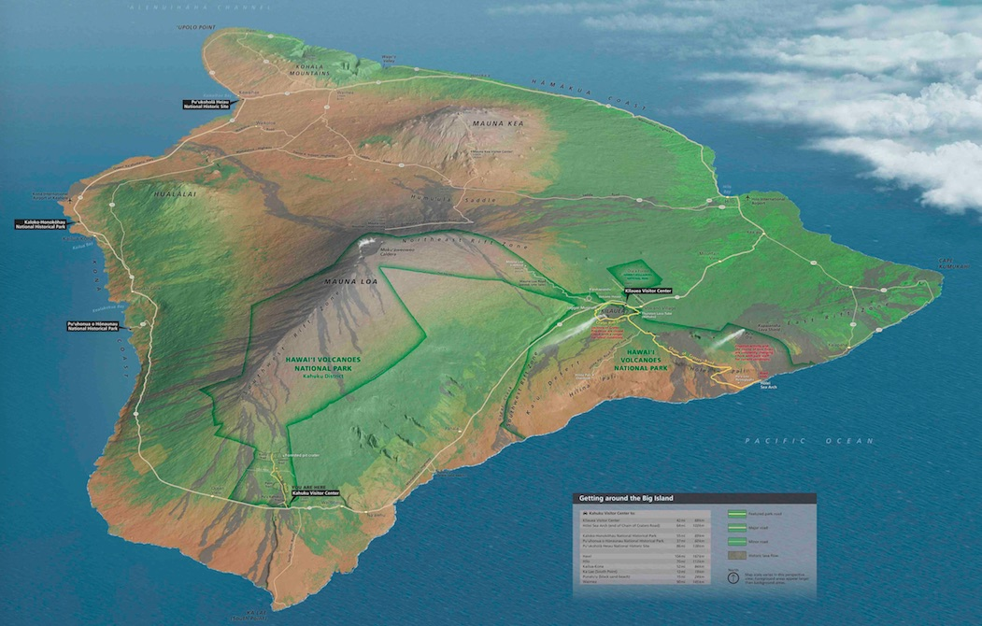
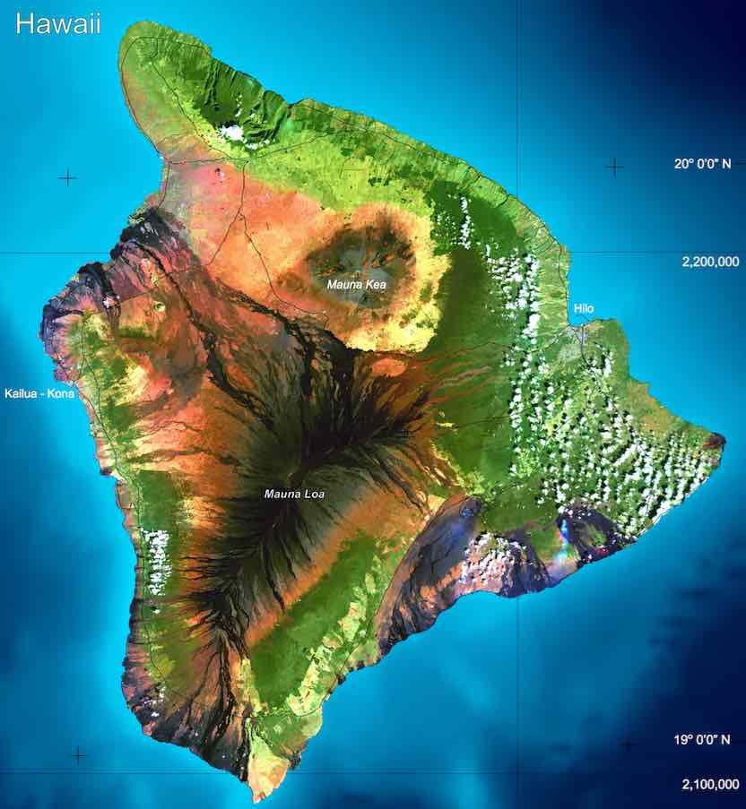
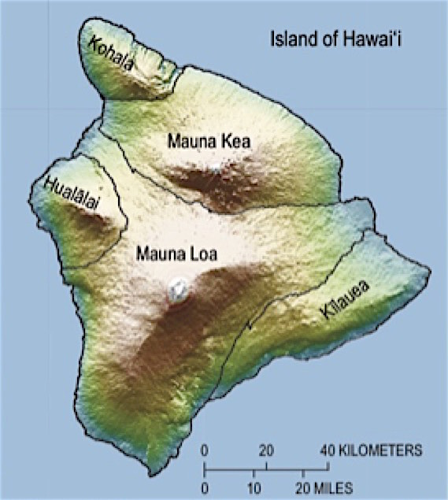
Grand Canyon Region

Slide 3
PDF Instructions – very detailed
Sources of Info for the lab
THIS PRESENTATION– you can jump around to get info on what you are working on
PDF: Important background information you will need this to do well.Goes over all the questions in Stages A, B and C
CANVAS PAGE: How to purchase, download & play videogame – pages in Canvas Welcome module.

Slide 4
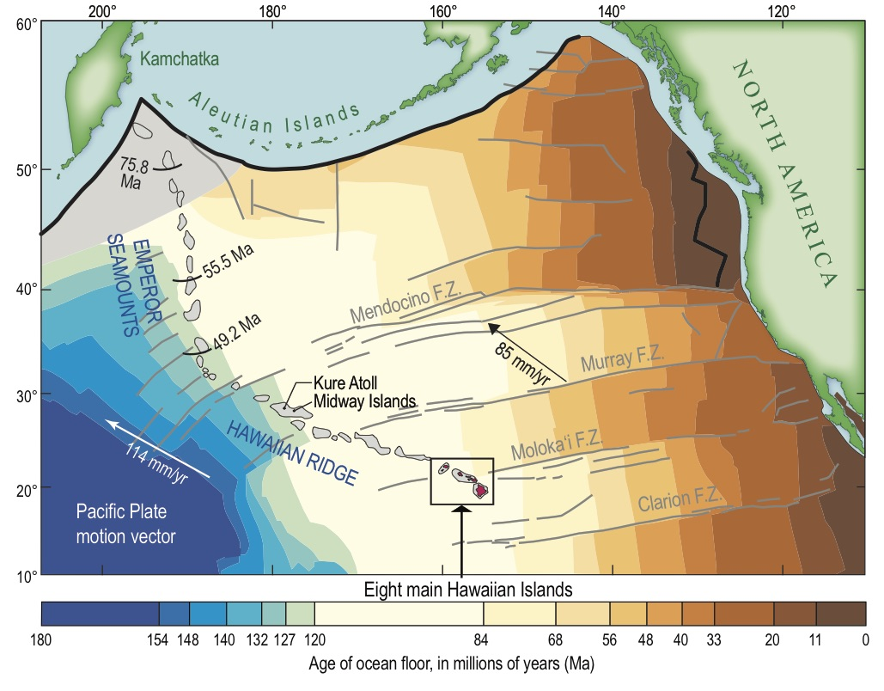
Quick Tectonic Overview

Slide 5
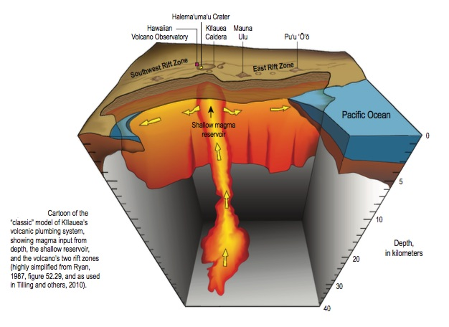

Slide 6
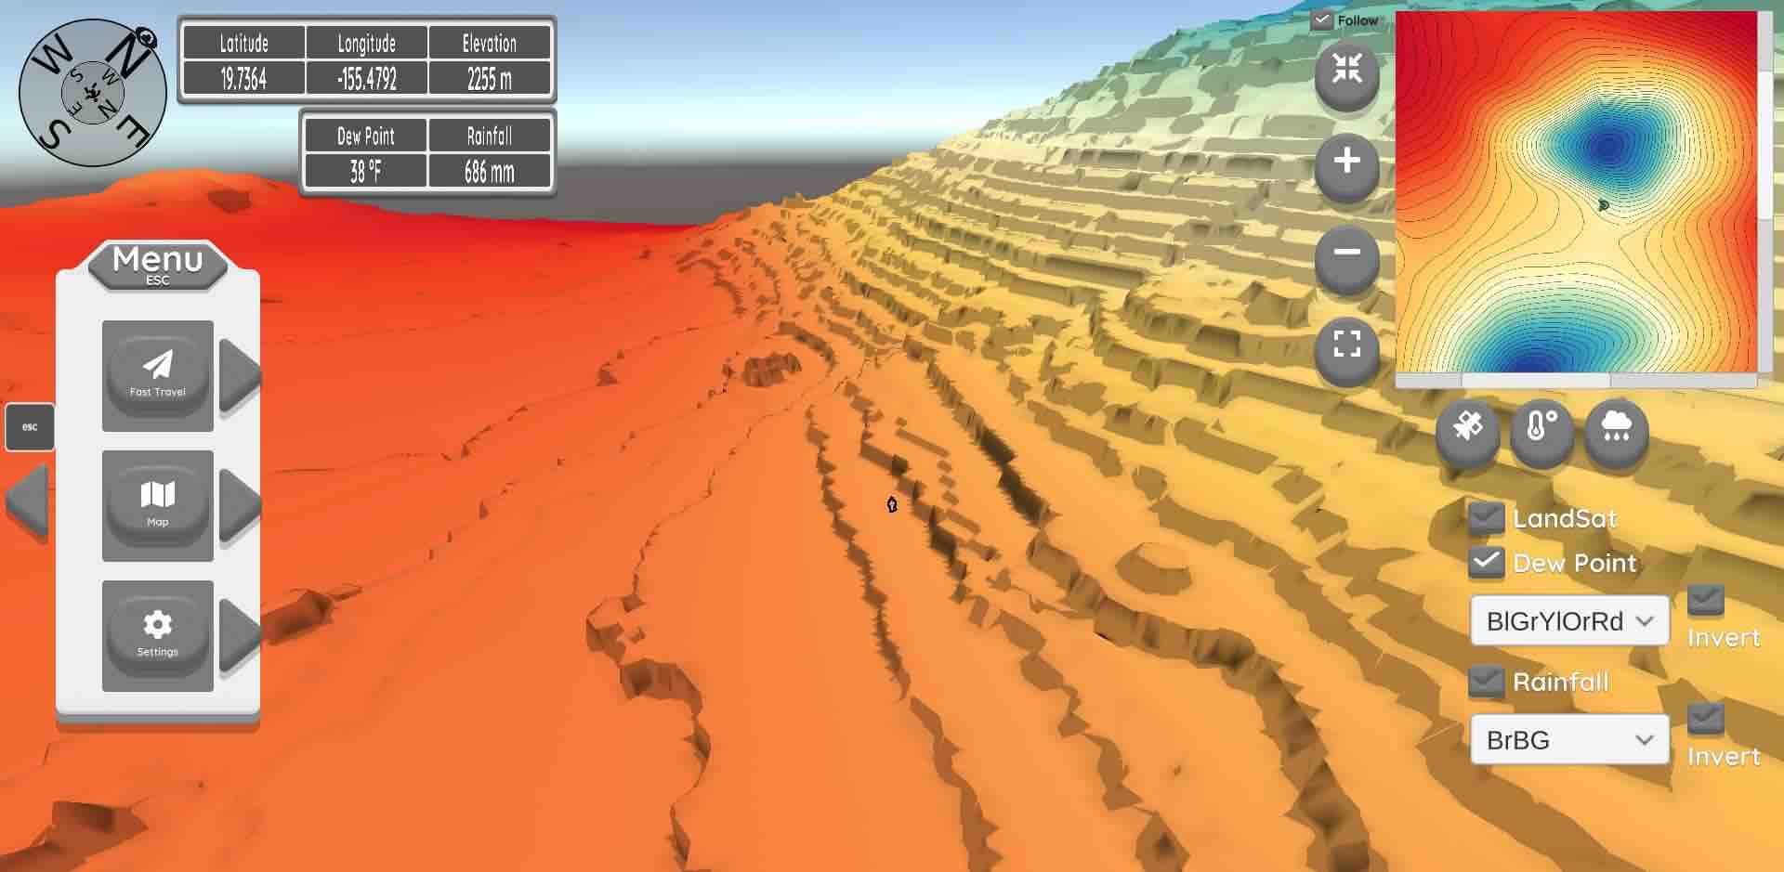
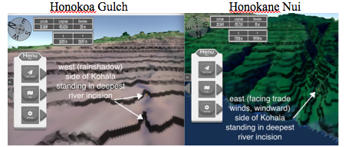
Physical Geography of the Big Island of Hawai’i
Exploration of the geovisualization
Detailed Analysis
Synthesis Essay
Dewpoints
on Mauna Kea

Slide 7
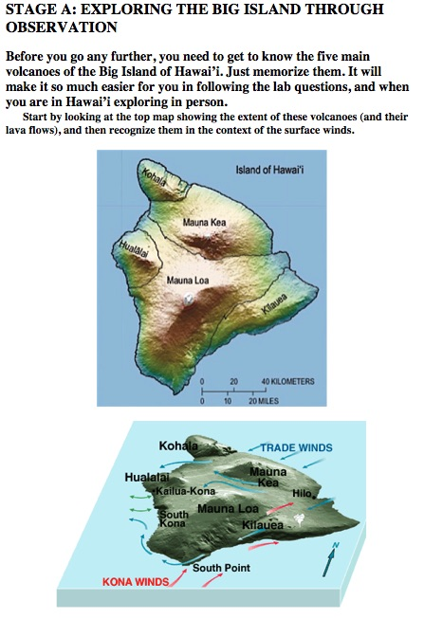
Study Site: Heart of the Grand Canyon
Stage A:
Before you begin, get to know the volcanoes
Source: NASA

Slide 8
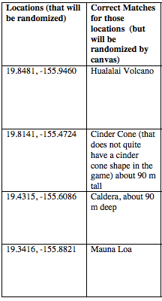
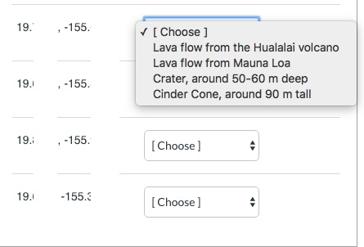
Study Site: Heart of the Grand Canyon
Stage A: Question 1 Matching
Example from PDF file with correct match
Example from question bank

Slide 9
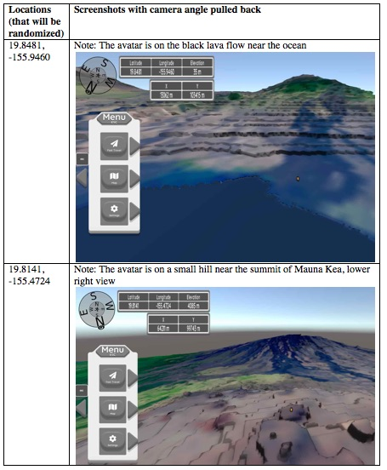
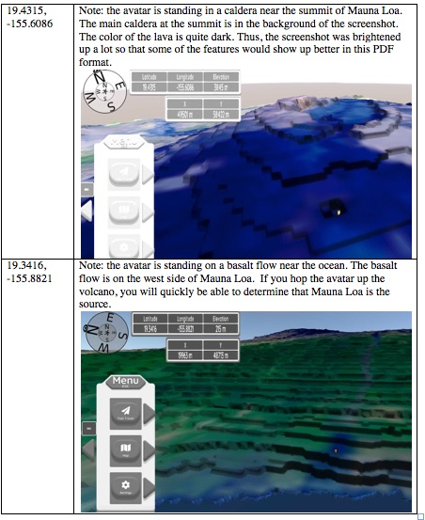
Study Site: Heart of the Grand Canyon
Stage A: Question 1 Matching
Walk to the top of the volcano or use the inset map
avatar
Walk to the top of the volcano or use the inset map

Slide 10
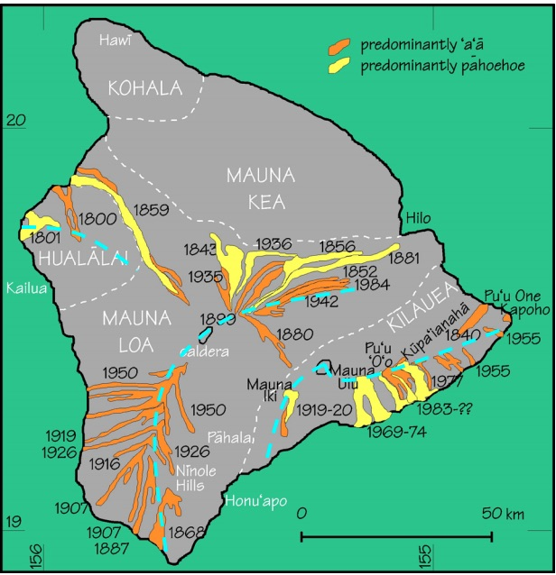
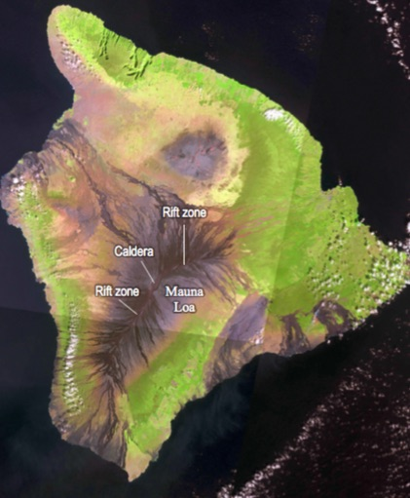
Study Site: Heart of the GrandmoreCanyon
Stage A: Question 1
Volcanoes Physical Geography Lecture & PDF background Materials

Slide 11
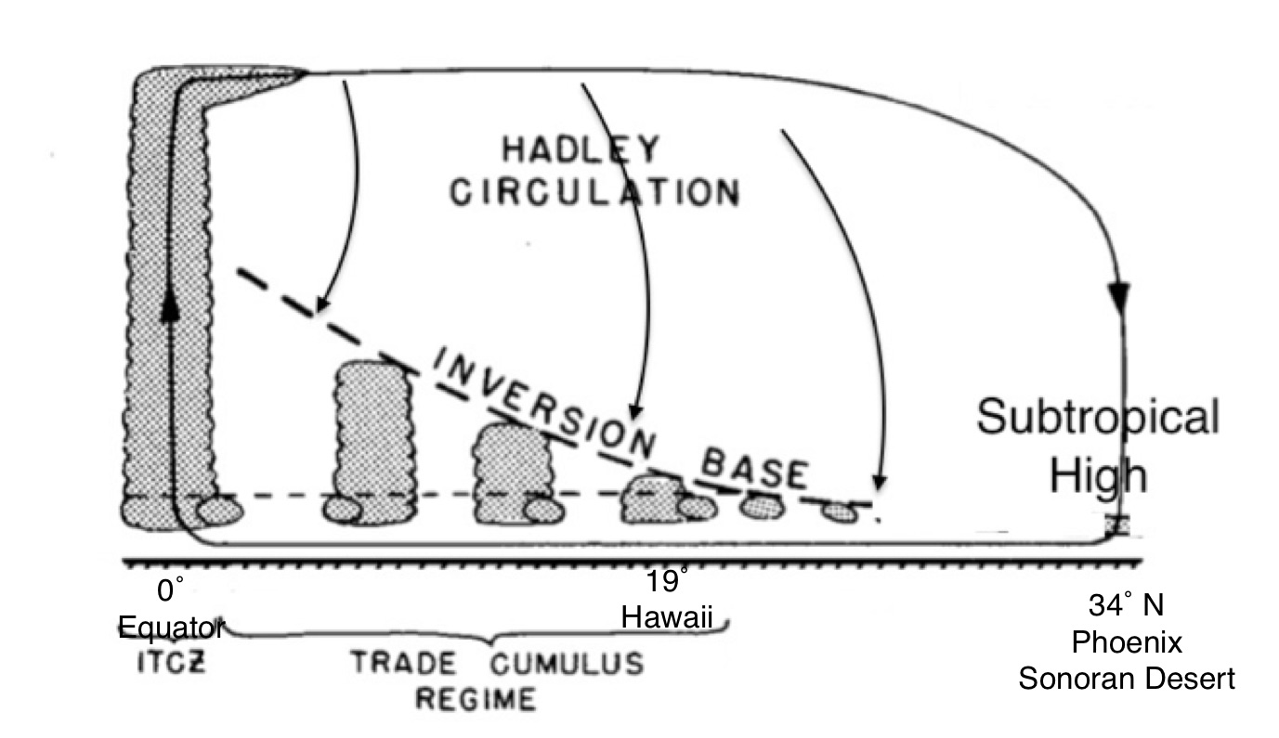
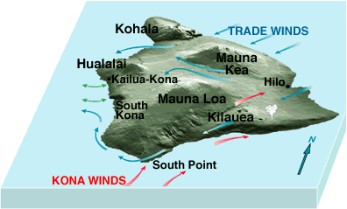
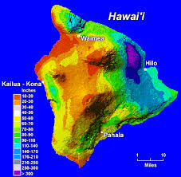
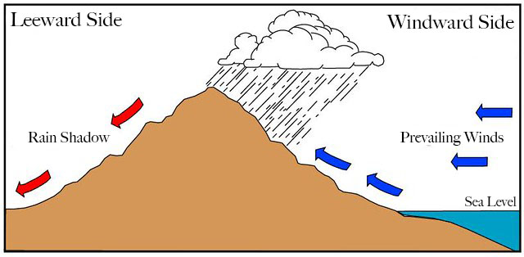
Study Site: Heart of the Grand Canyon
Precipitation Patterns
Trade wind inversion
Orographic Rain
Sea
Breeze
Wrap
Around
O
R
Rainshadow
TWI
O
Orographic Rain
R
SB

Slide 12
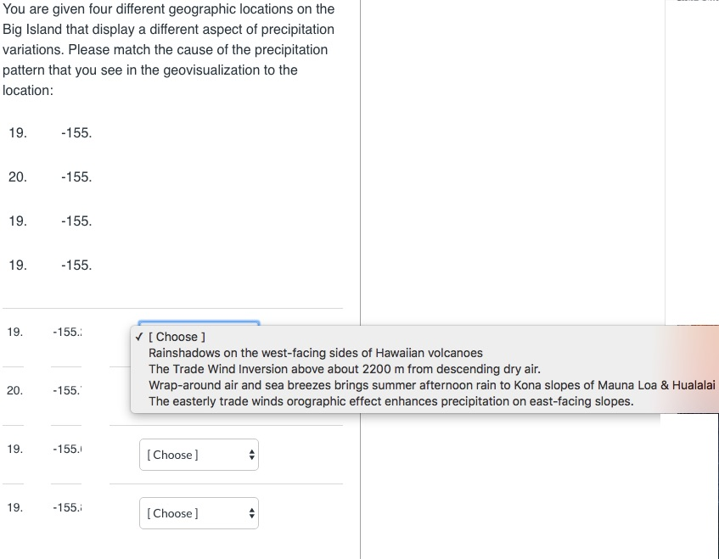
Study Site: Heart of the Grand Canyon
A2: Question 2 Stage A

Slide 13
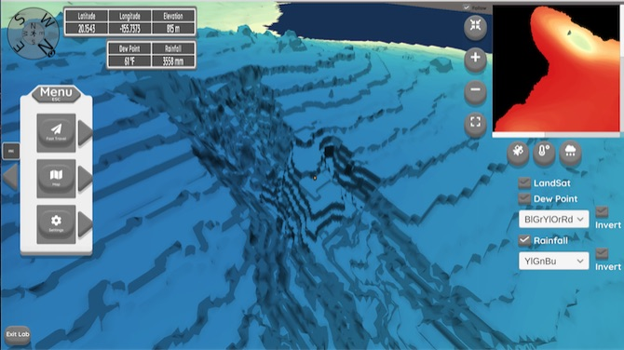
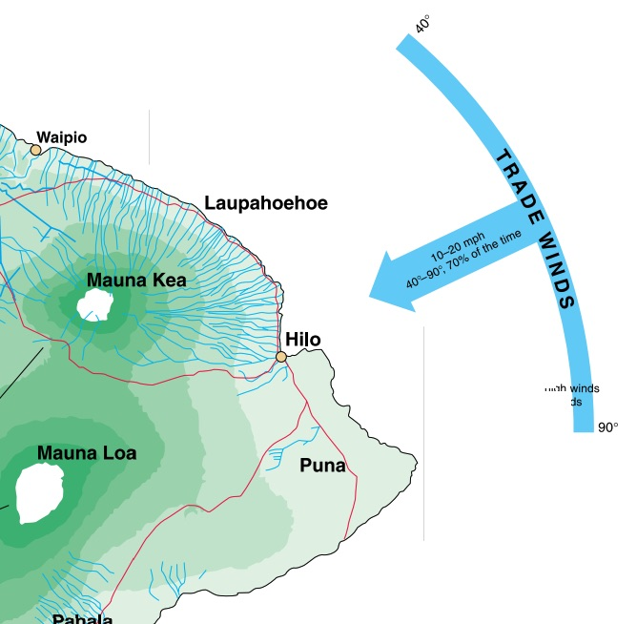
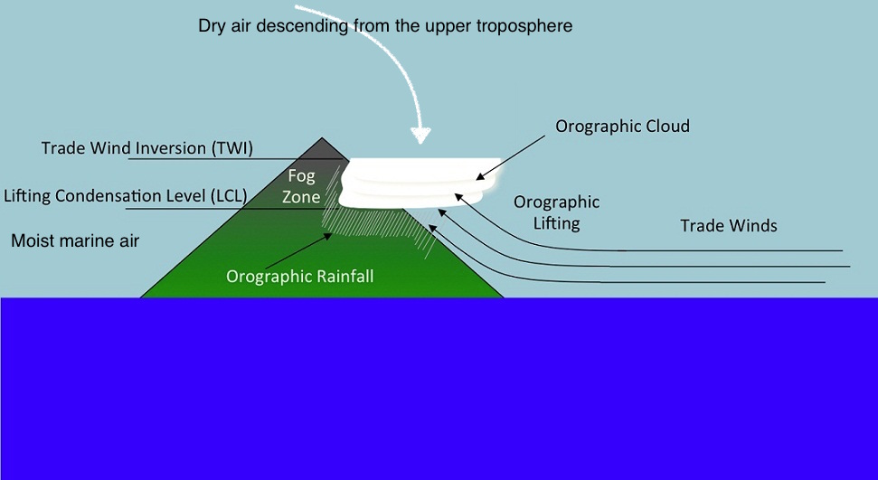
Study Site: Heart of the Grand Canyon
Orographic Uplifting Trade winds
Sea
Breeze
Wrap
Around

Slide 14
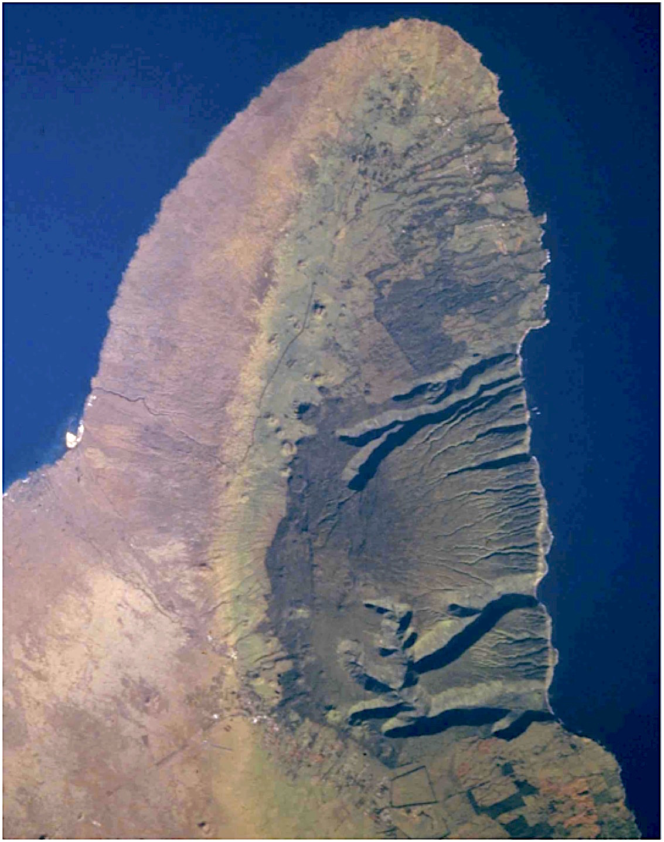
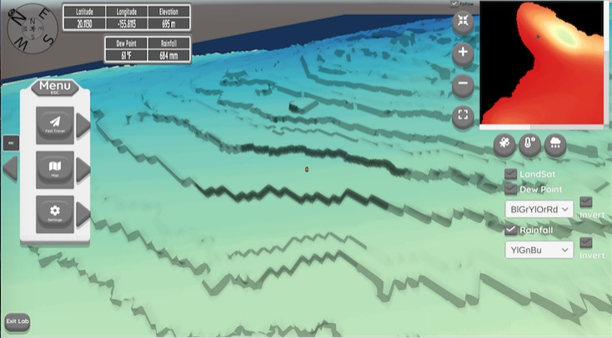
Rainshadow on west facing side
20.1130 -155.8113
Rainshadow of the trade winds

Slide 15
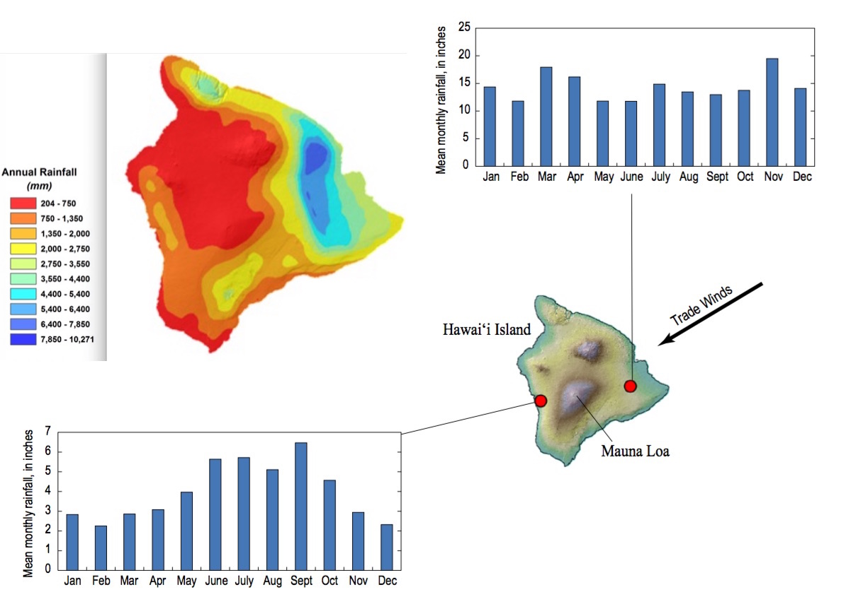
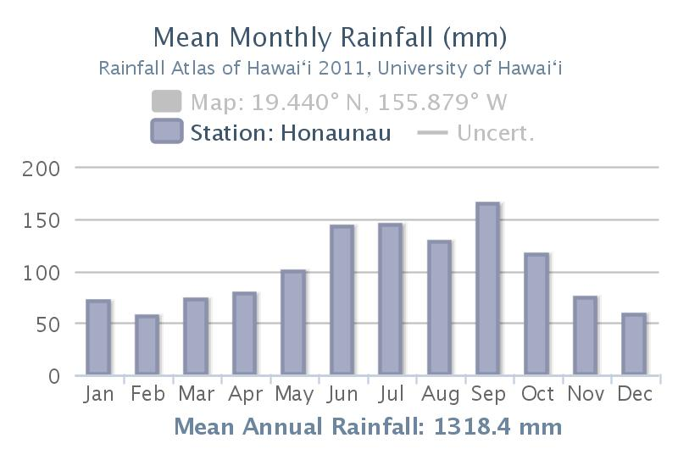
Wrap around moisture
Sea Breeze-Orographic
Summer precip max

Slide 16
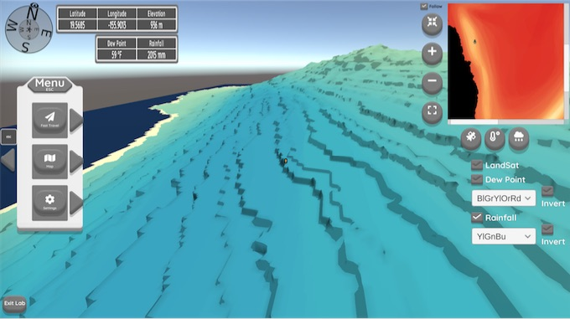
Wrap around moisture
Sea Breeze-Orographic

Slide 17
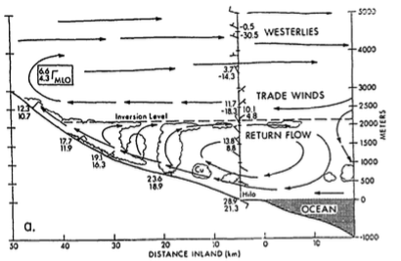
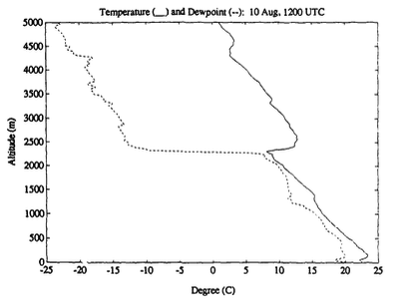
Trade Wind Inversion = dry air &
Little rain above it

Slide 18
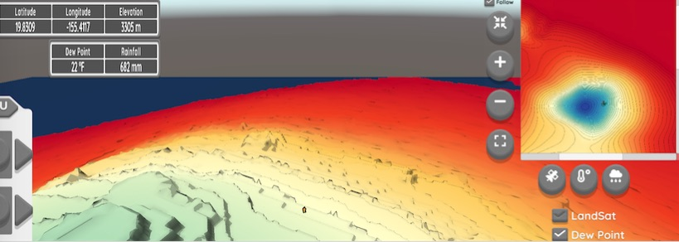
Trade Wind Inversion = dry air &
Little rain above it

Slide 19
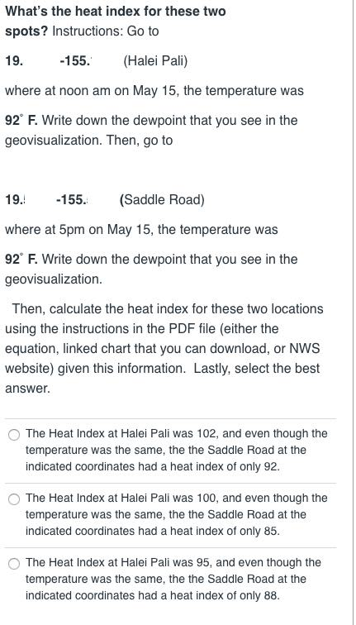
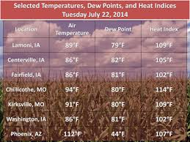
Study Site: Heart of the Grand Canyon
Stage A: Question 3
Source: NASA

Slide 20
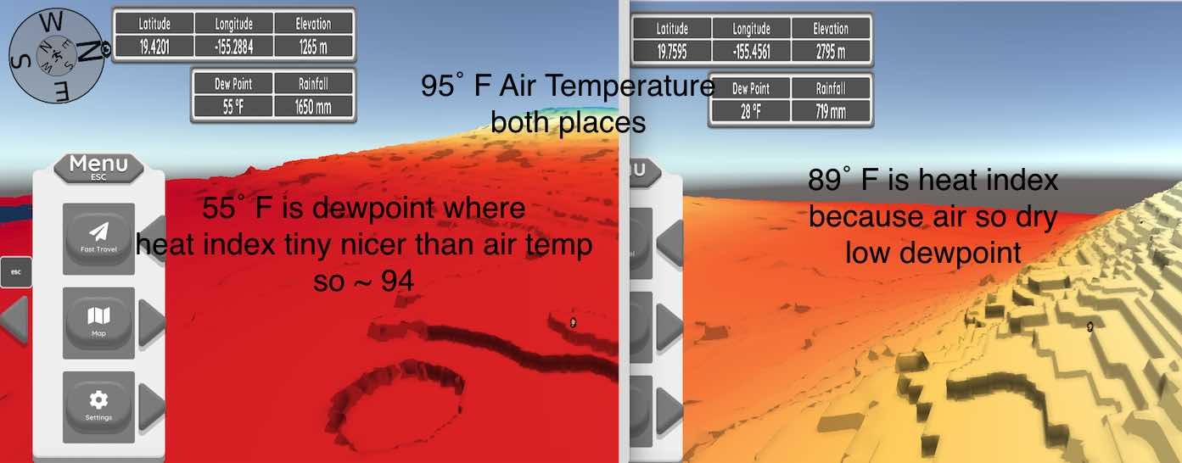
Study Site: Heart of the Grand Canyon
Stage A: Question 3
Another example from PDF file

Slide 21
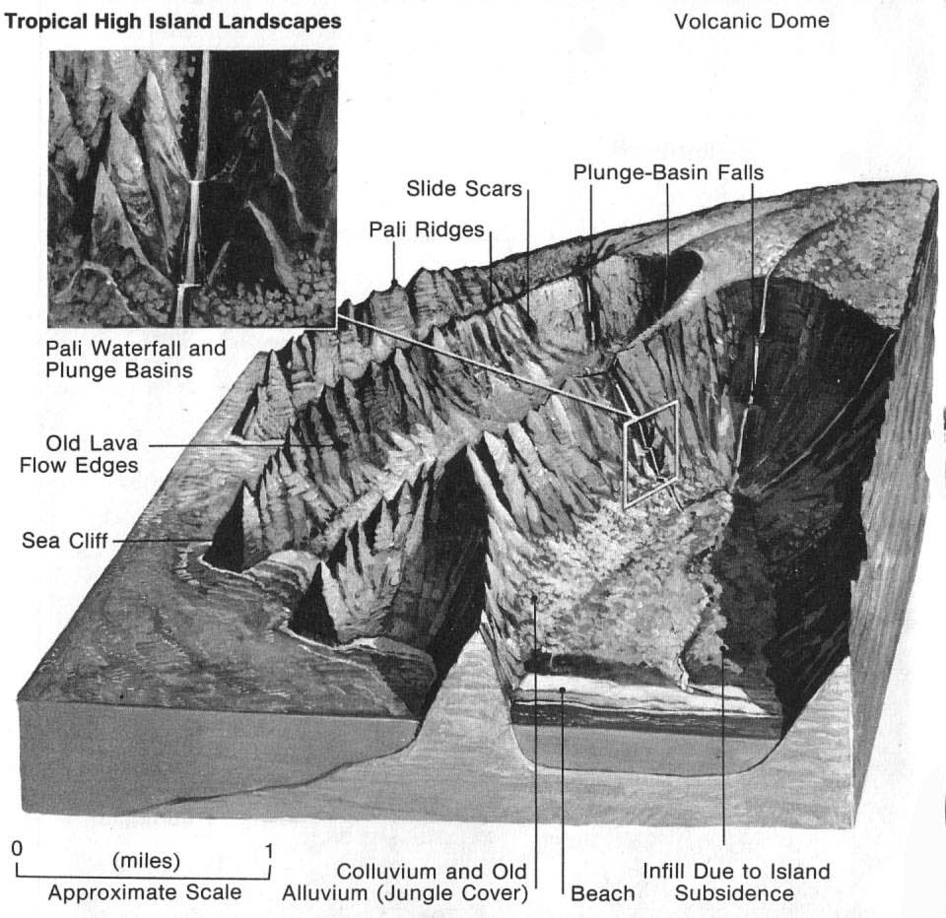
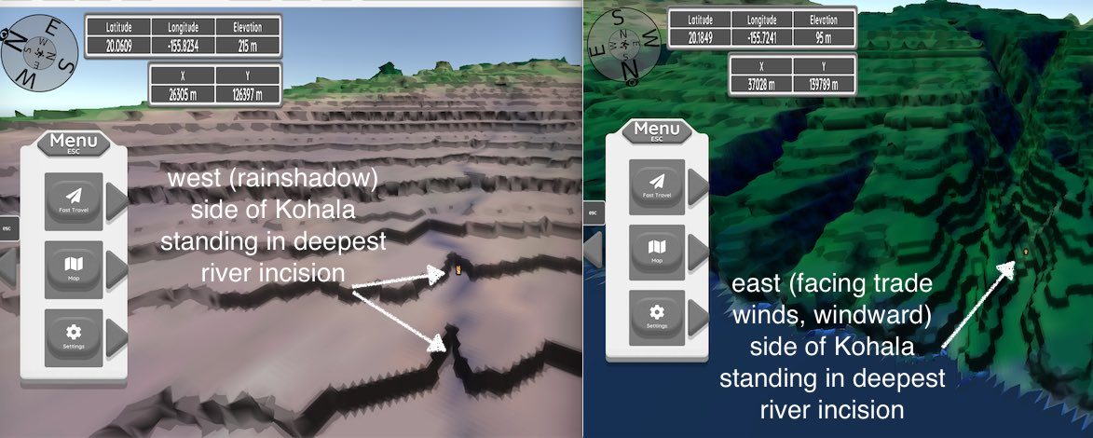
Study Site: Heart of the Grand Canyon
Stage A: Question 4

Slide 22
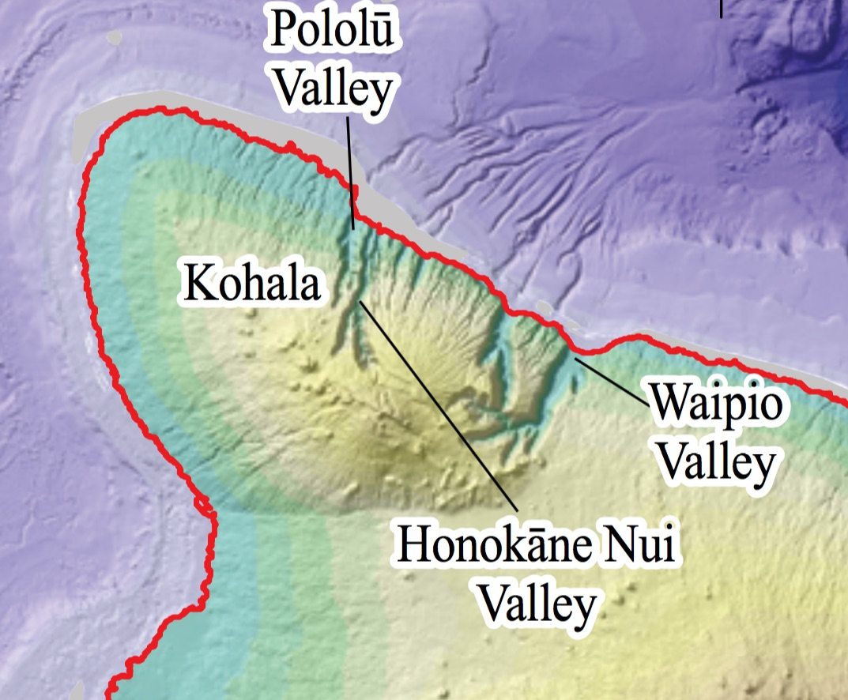
Study Site: Heart of the Grand Canyon
Stage A: Question 4

Slide 23
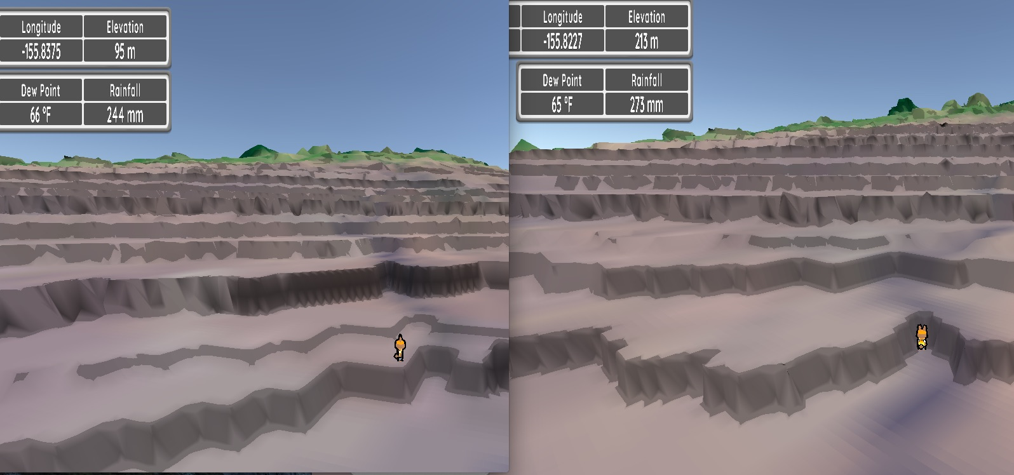
Study Site: Heart of the Grand Canyon
Rainfall (measured in stream) nearest 50 <1000mm
Stage A: Question 4

Slide 24
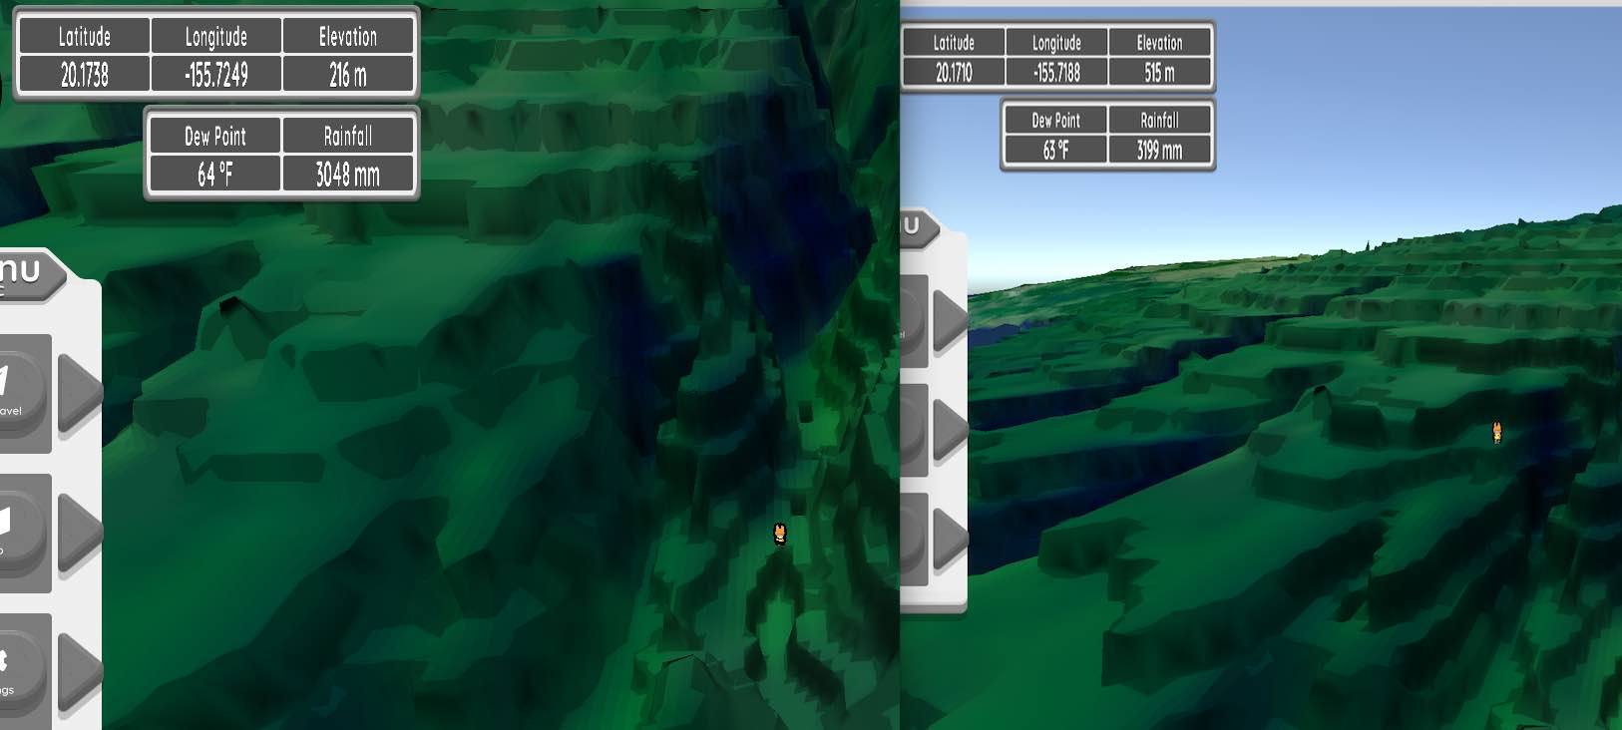
Study Site: Heart of the Grand Canyon
Rainfall ~3000 mm (nearest 100) in stream
515-216= ~300 m deep valley
Stage A: Question 4

Slide 25
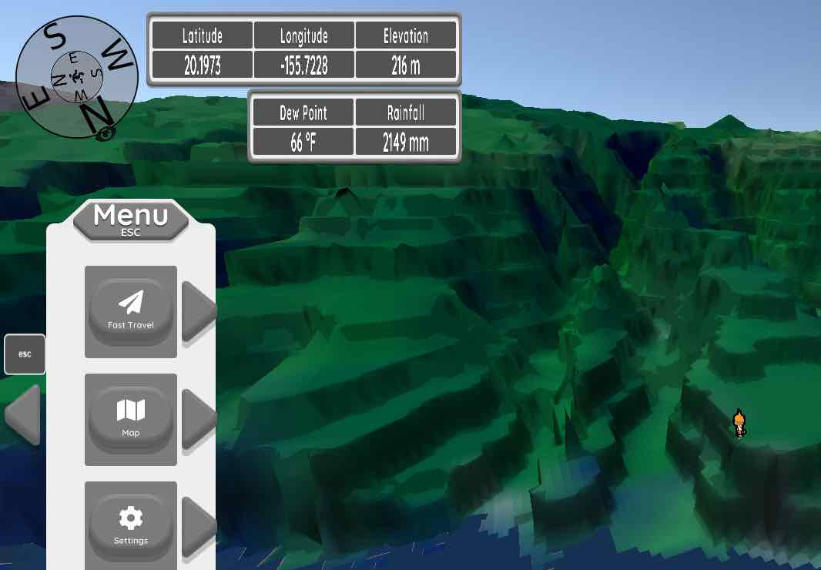
Study Site: Heart of the Grand Canyon
Rainfall measured in stream
216-35= ~180 m deep valley
Stage A: Question 4

Slide 26
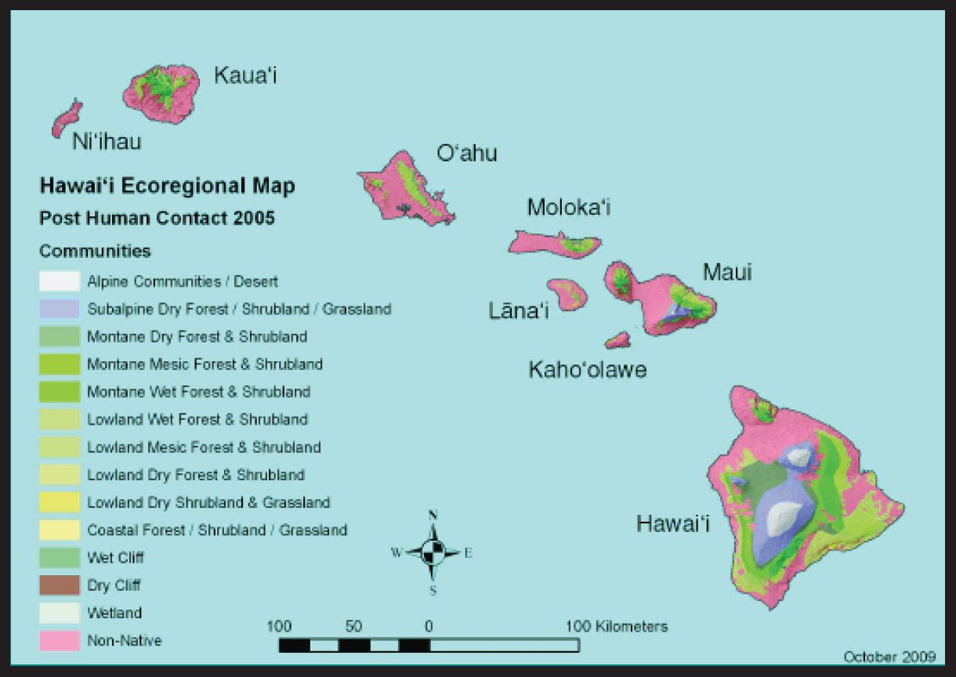
Study Site: Heart of the Grand Canyon
Stage A: Question 5 Biogeography & Treeline
Abiotic (temp, precipitation) & Biotic factors (predation, competition, disturbance) influence biotic distributions

Slide 27
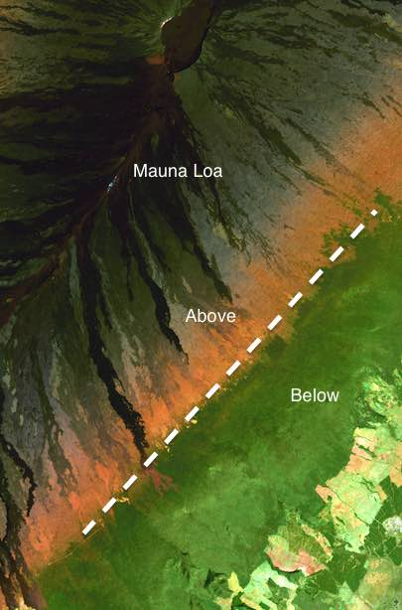
Study Site: Heart of the Grand Canyon
Stage A: Question 5
What controls the upper treeline of the rainforest?
Trade wind inversion

Slide 28
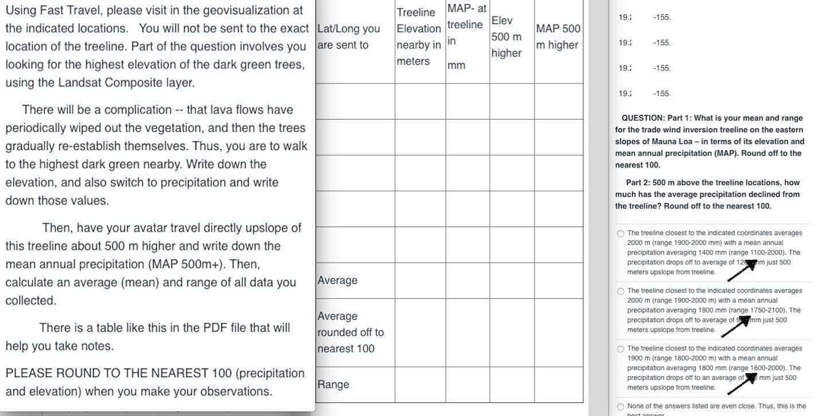
Study Site: Heart of the Grand Canyon
Stage A: Question 5

Slide 29
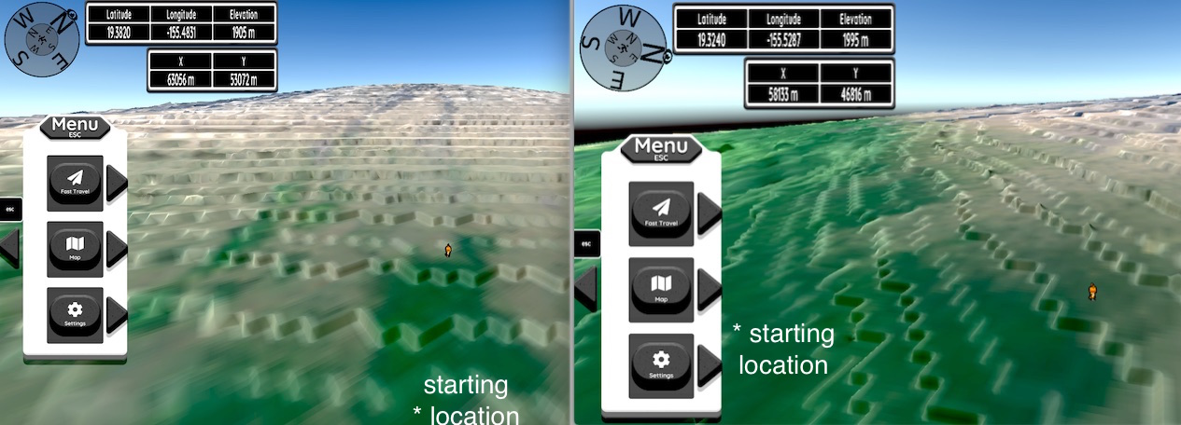
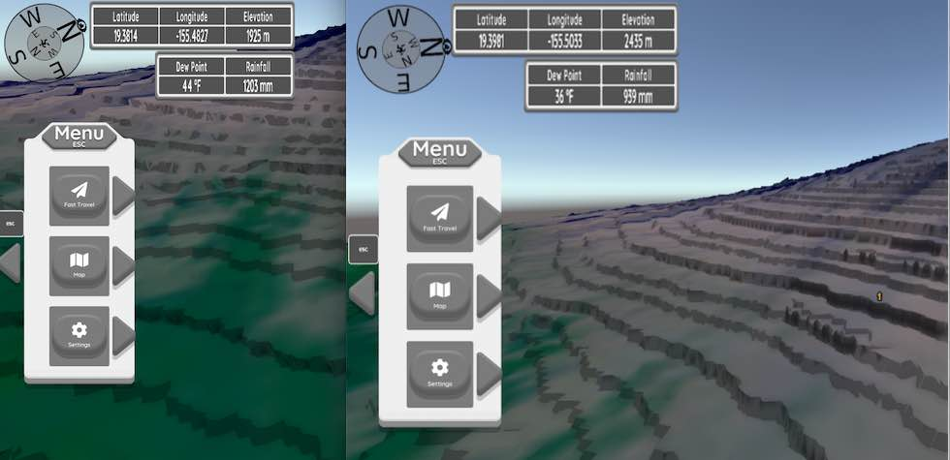
Study Site: Heart of the Grand Canyon
Stage A: Question 5
Walk up to
treeline
~500 m higher
Mean annual precip ~900 mm rounded to nearest 100
1200 mm (nearest 100) at treeline, top of dark green

Slide 30
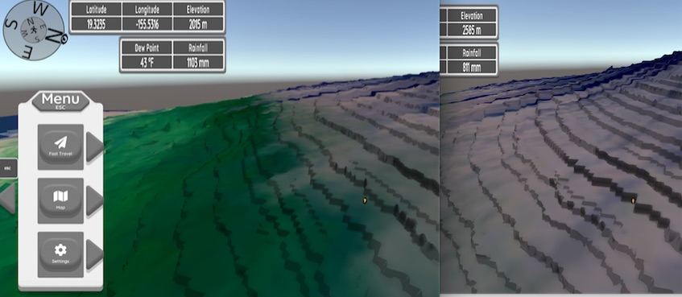
Stage A: Question 5
~500 m higher
Mean annual precip ~800 mm rounded to nearest 100
1100 mm (nearest 100) at treeline, top of dark green
Walk up to
treeline

Slide 31
Study Site: Heart of the Grand Canyon
Stage B

Slide 32
the Grand Canyon
Stage B Task 1 – differences in volcanoes on the Big Island
Source: NASA

Slide 33
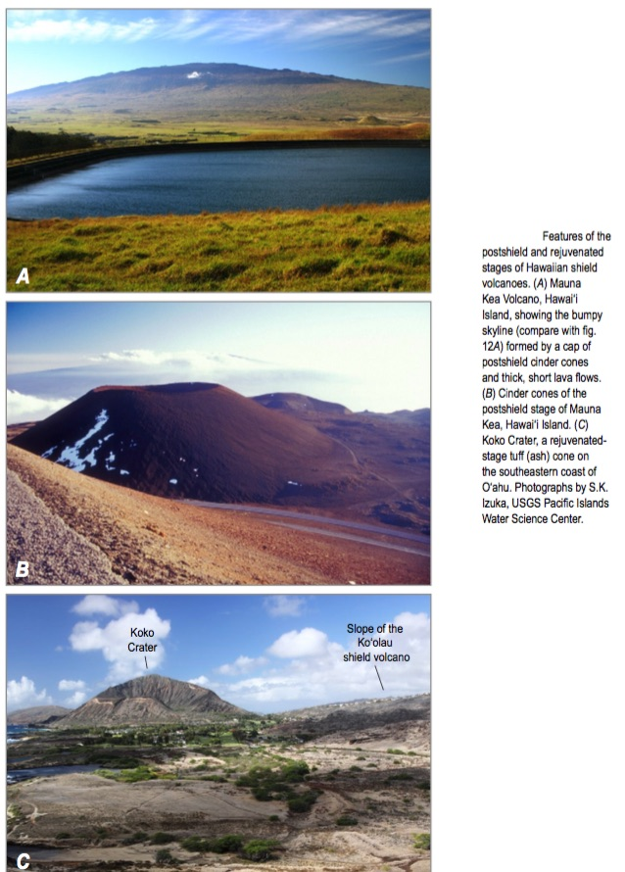

Slide 34
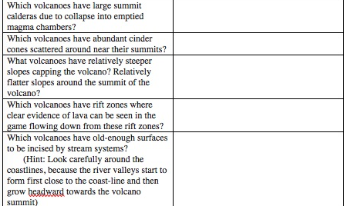
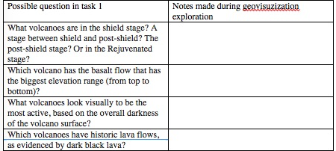
the Grand Canyon
Stages
Source: NASA

Slide 35
Study Site: Heart of the Grand Canyon
Stage B Task 2
Source: NASA

Slide 36
Study Site: Heart of the Grand Canyon
Stage B Task 2

Slide 37
Trimlines can tell thickness, but none on Mauna Kea

Slide 39
Use cinder cones that split flow

Slide 40
You measure cone height above till: 3785-3665 = ~120m
Ice cap at this location was less than 120 height of the cinder cone top above the topography on the up-glacier side of the cinder cone

Slide 41
Study Site: Heart of the Grand Canyon
Stage B Task 2
Depth
X
Area
=
Volume
PDF goes step by step

Slide 42
Study Site: Heart of the Grand Canyon
Stage B Task 3

Slide 43
Study Site: Heart of the Grand Canyon
Stage B Task 3

Slide 44
What does adiabatic mean?

Slide 45
As parcel goes up, cools & reaches the dew point
5˚C/1000m
In Hawaii
0.5˚C/100m
10˚C/1000m
Everywhere
1˚C/100m

Slide 46
At the Lifting Condensation Level

Slide 47
Temperature decrease in lapse rate lessens because latent heat is released with condensation

Slide 48
Why warm when air descends
10˚C/1000m
Or
1˚C/100m

Slide 49
Lapse Rate Changes Explain Rainshadows
10˚C/1000m
Or
1˚C/100m
10˚C/1000m
Or
1˚C/100m

Slide 50
Can see evaporation of clouds as air descends and warms
Grand Canyon Anza Borrego

Slide 51
Study Site: Heart of the Grand Canyon
Stage B Task 3

Slide 52
Study Site: Heart of the Grand Canyon
1200 mm

Slide 53
Study Site: Heart of the Grand Canyon
Dewpoint
20˚ C
Reached
500 m
Wet (saturated adiabatic lapse rate
0.5˚C/100 meters
Dry adiabatic lapse rate
1˚C/100 meters
20˚
2300 – nearest 100 mm

Slide 54
Study Site: Heart of the Grand Canyon
Dewpoint
20˚ C
Reached
500 m
Wet (saturated adiabatic lapse rate
0.5˚C/100 meters
22.5˚ 4000mm
Dry adiabatic lapse rate
1˚C/100 meters
20˚
2300 – nearest 100 mm

Slide 55
Study Site: Heart of the Grand Canyon
LCL &
Dewpoint
20˚ C
Reached
500 m
Wet (saturated adiabatic lapse rate
0.5˚C/100 meters
20˚ 3300mm
20˚ 3300mm
22.5˚ 4000mm
20˚
Dry adiabatic lapse rate
1˚C/100 meters
2300
ALWAYS USE GOING DOWN
Dry adiabatic lapse rate
1˚C/100 meters

Slide 56
Study Site: Heart of the Grand Canyon
LCL &
Dewpoint
20˚ C
Reached
500 m
Wet (saturated adiabatic lapse rate
0.5˚C/100 meters
20˚ 3300mm
20˚ 3300mm
25˚ 800mm
22.5˚ 4000mm
20˚
Dry adiabatic lapse rate
1˚C/100 meters
2300
ALWAYS USE GOING DOWN
Dry adiabatic lapse rate
1˚C/100 meters

Slide 57
Study Site: Heart of the Grand Canyon
LCL &
Dewpoint
20˚ C
Reached
500 m
Wet (saturated adiabatic lapse rate
0.5˚C/100 meters
20˚ 3300mm
20˚ 3300mm
25˚ 800mm
22.5˚ 4000mm
20˚
Dry adiabatic lapse rate
1˚C/100 meters
30˚ 400mm
2300
ALWAYS USE GOING DOWN
Dry adiabatic lapse rate
1˚C/100 meters

Slide 58
Study Site: Heart of the Grand Canyon
LCL &
Dewpoint
20˚ C
Reached
500 m
Wet (saturated adiabatic lapse rate
0.5˚C/100 meters
20˚ 3300mm
20˚ 3300mm
25˚ 800mm
22.5˚ 4000mm
20˚
Dry adiabatic lapse rate
1˚C/100 meters
30˚ 400mm
35˚ 250 mm
2300
ALWAYS USE GOING DOWN
Dry adiabatic lapse rate
1˚C/100 meters

Slide 59
Study Site: Heart of the Grand Canyon
Stage B Task 4
Source: NASA

Slide 60
Study Site: Heart of the Grand Canyon
Stage B Task 4
Source: NASA

Slide 61
Study Site: Heart of the Grand Canyon
Stage B Task 4
Source: NASA

Slide 62
Study Site: Heart of the Grand Canyon
Stage B Task 4

Slide 63
Study Site: Heart of the Grand Canyon
Stage B instructions
Download
Excel file
To help
Make gradient calculations
˚F/100m

Slide 64
Study Site: Heart of the Grand Canyon
Stage B: Task 5 Biogeography & Plant Succession
The Big Island is THE classic place to study how long it takes for a plant community to re-establish itself, because ages of lava flows knows & great climate differences

Slide 65
Study Site: Heart of the Grand Canyon
Stage B Task 5
Source: NASA

Slide 66
Study FCanyon
Forest Succession
Source: NASA

Slide 67
Study FCanyon
Forest Succession
Source: NASA

Slide 68
Study Site: Heart of the Grand Canyon
Stage B Task 5
Source: NASA

Slide 69
Study DCanyon
Rainshadow Dry Succession
Source: NASA

Slide 70
Study DCanyon
Rainshadow Dry Succession
Source: NASA

Slide 71
Study Site: Heart of the Grand Canyon
Stage B Task 5
Source: NASA

Slide 72
Study Site: Heart of the Grand Canyon
Source: NASA

Slide 73
Study Site: Heart of the Grand Canyon
STAGE C: Essay

