Slide 1
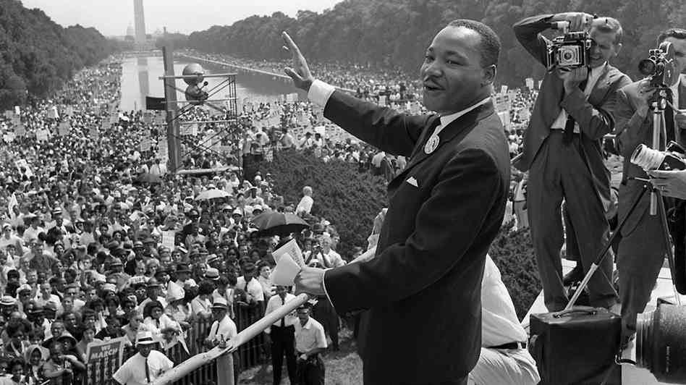
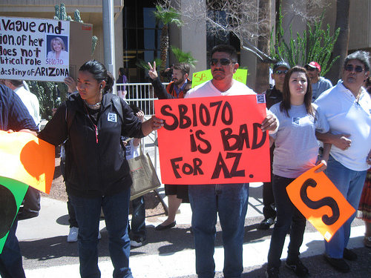
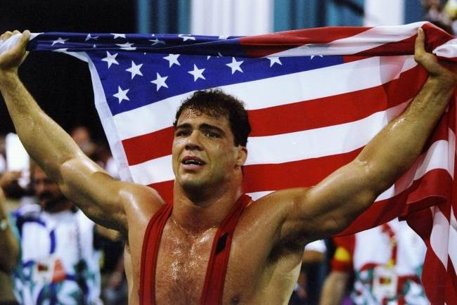
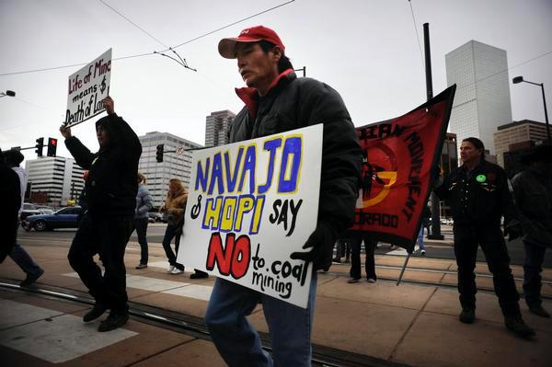
Learning How to Write from Young Adult Nonfiction: Linking Informational Text Reading and Writing
NCTE 2013
Boston
James
Blasingame,
Arizona State University

Slide 2
Instructional Shifts
Shift 1 | PK-5, Balancing Informational and Literary Texts | Students read a balance of informational and literacy texts. Elementary school classrooms are, therefore, places where students access the world-science, social studies, the arts and literature- through text. At least 50% of what students read is informational
Shift 2 | 6-12, Building Knowledge in the Disciplines | Content area teachers outside of the ELA classroom emphasize literacy experiences in their planning and instruction. Students learn through domain-specific texts in science, social studies and technical subject classrooms.
Shift 3 | Staircase of Text Complexity | In order to prepare for the complexity of college and career ready texts, each grade level requires a “step” of growth on the “staircase”. Students read the central, grade appropriate text around which instruction is centered. Teachers create more time and space in the curriculum for close careful reading of text.
Shift 4 | Text-Based Answers | Students have rich and rigorous conversations which are dependent on a common text. Teachers insist that classroom experiences stay deeply connected to the text on the page and that students develop habits for making evidentiary arguments both in conversation, as well as in writing to assess comprehension of text.
Shift 5 | Writing from Sources | Writing needs to emphasize use of evidence to inform or make an argument rather than personal narratives and other forms of decontextualized prompts. While the narrative still has an important role, students develop skills through written arguments that respond to the ideas, events, facts, and arguments presented in the texts they read.
Shift 6 | Academic Vocabulary | Students constantly build vocabulary they need to access grade level complex texts by focusing strategically on comprehension of pivotal words (such as “discourse,” “generation,” “theory,” and “principled” and less on literary terms (such as “onomatopoeia” and ”theme.” Teachers constantly insist that students use academic words in speaking and writing.
(New York Dept of Ed/Teacher Domain/Science Foundation)

Slide 3
Instructional shifts
Text complexity
Depth and breadth of knowledge
Rigor
Pivotal words
Informational texts
Balance of writing types
Literacy: History/Soc. Stud., Science, Tech
Text/evidence based writing

Slide 4
What do we want students to know and be able to do?
How can we guide them through it?
What resources are available?
What remains the same?

Slide 5
© Karin K. Hess, Ed.D., Senior Associate, Center for Assessment, Dover, NH
Depth and thinking | Level 1 Recall & Reproduction | Level 2 Skills &Concepts | Level 3 Strategic Thinking/ Reasoning | Level 4 Extended Thinking
Remember | - Recall, locate basic facts, details, events
Understand | -Select appropriate words to use when intended meaning is clearly evident | - Specify, explain Relationships – summarize – identify main ideas | - Explain, generalize, or connect ideas using supporting evidence (quote, example…) | – Explain how concepts or ideas specifically relate to other content domains or concepts
Apply | -Use language structure (pre/suffix) or word relationships (synonym/antonym)to determine meaning | – Use context to identify meaning of word - Obtain and interpret information using text features | – Use concepts to solve non-routine problems | - Devise an approach among many alternatives to research a novel problem
Analyze | -Identify whether information is contained in a graph, table, etc. | - Compare literary elements, terms, facts, events - Analyze format, organization, & text structures | - Analyze or interpret author’s craft (literary devices, viewpoint, or potential bias) to critique text | - Analyze multiple sources - Analyze complex/abstract themes
Evaluate |  |  | - Cite evidence and develop logical argument for conjectures | - Evaluate relevancy, accuracy, & completeness of information
Create | -Brainstorm ideas about a topic | -Generate conjectures based on prior knowledge | - Synthesize information within one source or text | - Synthesize information across multiple sources or texts

Slide 6
Strand: Writing Standards for Literacy in History/Social Studies,
Science, and Technical Subjects
Writing Standards for Literacy in History/Social Studies, Science, and Technical Subjects Text Types and Purposes
Standards | Explanations and Examples
Students are expected to:
6-8.WHST.1. Write arguments focused on Discipline- specific content. a. Introduce claim(s) about a topic or issue, acknowledge and distinguish the claim(s) from alternate or opposing claims, and organize the reasons and evidence logically. b. Support claim(s) with logical reasoning and relevant, accurate data and evidence that demonstrate an understanding of the topic or text, using credible sources. c. Use words, phrases, and clauses to create cohesion and clarify the relationships among claim(s), counterclaims, reasons, and evidence. d. Establish and maintain a formal style. e. Provide a concluding statement or section that follows from and supports the argument presented. | The standard asks the student to write an argument based on a social studies issue or topic. The topic or issue is presented with logical reasoning and relevant data to support the claim. Cohesion and clarification of claims are created with effective word choice and writing style. A sound conclusion supports the argument presented. Examples: • Students write a persuasive essay in which they form a logical argument about the importance of citizens being actively involved in the democratic process (e.g., petitioning public officials about an issue that concerns them). SS06-S3C4-03; SS07-S3C4-03; SS08-S3C4-03 .

Slide 7
Strand: Writing Standards for Literacy in History/Social Studies,
Science, and Technical Subjects
Writing Standards for Literacy in History/Social Studies, Science, and Technical Subjects Production and Distribution of Writing
Standards | Explanations and Examples
Students are expected to:
6-8.WHST.5. With some guidance and support from peers and adults, develop and strengthen writing as needed by planning, revising, editing, rewriting, or trying a new approach, focusing on how well purpose and audience have been addressed. | This standard addresses students developing and strengthening their writing through the writing process with a focus on purpose and audience. Writing in social science utilizes an academic voice and is mostly non-fiction and formal. At this level the writing process can be supported by peers and adults. Examples: • Students research a current, local environmental issue and write about how the changes in the natural environment affect human activities. The students interview people who were impacted by the issue and include their experiences in the writing. SS06-S4C5-03; SS07-S4C5-07 • Students read about government policies and programs dealing with the present economic condition and write an analysis of the impact of those policies and programs on the economic recovery. SS08-S5C3-03
6-8.WHST.6. Use technology, including the Internet, to produce and publish writing and present the relationships between information and ideas clearly and efficiently. | This standard requires the use of technology (Internet, keyboarding skills, formatting, storing) to create a published piece wherein information and ideas are connected and presented clearly and efficiently. Example: • The students utilize technology to create and publish any piece related to social studies content. The piece could be shared on a school or classroom website. ET06-S2C1-01; ET07-S2C1-01; ET08-S2C1-01;

Slide 8
Writing Standards for Literacy in History/Social Studies, Science, and Technical Subjects
Writing Standards for Literacy in History/Social Studies, Science, and Technical Subjects Research to Build and Present Knowledge
Standards | Explanations and Examples
Students are expected to:
6-8.WHST.7. Conduct short research projects to answer a question (including a self-generated question), drawing on several sources and generating additional related, focused questions that allow for multiple avenues of exploration. | This standard requires students to answer questions through research, including those they create themselves, to solve a problem. They will use and combine information from multiple sources to construct their answer(s). SS06-S2C5-01 • Following the study of important judicial decisions such as Dred Scott, Plessy v. Ferguson, or the Scopes Trial, students formulate a question related to the historical significance of the decision. Research is conducted using a variety of print and non-print sources. SS07-S3C3-01
6-8.WHST.8. Gather relevant information from multiple print and digital sources, using search terms effectively; assess the credibility and accuracy of each source; and quote or paraphrase the data and conclusions of others while avoiding plagiarism and following a standard format for citation.
6-8.WHST.9. Draw evidence from informational texts to support analysis reflection, and research.

Slide 9
Sullivan, Patrick. “An Essential Question: What Is ‘College-Level’ Writing?” What is “College-Level” Writing? Urbana, IL: National Council of Teachers of English. 2006. Print
CCSS Instructional Shifts and Rigor (not out yet)
Sophistication and Complexity of Ideas
Sophisticated writing vs. competent writing
Competent paper
Responds directly to prompt/assignment
Introduction, body and conclusion
Synthesizes research materials
Relatively free of errors in conventions
Sophisticated paper
Organization subtly moves the reader from idea to idea [not five paragraph progression]
Writer’s voice comes out through word choice sentence variety
Ideas demonstrate insight
Reader wants to reread parts
(27-28)

Slide 10
Quilligan, Mike. “Putting on the Sunglasses: The Argumentative Thesis as the Keystone to ‘Good’ College Writing” What is “College-Level” Writing? Ed. Sullivan, Patrick, and Howard Tinberg Urbana, IL: National Council of Teachers of English. 2006. Print
“[S]tudents often seem unable to integrate ideas in assigned readings with their own. One common concern of many of the students I talked to or tutored throughout their semester of first­ year composition was that they were unsure how to acknowl­edge the author's critical stance while at the same time incorporating their own observations and arguments into their essays. (298)

Slide 11
What do I think about this topic? What is my opinion?
Be open to new information but read critically and be aware of fallacies of logic:
http://writingcenter.unc.edu/handouts/fallacies/
Hasty or sweeping generalization
Missing the point
Post hoc (assuming causality)
Slippery slope
Weak analogy
Appeal to authority
Ad populum (bandwagon)
Ad hominem (against the person)
Appeal to pity
Appeal to ignorance/Lack of evidence
Straw man
Red herring
False dichotomy
Equivocation

Slide 12
https://www.google.com/#q=recognizing+bias
From Ohio State
MAPit Strategy
Message (fact/opinion; source cited/not cited; language neutral/loaded; POV balance/one-sided; coverage fair/selective)
Author (educational background; affiliations, peer review)
Purpose (Partisan organization? Mission, funding, members, linked sources)
This presentation gives excellent illustrations of examining information for bias.

Slide 13
Back to:
“Sophisticated papers,”
“supporting claim(s) with logical reasoning and relevant, accurate data,”
“Cohesion and clarification of claims are created with effective word choice
Organization subtly moves the reader from idea to idea [not five paragraph progression]
Ideas that demonstrate insight
Integrating an source’s ideas with their own
And let’s add evaluating sources

Slide 14
- Cite evidence and develop logical argument for conjectures | - Evaluate relevancy, accuracy, & completeness of information
- Synthesize information within one source or text | - Synthesize information across multiple sources or texts

Slide 15
Choice
“Choice equals ownership, and ownership equals success.”
Dr. John H. Bushman, Professor Emeritus, University of Kansas

Slide 16
And choice can give an interesting spin to an old topic.

Slide 17
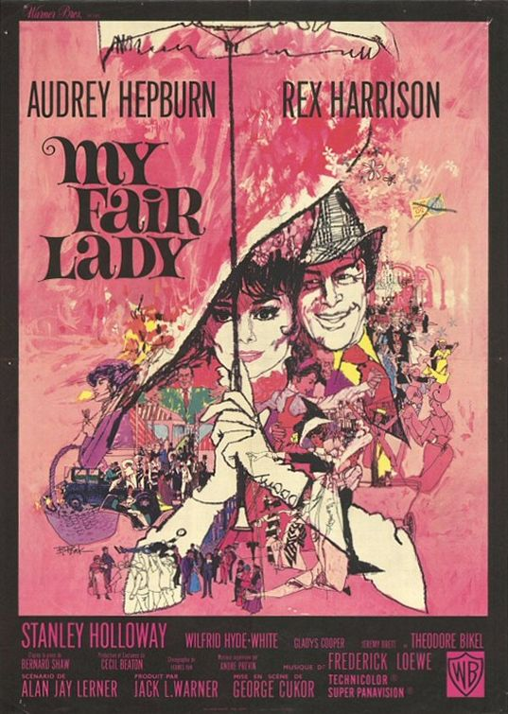
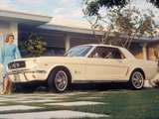
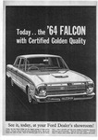
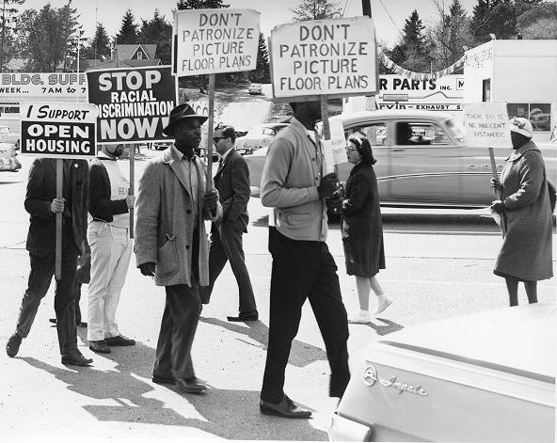
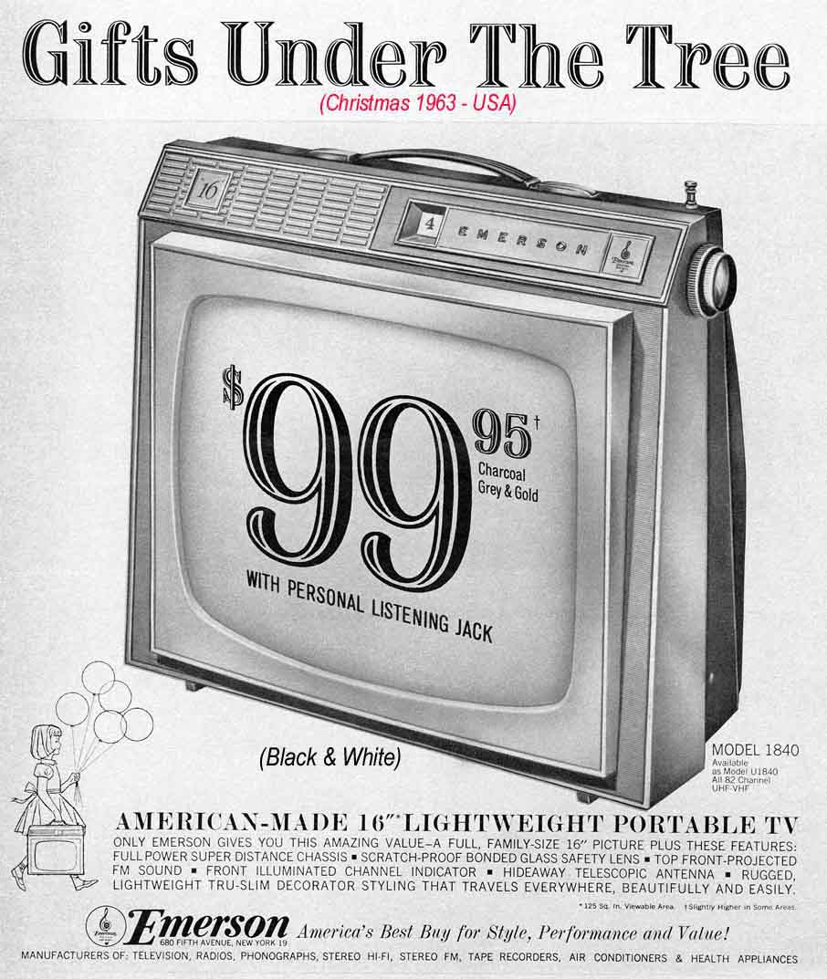
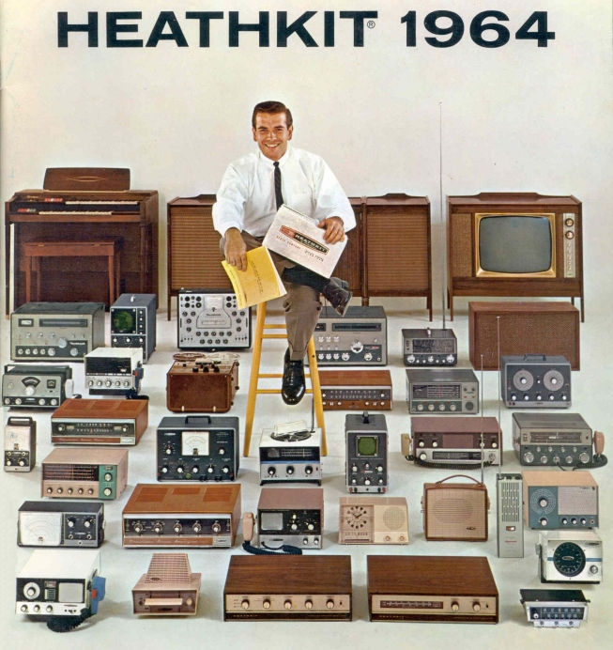
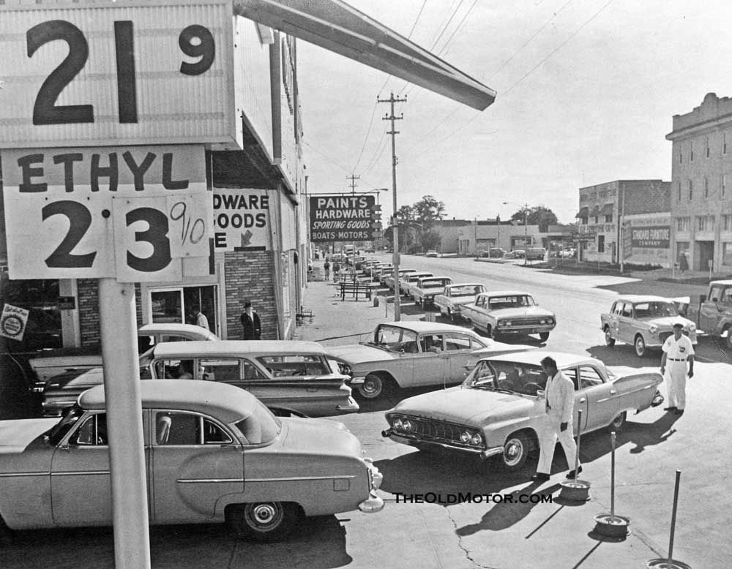
Consider 1964!

Slide 18
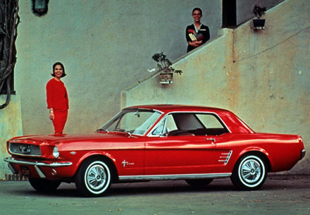

Slide 19
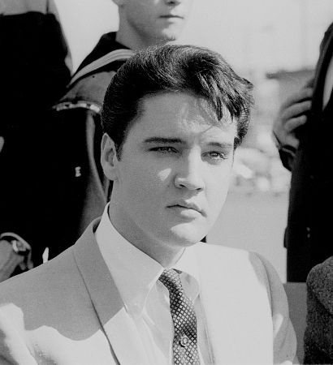
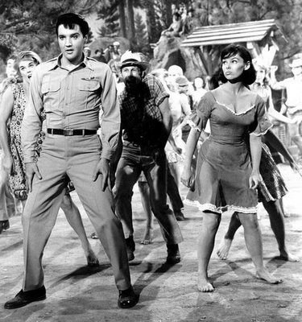
Elvis Presley was 28, and starred in Kissin’ Cousins with Yvonne Craig.

Slide 20
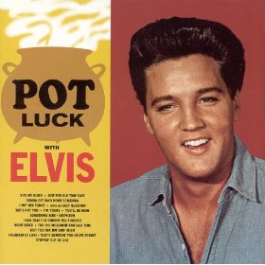
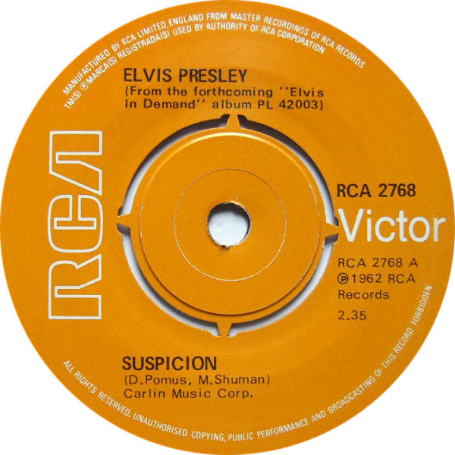

Slide 21
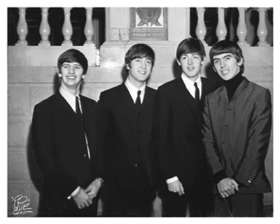
The Billboard Hot 100, April 4, 1964 No. 1, "Can't Buy Me Love" No. 2, "Twist and Shout" No. 3, "She Loves You" No. 4, "I Want to Hold Your Hand" No. 5, "Please, Please Me"

Slide 22
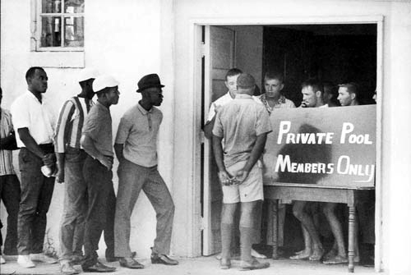
And segregation of public swimming pools was a reality, but things would get worse (Cairo, Illinois)

Slide 23
And that is exactly the problem Gloriana June Hemphill is about to run into in fictitious Hanging Moss, Mississippi, in the summer of 1964.

Slide 24
Which could pique a young person’s interest and make her or him want to know more.

Slide 25
Don’t let them forget what we’ve talked about so far, especially #7:
“Sophisticated papers,”
“supporting claim(s) with logical reasoning and relevant, accurate data,”
“Cohesion and clarification of claims are created with effective word choice
Organization subtly moves the reader from idea to idea [not five paragraph progression]
Ideas that demonstrate insight
Integrating an source’s ideas with their own
And let’s add evaluating sources

Slide 26
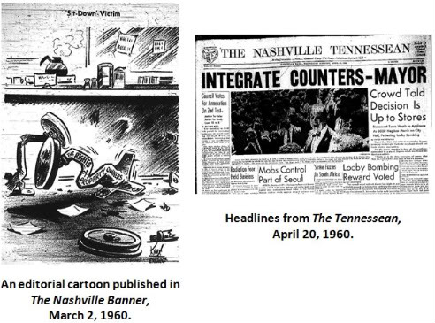
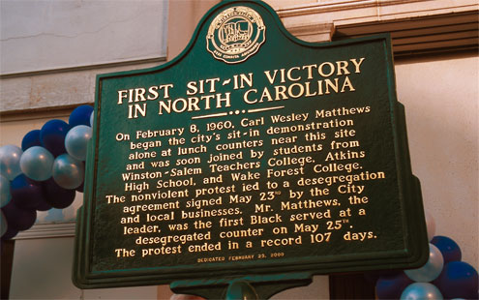
Where can they go to find information?

Slide 27
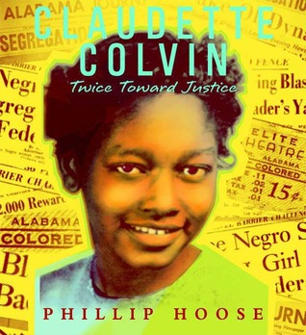
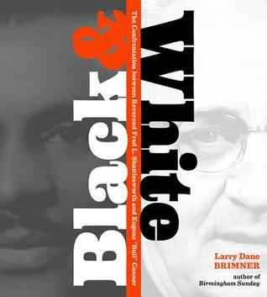
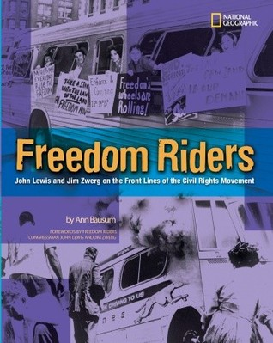
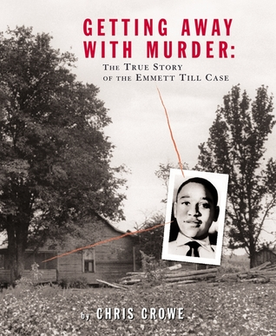
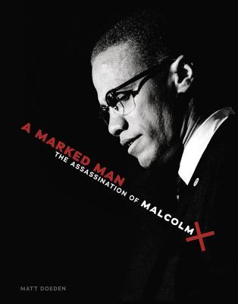
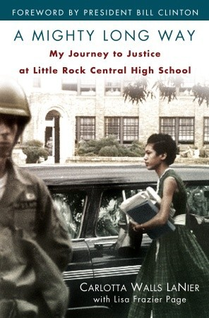
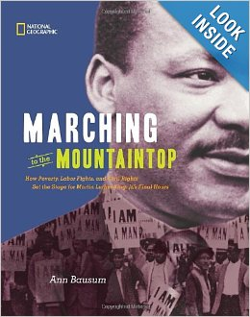

Slide 28
BUT LET’S DIG DEEPER!

Slide 29
[http://www.iste.org/STANDARDS ]
[http://www.ncte.org/library/NCTEFiles/Resources/PolicyResearch/21stCenturyClips.pdf ]

Slide 30
Use of Technology
1. Creativity and Innovation
Construct knowledge, and develop innovative products and processes using technology.
2. Communication and Collaboration
Use digital media and environments to communicate and work collaboratively, including at a distance, to
support individual learning and contribute to the learning of others.
*3. Research and Information Fluency
Apply digital tools to gather, evaluate, and use information.
4. Critical Thinking, Problem Solving, and Decision Making
Plan and conduct research, manage projects, solve problems, and make informed decisions using appropriate digital tools and resources.
5. Digital Citizenship
Practice legal and ethical behavior according to human, cultural, and societal issues related to technology.
6. Technology Operations and Concepts
Students demonstrate a sound understanding of technology concepts, systems, and operations.
From: [http://www.iste.org/STANDARDS ]

Slide 31
*3. Research and Information Fluency Apply digital tools to gather, evaluate, and use information.
a. Plan strategies to guide inquiry
b. Locate, organize, analyze, evaluate, synthesize, and ethically use information from a variety of sources and media
c. Evaluate and select information sources and digital tools based on the appropriateness to specific tasks
d. Process data and report results

Slide 34
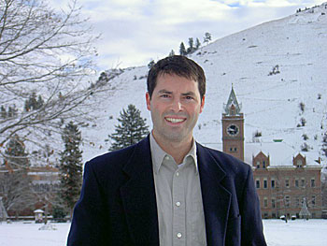
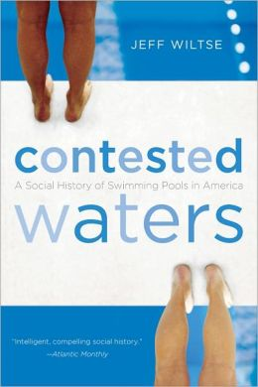
Contested Waters: A Social History of Swimming Pools in America
Chicago, Milwaukee, St. Louis
Are the consequences still with us? Research question that turns into a statement that turns into a thesis statement. BINGO!

Slide 35
http://www.instagrok.com
http://lib.asu.edu/

Slide 36
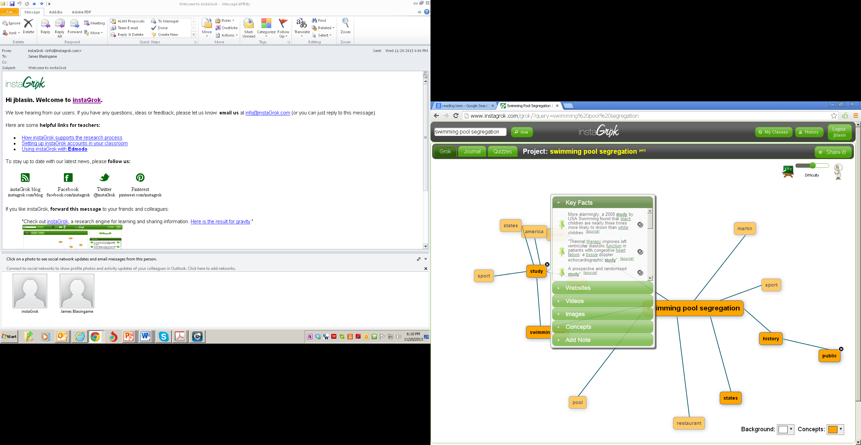

Slide 37
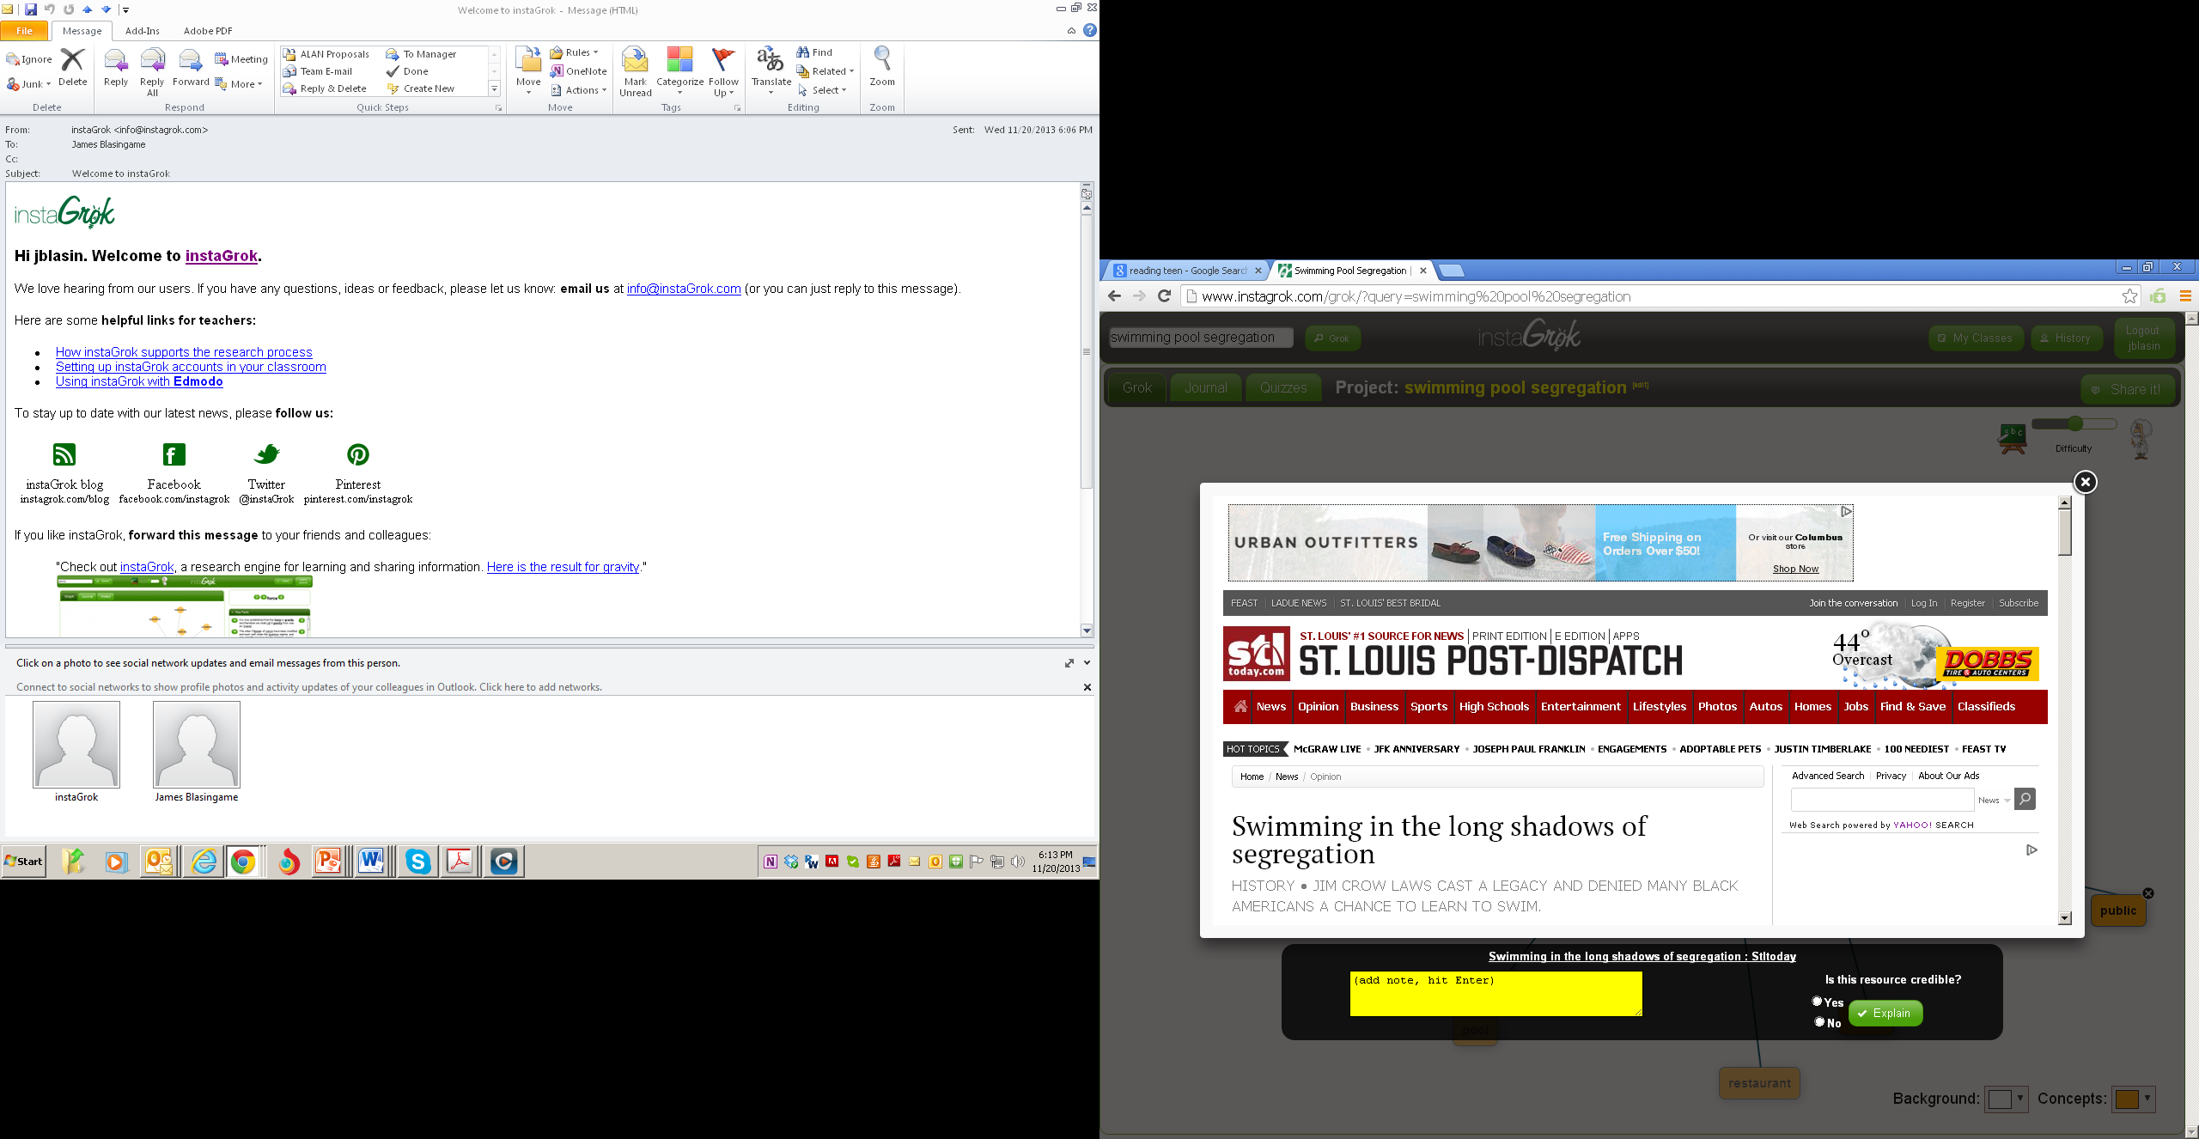

Slide 38
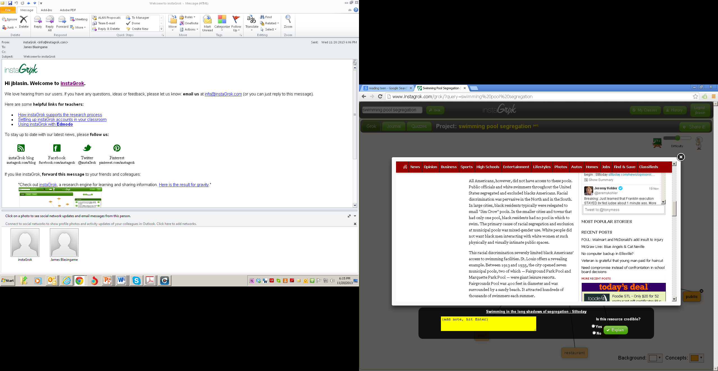

Slide 39
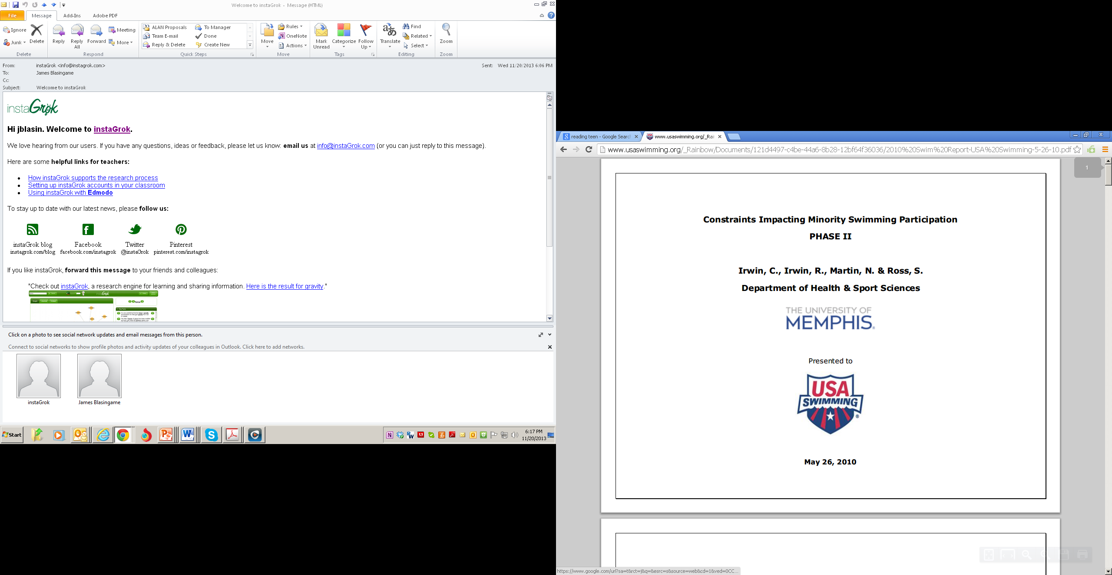

Slide 40
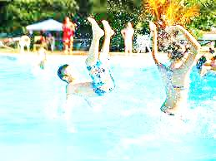
According to a study commissioned by USA Swimming in 2010
Constraints Impacting Minority Swimming Participation
PHASE II
University of Memphis, Department of Health & Sport Sciences
“69% of African American respondents self-reported low swimming skills.” (7)
“In fact, when controlling for income, Black/African American respondents were found to have significantly less swimming ability than White and Hispanic/Latino.” (7)

Slide 41
We’ve found the sources, we have a research question that became a thesis statement. Now it’s time to put all this together:
“Sophisticated papers,”
“[S]upporting claim(s) with logical reasoning and relevant, accurate data,”
“Cohesion and clarification of claims are created with effective word choice.”
Organization subtly moves the reader from idea to idea [not five paragraph progression]
Ideas that demonstrate insight
Integrating an source’s ideas with their own
Evaluating sources

Slide 42
Text Type: Argumentation
The basic purpose of argumentation is to convince a reader that the writer’s opinion about a topic is correct or is at least a valid one among many. This paper requires that the writer understand the construction of arguments to support an opinion. Historically, some composition courses were once called Rhetoric and Logic, and this applies well in this case. The writer attempts to show the reader a logical path of thought that leads to the same conclusion that the writer has arrived at and is espousing.

Slide 43
How can you teach argumentation or any paper in such a way as to avoid formulaic, fill-in-the blank organization?

Slide 44
(“Design smoothly embedded in text–never too obvious”). Think of the limbs of a healthy horse. The muscles neatly cover the bones (superstructure of the horse)

Slide 45
compared to a horse with its bones sticking out. It is in the paragraphs and their transitions.

Slide 46
One simple paragraph organization scheme states a central idea and then develops it.
Gloriana Hemphill, the protagonist in Augusta Scattergood’s book Glory Be, seems to be fearless. She stands up to anyone who violates her code of ethics. No matter how old or how established someone is in her town of Hanging Moss, Mississippi, Gloriana will tell them what she thinks of their actions. When Mrs. Simpson, Mr. Smith, and other powerful people in Hanging Moss try to exclude the African American citizens from public facilities, Gloriana writes a letter to the editor saying “What’s really broken and needs fixing most of all are the backward people running this town and the others who won’t do a thing about it” (127). Although Gloriana’s courage to stand up for what she thinks is right doesn’t “fix” everything, other people take courage from her example and hold their ground.
One those people is Miss Bloom, the librarian.
Topic
Restriction
Explanation/
Clarification
Illustration(s)
Conclusion
(including a paragraph
hook)

Slide 47
And now it’s time for the teacher to do some modeling. Teachers of writing must be writers and show your students how.
“[S]upporting claim(s) with logical reasoning and relevant, accurate data,”
“Cohesion and clarification of claims are created with effective word choice.”
Organization subtly moves the reader from idea to idea [not five paragraph progression]
Ideas that demonstrate insight
Integrating an source’s ideas with their own
Evaluating sources

Slide 48
We will read this piece once together, after which, you will reread it individually, looking for at least three examples of each of the following (beneath each example, in between the lines, explain how the writer accomplished this):
“[S]upporting claim(s) with logical reasoning and relevant, accurate data,”
“Cohesion and clarification of claims . . . created with effective word choice.”
Organization subtly moves the reader from idea to idea [not just ascending five paragraph progression]
Ideas that demonstrate insight
Integrating a source’s ideas with the writer’s own

Slide 49
Aiming for the Moon
James Blasingame
My mom and dad sat on the couch while we four kids sat on the basement floor, watching the black and white television with aluminum foil crumpled up on the rabbit ears antennae to improve the picture. Behind us, out the window of our walkout basement, cows swished their tails in Kvach’s pasture and grazed their way toward the pond. In front of us, a man was saying something none of us would ever forget: “"That's one small step for man, one giant leap for mankind." I was 15 years old and Neil Armstrong was walking on the Moon.

Slide 50
Our father had voted for Richard Nixon the first time he ran for president, but our mother had voted for John F. Kennedy. Kennedy, who had said, “I believe that this nation should commit itself to achieving the goal, before this decade is out, of landing a man on the Moon and returning him safely to the Earth,” in May of 1961, suggesting mankind could break free from the bonds of Earth’s gravity at a time when many Americans had not even broken free from the gravity of racial hatred. It never occurred to me at the time that Mom might have watched that first Moonwalk (appropriate props to Michael Jackson) with a certain sense of satisfaction, but we watched in grand silence, scarcely daring to breathe.
Kennedy had said that we would accomplish this in order “to win the battle that is now going on around the world between freedom and tyranny,” referring to that war that blew so cold and lined countries up on one side or the other. He said “the impact of this adventure on the minds of men everywhere,” would inspire humanity to become the very best it could. He pointed out that the Soviet Union had a big head start on us, and that everyone recognized the implications of winning the newly named “space race,” but he also said that Americans, dedicated to what they believed in, could accomplish anything, and he called upon “every scientist, every engineer, every serviceman, every technician, contractor, and civil servant to give his personal pledge that this nation will move forward, with the full speed of freedom, in the exciting adventure of space.”

Slide 51
In the years to come, academic endeavors in math and English and social studies yielded to science and patriotism at Wright Elementary School, when I was there in the early 1960s. The whole school filed into the gym to watch proceedings at Cape Canaveral, which might or might not happen on time, usually not. “T-minus 30 seconds and counting” had us holding our breath, as Alan Shepherd, and then John Glen risked their lives at the end of a long, slim rocket lifting off and disappearing into the sky.
And now we were watching Neil Armstrong bounce like a man underwater across the surface of the moon. We were watching him on the same old and fragile TV we had watched Star Trek for three seasons, and Lost in Space for three earlier seasons. The book that had turned me into a reader was the 1958 classic about a boy who travels to the Moon, Have Space Suit, Will Travel. The real Moon was not as interesting as other moons on Star Trek, moons that might harbor Klingons or beguiling alien females (Kirk was much slimmer in those days), but it was real, and we watched it as it happened. Nothing would ever be the same.

Slide 52
Kennedy’s presidency was often likened to Camelot, probably because the great musical by Lerner and Loewe had begun gracing the Broadway stage in 1960. Perhaps the Moon shot was Kennedy’s Holy Grail, and like Arthur he would not live to see it. But we did.
Those were tough times, the 1960s. Many Americans would hear about the Moon walk by radio, deep in the jungles of Vietnam. President Johnson had chosen not to run for another term, and President Nixon was struggling with a very messy war and a rising nation that threatened our nation’s place in the world, China. Soldier’s returning from Vietnam found it a rocky return and the effects of war on their hearts and minds were indelible. But we landed on the moon.
Although I am a supporter of President Obama, in general, I was somewhat dismayed when he cancelled Constellation, the program to return to the Moon by 2020 and to put people on Mars by 2030. President Obama explained that we would push back the goal for a Mars landing to 2035 and rather than an all or nothing rush to complete a manned flight to the red planet, NASA would attempt a number of lesser goals to “get a foothold in deep space” with robots and then people before another “giant leap for mankind.” The president explained that “Nobody is more committed to manned spaceflight, to human exploration of space, than me. But we have got to do it in a smart way, we can’t just keep doing the same old things that we’ve been doing and thinking that somehow that’s going to get us to where we want to go.” (A)

Slide 53
The “smart way” will include landing human beings on asteroids, and creating fuel depots to help with the long journey to Mars. This would be followed by manned orbiting missions and eventually by a landing in Neil Armstrong fashion. And how did Neil Armstrong, himself, take the news of a diminished Constellation program. He described this act as a “long downhill slide to mediocrity. It appears that we will have wasted our current $10-plus billion investment in Constellation and, equally importantly, we will have lost the many years required to re-create the equivalent of what we will have discarded” (1). Armstrong’s crewmate and hiking partner on the Moon, fellow astronaut Buzz Aldrin, disagreed with his friend, saying that the president’s cancellation of Constellation was accompanied by an increase in the overall budget for NASA to pursue research on travel to deep space, outsourcing of some projects to private enterprise, and a four-year extension on the International Space Station, which “will allow us to again be pushing the boundaries to achieve new and challenging things beyond Earth” (Goddard. Slow Road. 2).
In Kennedy’s plan, the nation coalesced around the Apollo Program. We had a clear goal as JFK had outlined it: “before this decade is out, of landing a man on the Moon and returning him safely to the Earth.” Without Constellation, will we, as Neil Armstrong fears, lose focus, take our eye off the ball and “slide into mediocrity”?

Slide 54
Admittedly, now, as in Kennedy’s time, many people question the priority of space exploration when life for many people is not equitable or even certain. In that time as in this one, many people need help to make it from day to day, just to put some food on the table. When nations are experiencing unrest and the devastation that comes with chaos, when natural disasters destroy a country and threaten the safety of the entire planet, it may make sense to pull back from efforts that are nonessential. But does the space program really take money away from humanitarian efforts? Even with a 4% increase for NASA this year, the total budget for the space program is only slightly more than on half of one percent of the total budget for the U.S. this year. Another disturbing fact is that the percentage of the US budget NASA receives has been steadily going down for 20 years, at this point being roughly half of what it was in 1991 in terms of percentage of the total budget. The idea that NASA takes a significant sum away from social programs (55% in 2010) or the nation’s defense (20% in 2010) is arithmetically incorrect. It is drop of rain in a thunderstorm.
And what about inspiration? John F. Kennedy inspired a nation. He was war hero, who saved his men through his own courage and physical endurance. He charged the whole nation to get physically fit with his 50 Mile Hike program, and he pushed us to “ask not what your country can do for you but what you can do for your country.”

Slide 55
We all walked on the Moon that day with Neil Armstrong. People who had been alive during the Civil War, people who were fighting in Vietnam, people who worked in factories on ranches and farms, people who had watched Alan Shepherd blast into the space and John Glen orbit the Earth, and held their breath when space capsules were retrieved at sea. We all felt like members of the team, and we looked forward to further challenges.
In my home state of Iowa, we have an expression. Most Iowa expressions involve hogs, or cows, or manure, or barnyards, and this one does, too. “Aim for the stars and you’ll probably make it at least to the top of the barn. Aim for the top of the barn and you’ll probably land in the barnyard.” Let’s aim for the stars again.
Works Cited
Goddard, Jacqui. “Armstrong Takes One Giant Swipe at Obama over NASA Cuts.”
Timesonline. 5/15/2010. Retrieved 3/31/2011 from http://www.timesonline.co.uk/tol/news/science/space/article7097868.ece
Goddard, Jacqui. “Barack Obama Ends NASA Space Race with Slow Road to Mars.”
Timesonline. 4/16/2011. Retrieved 3/31/2011 from http://www.timesonline.co.uk/tol/news/science/space/article7099244.ece
Geezer, Old. “Expressions I have Used.” Iowa Association of Old Farmers Coffee Talk
around the Stove at the Coop Journal 32.1. 33-35.

