Slide 1
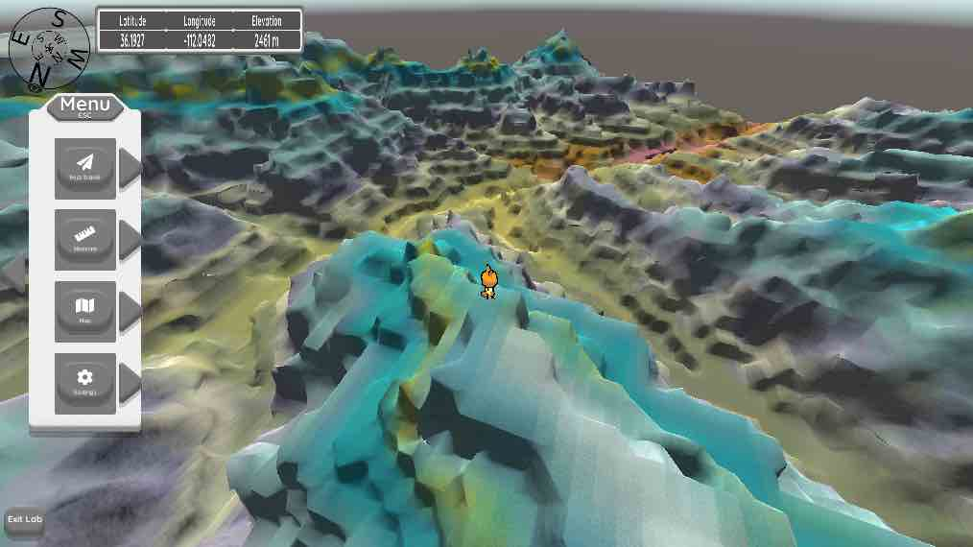
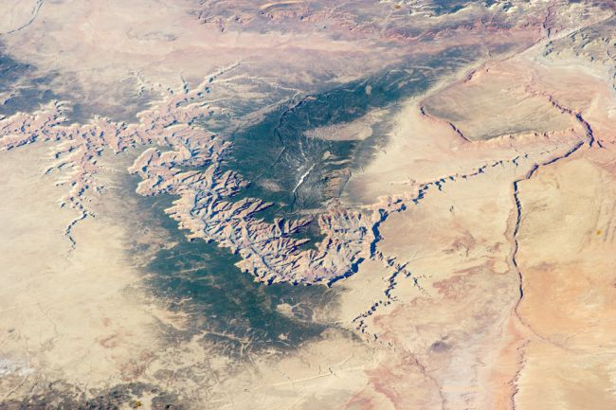
GPH 211 Grand Canyon Timescapes Multistep lab FAQ presentation

Slide 2
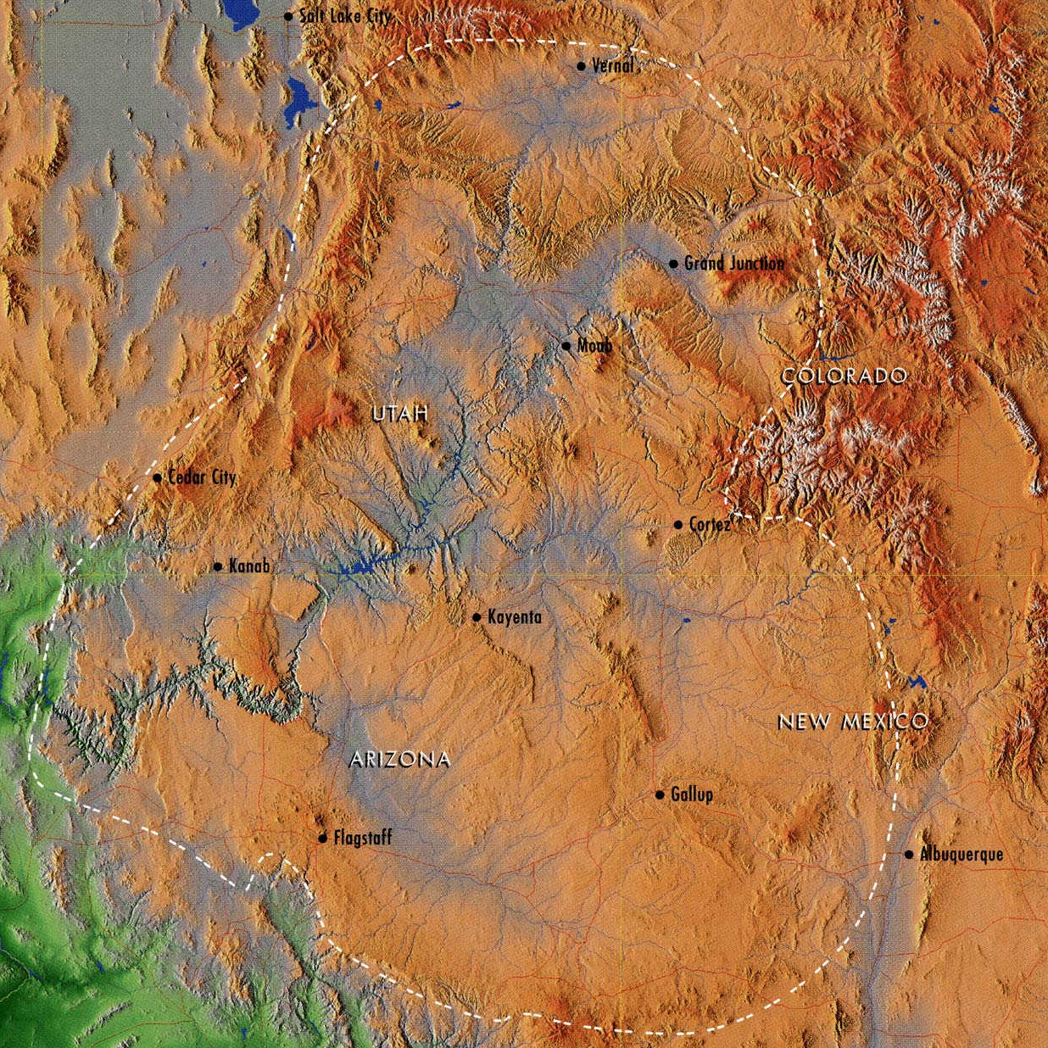
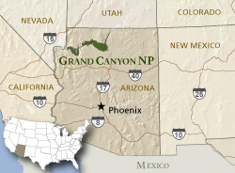
Grand Canyon Region
Colorado River Basin
Colorado Plateau
Source: nps.gov

Slide 3
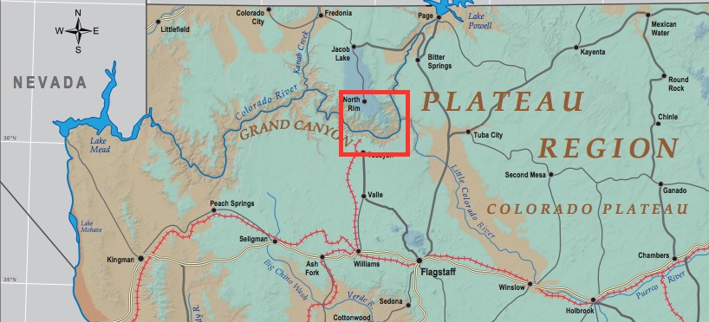
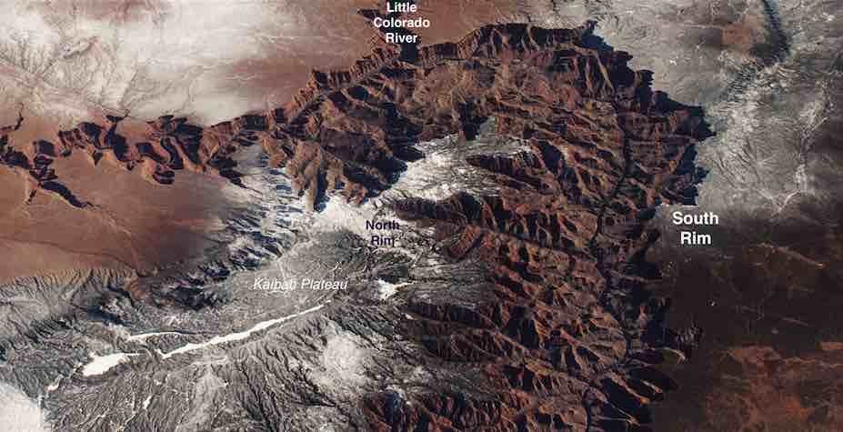
Heart of the Grand Canyon
Source: NASA

Slide 4
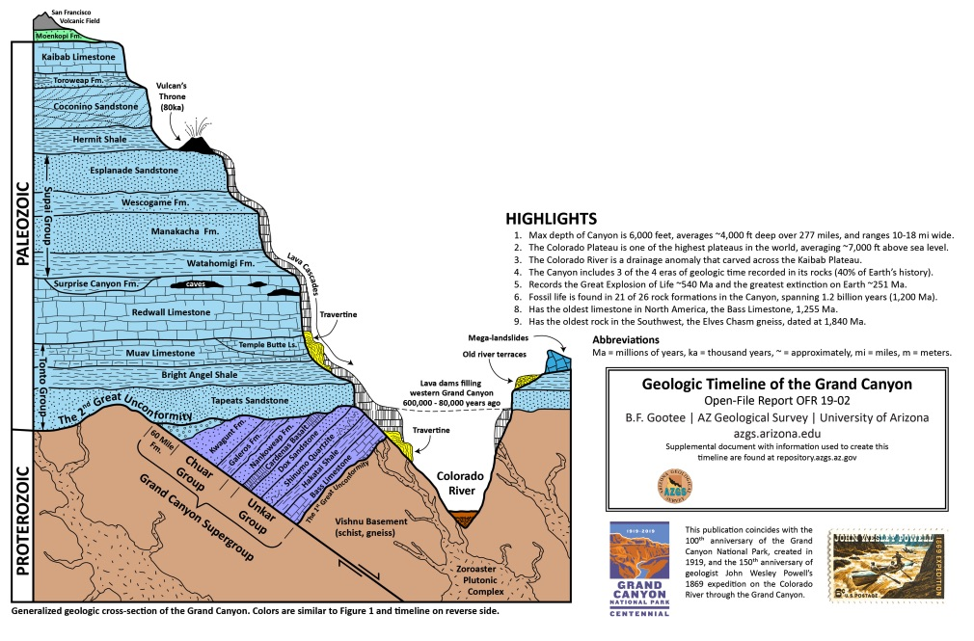
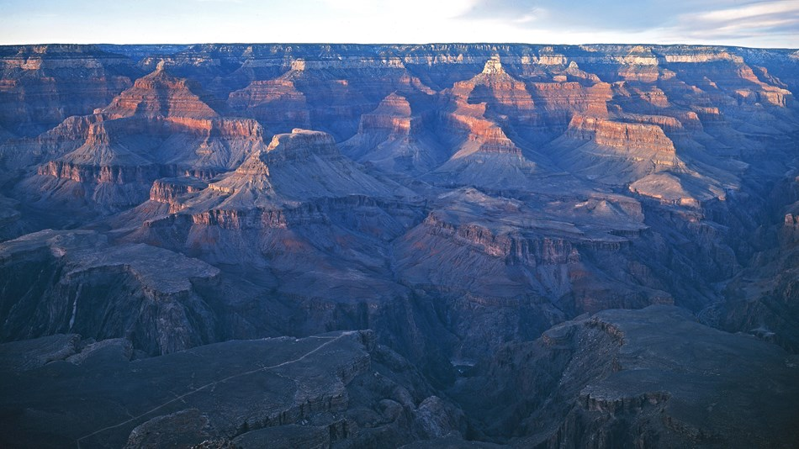
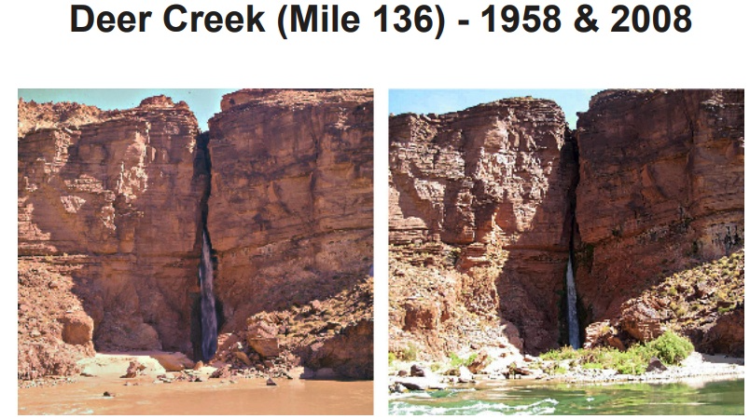
Lab Focus
Geological timescape
Geomorphic timescape
Historical timescape

Slide 5
Pieces of the lab
This presentation gives you an overview and tries to answer typical questions
PDF file goes over all of the questions you will be asked in canvas and how to answer them
Geovisualization “video game” – you purchase, download and play to obtain information (how to purchase – information on canvas page in module)
Canvas quiz – where the questions are graded

Slide 6
How to “do” the lab
Geovisualization plays on laptop/desktop with 4 GB RAM (at least)
Students tell me that they find it easiest to use another device (e.g. phone) to access the PDF file & canvas questions … taking physical notes on their observations in the game environment
You do not have to submit the lab right away. You can return after asking questions, after re-reading the PDF file.

Slide 7
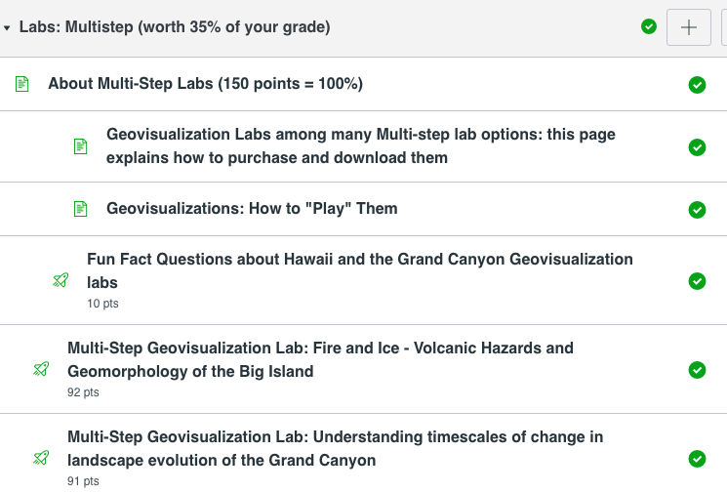
How to purchase game
SEPARATE PAGE ON CANVAS ON HOW TO PURCHASE

Slide 8
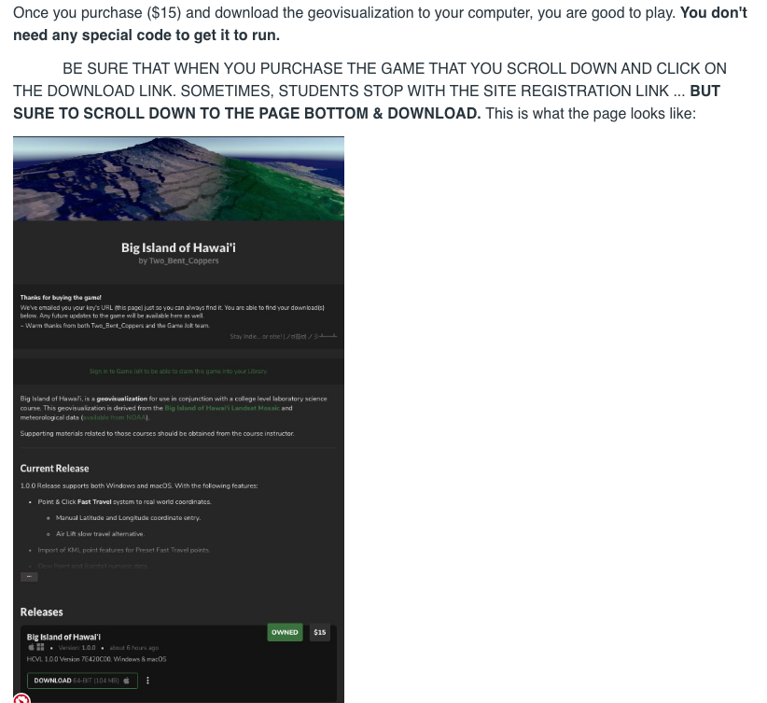
Heads up
Save zipped file!
Scroll to bottom & hit download
You do not have to do this lab. Other options

Slide 9
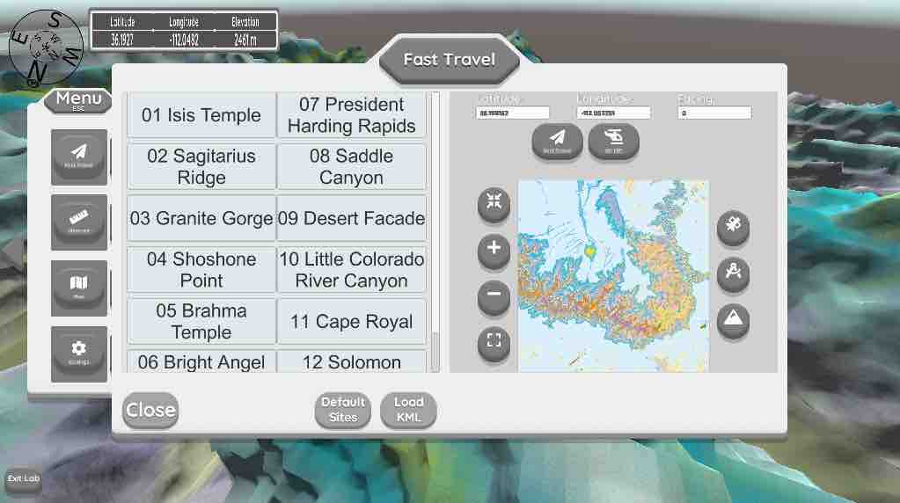
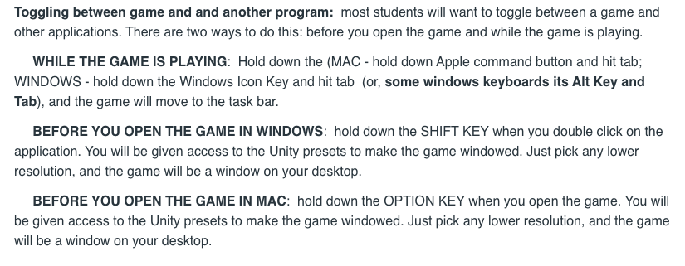
How to play the game
SEPARATE PAGE IN CANVAS ON HOW TO PLAY
Escape key on your keyboard – (on/off) giving you access to the menu (via the left arrow) or Play the game.
Fast travel – paste in or type
Latitude
Longitude from PDF file

Slide 10
Other hints

Slide 11
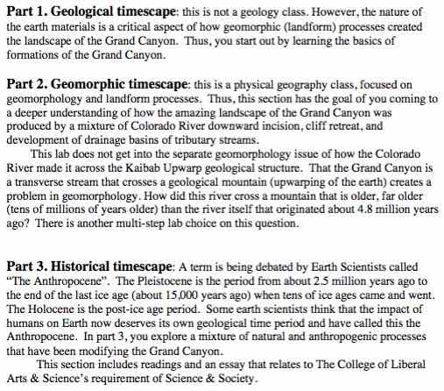
PDF File

Slide 12
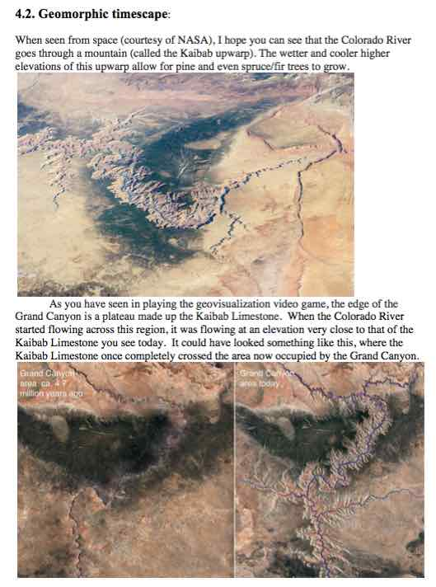
Background info

Slide 13
Geological timescape questions

Slide 14
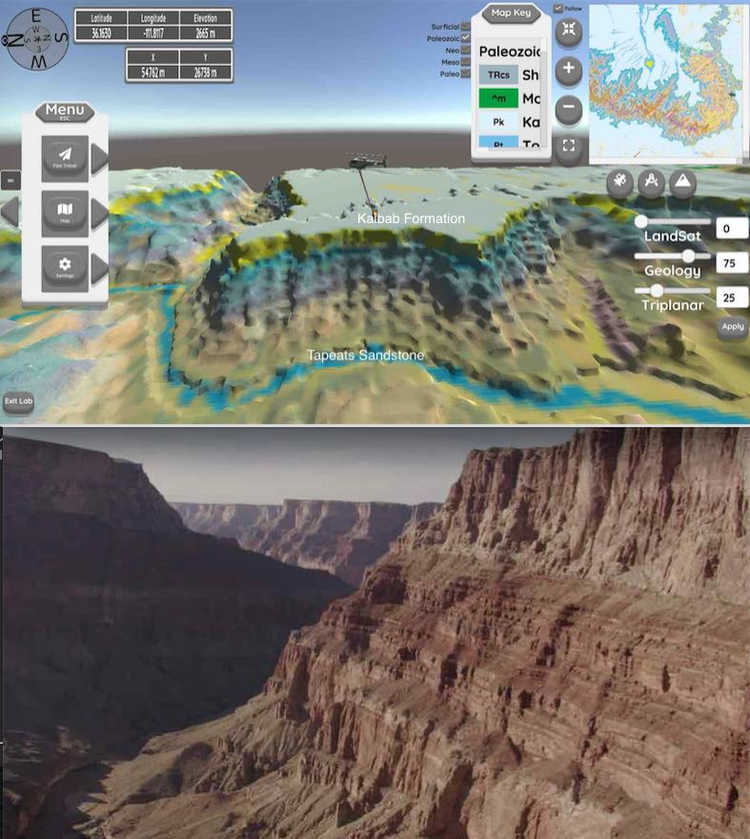
Video gives sense of place & game for this question is like learning to read a geologic map, but more fun

Slide 15
Geological timescape questions

Slide 16
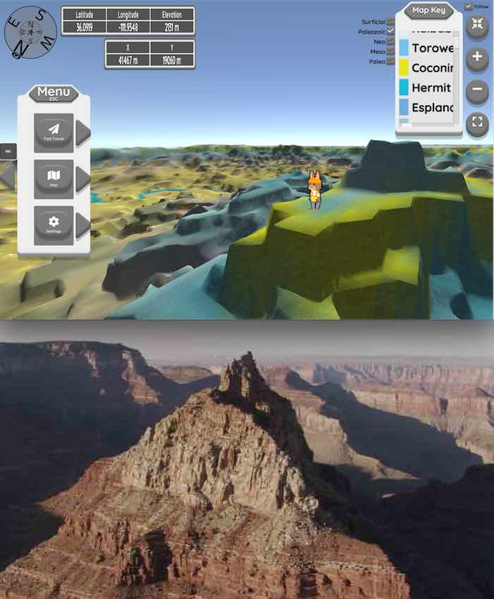
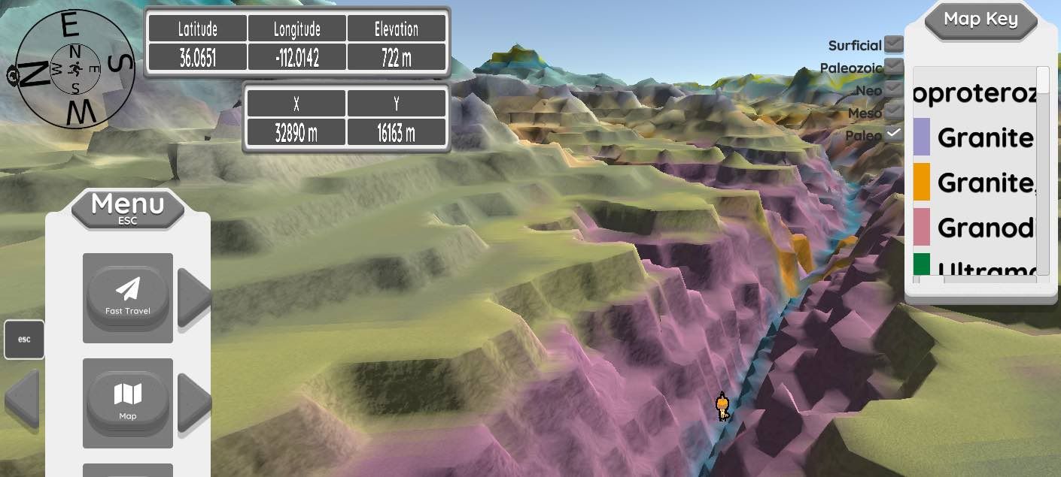
Video gives sense of place & game for this question is like learning to read a geologic map, but more fun
Key scroll is being worked on. We know! Font too big.

Slide 17
Geological timescape questions
READ CAREFULLY!! The answer is not for all rocks, but just the rocks you observed in Q1 and Q2.
Read background section on wording for the whole canyon.

Slide 18
Geomorphic Timescape Questions
Colorado River started to flow across the mountain about 4.8 million years ago. Since then, there’s been incision of the Colorado River & tributaries and retreat of the sides back from the river. This is what you will study in the questions

Slide 19
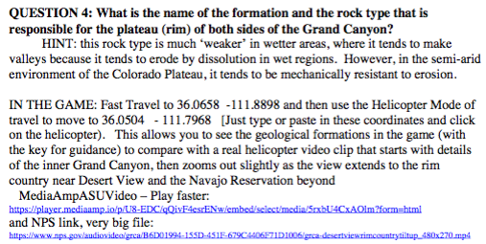
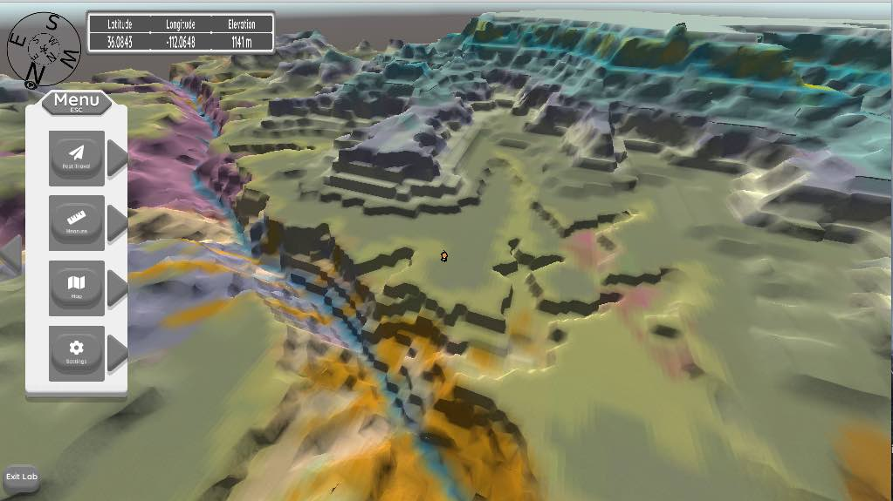
Geomorphic Timescape Questions

Slide 20
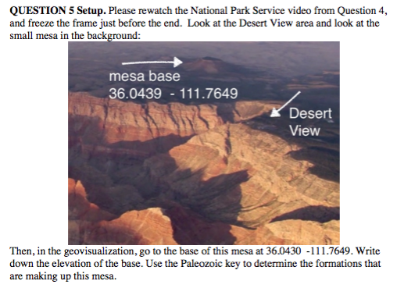
Geomorphic Timescape Questions

Slide 21
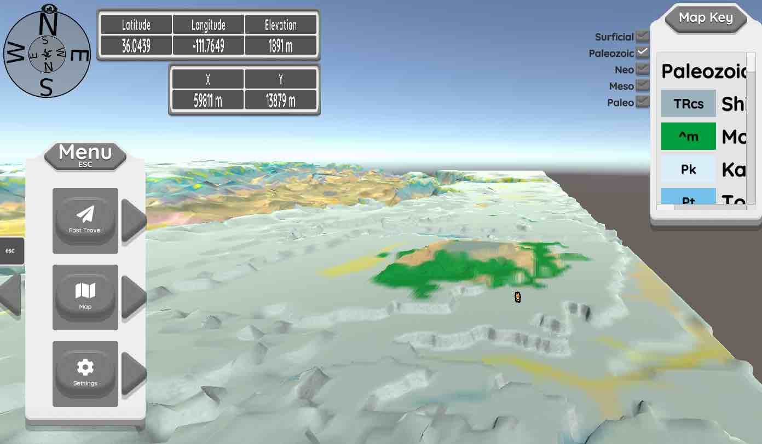
Geomorphic Timescape Questions

Slide 22
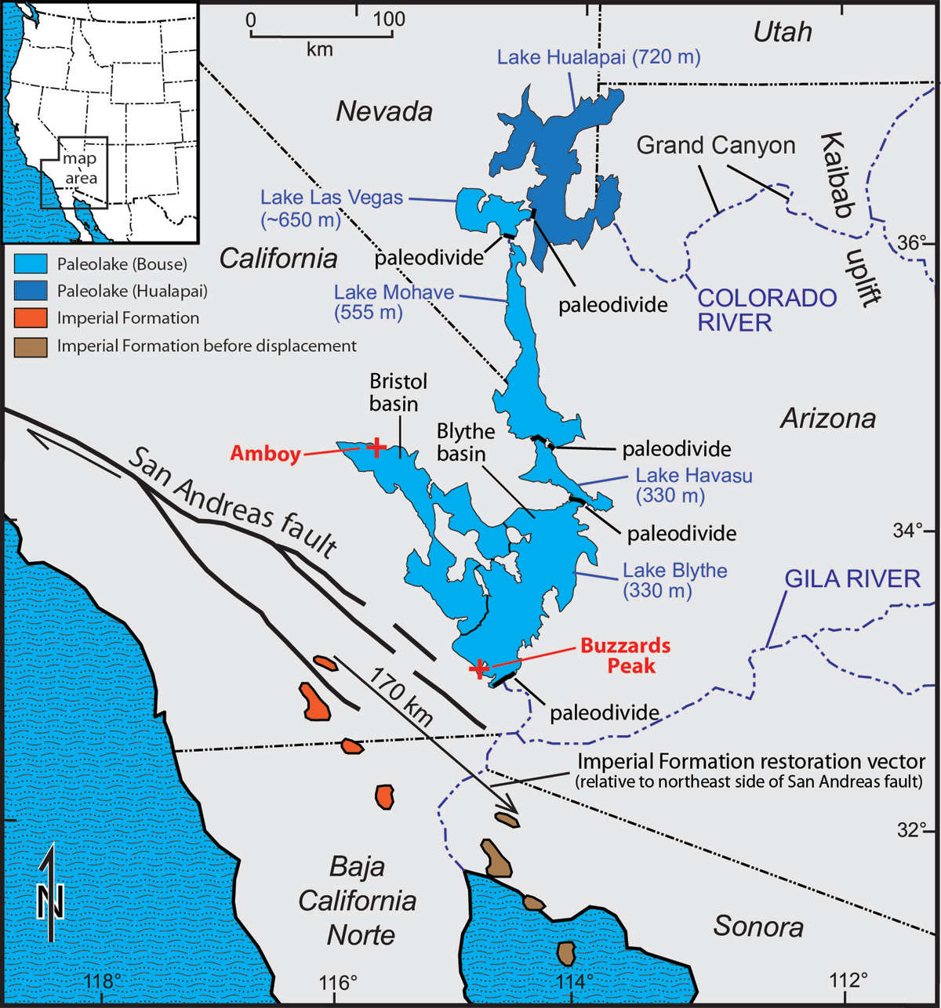
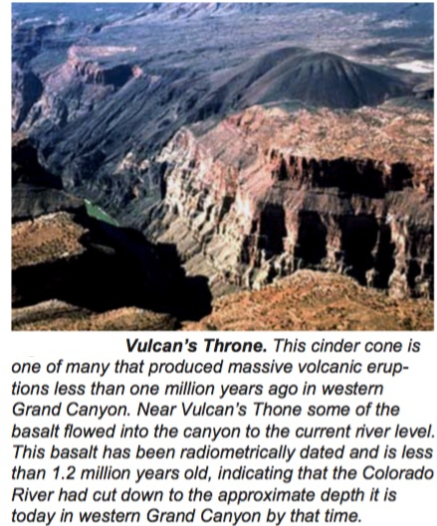
Questions 6 & 8
Radiometric dating volcanic events to understand rates of Grand Canyon area – mesa from Q5 & 7 and age of canyon
Before the Grand Canyon
When it stopped incising

Slide 23
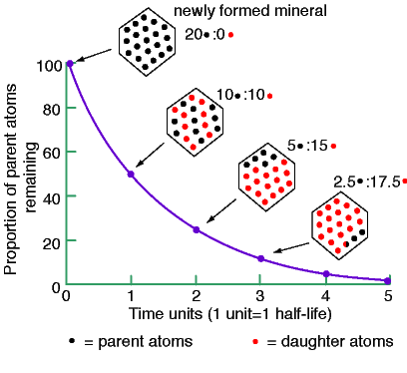
K-Ar Dating

Slide 24
Example in PDF File
Lots of half life calculators you can use. 5 are provided in the PDF file, or you can use one that you find.
You make two K-Ar age calculations given the percent daughter
Product (Argon) remaining for important volcanic events that are either ash deposits or lava resting on a landscape surface.

Slide 25
Q9 Rate of incision
PDF file provides needed background information on when the Colorado River started to incise (4.8 Ma) and when it reached its present position (1.2 Ma), so
3.6 Ma
Rim-River = Depth
Depth (m) /Ma

Slide 26
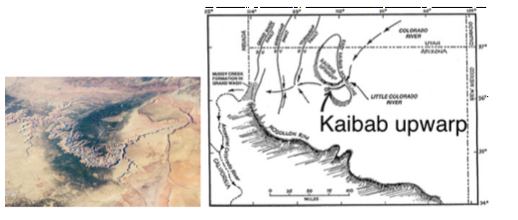
Q 10-11- 12-13 Compare heart vs. east/west
VERY DETAILED GUIDANCE IN PDF FILE!

Slide 27
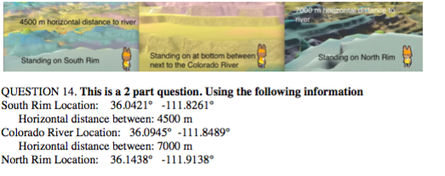
Questions 14 & 15 Compare incision vs. retreat
incise
retreat

Slide 28
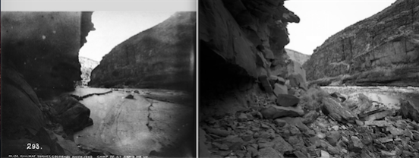
Historic timescape questions
Questions 16-19: True false, interpreting historic changes as viewed by photography
Example provided in PDF File

Slide 29
Science & Society Q20
No penalty for not doing
Points only add to your multistep lab points
There are readings about tourism and the environmental history of the Grand Canyon
You explore how science & tourism interact in the Grand Canyon setting. A third of the points based on evidence & reasoning on tourism. A third based on how people have impacted the Grand Canyon. A third on reasoning & evidence on interplay of science & society through the lens of the Grand Canyon
You can find your own readings, but you will cite them (not.com or wikipedia, but good academic scholarship)
Details in PDF file

