Slide 1
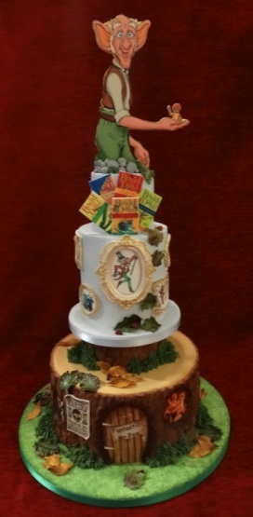
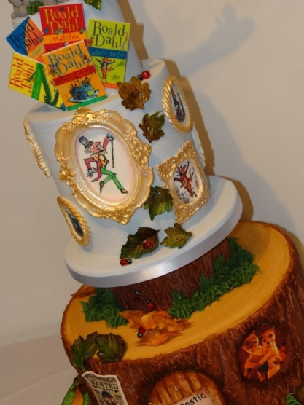
Happy Birthday to Roald Dahl (1916-1990) This is Dahl’s 100th Birthday
By Don & Alleen Nilsen

Slide 2
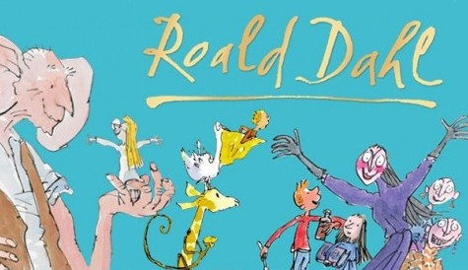
Roald Dahl’s 100th Birthday

Slide 3
Roald Dahl’s Biography
Roald Dahl was born in Wales to Norwegian parents. He wrote novels, short stories, poetry, and screen plays. His short stories tend to have unexpected endings and his children’s books tend to be comic, unsentimental and macabre.
The children tend to be cute and smart, and the adults tend to be quite despicable in one way or another.
Dahl was also a British fighter pilot. During the Second World War, Dahl was a flying ace and intelligence officer for the Royal Air Force.
Dahl engaged in aerial combat over Greece in his Hawker Hurricane Mk 1.

Slide 4
Repton School & Cadbury Favorites

Slide 5
Gloster Gladiator & Hawker Hurricane Mk 1

Slide 6
Roald Dahl and the Baker-Street Irregulars Helped to convince the Americans to enter World War II.

Slide 7
Roald Dahl, Noël Coward, Ian Fleming, Cary Grant, and David Niven were five of the members of the famous “Baker Street Irregulars.” Their name came from the title of one of Arthur Conan Doyle’s novels, Sherlock Holmes and the Baker Street Irregulars.
The Baker Street Irregulars was a British Spy Ring that operated in the United States. These agents belonged to the British Security Coordination (BSC) whose main office was in Rockefeller Center.
The Special Operations Executive (SOE), which was the parent organization of BSC, was located at 64 Baker Street, and it was their function to plant propaganda in American newspapers, radio stations and wire services that would help defeat America’s isolationist attitudes. These organizations needed to convince the Americans to join Great Britain in the war against Germany and Japan.
This is why they recruited famous and influential people to be part of their spy ring.

Slide 8
The Baker Street Irregulars had two major functions. 1). To convince the Americans to support the war, and 2). To report back to England news that related to war-related activities in the United States—both those activities that supported the war, and those activities that supported American isolationism.
Roald Dahl was a tall handsome courageous officer of the Royal Air Force who was a hero in battle, who was a hero in battle. Resplendent in his uniform, he was irresistible to women.
Although Dahl was arrogant and a bit idiosyncratic, he was also witty, charming, and aristocratically British, so these traits granted Dahl entry into the drawing rooms (and the bedrooms) of the rich and the powerful.
The Japanese attack on Pearl Harbor occurred in December of 1941. Roald Dahl arrived at the British Embasy in Washington D.C. in 1942.

Slide 9
Carl Silver, who is a Clinical Professor of Surgery at the University of Arizona College of Medicine-Phoenix and an Emeritus Professor of Surgery at Albert Einstein College of Medicine in New York, says that Roald Dahl’s main function was “to eavesdrop his way through breakfasts, teas, tea dances and innumerable parties, banquets and balls.”
It was also his function to find out from American politicians how they felt about the war. He was also expected to keep an eye on leading American isolationists, and especially on “Nazi sympathizers.”
Professor Silver notes that “Roosevelt was not entirely unaware of what was going on, and actually used Dahl…as a ‘back channel’ to Churchill.”

Slide 10
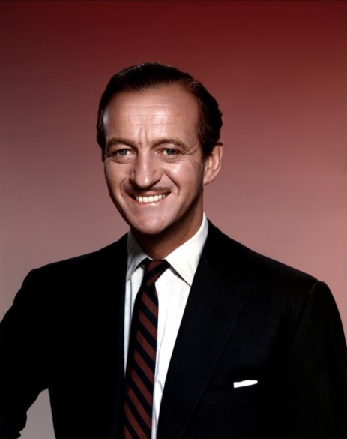
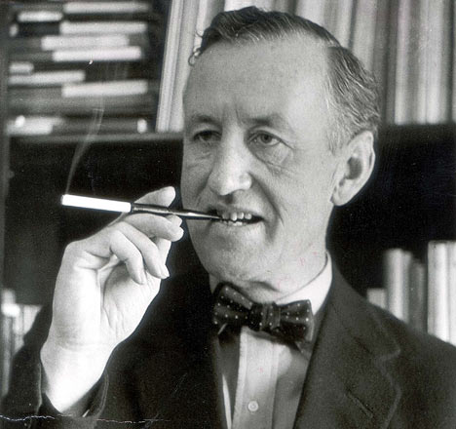
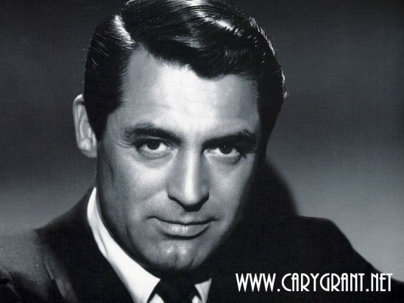
Some of the Baker Street Irregulars: Roald Dahl, Noel Coward, Ian Fleming, Cary Grant & David Niven

Slide 11
Roald Dahl’s Earliest Publications
Dahl’s first important publication was a Saturday Evening Post news account about crashing his Gloster Gladiator airplane in Libya. It was written so well that he was encouraged to write more stories. So he wrote…
The Gremlins (1943)
Over to You: Ten Stories of Flyers and Flying (1946)
Someone Like You (1953)
Kiss Kiss (1960)

Slide 12
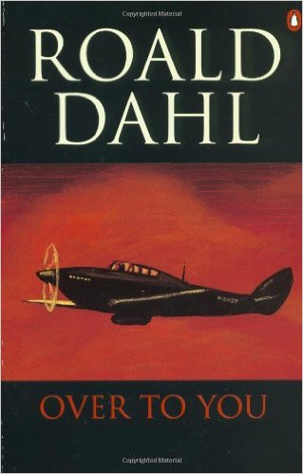
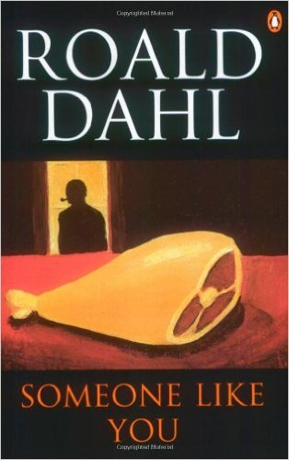
The Gremlins (1943)
Over to You (1946)
Someone Like You (1953)
Kiss Kiss (1960)

Slide 13
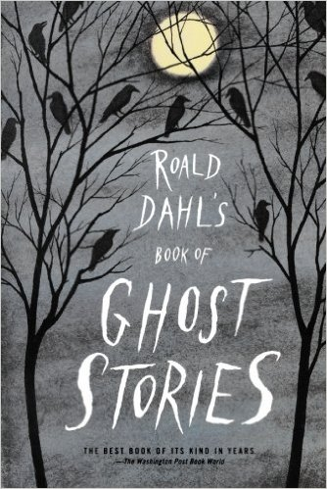
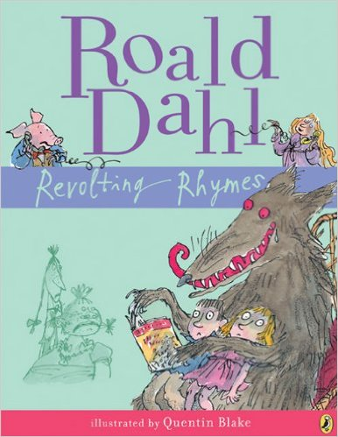
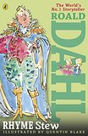
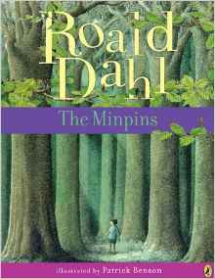
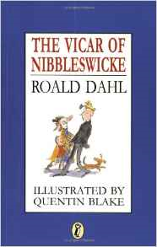
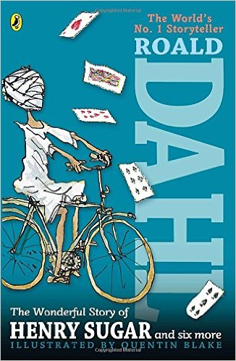
The Range of Roald Dahl’s Children’s Books

Slide 14
James and the Giant Peach (1961)

Slide 15
James Henry Trotter is a young boy who lived by the sea in England with his parents. For his birthday his parents plan to take James to New York to visit the Empire State Building.
But a charging ghostly rhinoceros from the sky kills James’s parents, and James is sent to live with his cruel aunts, Spiker and Sponge. They force him to work all day, and keep reminding him of the mysterious rhino that killed his parents.
When the aunts are trying to squash a spider, James rescues the spider. Then James meets a mysterious man who gives him a bag of magic green “crocodile tongues.”
But on his way home, James trips and the crocodile tongues spill out onto the ground. This causes a small peach on a withering peach tree to grow to an enormous size.
Of course Spiker and Sponge sell tickets to people who want to see this huge peach. In the meantime, James crawls into a hole in the peach and finds himself inside the peach.

Slide 16
This is where James meets the Miss Spider, whom he has just saved. He also meets Mr. Grasshopper, Mr. Centipede, Earthworm, Mrs. Ladybug and Glowworm.
Mr. Centipede cuts the stem that attaches the peach to the tree, and the peach rolls down to the Atlantic Ocean.
Then James remembers his birthday wish—to visit New York City. James and his sailing crew use Miss Spider’s web to attach a hundred seagulls to the peach stem, and they are off to see New York City.
There is a great storm just as they reach New York City, a storm in which James is frightened by a ghostly rhino.
But they survive the storm, and land on the Empire State Building, and they allow the New York children to eat up the delicious peach.
And the peach pit is made into a house in Central Park, where James lives happily ever after with his new family, the bugs.

Slide 17
Fantastic Mr. Fox (1970)

Slide 18
Fantastic Mr. Fox is about Mr. Fox and his wife Felicity who steal food every night from three wealthy-and-mean farmers. The Foxes are caged in a Fox trap when they attempt to raid Berk’s Squab Farm. This is when Felicity tells Mr. Fox that she is pregnant, and convinces him to become a more stable member of the community.
Two years later, Mr. Fox is a newspaper columnist, and they have a sullen son named Ash. They move from their hole to a better home at the base of a tree located very close to three farmers: Walter Boggis, Nathan Bunce and Franklin Bean.
Mr. Fox misses his days as a thief, so Mr. Fox and Kylie Opossom (his friend) steal some produce and poultry from the three farms. The farmers retaliate by shooting at Mr. Fox, but they miss his body, and only shoot off his tail.
As the Foxes lay low, they realize that they will have to eventually surface in order to obtain food and water. When they surface, Mr. Fox is with Badger, Mole, Beaver and Weasel as they tunnel in and rob the three farms clean.
After a number of similar adventures, Fox leads his family to a drain opening built into the floor of a supermarket owned by the three farmers.
They celebrate their new food source, and the news that Felicity is pregnant again. All of the happy animals dance.

Slide 19
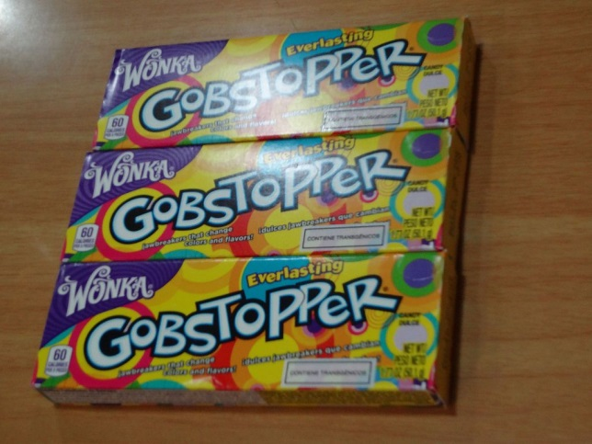
Charlie and the Chocolate Factory (1971)

Slide 20
Roald Dahl went to a famous English public school called Repton, very near the place where the Cadbury Chocolate Company would test their newest chocolate inventions.
The Cadbury Company would send Roald and his friends their newest chocolate inventions to test out.
The plain-packaged chocolate treats were always delicious, and the boys were invited to share their thoughts on each and every one.
This was the inspiration for Willy Wonka’s famous Inventing Room, with its burbling machines that produced the Everlasting Gobstoppers.
Charlie Bucket is a kind and loving boy who lives with his parents and four grandparents. Before he was terminated, Charlie’s Grandpa Joe had worked for Willy Wonka in his chocolate factory.

Slide 21
Early in the story, Willy Wonka announces that five Golden Tickets are hidden in Wonka bars, and that the children who find them will be given a tour of the factory.
The first four tickets are quickly found: one by the “greedy and gluttonous Augustus Gloop” from Düsseldorf, one by the “spoiled and rotten Veruca Salt” from Buckinghamshire, one by the “competitive and boastful Viiolet Beauregarde” from Atlanta, Georgia, and one by the “arrogant and aggressive Mike Teavee” from Denver, Colorado.
Every year, Grandpa Joe buys Charlie a Wonka bar for his birthday present. And this year’s Wonka bar contained the last Golden Ticket.
So these five children will be given a tour of the chocolate factory by the factory workers, the Oompa-Loompas.

Slide 22
The Oompa Loompa Song: https://www.bing.com/videos/search?q=oompa+loompa+songs+lyrics&view=detail&mid=1C5D224B93EFC83E0A631C5D224B93EFC83E0A63&FORM=VIRE

Slide 23
Because Augustus Gloop is greedy, he falls into a river of chocolate and is sucked up into the pipes before he is rescued.
Because Violet is competitive and boastful, she eats some chewing gum that makes her expand into an oversized blueberry.
Because Veruca is spoiled and rotten, she is thrown away as a bad nut by some trained squirrels.
Because Mike is arrogant and aggressive, he is transported into a Wonka television advertisement and is shrunk down to a few inches in height.
But because he is kind and thoughtful, Charlie wins the grand prize and becomes the heir to the chocolate factory, with the stipulation that he must leave his family behind. This is because Willy Wonka’s father was a dentist and didn’t allow him to eat candy.
But Charlie prevails, and his family moves into the factory and Charlie joins his grandfather Joe in planning new kinds of chocolate delights.

Slide 24
Danny, The Champion of the World (1975)

Slide 25
Danny is a young English boy who lives with his father, William in a Gypsy caravan. They fix cars for a living and love to poach pheasants from Victor Hazell’s woods.
They feed raisins, laced with sleeping potion, to the pheasants, and then there is this dialogue:
“It’s peculiar that a bird doesn’t topple off its perch as soon as it goes to sleep. After all, if we were sitting a branch and we went to sleep, we would fall off at once, wouldn’t we?”
“Birds have claws and long toes, dad. I expect they hold on with those.”
“I know that, Danny. But I still don’t understand why the toes keep gripping the perch once the bird is asleep. Surely everything goes limp when you fall asleep.”

Slide 26
Danny waited for his dad to go on. Then he continued,
“I was just thinking that if a bird can keep its balance when it’s asleep, then surely there isn’t any reason why the pills should make it fall down.”
“It’s doped. Surely it will fall down if it’s doped.”
“Why should we expect it to fall down just because it’s in a deeper sleep?”
Then they heard the thump, thump, thump of falling pheasants (143).

Slide 27
The Twits (1980)

Slide 28
Roald Dahl hated beards, and said he wanted to “do something against beards,” So he wrote The Twits. The first sentence in the story is, “What a lot of hairy-faced men there are around nowadays!” (1)
This book is about a hideous, vindictive, and spiteful couple known as the Twits, who live in a brick house without any windows.
The Twits are retired circus trainers who keep a family of pet monkeys called the Muggle Wumps. They’re trying to train the monkeys to stand on their heads. They want to have the world’s first “upside-down-monkey circus.”
Because each of them hates the other, they play practical jokes on each other.
Mr. Twit is a wicked person with hair that covers his entire face, except for his forehead, eyes and nose. He never washes his beard, so it contains scraps of food including tinned sardines, stilton cheese and corn flakes.
When he is very quiet, he is plotting evil tricks to play on Mrs. Twit, who is hideously ugly.
Mrs. Twit used to be beautiful, but her face was distorted by her constant horrible thoughts. The main reason she has a walking cane is to use as a weapon against innocent children and animals. She once served Mr. Twit a lunch of earthworms disguised as spaghetti.

Slide 29
One morning Mrs. Twit took out her glass eye and dropped it into Mr. Twit’s mug of beer when he wasn’t looking.
Mrs. Twit said, “When I see you starting to plot, I watch you like a wombat.”
“Oh, do shut up, you old hag,” Mr. Twit said. He went on drinking his beer.
Suddenly, as Mr. Twit tipped the last drop of beer down his throat, he caught sight of Mrs. Twit’s awful glass eye staring up at him from the bottom of the mug.
“I told you I was watching you” cackled Mrs. Twit. “I’ve got eyes everywhere so you’d better be careful.” (1)

Slide 30
George’s Marvelous Medicine (1981) British & American Versions

Slide 31
Mr. and Mrs. Kranky are George’s parents. George’s grandmother takes care of him while they are running an errand, and the grandmother bosses him around and scares him by saying that she likes to eat insects and thinks that she’s a witch.
George thinks that his grandmother’s medicine is making her mean, so he decides to make a magic medicine to replace his grandmother’s terrible old medicine.
George’s “marvelous medicine” consists of deodorant and shampoo from the bathroom, floor polish from the laundry room, horseradish and gin from the kitchen, animal medicines, engine oil and anti-freeze from the garage, and brown paint so that it will look like the original medicine.
When George gives the medicine to his grandmother, she blows up into a large balloon, and her belly catches on fire. Then she grows taller and taller until she breaks through the ceilings and the roof.

Slide 32
Then George tests out his marvelous medicine on a chicken that grows ten times its original size. When Mr. and Mrs. Kranky return home and see the huge chicken, Mr. Kranky has George give the medicine to the rest of the farm’s animals, and they all become giant animals.
Mr. Kranky tells George to make more medicine to sell to all of the farmers of the world, thus creating giant animals and resolving the problem of world hunger.
But when George tries to recreate his medicine, he can’t remember the exact ingredients or proportions.
His second medicine made a chicken with very long legs; his third medicine made a chicken with a long neck. His fourth medicine made the animals shrink.
The cruel grandmother storms out of the barn in disgust. She then sees the tea cup that George has been using to mix his medicine, and thinking that the cup contains tea, she drinks it.
The grandmother shrinks. She vanishes. And the rest of the Kranky’s live happily ever after.

Slide 33
The BFG (1982)

Slide 34
The BFG is about the night-time fears that children have. In the middle of the night, the heroine (Sophie) is snatched by a big ugly giant, who later turns out to be the BFG (Big Friendly Giant).
Every night, the Big Friendly Giant blows sweet dreams into the bedrooms of sleeping children.
Instead of eating “human beans” as other giants do, he eats only “icky-poo vegetables” (48).
When the BFG uses words like “scrumplet” (38), “langwitch” (44), “fibbling” (45), “disgusterous” (51) “figglers” (71), his child-like pronunciations bring the BFG down to the level of a child.
One of the best passages in The BFG is a conversation between the BFG and Sophie about “whizzpoppers.”

Slide 35
Whizzpopping is caused by drinking Frobscottle. Sophie notices that in the Frobscottle bottle, the bubbles travel downward (not upward), and burst on the bottom (not the top).
Sophie learns that people who drink Frobscottle don’t burp. They fart. The BFG calls this “whizzpopping,” and describes it as a “sign of happiness. It is music in our ears” (67).
“For a few moments, the Big Friendly Giant stood quite still, and a look of absolute ecstasy began to spread over his long wrinkly face.”
Then suddenly the heavens opened and he let fly with a series of the loudest and rudest noises Sophie had ever heard in her life.
They reverberated around the walls of the cave like thunder…; the force of the explosions actually lifted the enormous giant clear off his feet, like a rocket” (68).

Slide 36
BFG tells Sophie about his big ears:
“I is hearing the footsteps of a ladybird as she goes walking across a leaf.”
“I is hearing the little ants chittering to each other as they scuddle around in the soil.”
“One of the biggest chatbags is the cattlepiddlers.”
“They is argying all the time about who is going to be the prettiest butteryfly.”

Slide 37
The Witches (1983)

Slide 38
The Witches is about a seven-year-old English boy who goes to live with his Norwegian grandmother when his parents are killed in a car crash.
The grandmother tells the boy about witches, who look and act like regular human women, but are actually “demons in human shape.”
They cover their bald heads with wigs; they hide their clawed hands in gloves; they have large nostrils and toeless feet, and their spit is blue.
When the boy returns to England he builds a tree house, and while he is working on the roof, he sees a strange woman in black staring up at him with an eerie smile. He realizes that she must be a witch.
The grandmother later becomes ill with pneumonia and the doctor orders her to go to Bournemouth on the southern English coast. Here they stay in a luxurious hotel.

Slide 39
They soon discover that the “Royal Society for the Prevention of Cruelty to Children” is having their annual convention at this same hotel.
When one of the convention participants reaches underneath her hair to scratch at her scalp with a gloved hand, the boy realizes that the name of this organization is ironic. This is actually the annual convention of England’s witches.
At their grand opening, the witches plan to give away free sweets and chocolates containing “Formula 86 delay action mouse maker,” a magic potion that will turn the drinker into a mouse. Then, of course, everyone in Bournemouth will try to kill the mice (which are actually children).
But the boy pours the Formula 86 into the green pea soup that the witches will eat for dinner. The witches all turn into mice and the hotel staff and the guests end up killing the Grand High Witch and all of England’s witches.
But the boy has also drunk the potion, and has turned into a mouse that will only live another nine years. But that’s OK, because he doesn’t want to live any longer than his grandmother. In the end, they can both die together.

Slide 40
Matilda (1988)

Slide 41
In a survey conducted by School Library Journal, Matilda was ranked number 30 among all-time children’s novels.
Matilda is a very precocious child who lives in a small Buckinghamshire village in England. Because she is mistreated or neglected by her parents, she plays pranks on them.
She glues her father’s hat to his head. She hides her friend’s parrot in the chimney, making her family think that there is a burglar or a ghost in their house. She also bleaches her father’s hair white.
Miss Trunchbull is Matilda’s teacher; she is cruel and vindictive. Matilda, and her friend (Lavender) place a newt into Miss Trunchbull’s water glass. Then, with her power of telekinesis, Matilda tips the glass containing the newt onto Miss Trunchbull.

Slide 42
Since Matilda’s parents are neglectful and abusive, they think of Matilda as “nothing more than a scab, something you have to put up with until the time comes when you can pick it off and flick it away” (10).
The headmistress at Matilda’s school is named Miss Trunchbull. She is described as having a face like a boiled ham (166), fingers like salamis (144) and calf muscles as big as grapefruits (122).
Miss Trumbull doesn’t like small people. She likes to throw the kids out of the windows like Frisbees (110), and she likes to swing boys in the air by holding them up by their ears and proclaiming sarcastically,
“I have discovered through long experience…that the ears of small boys are stuck very firmly to their heads” (154).

Slide 43
Matilda develops a strong bond with Miss Honey, who is aware of Miss Trunchbull’s creative and over-the-top punishments of the children. Miss Honey tells Matilda that she was raised by an abusive aunt after the suspicious death of her father.
This abusive aunt is actually Miss Trunchbull herself, and furthermore, Miss Trunchbull is withholding Miss Honey’s inheritance, so that Miss Honey has to live a life of poverty in a derelict farm cottage.
So Matilda telekinetically picks up a piece of chalk in Miss Trunchbull’s classroom, and posing as the ghost of Miss Honey’s late father, she writes on the blackboard demanding that Miss Trunchbull concede Miss Honey’s house and her wages.
The ghost further demands that Miss Trunchbull leave the region forever.
Matilda has to concentrate on her studies as they become more advanced, so she loses her telekinesic abilities. But this is OK, because she can now use her mind in a more challenging curriculum.

Slide 44
Gene Wilder (1933-2016)
2016 is the centennial year of Roald Dahl’s birth. 2016 is also the year of Gene Wilder’s death.
In 1968, Gene Wilder played Leopold Bloom in Mel Brook’s film, The Producers. Wilder later collaborated with Brooks in Blazing Saddles and Young Frankenstein.
Wilder also played in four films with Richard Pryor: Silver Streak (1976), Stir Crazy (1980), See No Evil, Hear No Evil (1989) and Another You (1991).
But Gene Wilder’s most famous role was as Willy Wonka in Charlie and the Chocolate Factory (1971).

Slide 45
So “Goodbye” to Roald Dahl & Gene Wilder But “Hello” to all of the wonderful memories they have left with us.

