Slide 1
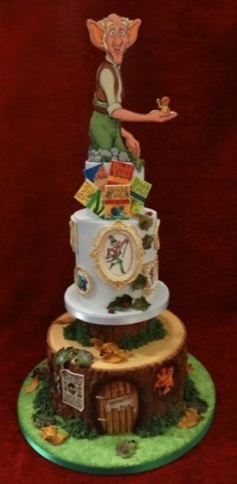
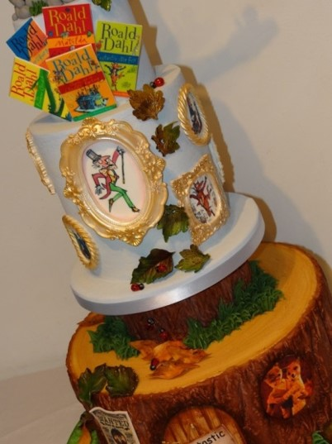
Novel Word Play in Roald Dahl’s Books In 2016 the world celebrated Roald Dahl’s 100th Birthday.
By Don and Alleen Nilsen

Slide 2
Roald Dahl was born in Wales to Norwegian parents, who sent him to a prestigious boarding school (Repton) in England.
As an adult, he wrote about cute and smart children, who mostly had to deal with despicable adults.
But long before he became an author for children, he was a fighter pilot and a spy for England.

Slide 3
The Gloster Gladiator and the Hawker Hurricane Mk1 were the planes he flew during World War I. His first published story was a true account of when he crashed on a solo flight in Libya. It was published in the Saturday Evening Post.

Slide 4
At the very beginning of World War II, Roald Dahl and the Baker Street Irregulars (a group of British spies) helped lower Americans’ isolationist attitudes. They were jokingly named after a Sherlock Holmes mystery by Arthur Conan Doyle.

Slide 5
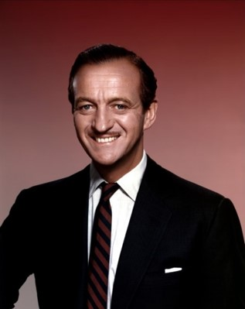
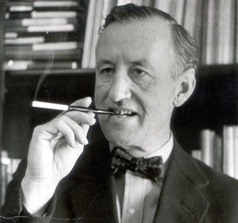
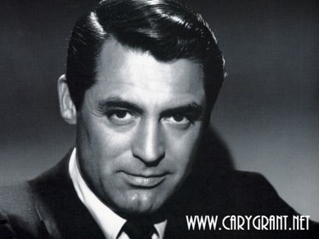
Of course these elegant “Baker Street Irregulars”-- Roald Dahl. Noel Coward, Ian Fleming, David Niven, and Cary Grant, were welcomed into America’s high society, where they planted propaganda and stories in American newspapers, radio stations and wire services aimed at convincing the Americans to join Great Britain in the war against Germany and Japan.

Slide 6
The Baker Street Irregulars had two major functions. 1). To convince the Americans to support the war, and 2). To report back to England on war-related activities in the United States—both those activities that supported the war, and those activities that supported American isolationism.
Roald Dahl was a tall handsome courageous officer of the Royal Air Force who was already a hero in battle. Resplendent in his uniform, he was irresistible to women. Even though he was arrogant and a bit idiosyncratic, he was also witty, charming, and aristocratically British, so these traits granted Dahl entry into the drawing rooms (and the bedrooms) of the rich and the powerful. He eventually married Patricia Neal, a popular American actress, but that’s another story.
The Japanese attack on Pearl Harbor occurred in December of 1941. Roald Dahl arrived at the British Embassy in Washington D.C. in 1942. According to Emeritus ASU Professor Carl Silver, “Roosevelt was not entirely unaware of what was going on, and actually used Dahl…as a ‘back channel’ to Churchill.”

Slide 7
James and the Giant Peach (1961)
James is a young boy who lives by the sea in England. For his birthday, his parents plan to take him to New York to visit the Empire State Building.
But a charging ghostly rhinoceros from the sky kills James’s parents and James is sent to live with his cruel aunts, Spike and Sponge, who force him to work all day.
When they try to squash a spider, James rescues it and then meets a man who gives him a bag of magic green “crocodile tongues.”

Slide 8
On his way home, James trips and the crocodile tongues spill and cause a small peach on a withering peach tree to grow to an enormous size.
Of course the aunts, Spiker and Sponge, sell tickets to people who want to see this huge peach. In the meantime, James crawls inside the peach.
Here he meets Miss Spider, whom he has just saved, along with Mr. Grasshopper, Mr. Centipede, Earthworm, Mrs. Ladybug, and Glowworm.
Mr. Centipede cuts the stem that attaches the peach to the tree and the peach rolls down to the Atlantic Ocean.
James remember his birthday wish—to visit New York City. James and his sailing crew use Miss Spider’s web to attach a hundred seagulls to the peach stem, and they are off to see New York.
Just as they reach New York, there is a great storm, but they survive and land on the Empire State Building. They allow New York children to eat the delicious peach.
The peach pit is made into a house in Central Park, where James lives happily ever after with his new family—the bugs.

Slide 9
Fantastic Mr. Fox (1970)
Fantastic Mr. Fox and his wife Felicity steal food every night from three wealthy-and-mean farmers.
The Foxes are caged in a Fox trap when they attempt to raid Berk’s Squab Farm. Felicity tells Mr. Fox that she is pregnant, and convinces him to become a more stable member of the community.
Two years later, Mr. Fox is a newspaper columnist and they have a sullen son named Ash.

Slide 10
They move their home to the base of a tree located close to farmers: Walter Boggis, Nathan Bunce, and Franklin Bean.
Mr. Fox misses his days as a thief, so Mr. Fox and Kylie Opossom (his friend) steal some produce and poultry from the three farms. The farmers retaliate by shooting at Mr. Fox, but they miss his body, and only shoot off his tail.
As the Foxes lay low, they realize that they will have to eventually surface in order to obtain food and water. When they surface, Mr. Fox is with Badger, Mole, Beaver and Weasel as they tunnel in and rob the three farms clean.
After a number of similar adventures, Fox leads his family to a drain opening built into the floor of a supermarket owned by the three farmers.
They celebrate their new food source, and the news that Felicity is pregnant again. All of the happy animals dance.

Slide 11
Charlie and the Chocolate Factory (1971)
Charlie Bucket is a kind and loving boy who lives with his impoverished parents and four grandparents. Before his job was terminated, Charlie’s Grandpa Joe had worked for Willy Wonka in his chocolate factory.
The Cadbury Chocolate factory was the real-life inspiration for Willy Wonka’s famous inventing room with its bubbling machines that produce the “Everlasting Gobstoppers,” a kind of candy bar invented and sold after the movie, but we haven’t seen it for years.
In the story, Willy Wonka tells his parents that five golden tickets will be hidden in Wonka bars. The children who get them will be taken on a tour of the factory.

Slide 12
Repton School & Cadbury Favorites It’s easy to see why the students at the real Repton School where Dahl studied, were excited when asked to evaluate the new samples of plain-wrapped candy that came to them from the nearby Cadbury factory.

Slide 13
The First Four Tickets Were Quickly Found
One by the “greedy and gluttonous Augustus Gloop” from Düsseldorf, who falls into a river of chocolate and is sucked into the pipes before he can be rescued.
One by the “spoiled and rotten Veruca Salt” from Buckinghamshire, who is spoiled rotten and is thrown away as a bad nut by the trained squirrels.
One by the “competitive and boastful Violet Beauregarde” from Atlanta, Georgia, who is competitive and boastful and eats some chewy gum that makes her expand into an oversized blueberry.
And one by the “arrogant and aggressive Mike Teavee” from Denver, Colorado, who is so arrogant and aggressive that he is transported into a Wonka television and advertisement and is shrunk down to a few inches in height.
Of course the story is about Charlies, whose Grandpa Joe buys him a Wonka bar every year for his birthday. And, of course, this is there Charlie finds the last Golden Ticket.
So these are the five children who get to go on the wonderful tour as guided by the factory workers and the Oompa-Loompas. Of course Charlie prevails as the best one to inherit the factory, which he runs with his Grandpa Joe. His father is not allowed to help because he is a dentist and doesn’t approve of candy at all.

Slide 14
The Oompa Loompa Song: https://www.bing.com/videos/search?q=oompa+loompa+songs+lyrics&view=detail&mid=1C5D224B93EFC83E0A631C5D224B93EFC83E0A63&FORM=VIRE

Slide 15
The Twits (1980)
Roald Dahl hated beards and so wanted to “do something against beards.”
The first sentence in this book is “What a lot of hairy-faced men there are around nowadays!”
The story is about a hideous, vindictive, and spiteful couple known as the Twits.
They live in a brick house without any windows.
They are retired circus trainers who keep a family of pet monkeys called the “Muggle Wumps.” They are training the monkeys to stand on their heads so they can have the first “upside-down-monkey circus.”

Slide 16
Because each of them hates the other one, they play practical jokes.
Mr. Twit is a wicked person with hair that covers his entire face, except for his forehead, eyes and nose. He never washes his beard, so it contains scraps of food including tinned sardines, stilton cheese and corn flakes.
When he is very quiet, he is plotting evil tricks to play on Mrs. Twit, who is hideously ugly.
Mrs. Twit used to be beautiful, but her face was distorted by her constant horrible thoughts. The main reason she has a walking cane is to use as a weapon against innocent children and animals. She once served Mr. Twit a lunch of earthworms disguised as spaghetti.

Slide 17
One morning Mrs. Twit took out her glass eye and dropped it into Mr. Twit’s mug of beer when he wasn’t looking.
Mrs. Twit said, “When I see you starting to plot, I watch you like a wombat.”
“Oh, do shut up, you old hag,” Mr. Twit said. He went on drinking his beer.
Suddenly, as Mr. Twit tipped the last drop of beer down his throat, he caught sight of Mrs. Twit’s awful glass eye staring up at him from the bottom of the mug.
“I told you I was watching you” cackled Mrs. Twit. “I’ve got eyes everywhere so you’d better be careful.”

Slide 18
Matilda (1988)
In a Library Association, survey Matilda ranked #30 among all-time children’s favorite books.
She is a precocious child who lives in a small village in England and was mistreated by her parents.
She gets even with them by pulling such tricks as gluing her father’s hat to his head and by hiding her friend’s parrot in the chimney so her family thinks they have a ghost.

Slide 19
Miss Trunchbull is Matilda’s cruel and vindictive teacher. Matilda, and her friend (Lavender) place a newt in Miss Trunchbull’s water glass. Then, with her power of telekinesis, Matilda tips the glass so the newt lands on Miss Trunchbull.
Matilda’s parents think of Matilda as “nothing more than a scab, something you just have to put up with until the time comes when you can pick it off and flick it away.”
Miss Trunchbull has a face like a boiled ham, fingers like salamis, and calf muscles as big as grapefruits.
She throws children out of windows like Frisbees, and she swings boys in the air by holding them up by their ears and proclaiming, “I have discovered through long experience…that the ears of small boys are stuck very firmly to their heads.”

Slide 20
Since Matilda’s parents are neglectful and abusive, they think of Matilda as “nothing more than a scab, something you have to put up with until the time comes when you can pick it off and flick it away.”
The headmistress at Matilda’s school is named Miss Trunchbull. She is described as having a face like a boiled ham, fingers like salamis and calf muscles as big as grapefruits.
Miss Trumbull doesn’t like small people. She likes to throw the kids out of the windows like Frisbees, and she likes to swing boys in the air by holding them up by their ears and proclaiming sarcastically,
“I have discovered through long experience…that the ears of small boys are stuck very firmly to their heads.”

Slide 21
Matilda develops a strong bond with another teacher, Miss Honey, who tells Matilda that she had been raised by an abusive aunt after the suspicious death of her father.
This abusive aunt is actually Miss Trunchbull, and she is withholding Miss Honey’s inheritance, so that Miss Honey has to live a life of poverty in a derelict farm cottage.
Matilda telekinetically picks up a piece of chalk in Miss Trunchbull’s classroom, and posing as the ghost of Miss Honey’s late father, she writes on the blackboard demanding that Miss Trunchbull give Miss Honey her house and her wages.
The ghost further demands that Miss Trunchbull leave the region forever.
Now, Matilda has to concentrate on her studies as they become more advanced. She loses her telekinesic abilities, but this is OK, because she can now use her mind in the real curriculum designed by Miss Honey.

Slide 22
INTERMISSION
BEFORE GOING ON TO LOOK AT
LANGUAGE PLAY IN
DAHL’S MOST POPULAR BOOK AND FILM,
The Big Friendly Giant
WE WILL TAKE SOME TIME TO DO A LITTLE OF OUR OWN LANGUAGE PLAY ANTICIPATING
A FEW OF DAHL’S TECHNIQUES.

Slide 23
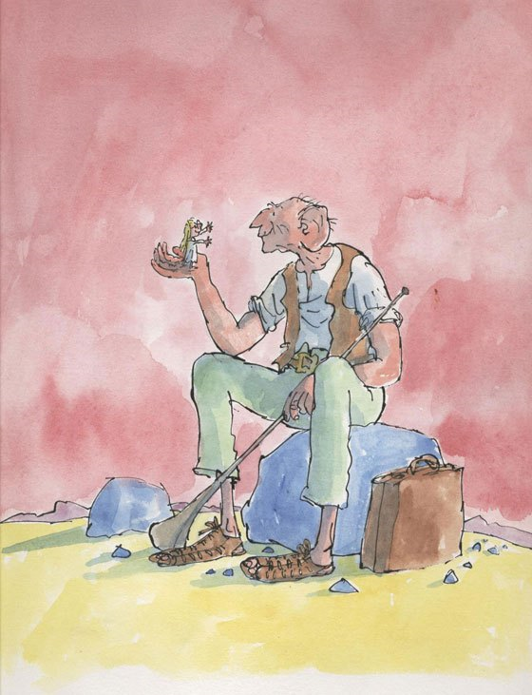
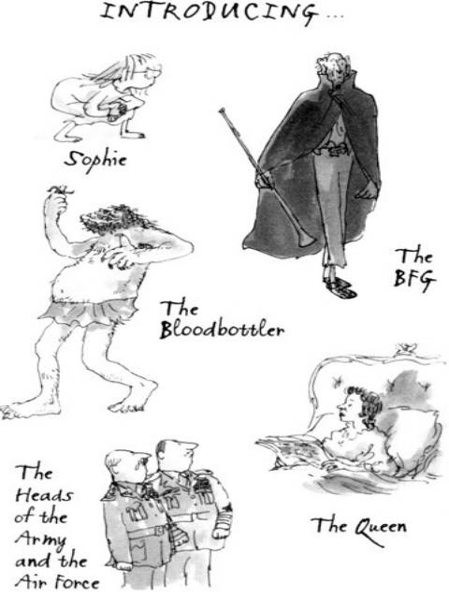
The BFG (the Book (1982) and the Movie (2016)
By Don and Alleen Nilsen

Slide 24
Schemes vs. Tropes
Schemes are superficial.
Schemes are the language-play devices that relate to sounds and spellings.
Alliteration, Assonance, Cacography, Eye Rhyme, and Slant Rhyme are examples of schemes.
Tropes are meaningful.
Tropes are the language-play devices that relate to meanings.
Cacophony, Double Entendre, Euphony, Hyperbole, Irony, Metaphor, Metonymy Sound and Visual Imagery, and Understatement are examples of tropes.

Slide 25
ALLITERATION (Repetition of Consonants):
The giants have such names as The
Childchewer, The Gizardgulper, The MaidMasher, The Bloodbottler and The Butcher Boy.
In the book, girls’ schools are called “gigglehouses,” and boys’ schools are called “boggleboxes.”

Slide 26
ASSONANCE (Repetition of Vowel Sounds)
Dahl uses such words as scotch-hopper and wraprascal.
To the BFG, “Words is oh such a twitch-tickling problem to me all my life.”
BFG describes a dream as a “winksquiffler,” but then says, “It’s…it’s…it’s…it’s even better. It’s a phizzwizard! It’s a golden phizzwizard!”
BFG also talks about the “bogrotting” night mares that result from having “trogglehumper” dreams.
The opposite of the “trogglehumper” dream is the “phizzwizard” dream

Slide 27
BFG Storing and Delivering Dreams
He stores dreams in bottles.
Then he blows them quietly into the minds of sleeping children.

Slide 28
CACOPHONY (Unpleasant Meanings)
The giants have such cacophonous names as The Fleshlumpeater, The Bonecruncher, The Manhugger and The Meatdripper.
The snozzcumber is also cacophonous.
it’s sickable! It’s rotsome! It’s maggotwise!
Whizzpoppers are also a bit cacophonous.

Slide 29
BFG Doesn’t Eat Human Beans. He eats Snozzcumbers and drinks Frobscottle.

Slide 30
The Cacophony of “Trogglehumpers”
Sophie cried, “But it’s…it’s horrible! It’s jumping about! It wants to get out.”
“That’s because it’s a troggleuhumper” said the BFG.
It’s a nightmare.”
“A dream where you is seeing little chiddlers being eaten is about the most frightsome trogglehumping dream you can get.
It’s a kicksy bogthumper.
It’s a whoppsy grobswitcher.”

Slide 31
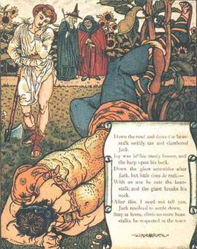
CLIPPINGS The Pictures Are of Jack, the Beanstalk and the Giant
Human beings are called human beans.
This gives a special meaning to the story of “Jack and the Bean Stalk,”
which is, of course, a story about a child and a giant.
In talking about his cave, the BFG says, “There is no human beans or stringy beans or jelly beans or any other beans in there.”

Slide 32
Deference to Royalty
When the BFG meets the Queen, he addresses her as follows:
“Oh, Magester! Oh, Queen! Oh Monacher! Oh, Golden Sovereign! Oh, Ruler! Oh, Ruler of Straight Lines!”
This is reminiscent of when Bilbo Baggins meets the Dragon, Smaug, in J. R. R. Tolkien’s The Hobbit.
In the picture, Smaug is saying, “You have nice manners for a thief and a liar.”

Slide 33
EUPHONY (Pleasant Meanings):
Frobscottle is described as delumptious and fizzy.
BFG says, “Whizpopping is a sign of happiness. It is music in our ears!”
“A look of absolute ecstasy began to spread over his long wrinkly face. Then suddenly the heavens opened and he let fly with a series of the loudest and rudest noises Sophie had ever heard in her life…. The force of the explosions actually lifted the enormous giant clear off his feet, like a rocket.”

Slide 34
The Euphony of the “Phizzwizard” Dream
This is what Sophie saw when she looked into the jar containing a “phizzwizard” dream:
“She saw the faint translucent outline of something about the size of a hen’s egg.
There was just a touch of colour in it, a pale sea-green, soft and shimmering and very beautiful.
There it lay, this small oblong sea-green jellyfish thing…pulsing gently…as though it were breathing.”

Slide 35
Foreshadowing is displayed in the planning of the Queen’s dream.
Sophie and The BFG make the following plan: “I want the Queen to dream that nine disgusting giants, each one about fifty feet tall, are galloping to England in the night.
Let her dream they will be reaching into the bedroom windows and pulling the little boys and girls out of their beds.
In her dream there is a Big Friendly Giant who can tell her where all those beasts are living…,
so that she can send her soldiers and her armies to capture them once and for all.”

Slide 36
Foreshadowing: The Queen’s Dream
When the Queen was having a nightmare, she said,
“Oh no! No! Don’t
—Someone stop them!
--Don’t let them do it!
--I can’t bear it!
--Oh please stop them!
--it’s horrible!
--Oh, it’s ghastlyl!
--No! No! No!....”
Later, when the Queen read the news in The Times she said that was exactly what she had dreamed.
She had even dreamed about Sophie sitting on her window sill,
And about the giant who had placed her there.

Slide 37
The Queen’s maid saw a little girl sitting in the window. The Queen also saw her:
The Queen “simply sat there staring wide eyed and white-faced at the small girl who was perched on her window-sill in a nightie. Sophie was petrified.”
The Queen had also dreamed all of the details of the story in The Times:
“Eighteen girls vanish mysteriously from their beds at Roedean School!
Fourteen boys disappeared from Eaton! Bones are found underneath dormitory windows!”

Slide 38
HYPERBOLE (Exaggeration)
BFG is talking about his big ears:
“I is hearing the footsteps of a ladybird as she goes walking across a leaf.”
“I is hearing the little ants chittering to each other as they scuddle around in the soil.”
“One of the biggest chatbags is the cattlepiddlers.”
“They is argying all the time about who is going to be the prettiest butteryfly.”

Slide 39
The Hyperbole of “Giant Country”
They were using an Atlas to help them find giant country.
At the end of the Atlas there were two blank pages.
Pointing to a spot on one of these blank pages the BFG said, “So now we must be somewhere here.”
What they thought was the firing of guns turned out to be the snoring of giants.

Slide 40
The Hyperbole of the Queen’s Breakfast
“By gumdrops!” he cried. “What a spliffling shoppsy room we is in! It is so gigantuous I is needing bicirculers and telescoops to see what is going on at the other end.”
For the breakfast, Mr. Tibbs, the Butler, multiplied everything by four. Two breakfast eggs became eight. Four rashers of bacon became sixteen. Three pieces of toast became twelve.
For knives, forks and spoons, they used a garden fork, a spade, and a sword that was hanging on the wall.

Slide 41
This is reminiscent of Gulliver among the Lilliputians

Slide 42
Why Huge Ears are Important in Dream Catching
“A dream” he said, “as it goes whiffling through the night air, is making a tiny little buzzing-humming noise.”
“But this little buzzy-hum is so silvery soft, it is impossible for a human bean to be hearing it.”

Slide 43
Hyperbole and Understatement
BFG is four times as big as a human bean.
Sophie is four times as small as an adult human bean.
But all of the other giants call BFG the runt.
Because BFG is much smaller than any of the other giants.

Slide 44
Giants at Play
BFG is the “runt” of all of the giants.
Because of this, they have fun throwing BFG from giant to giant.
Manhugger caught him and threw him to Bonecruncher, who caught him and threw him to Childchewer.
“And so it went on. The giants were playing ball with the BFG, vying with each other to see who could throw him the highest.”

Slide 45
IRONY:
In Coke and Pepsi, the bubbles rise to the top.
This causes people to burp.
But in the frobscottle that the BFG drinks, the bubbles flow downward rather than upward;
therefore, instead of causing burps, it causes whizpopping.

Slide 46
The Irony of Giants Being More Civilized than Human Beans
Sophie tells the BFG that it is very uncivilized for Giants to be eating human beans—especially children.
But BFG says that giants don’t eat other giants.
And BFG adds that giants don’t kill other giants, “but human beans is squishing each other all the time.”
“They is shootling guns and going up in aerioplanes to drop their bombs on each other’s heads.”
Sophy countered by saying “I think it’s rotten that those foul giants should go off every night to eat humans.
Humans have never done them any harm.”
BFG countered this by saying, “That is what the little piggy-wig is saying every day.
He is saying, ‘I has never done any harm to the human bean so why should he be eating me?’”

Slide 47
Leit Motif (a phrase, sound or behavior that is associated with a particular character)
In Prokofiev’s Peter and the Wolf, a particular musical phrase is associated with each of the chracters—Peter, the grandfather, the bird, the wolf, etc.
In Wagner’s Ring Cycle a particular musical phrase is associated with the Valkyries as they come to take the wounded warriors off to Val Halla.
In Star Wars a particular musical phrase is associated with Darth Vader.
Very often when the BFG says something controversial to Sophie he asks her, “Is I right, or Is I left?”
And she responds, “Right!”

Slide 48
METATHESIS (Reversing the order of words or sounds) This is a Leit Motif for The BFG
“You is welcome to search my cave from frack to bunt. You can go looking into every crook and nanny.”
BFG also uses the term “snappy whippers” instead of “whipper snappers.”
Instead of saying “every now and then,” BFG says, “every then and now.”
Sophie was reading Nicholas Nickleby.
BFG assumed that the book was written by Dahl’s Chickens.

Slide 49
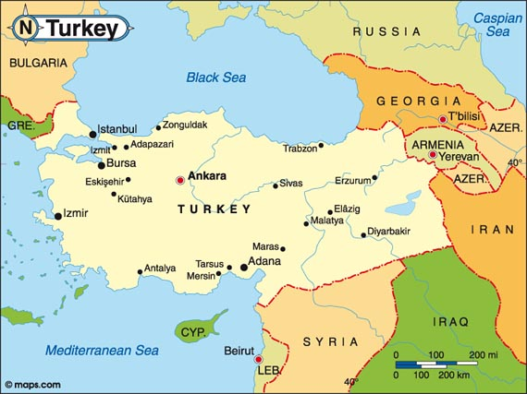
METONYMY (Word Association)
When the giants eat “human beans,” the people from Turkey taste like turkey, the people from Greece are greasy. The people from Panama taste like hats, and the people from Wales have a fishy taste (like whales).
The people from Chile taste either like chile beans or like chilly beans.

Slide 50
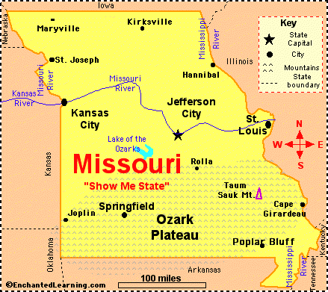
Mondegreens (Incorrect Word-Breaking or Phrase-Breaking)
Two lines of a famous Scottish poem read as follows:
“They ha slain the Earl of Murray
And they laid him on the green.”
This last line is mis-interpreted as, “and the lady Mondegreen.”
Similarly, the BFG offers “a sistance” to the Queen, and talks about “Mrs. Sippi,” and “Miss Souri.”

Slide 51
Sound Imagery
The BFG failed to see the enormous crystal chandelier in the Queen’s Ballroom.
“Crash went his head right into the chandelier.
A shower of glass fell upon the poor BFG. ‘Gunghummers and bogswinkles!’”

Slide 52
More Sound Imagery
“Just then, there came a tremendous noise of galloping feet from outside the cave. ‘What’s that?’ Sophie cried.
“That is all the giants zippfuzzing off to another country to guzzle human beans” the BFG said.
After BFG blew a “trogglehumper” nightmare into the face of Fleshlumpeater, one of his flailing fists hit the still-fast-asleep Meatdripping Giant, who thrashed his legs to kick the snoring Gizzardgulping Giant.”
Both the injured giants woke up and began to fight.

Slide 53
Squishy Language (Language on the Slant)
The BFG is always using the wrong words.
But the BFG’s words are funny, and they are suggestive.
The BFG explains why it is important for him to hide from human beans:
“They would be putting me into the zoo or the bunkumhouse with all those squiggling hippodumplings and crocadowndillies.”

Slide 54
More Squishy Language
The BFG continues,
“If I do, they will be putting me in the zoo with all the jiggyraffes and cattypiddlers.”
BFG continues, “Grown-up human beans is not famous for their kindnesses.
They is all squifflerotters and grinksludgers.”
BFG said, “I is telling you once before that I is never having a chance to go to school.
I is full of mistakes.
They is not my fault.
I do my best.”

Slide 55
Taste and Smell Imagery and Analogy (Similarity) of Processes
Mixing dreams is like mixing a cake.
“If you is putting the right amounts of all the different things into it, you is making a cake come out any way you want, sugary, splongy, curranty, Christmassy or grobswitchy.”
It is the same with dreams.”

Slide 56
The Visual and Sound Imagery of the Giants What Sophie Saw and Heard
“In the light of the moon, she saw all nine of those monstrous half-naked brutes thundering across the landscape together.
They were galloping in a pack, their necks craned forward, their arms bent at the elbows, and worst of all, their stomachs bulging.
The strides they took were incredible.
Their speed was unbelievable.
Their feet pounded and thundered on the ground and left a great sheet of dust behind them.”

Slide 57
The Visual and Sound Imagery of Mixing Dreams
BFG had a gigantic egg-beater.
“It was one of those that has a handle which you turn, and down below there are a lot of overlapping blades that go whizzing around.”
“Flashes of green and blue exploded inside the jar. The dreams were being whisked into a sea-green froth.”
“Quite slowly, the topmost bubble rose up through the neck of the jar and floated away.
A second one followed. Then a third and a fourth.
Soon the cave was filled with hundreds of beautifully coloured bubbles, all drifting gently through the air.

Slide 58
The Visual, Sound and Smell Imagery of Nine Sleeping Giants
“They looked even more grotesque now than when they were awake.
Sprawled out across the yellow plain, they covered an area about the size of a football field.
Most of them were lying on their backs with their enormous mouths wide open, and they were snoring like foghorns.
The noise was awful.”
Sophie described Fleshlumpeater’s face as follows:
“Every now and again a big bubble of spit formed between his two open lips…
and then it would burst with a splash and cover his face with saliva.”

Slide 59
Zeugma (Intentional Faulty Parallelism)
“Then out he came!
Twenty-four feet tall, wearing his black cloak with the grace of a nobleman, still carrying his long trumpet in one hand,
he strode magnificently across the Palace lawn toward the window.”
“The maid screamed.”
“The Queen gasped.”
“Sophie waved.”

Slide 60
In Conclusion, The BFG is an Autobiography
With the Queen’s help, the BFG learned how to read…, and how to write.
And he wrote a book, but he was too modest to put his name on it.
“But where, you might ask, is this book that the BFG wrote?”
“It’s right here.”
“You’ve just finished reading it.”

