Slide 1
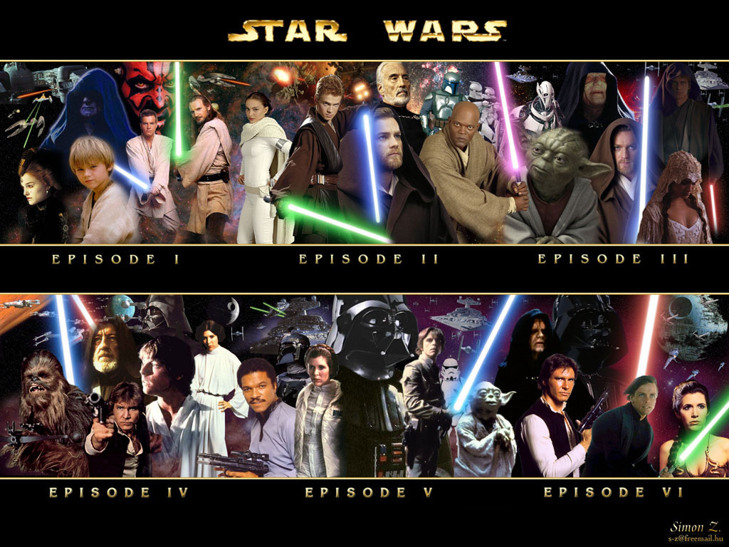
The Humor of Star Wars
By Don and Alleen Nilsen

Slide 2
As an over-the-top melodrama, Star Wars is a parody of science fiction, as well as a “Comedy of Humours.”
The exaggerated characters are sanguine, bilious or phlegmatic, i.e. named after the “humours” that long-ago physicians viewed as the liquids of the body, which when out-of-balance would cause unique traits to develop.
Star Wars is also a “Romance,” in which the characters are placed into one of two categories—either the dark side, or the light side.
Because these “humours characters” are so exaggerated, they can also be classified as “Eccentrics,” and in some cases, even as “Grotesques” as seen in the following slide where one “normal” woman stands out simply because she is so ordinary.

Slide 3
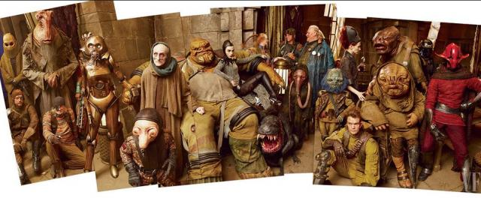
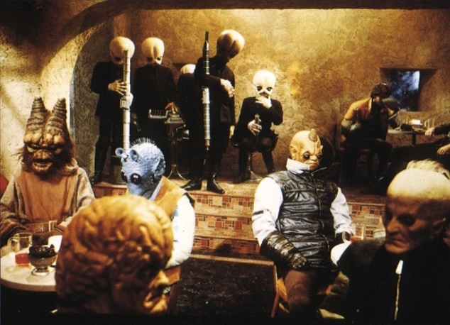
Grotesques

Slide 4
The Importance of Names
Names are the only part of a language that speakers can invent for themselves.
The creators of Star Wars were so good at inventing names that we come away feeling we have figured out a foreign language (or several foreign languages) when we toss around such character names as, Boba Fett, Adi Gallia, Hu Yang, and Gardulla the Hutt, along with such place names as Naboo City and Coruscant.
Some of the invented names follow authentic patterns of English word development, as with Darth Vader for “Dark Father,” and Luke Skywalker, where “Skywalker” describes Luke’s job, and Luke relates to words meaning “light” (as in Latin luc and luk) and in Greek leukis meaning “white”).
However, most of the created names are just suggestive of an English meaning which in a slipshod fashion helps the audience connect the name to either the characters’ appearance or actions.

Slide 5
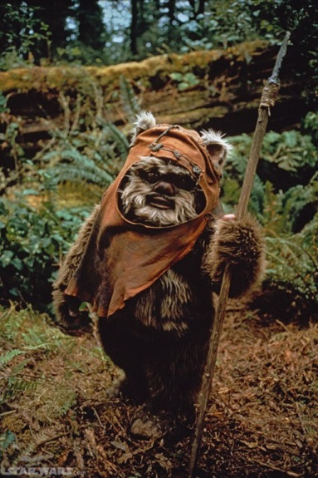
The Wookies and the Ewoks
For example, our familiarity with the concept of “chewing tobacco” may trigger an almost subconscious mental association to Chewbacca’s brown, hairy fur, while his species name of Wookie, might trigger us to think of “Whoops!”
In contrast, Ewoks are short, violent cannibals, which look like Teddy bears but act like savages so that if we should happen to run into one we would at least think “Eek!”

Slide 6
And, surely viewers are waiting for Jar Jar Binks to “blink his eyes.” In spite of their prominence, he’s always bumping into things.
Some names are obviously created as descriptors as with Hevy who during the Clone Wars carries the “heavy guns.”
Other names are just easy to say and to remember as with Yoda, whose name is just one letter away from yoga. Yoda is an important character in video games.

Slide 7
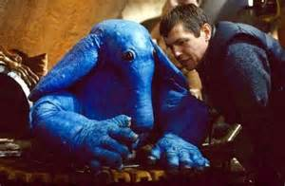
More Grotesques

Slide 8
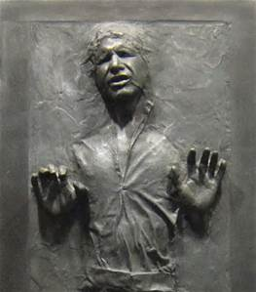
Jabba the Hutt and Princess Leia
Jabba the Hutt “jabbers” as he smokes marijuana from a hookah and speaks a strange language that requires sub-titles.
We can understand his names of people and places, but even they are pronounced in a strange fashion.
He is a cruel mountain of lava, who makes Princess Leia his Slave Dancer and freezes
Han Solo in carbonite

Slide 9
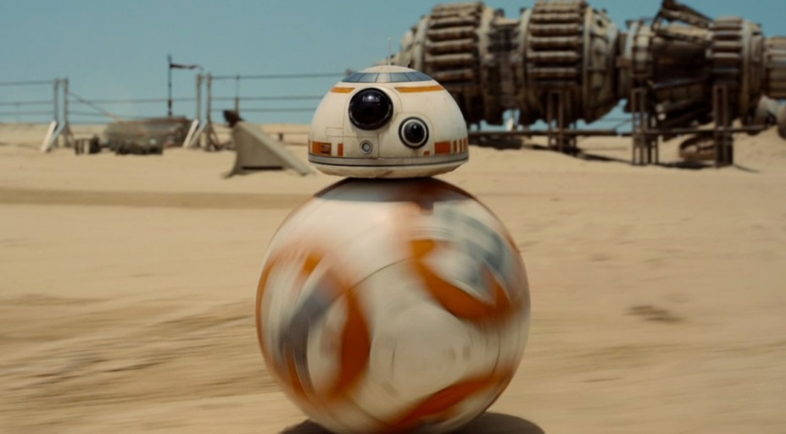
Dramatic Contrasts
When numbers and letters are used together in a name, we know that machines are being personified.
For example, C-3PO is a tall, shiny android who walks stiffly and gingerly, while speaking with a British accent.
R2-D2 is a squat metallic grey robot who rolls as he squeaks and whistles. Ironically English speakers can make sense out of these squeaks and whistles.
BB-8 is a recently developed “astromech droid,” the newest name for androids. His domed head stays in place, while his body is a round ball that can roll in any direction.

Slide 10
The Names of Androids
In Android naming, a hyphen separates the first name from the last name.
Thus we have C-3PO, R2-D2 and BB-8.

Slide 11
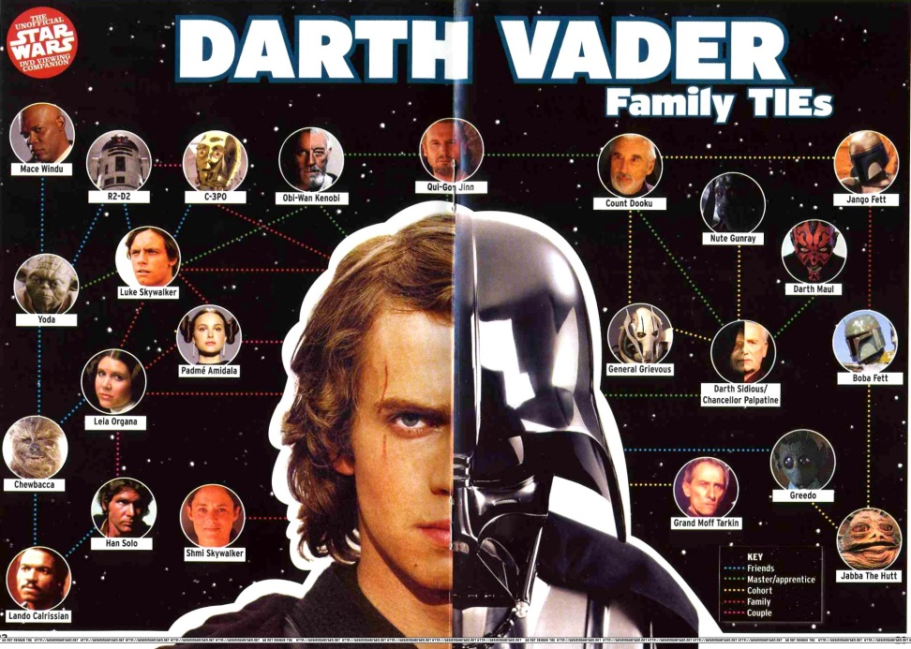
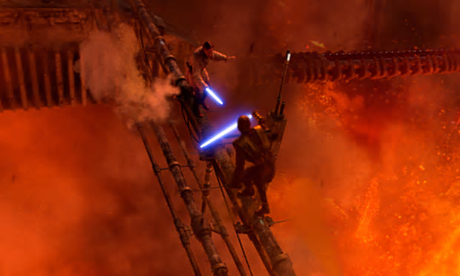
On the Lava Planet Anakin Skywalker becomes Darth Vader. This is another example of a dramatic contrast.

Slide 12
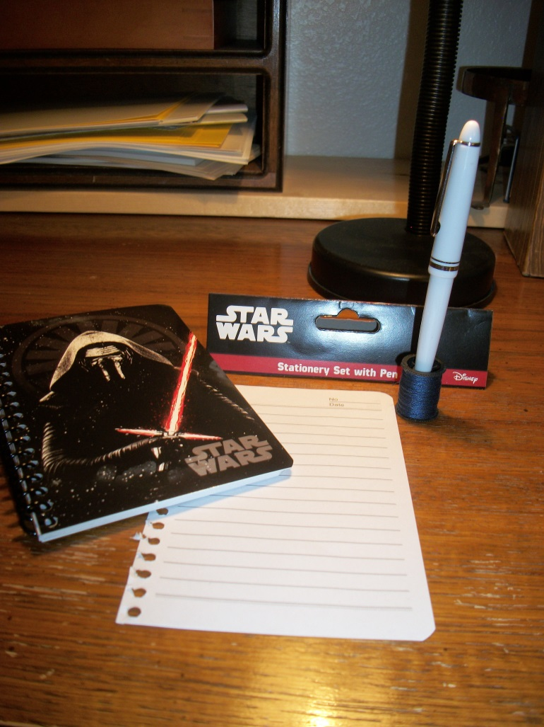
The Merchandising of Star Wars Icons

Slide 13
Collecting Souvenirs is a Fun Way to Be Involved
The items shown in the previous slide all came from a neighborhood “Dollar” store:
A shopping bag,
A poster,
A memo pad and pen,
A box of stationery,
A coloring book,
A sticker book and
boxes of macaroni and cheese.
We spent just a little more than $8.00. Our most surprising “find” was a display of boxes of macaroni and cheese, each adorned with a portrait and the message, “COLLECT ALL 8 BOXES.” They were sold out except for Yoda, C-3PO and Darth Vader.

Slide 14
We were proud of our shopping until we went online and found what people with higher levels of taste spend on jewelry, costumes, conventions and original art work. On Pinterest, Star Wars has 5.9 million followers.
Our specific temptations included:
A British postage stamp featuring the Star Wars Storm Troopers.
A sleeping bag that would disguise one of us as R2-D2 once we were zipped inside.
The idea of waltzing through airports looking as if we were shepherding R2-D2, instead of dragging a carry-on bag.
Directions for building our own BB-8 with Lego.
A “Death Star” fire pit for barbecuing in our back yard.
A Poster of Princess Leia choking a man who had confused “Star Wars” with “Star Trek.”
An attractive poster that clearly showed the timelines and the relationships of the films through 2019.
Complete plans for a Star Wars party.

Slide 15
John Williams Leit Motif for Darth Vader
https://www.youtube.com/watch?v=-bzWSJG93P8

Slide 16
The Original Trilogy, the Prequel Trilogy and the Sequel Trilogy
In the original Star WarsTrilogy we are shown how Emperor Palpatine seduces Anakin Sky Walker to join the dark side.
Anakin had lost his mother at a very early age. Now, Anakin’s wife is pregnant with Luke Sky Walker, and the wicked Emperor Palpatine convinces Anakin that he will lose his own wife in child birth.
Emperor Palpatine convinces Anakin Sky Walker that in order to save his wife, he will have to come to the dark side, which he does.
The Prequel Trilogy showed how Anakin had lost a light-saber fight on the Lava Planet, and his body had ended up so damaged that he had to wear a respirator wherever he went.
Thus, Anakin Sky Walker became Darth Vader.

Slide 17
Coruscant: A Futuristic City in Star Wars
The Senate Building is the mushroom building in the background.
This is where the Jedi Forces meet to discuss the future of the Galaxy.

Slide 18
In contrast, Naboo City, where Anakin Sky Walker was born, is nothing like Coruscant City.
Even when he was young, Anakin Sky Walker had amazing skills.
He won races against much older and skilled opponents driving much better racing vehicles.

Slide 19
English Speakers in Star Wars
All of the human-shaped characters in Star Wars speak English.
But they have the uncanny ability to converse with non-English-speaking Wookies who only grunt and groan, and androids who mainly squeak and whistle.
It’s very much like listening to one end of a telephone conversation.

Slide 20
Han Solo and Luke Sky Walker are both on the light side, and they both speak English.

Slide 21
Obi Wan Kenobi
Obi Wan Kenobi was Anakin Sky Walker’s Jedi Master.
He trained Anakin well, but was forced to fight him on the Lava Planet.
He could have destroyed Anakin, but didn’t, which is why Anakin can later return as Darth Vader.

Slide 22
Yoda
Yoda is Luke Sky Walker’s Jedi Master.
He is very old, very small, very oriental, and very green.
He has big ears, and is amazingly agile as a fighter with light sabers.

Slide 23
Emperor Palpatine: The top picture shows himas a Hologram; the bottom picture shows him as an Evil Emperor
In the beginning, Emperor Palpatine appeared to be one of the good people, but then he saw the power of the dark side.
He took his Empire with him, so the Jedi forces had to become part of the rebellion.
He is one of the few on the Dark Side who speaks English.

Slide 24
Princess Leia and Storm Troopers
Princess Leia is actually Luke’s sister and Anakin Sky Walker’s daughter.
In the first two trilogies it is suggested that she has special powers.
In “The Force Awakens” she has become a General of the Rebel forces.
In this picture, Princess Leia is being
Held captive by some Storm Troopers.

Slide 25
Storm Troopers
In one episode, the Federation
learns how to clone Storm Troopers, creating a formidable enemy against the Jedi Rebel forces.

Slide 26
Star Wars Weapons
The light saber is the weapon of choice in Star Wars.
The light saber comes in green and red, and it makes dramatic whoosh and sizzle sounds as it deflects bullets and clashes with other light sabers.

Slide 27
Death Star
The Death Star has only one function—
Destruction of the Rebel forces.

Slide 28
Hover Craft
The Good Guys fight the Bad Guys in these straddled hover crafts.
The riders have to avoid trees and other obstacles as they try to outmaneuver each other in the dense forests.

Slide 29
Lambda Shuttle Craft
The wings on this craft move up and down.
It is very much like a butterfly.

Slide 30
Millenium Falcon
Han Solo and Chewbacca pilot the Millenium Falcon.
Han Solo is something of a space pirate.
But he has good intentions.

Slide 31
Walkers
The Walkers are commanded by people who ride in the heads of each Walker.
The Walkers have a wide range of vision, but they’re very unstable.
Such “inventions” resemble vehicles in the new genre of “Steam Punk.”
One of the functions of “Steam Punk” is to suggest how the world would have been if machines had evolved differently.
Instead of tanks with tracks, we might have had tanks with long legs in this alternate reality.

Slide 33
The Sequel: The Force Awakens: Poe Dameron, Ren and Finn

Slide 34
TIE Interceptor
Poe Dameron flies a TIE Interceptor in Star Wars “The Force Awakens.”
Finn is with him. Finn’s name is a clipping from a longer name.

Slide 35
Finn, Rey and BB8
Here is a picture of Finn, Rey, and BB8.
Finn was a Storm Trooper before he “saw the light.”

Slide 36
Kylo Ren
Kylo Ren is a bad guy.
Don’t you think he looks like a bad guy?

Slide 37
Lando
Lando is a good guy (sort of).
Lando’s co-pilot is a grotesque character.

Slide 38
Poe Dameron
Here is Poe Dameron and his TIE Interceptor.

Slide 39
John Williams Music for Star Wars Opening Theme
https://www.youtube.com/watch?v=_D0ZQPqeJkk

