Slide 1
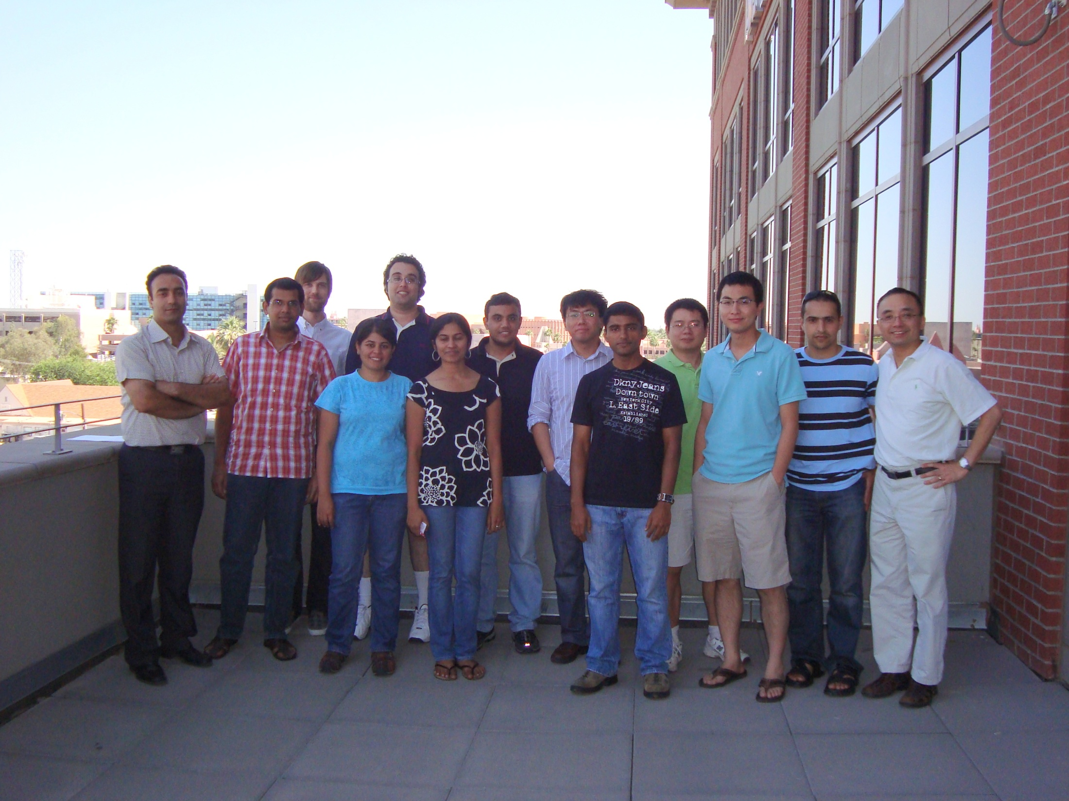
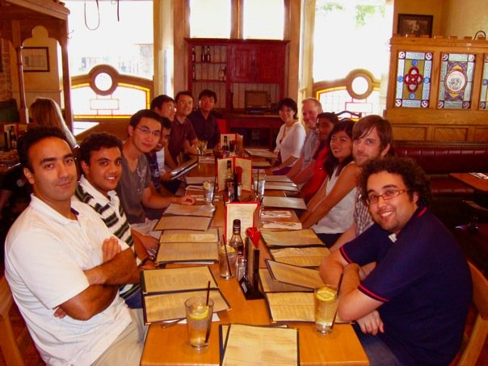
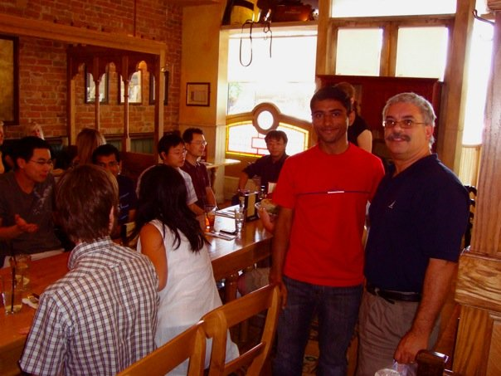
Data Mining and Machine Learning (DMML)
Group Members (Right to Left):
Huan Liu, Salem Alelyani, Lei Tang, Jian Yang, Nitin Agarwal (Dr.), Zheng Zhao, Shamanth Kumar, Gayathri Varadarajan, Reza Zafarani, Shashvata Sharma, William Cole, Sai Moturu (Dr.), Ali Abbasi; Magdiel Galan, , Xufei Wang, Geoff Barbier, Steve Day, Som Shahapurkar

Slide 2
Some Research Projects
Project | Funding Agency | Collaborators
III-COR-Small: Beyond Feature Selection and Extraction | NSF | Prof. Jieping Ye, SCIDSE
III-Medium: A Machine Learning Approach to Computational Understanding of Skill Criteria | NSF | Prof. Baoxin Li (PI), SCIDSE, Prof. Kanav Kahol, BMI
Modeling Group Interaction via Open Data Sources | AFOSR | Dr. John Salerno, AFRL
BlogTrackers: Building Search and Tracking capabilities | ONR | Prof. Merlyna Lim, Social Transformation
DHS COE: Reducing False Alarms | UA/DHS | Prof. George Runger, Dr. Jeremy Rowe
Online social behaviors and prediction of their implications for the physical world - A Comparative Study | UH/ONR | Prof. Sun-ki Chai, Sociology, University of Hawaii
Developing a culture analysis and sociological network theory | UH/AFOSR | Prof. Sun-ki Chai, Sociology, University of Hawaii

Slide 3

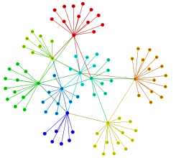
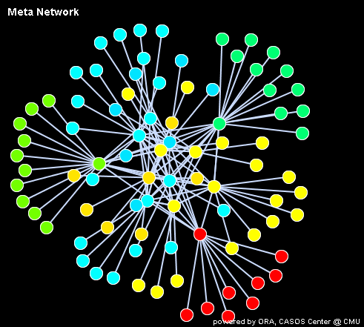
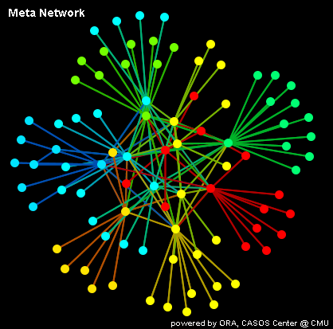
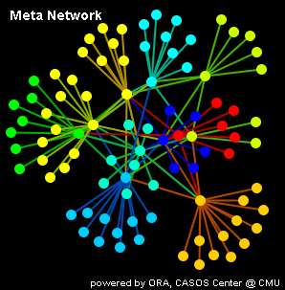
Contacts/friends
Lei Tang
Tagging on Social Content
Fans/Subscriptions
Response to Social Content
………………
Heterogeneous Networks
Social
Computing
Behavior Prediction
Group Evolution and Profiling

Slide 4
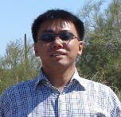
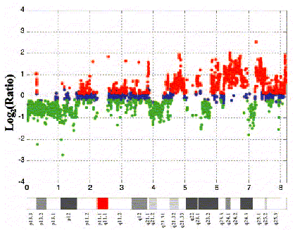
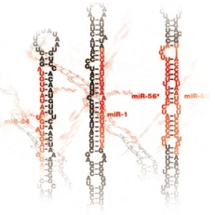
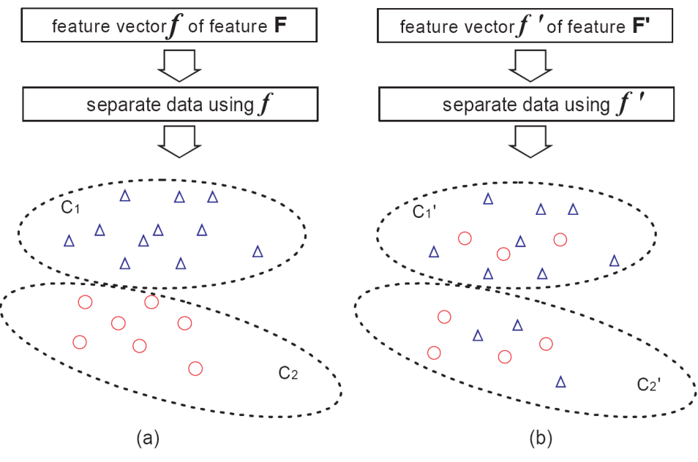
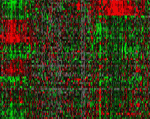
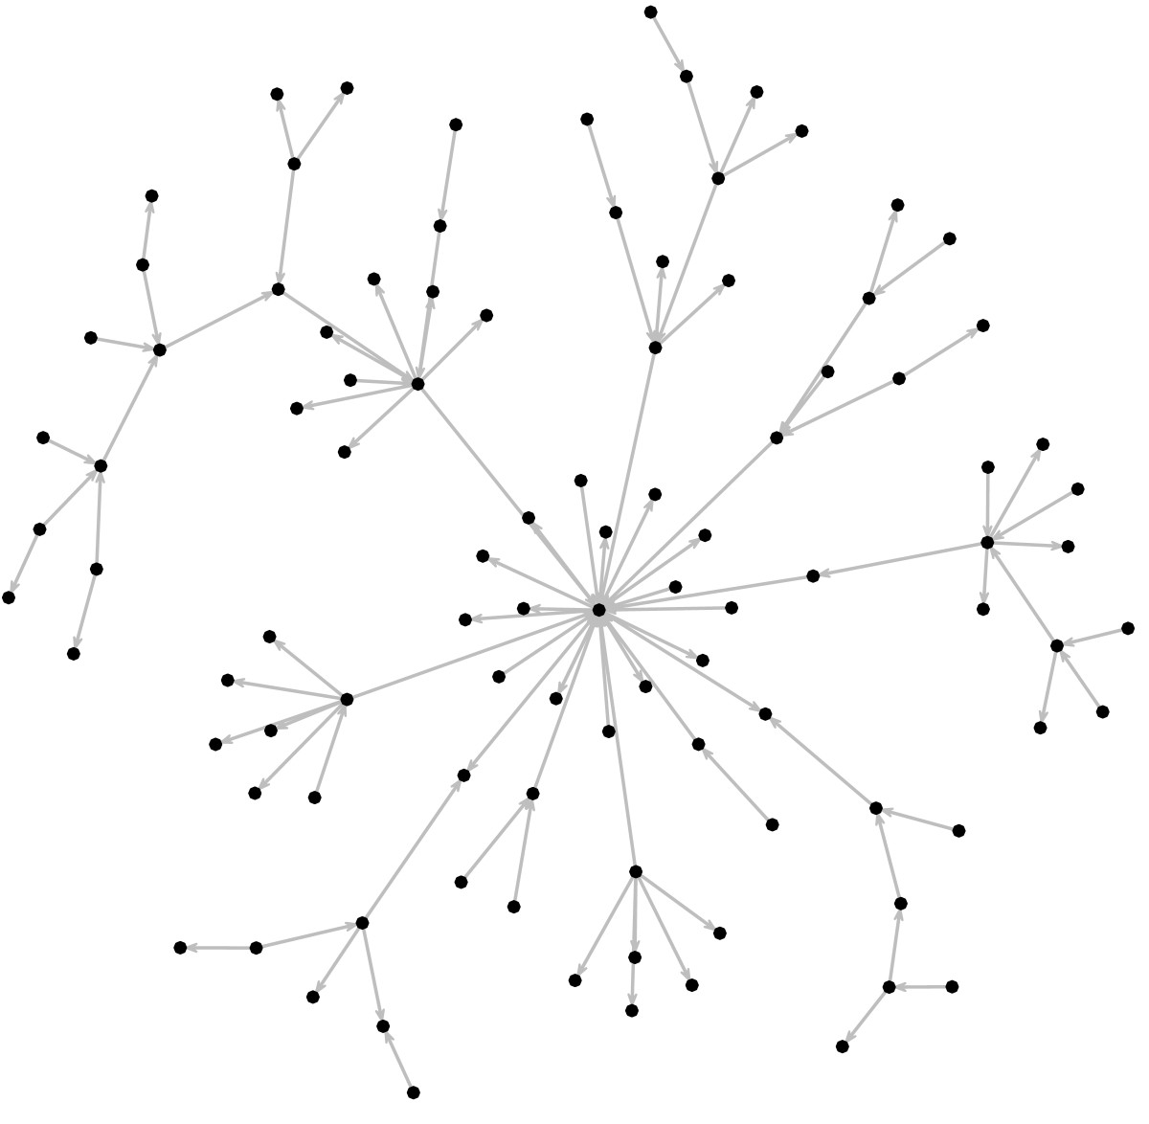
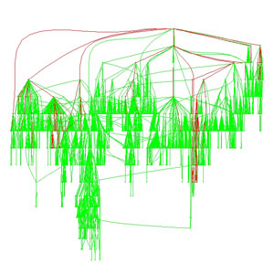
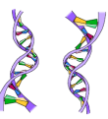
Feature Selection
Alan (Zheng) Zhao
Outstanding PhD
Student 2008
Feature Selection Based on Spectral Analysis
Multi-source Gene Selection
CGH
cDNA Microarray
MicroRNA
Gene Selection
Unsupervised, Supervised, and
Semi-supervised Feature Selection
Multi-Source Feature Selection
Feature Interaction
Gene Regulatory Network
Gene Ontology
Knowledge Based Gene Selection
Multi-Criteria Gene Selection
Gene Selection Based Biological Robustness Analysis

Slide 5

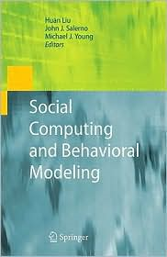
Accomplishments
Nitin Agarwal, Ph.D., Social Computing in Blogosphere, July 2009; University of Arkansas at Little Rock, tenure Track, August 2009; Outstanding Ph.D. Student Finalist in SCI, ASU in April 2009
Sai Moturu, Ph.D., Quantifying Trustworthiness of User-Generated Social Media Content; PostDoc at DMML/ASU and Media Lab/MIT
Nitin Agarwal and Huan Liu, Modeling and Data Mining in Blogosphere, Morgan And Claypool Publishers, 2009
Our work is published in KDD, ICWSM, ICWE, ICML, EMBC, WSDM, SDM, IJCAI, ICDM, PAKDD, TKDD, TKDE, JMLR, DMKD, among many others
The former graduated students are now professors in research universities, employed by high-tech IT companies (Google, Honeywell, Microsoft, and Yahoo, Amazon, among others) , and entrepreneurs/consultants.

Slide 6
Further Information
Huan Liu (http://www.public.asu.edu/~huanliu/)
Wiki (http://wiki.asu.edu/dmml)
Mailing List (dmml@yahoogroups.com)
This set of slides can be found at http://www.public.asu.edu/~huanliu/students.htm
CSE 471/598 Introduction to AI (Fall 2009) http://www.public.asu.edu/~huanliu/AI09F/cse491-598.htm
DMML Web site: http://dmml.asu.edu

