Slide 1
Welcome to Young Adult Literature
http://www.youtube.com/watch?v=GTXBLyp7_Dw

Slide 2
ENG 471
Fall 2013, room CDS 15 , 1:30-2:45 Tuesday and Thursday
Tracey Flores and James Blasingame
Office: LL 215; Phone: 965-6074; E-mail: James.Blasingame@asu.edu
Office hours: Monday 12:00-1:00 Tuesday and Thursday and by appt.
August 22, 2013
Opening Poem: “I Never Said I Wasn’t Difficult,” by Sara Holbrook
Book Recommendations: Twisted, by Laurie Halse Anderson; You Haven’t Got a Clue, edited by Sarah Cortez
Publishing book reviews
Introductions
“Who’s Afraid of Virgina (Euwer) Wolf?: Choosing and Using Young Adult Literature”
Overview of class (syllabus, MyASU, schedule)
Publishing book reviews

Slide 3

I Never Said I wasn’t Difficult by Sara Holbrook
I never said I wasn't difficult,
I mostly want my way.
Sometimes I talk back
or pout
and don't have much to say

Slide 4

I've been known to yell, "so what,"
when I'm stepping out of bounds.
I want you there for me
and yet,
I don't want you around.

Slide 5

I wish I had more privacy
And never had to be alone.
I want to run away,
I'm scared to leave my home.

Slide 6

I'm too tired to be responsible.
I wish that I were boss.
I want to blaze new trails.
I'm terrified that I'll get lost.

Slide 7

I wish an answer came
every time I asked you, "why."
I wish you weren't a know-it-all.
Why do you question when I'm
bored?
I won't be cross-examined.
I hate to be ignored.

Slide 8
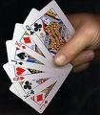
I know;
I shuffle messages like cards,
Some to show and some to hide
But, if you think I'm hard to live with . . .

Slide 9

You should try me on inside!!!

Slide 10
What is Sarah saying, do you think?
(You can say anything you want to.)

Slide 11
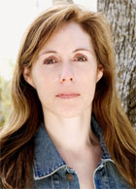
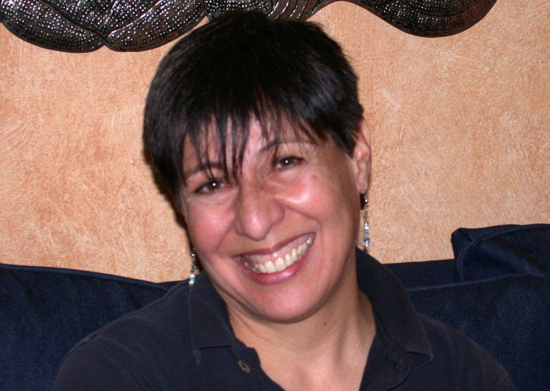
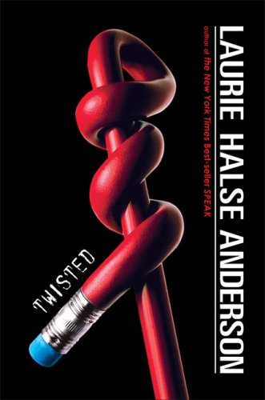
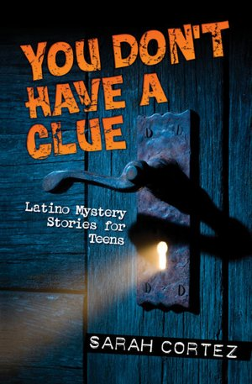
http://www.public.asu.edu/~jblasin/

Slide 12
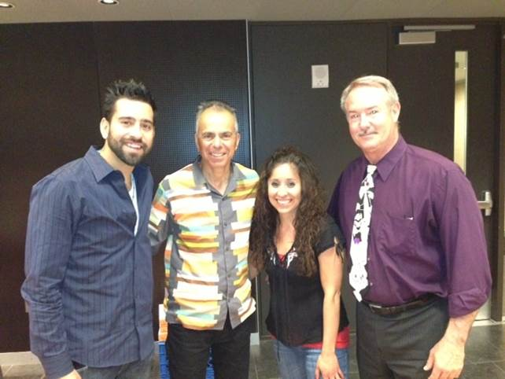
Co-Teachers
Ms. Flores and Dr. B

Slide 13
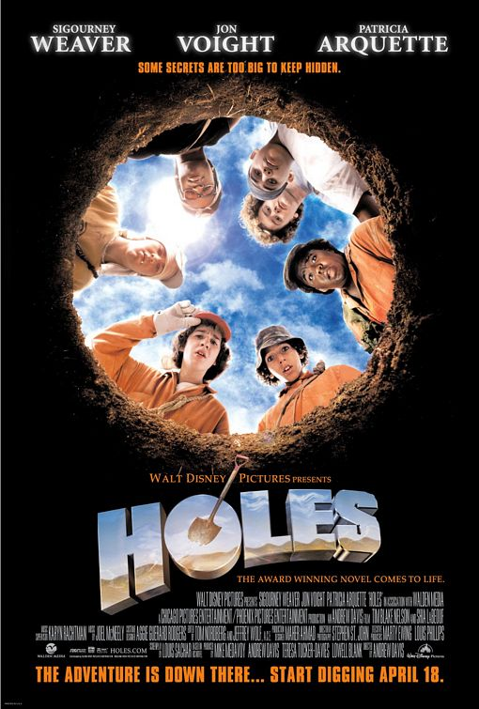
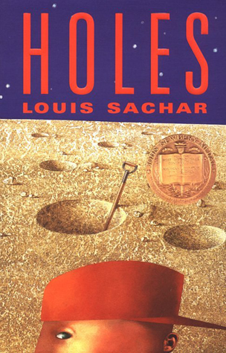
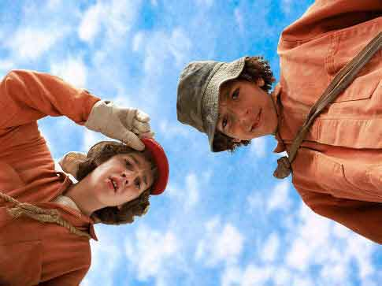
Holes

Slide 14
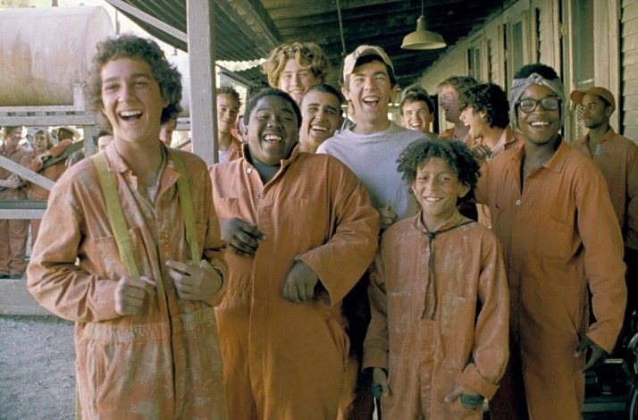
Nicknames!
Zero, Armpit, X-Ray, Magnet, Zigzag

Slide 15
Ms. Marathon and Dr. Ice

Slide 16
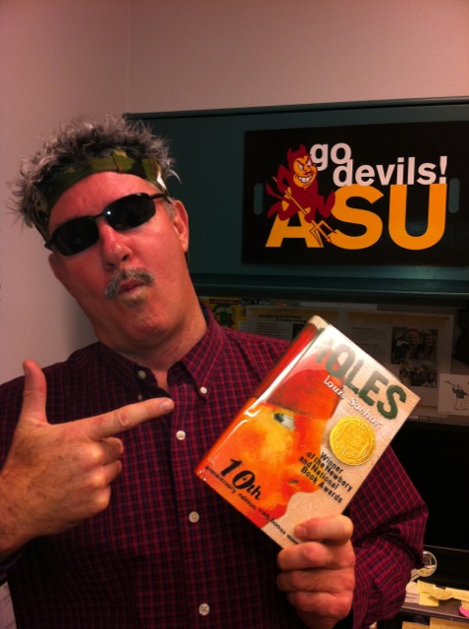
Dr. Ice says, “Nicknames are cool!” Watch for how things are changing when Stanley gets his very first nickname.

Slide 17
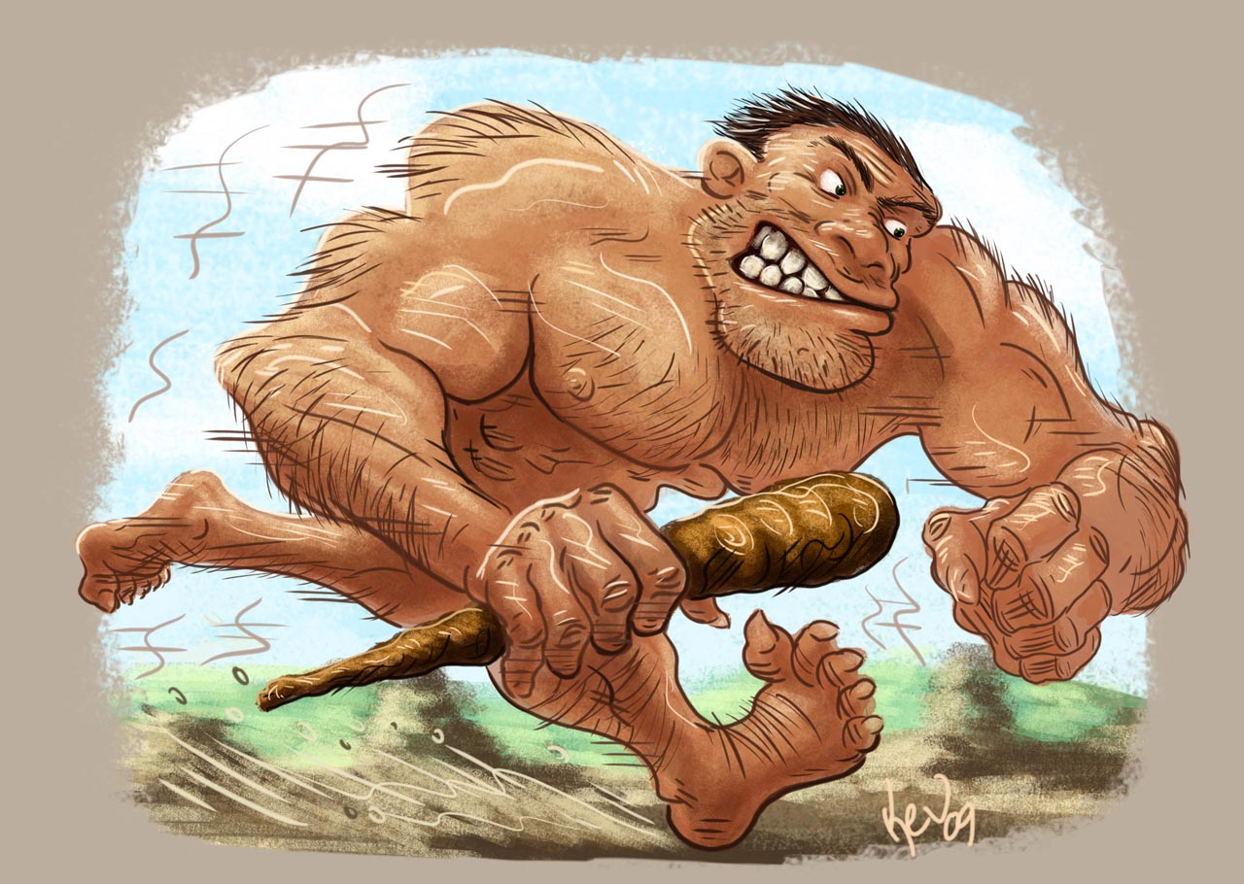
Stanley Yelnats
AKA: Caveman”

Slide 18
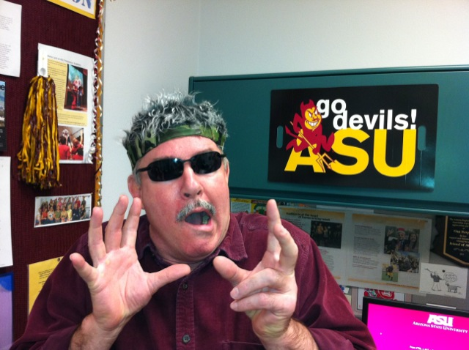

This YA class is bogus!! How can I get closer to the bone, feel the real deal, get down with my YA peeps, meet real authors?

Slide 19


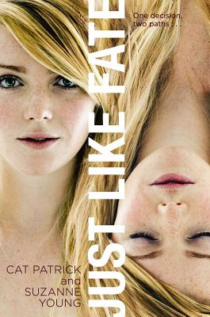
http://www.changinghands.com/event/young-aug13
Teen Event | Suzanne Young
Just Like Fate
Start: 08/27/2013 7:00 pm
7PM TUESDAY, AUGUST 27
Suzanne Young: Just Like Fate
Extra Credit Points?

Slide 20
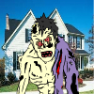
http://vhss.oddcast.com/vhssplayer.php?acc=3818225&ss=2326962&sl=0&l=0&h=300&w=400&bc=FFFFFF&mid=119858&t=1

Slide 21
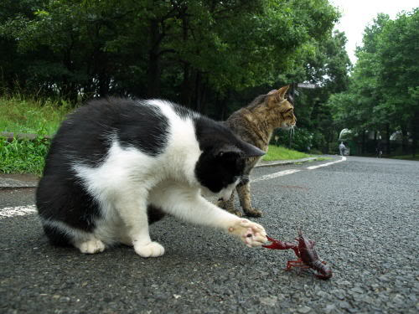
Introductions
Your name
Your major
Where you think of as home

Slide 22


Syllabus on Blackboard: Quiz and Discussion on Tuesday

Slide 23

Let’s go back to Sara Holbrook’s poem
“I Never Said I Wasn’t Difficult!”

Slide 24

Sara Holbrook wrote that poem, and it appears in a book by the same name.
She really didn’t have teenagers in mind when she wrote it,
but . . .

Slide 25
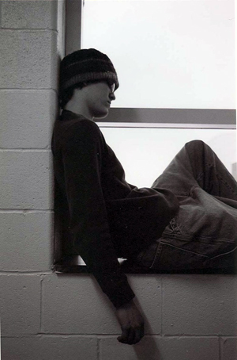
To people who work with adolescents every day this poem might accurately reflect the polar opposites that characterize this age group.
According to the Academy of Child and Adolescent Psychiatry this includes a heavy
“focus on self, alternating between high expectations and low self esteem.”
(ACAP, 2004)

Slide 26

Educational psychologist Eric Erikson went into great detail about the polar opposites of
Erikson coined the phrase “identity crisis.”
He also characterized adolescence as a time when people experienced an uncomfortable tension between what he called “identity” and “role confusion.”

Slide 27

Teens are trying to figure out who they are.
BUT
They must balance their
need to be accepted by
their peers with their need
to be unique individuals.

Slide 28

What we want to do as teachers, librarians and advocates for kids is:
Find the right literature to harness these emotional, psychological, and developmental forces so that kids are highly motivated to use reading and writing to make meaning of their lives as they live vicariously through the lives of the characters they read about.

Slide 29

And we need to treat young readers with respect.
Sherman Alexie, winner of the National Book Award for Young People’s Literature (The Absolutely True Diary of a Part-Time Indian) expresses his insistence upon respecting young readers:
“Kids have complicated and emotional lives” and disallowing literature that reflects this is a failure “to take kids seriously. It’s condescension. Kids respond well when they are taken seriously. ”
Blasingame. “From Wellpinit to Reardan: Sherman Alexie’s Journey to the National Book Award.” The ALAN Review, 35.22 (2008).

Slide 30
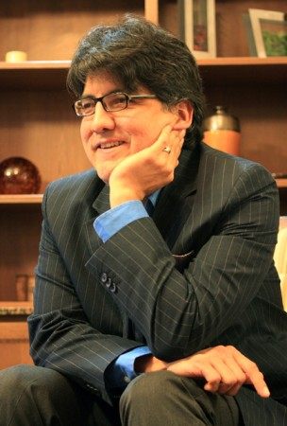
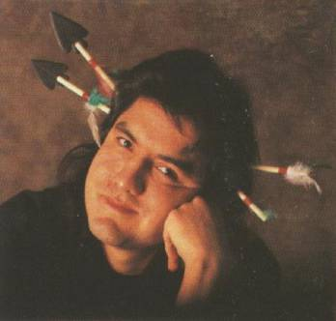
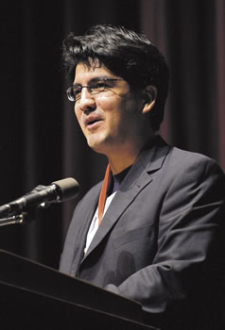
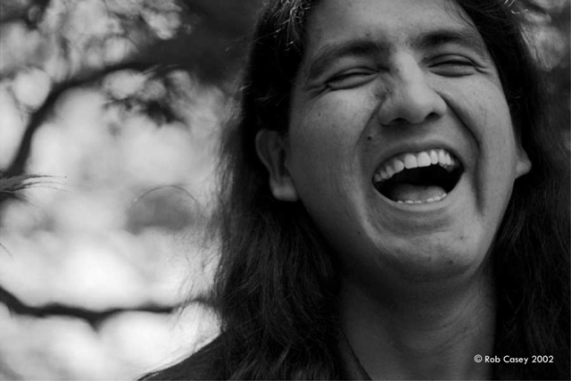
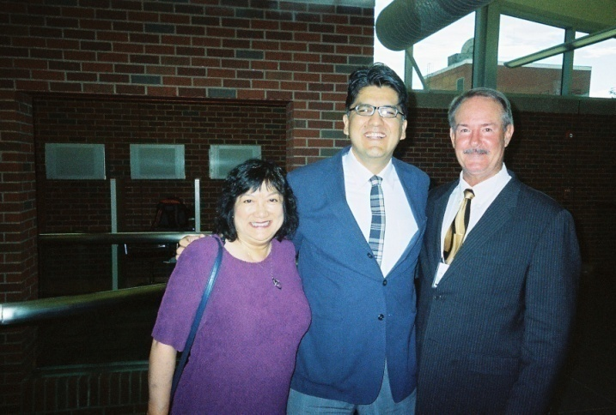
But complete gravity and seriousness are not good either. Humor is a requirement for coping with life’s problems.

Slide 31
“Humor can be used both defensively and offensively. Sometimes life can be so bad that humor is the only way you can talk about it. The only option to humor is silence. Unfunny people scare me. Unfunny people are up to no good.”
Blasingame. “From Wellpinit to Reardan: Sherman Alexie’s Journey to the National Book Award.” The ALAN Review, 35.22 (2008).

Slide 32

How do we select the right books?!!!??

Slide 33
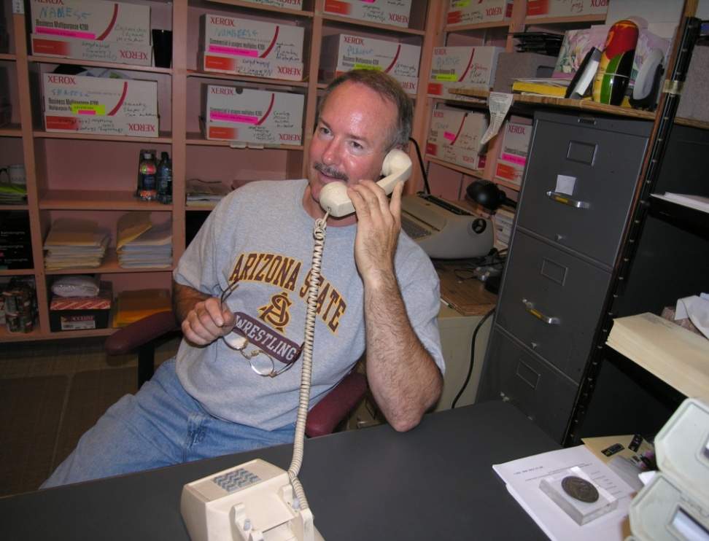
A few years ago, just as my teenaged niece was starting the fall semester of school, I talked to her long distance.
“Hi, Katelin. How was the first week of school?”
“OK, Uncle Jim. I like my classes, mostly.”
“What are you going be reading in English? Do you know, yet?”

Slide 34

“I don’t know, yet, but I hope it’s the good, interesting stuff and not the dumb, boring stuff.”

Slide 35

“Dumb, boring stuff!?”
I couldn’t help but wonder if I was guilty of using the “dumb, boring stuff” when I was a secondary English teacher.

Slide 36
And I thought back to the literature anthology I used for years with my students.
The first three short stories in the book, which we read right in a row to open the school year, all had two things in common.

Slide 37
Nothing really happened (they were boring) and the main character died.

Slide 38
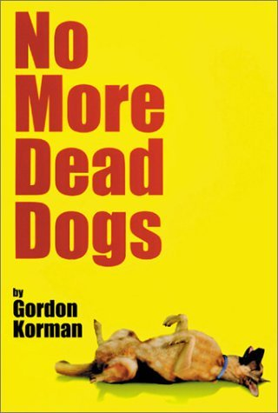
This sounded a little familiar.

Slide 39
Maybe that was a bad idea.
So, I thought about the kinds of books and the different authors Katelin really liked, the kind of reading she did when it wasn’t an assignment and the reading she did in English classes that she liked to attend.

Slide 40
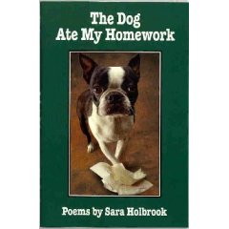

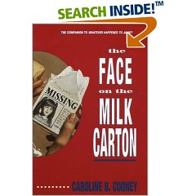
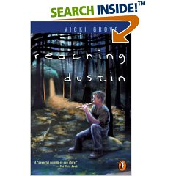
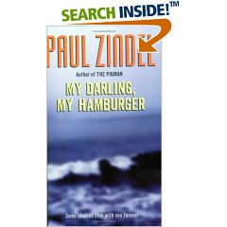
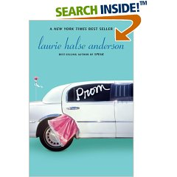
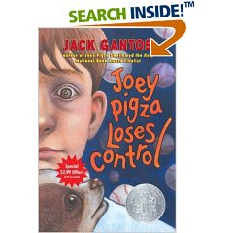
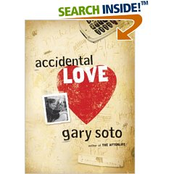
And especially some of her favorites over the years:

Slide 41
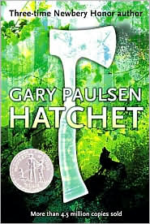
And especially this book.
Which she had read when she was a little younger, but which really got to her (the little problem solver that she was) as she followed Brian Robeson through his struggles with the great North Woods. This was the kind of “fun, interesting stuff” she loved to read.

Slide 42
“Uncle Jim,” she said back then. “Hatchet is really cool but pretty scary at times, like when Brian is attacked by a bear and a moose and even a skunk, but is it all just made up or did some of that stuff really happen to Gary Paulsen?”

Slide 43
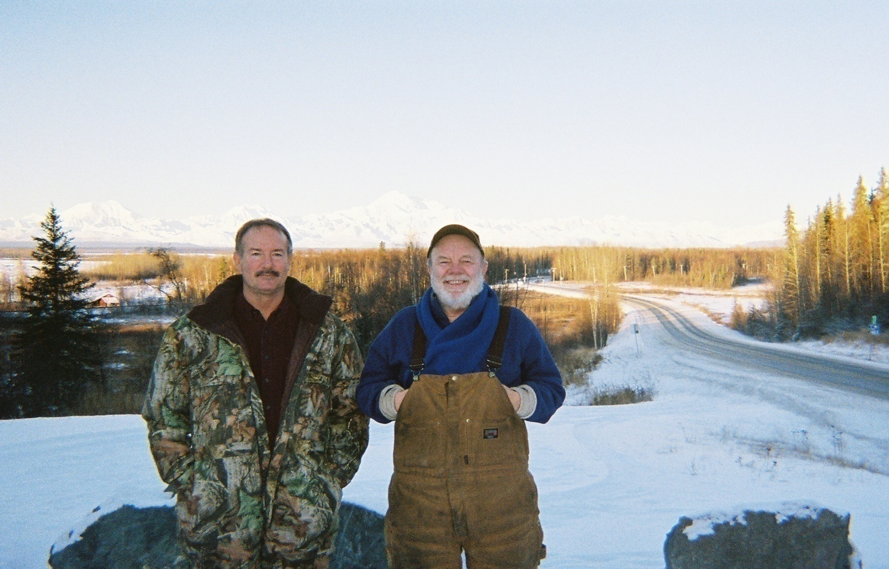
Katelin, I said, “Every single thing in that book happened to Gary Paulsen in one way or another.”

Slide 44
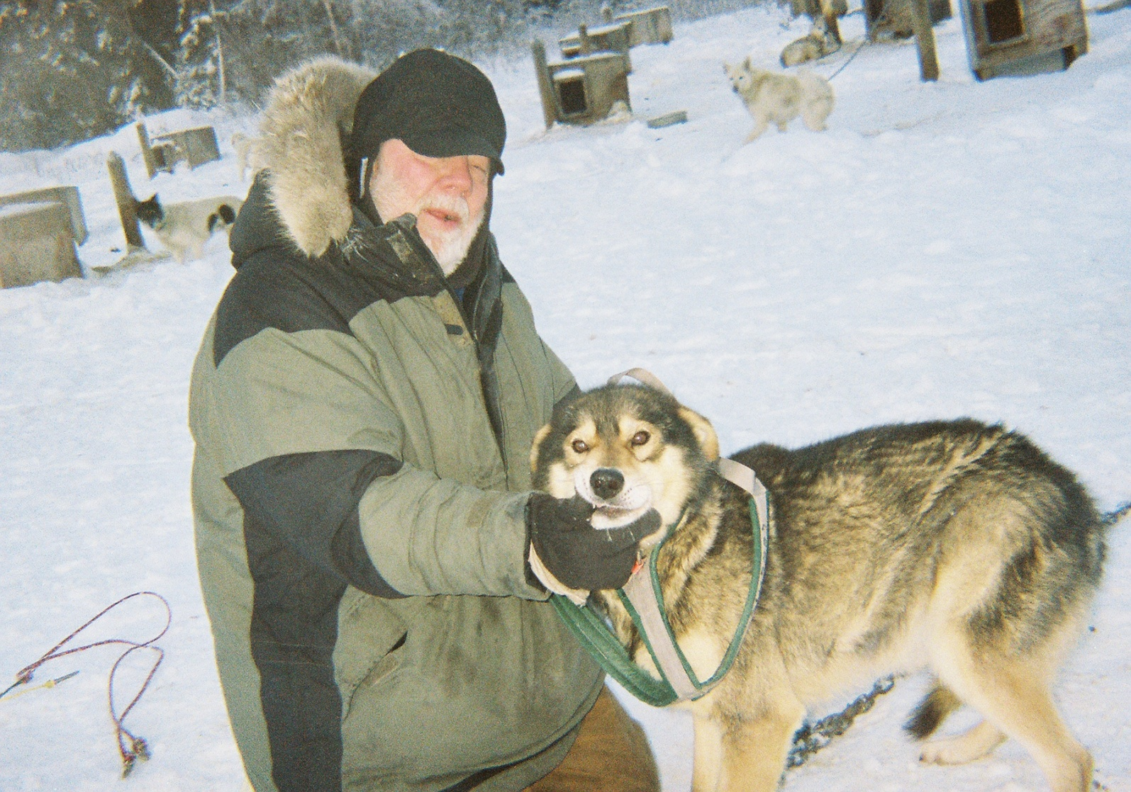
“And a lot more!!”

Slide 45
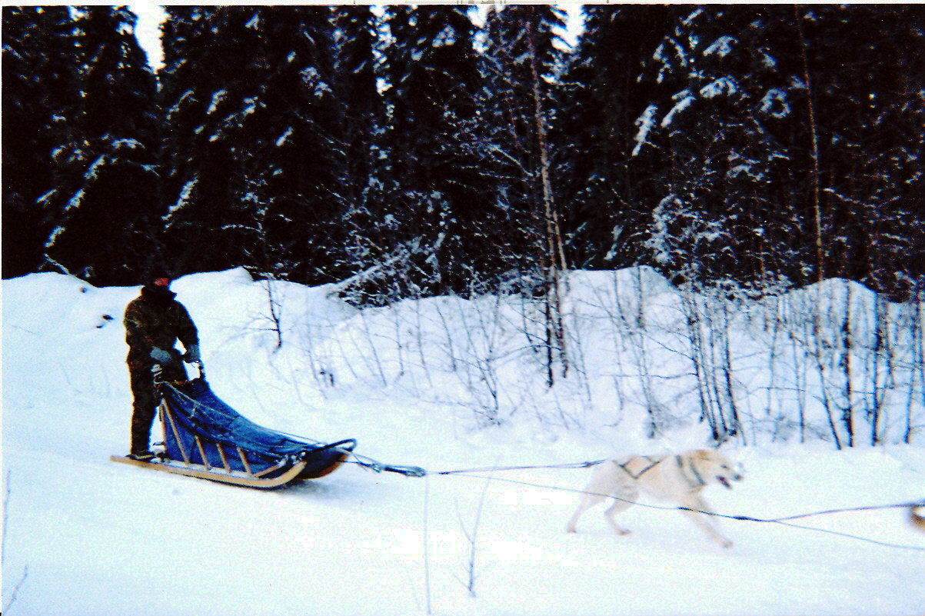
And I know that for a fact!

Slide 46
ENG 471 Adolescent Literature
August 27, 2013
Opening Poem: “Letter to a Playground Bully, from Andrea, Age 8,” by Andrea Gibson
Book Recommendations: No More Dead Dogs, Gordon Korman; Wake, Lisa McMann
Reading Lists
Syllabus Quiz
“Who’s Afraid of Virgina (Euwer) Wolf?: Choosing and Using Young Adult Literature”
Reader response theory
Literature Circles

Slide 47
As you listen to the poem, try to catch the “My mother says” moments.

Slide 48
For attendance today, make up your own “My mother says”

Slide 49
My mother says one day someone special will fall in love with me who appreciates how wonderful I am.

Slide 50
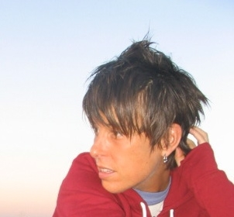
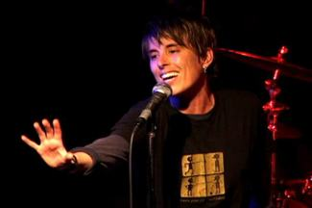
“Letter to a Playground Bully from Andrea, age 8”
http://www.youtube.com/watch?v=wsCFQlinZuE

Slide 51
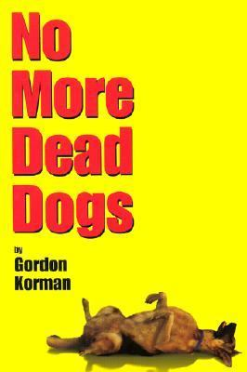
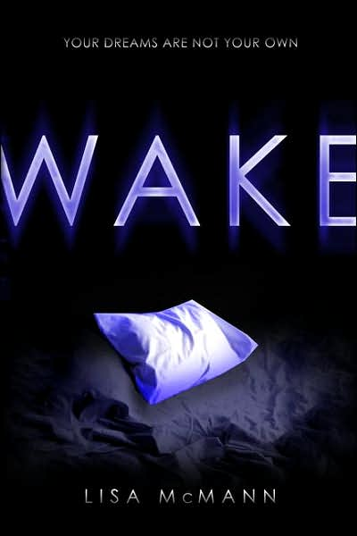


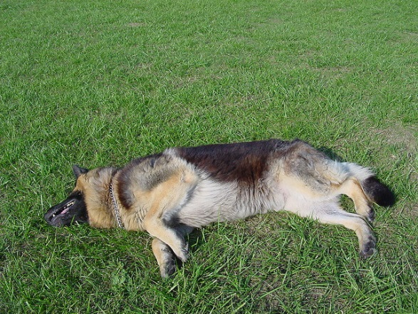

Slide 52
http://www.changinghands.com/event/young-aug13
Teen Event | Suzanne Young
Just Like Fate
Start: 08/27/2013 7:00 pm
7PM TUESDAY, AUGUST 27
Suzanne Young: Just Like Fate
Three (3) Extra Credit Points

Slide 53
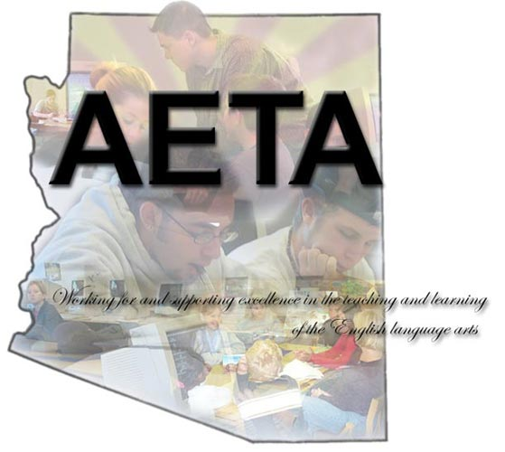
Arizona English Teachers Association (AETA) Conference
Arizona State University Polytechnic: September 27‐28, 2013

Slide 54

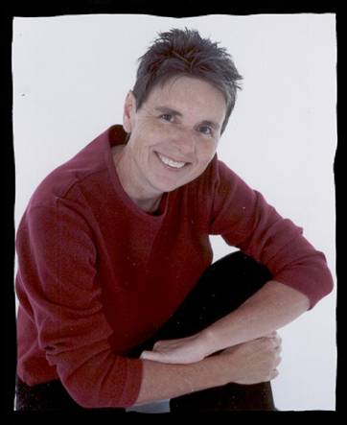
Seventeen-year-old Alyssa thought she knew who she was. She had her family and her best friends and, most important, she had Sarah. Sarah, her girlfriend, with whom she dreamed about the day they could move far away and live out and proud and accepted for themselves, instead of having to hide their relationship.
Alyssa never thought she would have to make that move by herself. But disowned by her father and cut off from everyone she loves, she is forced to move hundreds of miles away to live with Carly, the biological mother she barely knows, in a town where everyone immediately dismisses her as "Carly's girl." As Alyssa struggles to forget her past and come to terms with her future, will she be able to build a new life for herself and believe in love again? Or will she be forced to relive the mistakes that have cost her everything and everyone she cared about?
National Book Award finalist Julie Anne Peters has written a compelling novel about coming out, finding love, and discovering your place in the world. Alyssa's story will speak to anyone who has known the joy and pain of first love and the struggle to start over again.

Slide 55
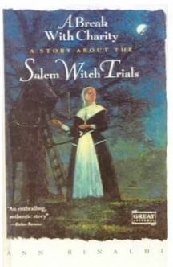
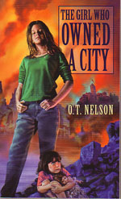
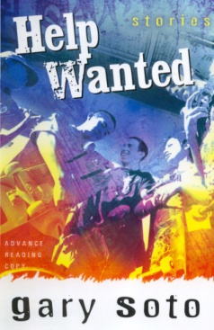
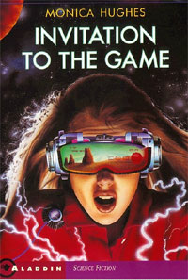
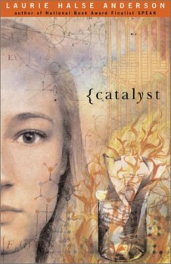

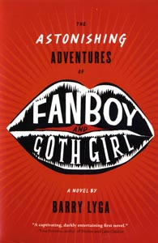

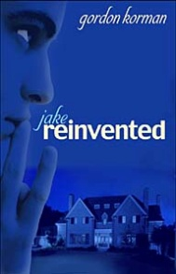


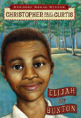





Webquests!!
http://www.public.asu.edu/~jblasin/yalit/index.html
An online teaching and learning tool
http://www.asuwintergirls.com/

Slide 56

http://vhss.oddcast.com/vhssplayer.php?acc=3818225&ss=2327613&sl=0&l=0&h=300&w=400&bc=FFFFFF&mid=119884&t=1

Slide 57

Reading Lists

Slide 58
READING LISTS
Citation: Author’s last name, first name. Title. Publisher. Copyright date. Number of pages.
Genre: In your total of 21 books of your choice (not counting your required books—LTYA, BTDBE, Holes, and The Giver), I recommend, but do not require, that you include one romance, one science fiction, one mystery, one fantasy, one adventure, one historical fiction, one humorous book, one landmark book (something from the 1960’s or early 1970’s), one book that deals with a dysfunctional family, one Newbery Medal book, one Honor List book, one biography (can be fictionalized), two books with 2005-2006 copyright dates. This is to ensure that you get an idea of what is out there for young readers. Many books could easily be categorized in more than one category. Book reviews done for the Journal of Adolescent and Adult Literacy count-send them to Dr. B individually by email but also add them into your reading list.

Slide 59
Summary and analysis: Without giving away the ending, summarize the plot and characters in about two paragraphs. It is OK to be creative and write it like a movie review. It is also OK to give your personal opinion of how it good it is and why at the end, remembering that the book is not written for adults. Your summary and analysis should be between 200 and 300 words.
Teaching ideas: Explain why you think this book would be worthwhile for students to read and at what age. Explain why it would be a best as an individual read or a whole class read. List possible thematic units that it could fit. Describe activities that would work well in coordination with this book, such as literature circles, reader response activities, and character analysis paper. I have placed a 100 page book chapter (deleted from my young adult literature book by Scholastic) on our MyASU site entitled “Theories, Strategies and Activities,” and you can go there for teaching ideas, too.
Length: My example here of Earl Fleck’s novel, Canoe Country, is about 450 words, or one and a half pages in 12 point font, double-spaced. That’s about the right length, but you can surely go longer if you want to.

Slide 60



Slide 61

“You should tell your friends and teacher about a book called,
GUTS:
The True Stories behind Hatchet and the Brian Robeson Books”

Slide 62

There are so many great books and great authors out there, mountains of books that young readers would love if they only knew about them.
A little help is just needed sometimes in finding the best books for kids and providing a little background about the topic and author to help.

Slide 63

What are the hallmarks of the very best in literature for adolescents? Perhaps a better way to ask the question would be: What kind of books do young adults need in their lives?
What kinds of books appeal to kids?
What kinds of books reflect the reality of their world?
What teaching activities used with which books will lead to what Arthur Applebee has called “complex literacy tasks”?
What questions should be asked when considering a book for use in class or even just for an independent reading recommendation?

Slide 64


What genres are available?
Who are the some of the best authors and best publishers of young adult books?

Slide 65




http://www.thelesserblessed.com/

Slide 66

What is young adult literature?
According to a past president of the Assembly on Literature for Adolescents and editor of Scarecrow Press, Patty Campbell, “The central theme of most YA literature is becoming an adult, finding the answer to ‘Who am I and what am I going to do about it?’ No matter what events are going on in the book, accomplishing that task is really what the book is about, and in the climactic moment the resolution of the external conflict is linked to a realization for the protagonist that helps shape an adult identity” (3)

Slide 67

Literature for Today’s Young Adults identifies these characteristics as present in good YA literature:
Told through the eyes of young person
Adults on the periphery only
Fast-paced
Includes a variety of genres (mystery, science fiction, biography, poetry, etc.)
Represents all the various ways of being a human being (gender, cultural group and so on)
Characters face challenges and experience growth
Deals with issues important to young people (and respectfully so)

Slide 68
ENG 471/540
I. Opening Poem: “Carbon Copy,” by Joshua Bennett
II. Book Recommendations: The Shadow Children Series, by Margaret Peterson Haddix, The Lightning Thief, by Rick Riordan
IV. Literature Circle Preparation
V. Webquests
VI. History of YAL

Slide 69
For attendance today answer this question:
  Is there anyone in your life, you would like to say you are a carbon copy of?

Slide 70


http://www.hbo.com/russell-simmons-presents-brave-new-voices/cast-and-crew/team-philadelphia/video/josh-bennett.html

Slide 71


The Shadow Children
Series
Among the Hidden
Among the imposters
Among the betrayed
Among the barons
Among the brave
Among the enemy
Among the free

Slide 72



Percy Jackson
and the
Young Olympians
1. The Lightning thief
The sea of monsters
The titan’s curse
The battle of the labyrinth
The last Olympian

Slide 73

http://www.changinghands.com/event/young-aug13
Teen Event | Suzanne Young
Just Like Fate
Start: 08/27/2013 7:00 pm
7PM TUESDAY, AUGUST 27
Suzanne Young: Just Like Fate
Three (3) Extra Credit Points

Slide 75
http://vhss.oddcast.com/vhssplayer.php?acc=3818225&ss=2327613&sl=0&l=0&h=300&w=400&bc=FFFFFF&mid=119884&t=1

Slide 76
Webquests!!
http://www.public.asu.edu/~jblasin/yalit/index.html
Plot summary, (2) author bio, (3) links,
(4) writing activities & grading rubric
WWW.ASUwintergirls.com

Slide 77
Literature Circles!!
Hurray!
Create a group of six and introduce yourselves.

Slide 78

What characteristics does YA lit have that adult lit might not?
According to Patty Campbell:
  grabs kids by their short attentions spans from paragraph one and never lets go
  economy of words
  taut structure
  conclusion that matters
  “subtlety of expression, richness of character development and setting, intricacy of voice and plot, integrity of moral thought” must be done “without losing this necessary spareness” (4)
  And that’s not an easy task for a writer.

Slide 79

YA literature is transitional literature that bridges the gap between children’s literature and adult literature, between children’s reading skills and adult reading skills, and between children’s experiences and adult experiences.

Slide 80

Reader Response Theory
An old philosophy conundrum asks: “If a tree falls in the woods and no one is there to hear it, does it make a noise?”

Slide 81

If a writer writes a novel or poet writes a poem and no one reads it, does it still make a statement?

Slide 82



The proponents of reader-response theory came along and voiced a resounding,
“No!”
!”
Without a reader, a text is nothing more than marks on a page.

Slide 83

Rosenblatt rejected the idea (begun by the New Critics in the 1960s) that a text (book, poem, whatever the written document) has one universal (true) meaning and that his meaning resides within the text itself, independent of the author’s intention or the author’s cultural bias or the reader’s interpretation.

Slide 84

Rosenblatt said that when a text and a reader come together, something is created that never existed before because every reader is a unique individual and at a unique point in life.

Slide 85

“The reader brings to the work personality traits, memories of past events, present needs and preoccupations, a particular mood of the moment, and a particular physical condition. These and many other elements in a never-to-be-duplicated
combination determine
his response to the
peculiar contribution
of the text.”
(30-31)

Slide 86

According to Rosenblatt, a reader is required and that reader participates in a “transaction” with the writer’s text in which the meaning is arrived at. Rosenblatt’s theory is also called Transactional Theory because it is in the transaction between the reader and the text in which meaning is made.

Slide 87


Slide 88

In his influential work Adolescent Literature: Response and Analysis (Merrill, 1984), Robert Probst says, “When literature is read, rather than worked upon, it draws us into events and invites us to reflect upon our perceptions of them. [. . .] . Literature [. . .] allows us both to experience and to reflect upon experience, and thus invites the self indulgence of those who seek to understand themselves and the world around them” (4).

Slide 89

Probst sets forth five necessities for teaching literature with a reader-response approach (24-27):

Slide 90

Receptivity: Students must recognize the classroom as an environment where their ideas are valued and welcomed.

Slide 91
Tentativeness: Students must feel that they are not expected to be “right,” and should express their ideas even when the ideas are only initial ones and may change as the reading or discussion goes forth.
“If you never change your mind, why have one?”
“Argument is meant to reveal the truth, not to create it.”
  Edward de Bono (1933-present)
“If you do not change direction, you may end up where you are heading.”
  Lao Tzu (600-531 BC)

Slide 92

Rigor: Students must be challenged to dig deeply into their own experiences, examine their own beliefs and define their own interaction with the text. And they must find ambiguity acceptable.

Slide 93

Cooperation: Students must understand the art of interacting in a group.

Slide 94

Suitable Literature: Books need to have adequate “substance—ideas, style, language, attitude, whatever—worthy of reflection” (27).

Slide 95
In the coming days we’ll delve deeper into this topic, including Arthur Applebee’s study of nearly 1,000 students in many different schools to explore what instructional approaches most often result in “high literacy acts.”

Slide 96
See you Tuesday!

Slide 97
ENG 471
Opening Poem: “Beneath Two Skies,” by Myrlin Hepworth (Friday night at AETA)
Book Recommendations: Wonder, by R.J. Palacio; The Perks of Being a Wallflower, by Stephen Chobsky
History of Young Adult Literature

Slide 98

http://www.youtube.com/watch?v=ncp6KgiJO3A
For attendance: How many skies do you live under? What are they?

Slide 99
Registration forms for presenters!!

Slide 100


Wonder
By: R.J. Palacio
"I won't describe what I look like. Whatever you're thinking, it's probably worse.” ~August Pullman
Auggie Pullman was born with a severe facial deformities. He has beat many odds and continued to live, longer than initially expected. He is a miracle, a wonder.
Much of his spent his life undergoing operations to help him live more comfortably and being homeschooled. Now, Auggie will enter school for the first time, facing many of his
greatest fears.
A story of growth
and pain, packed with
love and hope.
http://rjpalacio.com/index.html

Slide 101


The Perks of Being a Wallflower
By: Stephen Chbosky
We. Are. Infinite.

Slide 102

http://jenncooksey.blogspot.com/

Slide 103
Literature Circles!!
Hurray!
Complete roles/forms for pages 1-58 for Thursday’s discussion in your group.

Slide 104
Dr. Ice says, “Nicknames are cool!” Watch for how things are changing when Stanley gets his very first nickname.

Slide 105

Let’s consider what young adult readers need to keep them reading and engaging with what they read.
1. Young adults need books with characters and situations they can relate to.
2. Young adults need books that treat the issues that adolescents face respectfully.
3. Young adults need books that are accessible to them.
4. Young adults need books that reflect the diversity of their world.
5. Young adults need books that help them to make sense of their own lives.

Slide 106

LTYA identifies stages in literary appreciation and at what level they most often happen:
Upper elementary: losing oneself in books
Middle school: finding oneself in books
High school: venturing beyond self
College: reading widely
Adulthood: Aesthetic appreciation

Slide 107

Where did it come from?

Slide 108

Name and date
Guess why Tarzan of the Apes was banned in Los Angeles in 1929

Slide 109
Early ancestors of what we now call adolescent or young adult literature include the dime novel.
Dime novels were often set in the West or in the past but on the frontier (no longer the frontier at that time)
Malaeska: Indian Wife of the White Hunter (1860)
Seth Jones, or The Captives of the Frontier (1860)
Why did the price drop to a nickel?

Slide 110
Dime novels about the West had stock characters and archetypal plots, as did what is called the domestic novel.
A young (usually orphaned) girl as protagonist
She is sent off to live with a (sometimes mysterious) relative.
She ultimately succeeds through strength of character, submission to authority (of men?).
She may tame a dark, handsome, stranger with an unsavory past.
Traditional virtues (and stereotypes?) are reinforced through the plot and characterization.
The Wide, Wide World (1850)
St. Elmo (1867)

Slide 111


Can you see the vestiges of any of these characteristics in a very popular young adult novel today?
A young (usually orphaned) girl as protagonist
She is sent off to live with a (sometimes mysterious) relative.
She ultimately succeeds through strength of character, submission to authority (of men?).
She may tame a dark, handsome, stranger with an unsavory past.
Traditional virtues (and stereotypes?) are reinforced through the plot and characterization.

Slide 112

Two authors who had great success in the 1860’s and beyond were Louis May Alcott and Horatio Alger.
Alcott is best known for Little Women (1868), which is still popular today. Ken Donelson describes this book as “harsh but honest.”
Alger is best known for Ragged Dick, or Street Life in New York (1867), which is not often read today except by scholars. The protagonist, Dick, is from the lower class but rises in what has come to be known as a “rags to riches” story.

Slide 113
Can you think of any pop culture descendent of Little Women?
A group of women who each represent a different archetype?
Maybe there was a television show, maybe a movie,

Slide 114

Or two?

Slide 115


Slide 116
Some things happened in the 1870’s to increase the accessibility of books to everyone.
W.M. Stevenson claimed that libraries were educational institutions and not for the general public’s use and certainly not for its entertainment. That would be socialistic, he said.
William Poole claimed that it wasn’t right to tax people for a library if the books there weren’t for everyone.

Slide 117
The series phenomenon from the late 1800’s and into the 20th Century is perhaps most associated with Edward Stratemeyer
If a book was successful, why not publish sequels?
And if a series became successful, why not outline the basic plots and send them off to be fully developed by journeyman writers (like a factory, almost)?

Slide 118
Richard Dare’s Venture, or Striking Out for Himself (1894) became the Bound to Succeed series.
Under Dewey at Manila, or the War Fortunes of a Castaway (1898) became the the Old Glory series.
The Stratemeyer Syndicate was taken over by his daughters in 1930 and still exists today.
The literary quality of the books was often attacked an by reputable organizations and persons, but the sales of popular series seemed unharmed.

Slide 119
In general these series books were recognized as being recreational reading and not having much depth.
They were also very moral (as defined in that time), holding traditional values and nothing objectionable.
They may, however, have reinforced cultural flaws and stereotypes of the time through the assumptions that plots often made. Such as?
Are there any series books today of which you question the literary value?

Slide 120

As the century turns (1800-1900), educational reform (No, it didn’t just start recently) targeted what kids were/should read.
The Committee of Ten on Secondary Schools said that English should be a separate class that meets every day.
Universities created a list of reading that would be reflected on their entrance exams. Which author from this list do you suspect was not on chosen?
  Shakespeare
  Milton
  Sir Walter Scott
  Gordon Korman

Slide 121
Wait a minute!
In 1911 Wilbur Hatfield (Illinois Association of Teachers of English), said that if the schools only use “old books,” the students will have no knowledge of modern literature, and that’s what they will often be choosing as adults.
James Fleming Hosic (Reorganization of English in Secondary Schools 1917). Teachers should include some literature in which kids will see themselves. Teachers need to make reading “an unfailing resource and joy in the lives of all.”

Slide 122




OOOH! DID THAT CREATE A BACKLASH??!!!
1926 Winnetka Graded Book List. No books that are “trashy or unsuitable for children” such as anything by Zane Grey.

Slide 123
Name and date
Guess why Tarzan of the Apes was banned in Los Angeles in 1929
Hand in on your way out.

Slide 124


Tarzan and Jane lived together outside the bonds of holy matrimony!

Slide 125
And counter arguments:
Professor William Lyon Phelps counters that teachers who disapproved of these kinds of books didn’t begin by reading the classics but by reading books that were aimed at young people.
He called it “The delight of reading. Once a taste for reading is formed, it can be improved.” But if kids never enjoyed anything they read, he doubted they would move on to “stories by good artists later.”

Slide 126

Dora Smith (University of Minnesota 1928-1958) was probably the first professor who separated out YA lit and began its legitimization as a genre.

Slide 127
http://vhss.oddcast.com/vhssplayer.php?acc=3818225&ss=2328684&sl=0&l=0&h=450&w=600&bc=Transparent&mid=119908&t=1

Slide 128
1946, right after WWII---
George W. Norvell study:
Let students choose some of their reading
Try to increase interest in reading
Try to create a reading habit
Too much of what students read in school was beyond their ability to understand or enjoy.
    Too mature
    Too subtle
    Too erudite

Slide 129
What were kids reading right after WWII?
Hotrod
The Black Stallion
Seventeenth Summer
Double Date

Slide 130

Robert Carlsen (University of Iowa), into the 1960’s and beyond.
Young people’s reading interests are largely tied in to their developmental process, and in adolescence they read “to reassure themselves about their normality and their status as human beings.”

Slide 131
“With the developing of their personalities through adolescence, they come to a partially integrated picture of themselves as human beings. They want to test this picture of themselves in the many roles that it is possible for a human being to play and through testing to see what roles they may fit into and what roles are uncongenial.” (69)

Slide 132

Up until the 1960’s certain topics were taboo in YA lit:
obscenity
suicide
sexuality
homosexuality
protests against anything
  significant
social or racial injustice
Or as bad examples:
pregnancy
early marriage
drugs, smoking, alcohol
divorce
school dropouts

Slide 133

In 1967
And then in her senior year at Will Rogers High School in Tulsa, Oklahoma, Susan Eloise Hinton wrote a book inspired by two rival gangs at her school, and some of the most famous characters in literature were born, Ponyboy Curtis, Johnny, Sodapop, and Cherry Valance, to name a few. This book even had teen on teen violence and homicide.

Slide 134

Also in 1967
Putnam published the story of a high school football star, Bo Jo Jones, and his girlfriend, July, who become parents after things go farther than planned on the night of the prom.

Slide 135

Sports writer Robert Lipsyte added The Contender in 1967.
Alfred Brooks is on the verge of drug addiction and possible incarceration when he takes up boxing. Will he survive and rise above the problems of life on the streets of New York City?

Slide 136
See you on Thursday.

Slide 137
ENG 471/540
I. Opening Poem: “Television,” by Todd Alcott.
II. Book Recommendations:
III. AETA Webquest group
IV. Literature Circles (pages 1-58)
V. For Tuesday: Holes lit. circles 59-119 and be ready with new roles

Slide 138
For today’s attendance, answer this question:
What role do you think television plays in a teenager’s life? You can choose any teenager, from any walk of life.

Slide 139

Look at me. Look at me. Look at me, look at me, look at me. Look at me. No no no, don't look over there, there's nothing to look at over there, look at me, look at me, look at me.
Are you looking at me? Is everybody looking at me? Do I have your attention? Good.

Slide 140
Don't get the wrong idea. I'm not trying to take
over your life. You need, what? What do you
need? You need to, what? Go to the bathroom?
Fine. Get up, go to the bathroom, come
back, look at me. You need, what? You need
to get something to eat? Fine. Get up, go to
the kitchen, get something to eat, come back,
look at me. You need to, what, sleep? Fine,
get up, go to bed, go to sleep, get up, come
back, look at me.

Slide 141
Okay. So we have an agreement. You will do what
you absolutely need to do, and when you're
done, you will come back and look at me.

Slide 142
Don't worry about your schedule. I am here for
you. I am here for you. Twenty-four hours a
day, seven days a week, I am here for you.
I am here for you. You need me, I'm here. Fair
and foul, thick and thin, I am here for you. I
am here for you. People try to tell you I'm
bad? You tell them that I am here for you.
Twenty-four hours a day, fair and foul, thick
and thin, I am here for you. I am here for you.
People try to tell you I'm bad, know what it
sounds like to me?

Slide 143
Sour grapes.

Slide 144
You see what I- hey, hey, hey, hey, hey, no, don't
look over there, there's nothing going on over
there, look at me, look at me, look at me.

Slide 145

I've got stuff you wouldn't believe. Danger? Sex?
Action? Death? Thrills? Comedy? All here,
all in the next eight minutes.

Slide 146

Can you believe it? You can't. It's unbelievable.
You can't believe it because it’s unbelievable!
It's a miracle.

Slide 147

SO
Just keep looking at me. Just keep looking at me.
Just keep looking at me. Look at me, look at
me, look al me, look at me, look at me.

Slide 148


The Skin I’m In
By: Sharon Flake
Maleeka is constantly taunted because of her dark skin and homemade clothes. She has a group of “friends” who use her and treat her like garbage, but it is better than being alone.
In step, Miss Saunders,
a new teacher, despite a
a large birthmark on
her face, loves the
skin she in. She sees
Maleeka and all her
gifts and talents,
her to overcome
negative image she
has
of herself.
http://www.sharongflake.com/bio/

Slide 149


Local News
By: Gary Soto
Thirteen stories about growing up told
from a teenager’s point of view.
Written with humor, wit, and honesty
only the way Gary can write them.

Slide 150




Following our students in their reading journey…

Slide 151

Step one: Read the book
Step two: peruse www.asuwintergirls.com
Step three: Meet as a group and divide up responsibilities
Step four: show to Dr. B
Step Five: Premier presentation to the class
Step Six: be superstars at AETA

Slide 152

http://www.asuwintergirls.com

Slide 153
www.Yalittech.com http://www.yalittech.com/illuminated-texts.html

Slide 154


Slide 155


Slide 156
Literature Circles!!
Hurray! 1-58
Choose roles for pages 59-119 for tomorrow.

Slide 157
See you on Tuesday!!

Slide 158
ENG 471
9/10/2013
Opening Poem: “Love Letter to Albuquerque Schools,” by Miguel Figueroa, Reed Bobroff, Olivia Gatwood, and Khalid Binsunni
Book Recommendations: Flight, by Sherman Alexie; The Circuit, Reaching Through, Breaking Out, La Mariposa, and The Christmas Gift, by Francisco Jiménez
Literature Circles 59-119 (and prepare for 120-181)
Dialogic Approach to Literacy Instruction from Arthur Applebee and Team
Reader Response Journals from Linda Berger

Slide 159
For today’s attendance:
Number one to three
One: List one of the complaints of the Albuquerque students
Two:
Three:

Slide 160

http://www.youtube.com/watch?v=z4A6e8Rk8Oo

Slide 161


The Circuit
By:
Francisco Jimenez
http://www.teachingbooks.net/author_collection.cgi?id=27&a=1
“La frontera” …I heard it for the first time back in the late 1940s when Papa and Mama told me and Roberto, my older brother, that someday we would take a long trip north, cross la frontera, enter California and leave our poverty behind” (1).

Slide 162




Follow Francisco’s
inspiring journey…
**Also available in Spanish

Slide 163


Flight
By:
Sherman Alexie

Slide 164
Literature Circles!! Hurray! Pages 59-119
Decide on new roles for next reading (120-181). Hand in role sheets to discussion leader.

Slide 165
Rachel Dominy, Elizabeth Holden, Shannon Murray, Kelsey Zubikoff, Elizabeth Monnig, Bonnie Miller.
Registration forms for presenters!!

Slide 166

Edward Applebee’s
“Dialogic Approach”
For Thursday, be ready to answer this question and give three details in support:
How should teachers approach literature study instead of the “I-R-E” approach?

Slide 167
http://vhss.oddcast.com/vhssplayer.php?acc=3818225&ss=2329720&sl=0&l=0&h=300&w=400&bc=FFFFFF&mid=119934&t=1

Slide 168

As Linda Berger points out in “Reader Response Journals: You Make the Meaning … and How,” (Journal of Adolescent and Adult Literacy 39.5: 380-385)
Asking students to respond to literature with no guided instruction or modeling, can have disappointing results. The same thing is true of asking students to respond to other students’ writing (or their own).

Slide 169

Although we do want to teach our students how to make meaning of their reading, we must provide appropriate scaffolding to enable them to do develop skills of responding and interpreting.

Slide 170

Linda Berger arrived at a set of questions designed to help students respond with their own ideas.
1. What do you notice?
2. What do you question?
3. What do you feel?
4. What do you relate to?

Slide 171
And she gave them some examples:
What do you notice: Do you notice any changes in the personality of your protagonist or antagonist? Do you notice any emphasis on an object or minor character that might later be important? Do you notice any repeating patterns in the book? Do you notice the significance of the title in the chapter you’re reading? Is there anything unusual about the book’s beginning or ending?

Slide 172
What do you question: Do you question any of the decisions made by the protagonist or other character? Do you wonder what a certain passage might mean? Do you question whether or not the author realistically presented a certain part of the book? Do you question if something that happened in the author’s life might have influenced the writing of this novel?

Slide 173
What do you feel: Does any part of the book make you feel scared, annoyed, sad, frustrated, happy, or horrified? Which part and why? Do you feel differently about a character or situation in the novel than you did earlier? Why have your feelings changed? Do you want to read another novel by this author? Why or why not?

Slide 174
What do you relate to: Does anything in the book remind you of something from your own experience, or a movie, or television, or another book? Tell about the similarities an differences.

Slide 175
See You Thursday!

Slide 176
ENG 471
9/12/2013
Opening Poem: “Touchscreen,” by
Marshall Davis Jones
II. Book Recommendations: Party, by Tom
Leveen; Heir Apparent, by Vivian Vande Velde (Chrystina Ball);
III. Holes Literature Circles (120-181)
IV. The New Realism
V.

Slide 177

“Touchscreen” http://www.youtube.com/watch?v=GAx845QaOck
Marshall Jones make a number of rapid-fire arguments for turning away from social media. Let’s try making a few notes to ourselves about this poem using Linda Berger’s reader response questions: 1. What do you notice? 2. What do you question? 3. What do you feel? 4. What do you relate to? We will start our lit circle group with a voluntary sharing of your responses to the poem. See how well you can interact as a group.

Slide 178


Party
By: Tom Leveen
“SAY WORDS”

Slide 179


“I asked, “You mean like”– I paused to remember--- “ ‘Listen, my children and you shall hear / Of the midnight ride of Paul Revere’?”
“Cute,” She said, “though a bit short”
“No, that wasn’t the whole thing.” I started panicking because I didn’t know the whole thing. I’d just said all I remembered. Did I know any poem in its entirety?
No matter, for she said, “But it has to be a poem of your own making.”
“Oh,” I said. How hard could that be?
“Of course,” Feordina said, “if Saint Bruce doesn’t like your poem, he chops your head off.”

Slide 180
Literature Circles!! Hurray! Pages 120-181)
Decide on new roles for next reading (182-233).

Slide 181
Rachel Dominy, Elizabeth Holden, Shannon Murray, Kelsey Zubikoff, Elizabeth Monnig, Bonnie Miller.
Registration forms for presenters!!

Slide 182
The New Realism in Young Adult Literature
With the explosion in young adult literature that happened in the late sixties, a new genre evolved that was different from the coming-of-age or initiation story common in British and American literature.

Slide 183
This “New Realism” involved much more realistic conflict, characters and settings.
Characters were more like real people.
  Could come from any walk of life.
  Were not all good or all bad.
Settings were more familiar to readers.
Language more closely resembled that of the real world.
Protagonists didn’t automatically live happily ever after.

Slide 184
Young readers were perceived with a new respect for their maturity and intelligence.
Young readers could handle seeing the world portrayed with all its ugliness unhidden.
Young people would be better equipped to live in the real world if they had realistic expectations.

Slide 185
The protagonist was easier for readers to identify with.
Not a superstar.
Not blessed with amazing talent.
Not especially lucky.
Sometimes even an antihero type.

Slide 186

In fact, a sort of comfort could come from following a protagonist for whom the world was not a bowl of cherries.

Slide 187
The reader experiences the protagonist’s thoughts and feelings almost as if they were his/her own.
As the main character moves through the conflict, the reader lives vicariously through him/her without actual risk.
Seeing the protagonist struggle may help the reader to feel less hopeless about his/her own problems.
The reader may even gain insights into the real world from approaches the main character uses (or fails to use).

Slide 189


Slide 190


Slide 191

Teen Event | Openly YA Tour | David Levithan, Aaron Hartzler, and Bill Konigsberg
Start: 09/15/2013 2:00 pm
2PM SUNDAY, SEPTEMBER 15
Openly YA Tour: David Levithan, Aaron Hartzler, and Bill Konigsberg
Three authors visit Changing Hands to present the story of a record-breaking gay kiss, a memoir of growing up evangelically, and a tale of what happens when you go back in the closet.

Slide 192

Robert Cormier’s The Chocolate War is a good example.

Slide 193

Jerry Renault,
the main character, is no one special, just an average kid (although he goes to a parochial school).

Slide 194
The school is an inhospitable place where the strong (Brother Leon, the chocolate sales sponsor; and Archie Costello, the leader of the Vigils quasi-gang) control everyone.

Slide 195
About the only way that Jerry can really win is by not cooperating with either power center, but right will hardly triumph at Trinity School.

Slide 196
Some other aspects of the realistic/problem novel that help make it a step forward in the evolution of YA lit (and probably more popular with young readers):
Authentic sounding dialogue.
The presence of a theme but not a preachy moral.
The absence of predictability.
A realistic problem(s), often one that many teens experience.
Something true to say about life, the world or society.

Slide 197
The realistic/problem novel admits that life for young people is not carefree as previously portrayed but rather involves some serious issues.
Sex
Substance abuse
Physical/sexual abuse
Dysfunctional families
Peer pressure
Psychological and physical health
New and previously unheard of problems

Slide 198
Sylvia Plath (The Bell Jar) may have been the first, but regardless of which book began it, the realistic problem novel did not turn away from mental problems, whether of internal, external or a combination of causes.
Protagonists in juvenile detention centers exploring their past with counselor/therapists
Victims of abuse trapped in self-destructive behaviors

Slide 199
Violence was no longer off limits.
Violence in the streets
Violence in school
Domestic violence
Teen on teen violence
Many young people live with violence in many forms as an every day part of their lives.

Slide 200
The issue of self acceptance could be front and center in a novel.
Acceptance/love of physical self
Acceptance/love of cultural and ethnic heritage
Acceptance of a less than pleasant life history
Acceptance/love of gender identity
And all that comes with self worth.

Slide 201
In fact, the modern realistic/problem novel enabled the reader to embrace or celebrate many issues that were previously ignored.

Slide 202
http://vhss.oddcast.com/vhssplayer.php?acc=3818225&ss=2330025&sl=0&l=0&h=300&w=400&bc=FFFFFF&mid=119951&t=1

Slide 203
ENG 471
September 17, 2013
Opening Poem: “Richie Valens (Valenzuela),” by Myrlin Hepworth
Book Recommendations: The Pigman, by Paul Zindel; Hole in My Life, Rotten Ralph, Joey Pigza Swallowed the Key, Jack’s Black Book, by Jack Gantos
Literature Circles, final pages
Dialogic Approach (Arthur Applebee)

Slide 204

http://www.youtube.com/watch?v=AvVulbbm85s&feature=relmfu

Slide 205

http://www.youtube.com/watch?v=Jp6j5HJ-Cok

Slide 206



Slide 207




Jack Gantos
Following Young Readers…
Hole In My Life

Slide 208


Teen Event | Suzanne Lazear | Charmed Vengeance
Start: 09/21/2013 4:00 pm
4PM SATURDAY, SEPTEMBER 21
Suzanne Lazear: Charmed Vengeance

Slide 209
Literature Circles!! Hurray! Pages 182-233

Slide 210
Edward Applebee’s
“Dialogic Approach”
For attendance today, answer this question and give three details in support:
How should teachers approach literature study instead of the “I-R-E” (intiation , response, evaluation) approach?

Slide 211
Arthur N. Applebee; Judith A. Langer; Martin Nystrand; Adam Gamoran, 2003
California, New York, Florida, Texas, Wisconsin
19 schools
1412 students
Middle and high school
Across de facto tracking
In addition to “high academic demands”
  Hours of homework
  Complexity of writing tasks
    “Level of abstraction”
    “Level of elaboration”

Slide 212
“The results converge to suggest that comprehension of difficult text can be significantly enhanced by replacing traditional I-R-E patterns of instruction with discussion-based activities in which students are invited to make predictions, summarize, link texts with one another and with background knowledge, generate and answer text-related questions, clarify understanding, muster relevant evidence to support an interpretation, and interrelate reading, writing, and discussion.”
(693)

Slide 213
In classrooms in which students rose to “high literacy acts”
Students were allowed room to develop their own understandings in reading and writing activities;
Students spent class time in purposeful conversation with peers and teachers;
Students were encouraged verbally or through modeling to take a position, express opinions, or explore personal reactions;
Students asked questions that showed comprehension;
Students asked questions that showed evaluation or analysis;
Students were allowed to shift discussions in a new direction;
The teacher encouraged students to use others' questions and comments to build discussion;
Students actually did so;
Students responded to other students or to the teacher with challenges, comments, opinions;
Students challenged the text (e.g., by bringing in alternative points of view); and
The teachers' questions required analysis.
(701)

Slide 214

Cooperative Learning, as per
Johnson and Johnson

Slide 215
Literature Circles!! Hurray! Pages 182-233

Slide 216
See You Thursday!
At the bottom of the steps of Old Main at 1:30

Slide 217
Lets’ take a moment to reflect and write about our thouhts and feelings about this poem.
You can write any kind of response, but you might try one of these:
1. What did you notice?
2. What did you relate to?
3. What did you question?
4. What came to mind?

Slide 218
ENG 471/540
September 19, 2013
Opening Poem: “Oranges,” by Gary Soto, from A Fire in My Hands
Book Recommendations: Bud, not Buddy, by Christopher Paul Curtis; and A Fire in My Hands, by Gary Soto
A letter to the past

Slide 219


Slide 220





Slide 221
Take a moment to
Write a letter to the past. (about a page)
You are either Stanley Yelnats writing back to his “yada yada yada great, great, great, grandfather,”
Or you are the warden writing to her dad.
Tell how things turned out and how you feel about it.

Slide 222
ENG 471
9/24/2013
Opening Poem: “Jupiter Booger Love,” by Myrlin Hepworth (has the mf word in it)
Book Recommendations: Confetti Girl, by Diana López; The Medusa Project: The Set Up, by Sophie McKenzie
Zombie Romp: Interview with Tom Leveen

Slide 223

http://vimeo.com/imaginationasu/review/75247668/aaad3d867c

Slide 224
http://www.youtube.com/watch?v=Biq2EVpJSRE&list=PL0D6205BB9F4F3D44

Slide 225


Confetti Girl
By: Diana López

Slide 226


The Medusa Project: The Set-Up
By: Sophie McKenzie

Slide 227



Medusa Project Series
Book #1: The Set-Up
Book #2: The Hostage
Book #3: The Thief
Book #4: The Rescue
Book #5: Hunted
Book #6: Double Cross
Book #7: Hit-Squad

Slide 228
ENG 471
10/8/2013
Opening Poem: “Speak with Conviction,” by Taylor Mali
Book Recommendations: Scorpions, by Walter Dean Myers; My Life and Death by Alexandra Canarse, actually by Susan Heyboer O’Keefe
Book Cover Selection for Janette Rallison
It’s Kind of a Funny Story
Censorship

Slide 229


http://www.youtube.com/watch?v=OEBZkWkkdZA http://www.youtube.com/watch?v=eHEVf6z1RoU

Slide 230





Slide 231

Hi Jim,
Did you get a chance to poll your students about this? The results are close--your class will most likely be the tie-breaker.
Thanks!
Janette Rallison
There's no escape from the future
Erasing Time by C.J. Hill
http://www.janetterallison.com/
http://janetterallison.com/category/blog/

Slide 232


One Two Three Four
  Five

Slide 233
Email message to Janette
Voting results
  1.
  2.
  4.
  5.

Slide 234

Teen Event | C.J. Hill | Friends & Traitors
Start: 10/15/2013 7:00 pm
7PM TUESDAY, OCTOBER 15
C.J. Hill: Friends & Traitors
Local author C.J. Hill hosts a launch party for her teen fantasy novel Friends and Traitors, the sequel to Slayers.
Tori thought she'd have one more summer to train as a dragon Slayer, but time has run out. The dragon eggs are hatching, and the Slayers are in trouble. In less than a year, the dragons will be fully grown and completely lethal. The Slayers are still not complete, and Tori is determined to track down Ryker—the mysterious missing Slayer. What Tori doesn't bargain for, however, is the surprising truth about her powers. How can Tori fight to save her friends when half of her is programmed to protect dragons?
ABOUT THE AUTHOR
C.J. HILL is the mother of twins. They aren't identical, but this doesn't mean she always calls them by the right name. In fact, she occasionally calls all her children by the wrong names (she has five) and has even been known to throw the dog's name into the mix. Laugh now, but you'll do the same thing when you have kids. If C.J. had a time machine and could visit another century, she would probably go to the Regency era instead of the future. According to all the novels she's read, the past was filled with a multitude of dashing lords and viscounts who were always on the lookout for damsels in distress, whereas the future is populated by scary dystopian societies.
http://www.changinghands.com/event/cjhill-oct13

Slide 235

SICK: Because High School is Full of Monsters
https://www.facebook.com/imaginationASU
http://www.statepress.com/2013/10/01/students-dress-as-zombies-for-book-launch/

Slide 236

Discussion Part 2
Prepare for Part 3 & 4

Slide 237

Censorship

Slide 238
Purely Optional
https://asunews.asu.edu/20130923-in-the-news-blasingame
http://www.washingtonpost.com/blogs/answer-sheet/wp/2013/09/23/a-plea-for-book-censors-to-stand-down/
http://voices.washingtonpost.com/answer-sheet/guest-bloggers/my-guest-is-james-blasingame.html

Slide 239




1913: United States v. Kennerly—“The rule (England: The Queen v. Hicklin-the test of obscenity is “to deprave and corrupt those whose minds are open to such immoral influences”) as laid down, however consonant with mid-Victorian morals, does not seem to me to answer to the understanding and morality of the present time, as conveyed by the words, ‘obscene, lewd, or lascivious.’ [in the future people will decide] that truth and beauty are too precious to society at large to be mutilated in the interest of those most likely to pervert them to base uses.”

Slide 240


1933: Judge John M. Woolsey Southern New York Federal District Court” a work must be judged as a whole and not on the basis of its parts (James Joyce’s Ulysses).
1934: Federal Circuit Court of Appeals upholds Woolsey’s decision.

Slide 241

1957: Butler v. Michigan: challenged state law that used the effect of a written work on children as the test for obscenity, “thus quarantining the general reading public against books not too rugged for grown men and women to shield juvenile innocence.”

Slide 242



1957: Roth v. United States: U.S. Supreme Court: “implicit in the history of the First Amendment (right to free speech) is the rejection of obscenity as utterly without redeeming social importance.” “Obscenity is material which deals with sex in a manner appealing to prurient interest [. . .]. To the average person, applying contemporary standards, the dominant themes of the material taken as a whole appeal to prurient interests.” prurient according to Webster is: “marked by or arousing an immoderate or unwholesome interest or desire.”

Slide 243


1964: Jacobellis v. Ohio: “contemporary community” means nationally not locally. Minority dissent: “community standards [does] mean local.”

Slide 244


1966: Memoirs v. Attorney General of Massachusetts: Three things must happen: (1) dominant theme appeals to prurient interest in sex. (2) offensive to contemporary community standards (3) no redeeming social value

Slide 245

1969: Tinker v. Des Moines: Students Constitutional rights do not stop at the school house door.

Slide 246

Thirty years ago Piri Thomas made literary history with this lacerating, lyrical memoir of his coming of age on the streets of Spanish Harlem. Here was the testament of a born outsider: a Puerto Rican in English-speaking America; a dark-skinned morenito in a family that refused to acknowledge its African blood. Here was an unsparing document of Thomas's plunge into the deadly consolations of drugs, street fighting, and armed robbery--a descent that ended when the twenty-two-year-old Piri was sent to prison for shooting a cop.
As he recounts the journey that took him from adolescence in El Barrio to a lock-up in Sing Sing to the freedom that comes of self-acceptance, faith, and inner confidence, Piri Thomas gives us a book that is as exultant as it is harrowing and whose every page bears the irrepressible rhythm of its author's voice. Thirty years after its first appearance, this classic of manhood, marginalization, survival, and transcendence is available in an anniversary edition with a new Introduction by the author.
1972: Presidents Council, District 25 v. Community School Board 25: Down these Mean Streets removal from school library upheld: no apparent literary value and school boards have been given the authority for such determination by the state
1973: Miller V. California: (1) average person applying contemporary community standards would find the material as a whole to appeal to prurient interests (2) offensive descriptions/ depictions of sex as defined in state law (3) the work on the whole lacks literary, artistic, political or scientific value.

Slide 247
See you Thursday! Be ready with Parts 3&4 of It’s Kind of a Funny Story.

Slide 248
ENG 471
10/10 2013
Opening Poem: “The Crickets Have Arthritis,” by Shane Koyczan
Book Recommendations: Peace, Locomotion, by Jacqueline Woodson; Almost Home, by Joan Bauer
Censorship
Group Discussion: Parts 3 & 4 IKOAFS
Group Prepare Censorship Drama
Prepare for Parts IKOAFS for Thursday

Slide 249

http://www.youtube.com/watch?v=6VrZE8MCnIA
http://www.shanekoyczan.com/about-shane-koyczan/

Slide 250


Peace, Locomotion

Slide 251


Almost Home

Slide 252
Censorship

Slide 253



Blasingame Washington Post Twisted
Blasingame Washington Post Dreaming in Cuban

Slide 254

1968: Ginsberg v. New York: Children’s wellbeing is within states’ powers. . . . Obscenity for minors is not the same as obscenity for adults. State can set the bar. “no causal link between obscenity and moral development has been proven, but neither has it been disproven.”

Slide 255


1977: Minarcini v. Ohio: School board would not allow a teacher to use Catch 22 or God Bless You Mr. Rosewater. US Circuit Court of Appeals: Once a book is in, it may not be withdrawn by subsequent school boards or the library will fail to be a storehouse of knowledge and be winnowed down over time. Books could earn a sort of tenure

Slide 256

1978: Right to Read Defense Committee of Chelsea, MA, vs. School Committee of Chelsea, MA. A school librarian put Male and Female under Eighteen in the library, and the poem “The City to the Young Girl” and other poems were allegedly “lewd, lascivious, filthy, suggestive, licentious, pornographic” and “obscene,” according to patrons. The School Committee claimed “an unconstrained authority to remove books from the shelves of the school library.” The judge agreed that local school boards had power, given by the federal government to create school curriculum and choose books for the students’ use, but no individual or committee has “unreviewable authority” to censor books from the schools. The judge said that the idea of school committees year-in year-out “sanitizing” the school library of “views divergent from it’s own” was frightening. “What is at stake here is the right to read and be exposed to controversial thoughts and language—a valuable right subject to First Amendment protection.”

Slide 257
1982: Board of Education, Island Trees Union Free School District vs. Pico (summary taken verbatim from Chris Crutcher’s website at http://www.chriscrutcher.com/content/blogcategory/60/49/
In 1982, the Supreme Court heard a case known as the Board of Education, Island Trees School District v. Pico. In it, seventeen-year-old Steven Pico and four other teens, 14 to 16, challenged the school board's decision to pull eleven titles from library shelves in 1976, based on a complaint by conservative community group, Parents of New York United.
This group maintained that The Fixer, by Bernard Malamud; Slaughterhouse Five, by Kurt Vonnegut Jr.; The Naked Ape, by Desmond Morris; Down These Mean Streets, by Piri Thomas; Best Short Stories of Negro Writers, edited by Langston Hughes; Go Ask Alice, authorship anonymous; Laughing Boy, by Oliver LaFarge; Black Boy, by Richard Wright; A Hero Ain’t Nothin’ But a Sandwich, by Alice Childress; Soul on Ice, by Eldridge Cleaver; and A Reader for Writers, edited by Jerome Archer were objectionable -- many based on the review of excerpts only.
After a school board review committee agreed the books were irrelevant, vulgar, immoral, in bad taste and educationally unsuitable, the books were pulled from library shelves. When the local press reported the book banning, the board defended its actions, calling the books "anti-American, anti-Christian, anti-Semitic and just plain filthy.”
Senior Steven Pico and his peers filed a lawsuit challenging the board's ruling that went all the way to the United States Supreme Court and won. According to legal expert Claire Mullally, "The Court recognized that the First Amendment rights of students are 'directly and sharply implicated' when a book is removed from a school library. Therefore, the discretion of school boards to remove books from school libraries is limited. The law requires that if a book is to be removed, an inquiry must be made as to the motivation and intention of the party calling for its removal. If the party’s intention is to deny students access to ideas with which the party disagrees, it is a violation of the First Amendment."

Slide 258
After a school board review committee agreed the books were irrelevant, vulgar, immoral, in bad taste and educationally unsuitable, the books were pulled from library shelves. When the local press reported the book banning, the board defended its actions, calling the books "anti-American, anti-Christian, anti-Semitic and just plain filthy.”
Senior Steven Pico and his peers filed a lawsuit challenging the board's ruling that went all the way to the United States Supreme Court and won. According to legal expert Claire Mullally, "The Court recognized that the First Amendment rights of students are 'directly and sharply implicated' when a book is removed from a school library. Therefore, the discretion of school boards to remove books from school libraries is limited. The law requires that if a book is to be removed, an inquiry must be made as to the motivation and intention of the party calling for its removal. If the party’s intention is to deny students access to ideas with which the party disagrees, it is a violation of the First Amendment."

Slide 259

1. You propose to use a book in class by going through the school board approved procedure for approval. One of your colleagues disapproves of the book and contests it in the last stage which is the open discussion at the school board meeting where final approval is given or denied. The school board votes against the book’s use at your school. Can they do that?

Slide 260

2. A copy of I Know Why the Caged Bird Sings has been in the school library for ten years. One of the parents arranges to have part of the next school board meeting to discuss whether or not it should remain in the library. After listening to both side of the argument on whether or not to remove the book, the school board votes and requires that the book be removed. Can they do that?

Slide 261

3. In your hometown of Elephant’s Breath, Iowa, the school board finds itself in a lawsuit over the removal of Shakespeare’s Romeo and Juliet from the school curriculum (there are some very obscene jokes in it and a love scene). In the trial the school board’s attorney says that by the moral standards of the town, this book is obscene and without redeeming literary or social value. Can they do that?

Slide 262

4. A teacher claims that James Joyce’s Ulysses should remain in the school curriculum, but a parents’ group says that it appeals to prurient interest and so should be removed. Who is right?

Slide 263

5. A public library (once again, in Elephant’s Breath, Iowa) removes all of the Ann Rice books from the shelves and discards them because they are not appropriate for children and children to use the library. Can they do that?

Slide 264
6. If you had to summarize the law about censorship of books in three sentences, what would you say?

Slide 265
Discussion Parts 3 & 4
Prepare for Part 5
Prepare your censorship drama for next Thursday

Slide 266
ENG 471
10/17/2013
Opening Poem: “Change,” by B. Yung
Book Recommendation: My Father the Angel of Death, by Ray Villareal; Accidental Love, by Gary Soto
Censorship Plays
It’s A Kind of A Funny Story?
Webquest

Slide 267

“They Used to Put Death to People Like Me”
http://www.youtube.com/watch?v=VqERbsQlcBI

Slide 268


My Father, The Angel of Death
By: Ray Villareal

Slide 269


Accidental Love
By: Gary Soto

Slide 270


Slide 271
Censorship

Slide 272
Discussion Part 5
Prepare for Part 6 & 7

Slide 273
ENG 471
10/22/2013
Opening Poem: Dowell Middle School,
McKinney, Texas (chosen by Dr. Ice)
II. Book Recommendations: Double
Identity, By Margaret Peterson Haddix
Flipped, by Wendelin Van Draanen
III. Ned Vizzini (not until next Tuesday)
IV. Steampunk Day, Thursday!!!
V. Censorship Plays
VI. It’s Kind of a Funny Story

Slide 274
Dr. Ice Picked the Poem Video Today (He says it’s one of Ms. Flores’s favorites).

Slide 275


All the way from McKinney, Texas: a school board meeting
For Attendance today: What is the name of the final school board member in the video?
http://www.youtube.com/watch?v=LFcTBTltkEQ

Slide 276


Double Identity
By: Margaret Peterson Haddix

Slide 277


Flipped
By: Wendelin Van Draanen

Slide 278
Not until next Tuesday!

Slide 279

Steampunk is a sub-genre of fantasy and speculative fiction that came into prominence in the 1980s and early 1990s. The term denotes works set in an era or world where steam power is still widely used—usually the 19th century, and often Victorian era England—but with prominent elements of either science fiction or fantasy, such as fictional technological inventions like those found in the works of H. G. Wells and Jules Verne, or real technological developments like the computer occurring at an earlier date. Other examples of steampunk contain alternate history-style presentations of "the path not taken" of such technology as dirigibles, analog computers, or digital mechanical computers (such as Charles Babbage's Analytical engine); these frequently are presented in an idealized light, or with a presumption of functionality.

Slide 280


Steampunk is often associated with cyberpunk and shares a similar fanbase and theme of rebellion, but developed as a separate movement (though both have considerable influence on each other). Apart from time period and level of technological development, the main difference between cyberpunk and steampunk is that steampunk settings usually tend to be less obviously dystopian than cyberpunk, or lack dystopian elements entirely.
Various modern utilitarian objects have been modded by individual artisans into a pseudo-Victorian mechanical "steampunk" style, and a number of visual and musical artists have been described as steampunk.
Steampunk affinity group website: http://steampunkworkshop.com/
Steampunk online magazine (ezine): http://www.steampunkmagazine.com/
Steampunk clothing and accessory line:
http://www.steampunkemporium.com/steam.php?source=google&campaign=steampunk&gclid=CL7BsMCblZ4CFRESawod-GY4ow

Slide 281








Slide 282








Slide 283




Steampunk Day, Thursday!

Slide 284
Censorship

Slide 285
Discussion Part 6 & 7
Prepare for the rest of the book!

Slide 286
ENG 471
10/24/2013
Opening Poems: MYRLIN HEPWORTH!!!
Book Recommendations: Raven Graeve with Lloyd Alexander
Steampunk with Suzanne Lazear
Door Prizes
It’s Kind of a Funny Story final group discussion

Slide 287



Slide 288



The Book of Three
Taran of Caer Dallben, assistant pig keeper to Dallben, a master enchanter, is swept into an adventure when Hen Wen, the fortune-telling pig, runs off into the woods beyond his lands.
Lloyd Alexander
“Hoofbeats thudded in front of him. The forest shook as they grew louder. In another moment, a black horse burst into view.
Taran fell back, terrified. Astride the foam-spattered animal roda a monstrous figure. Acrimson cloak flamed from his naked shoulders. Crimson stained his gigantic arms. Horror-stricken, Taran saw not the head of a man but the antlered head of a stag.”
The Chronicles of Prydain

Slide 289



Slide 290

Suzanne Lazear writes for teens because her dancers made her and she never looked back. Sometimes known as “Lolita Suzanne,” she’s a regular blogger at the Steampunk group blog Steamed! and a member of the Los Angeles Romance Writers. Suzanne's never had trouble standing out in the crowd, but wearing a tiara will do that. She occupies a small corner of the West Coast where she lives with the hubby, the tot, a hermit crab, and two chickens, and is currently trying to make a ray gun to match her ball gown. Visit her blog or find her on twitter and goodreads.

Slide 291


Slide 292
Final Thoughts on Censorship
Balancing the rights of the individual with the rights of the whole
First Amendment Rights
"Congress shall make no law respecting an establishment of religion, or prohibiting the free exercise thereof..."

Slide 293
Final Discussion!!

Slide 294
ENG 471
10/31/2013
Opening Poem: “Someone Ate the Baby” by Shel Silverstein
Book Recommendations: Blankets, by Craig Thompson
Silent Discussion
Unit Plans

Slide 295

And now, in honor of Halloween, and sixth and seventh grade middle school English classes all over the country

Slide 296


“Someone Ate the Baby” by Shel Silverstein

Slide 297
Someone ate the baby
it's rather sad to say
Someone ate the baby
so she won't be out to play
Someone ate the baby
what a frightful thing to eat
Someone ate the baby
though she wasn't very sweet

Slide 298
We'll never hear her whiney cry or have to feel if she is dry
We'll never hear her asking “why”
Someone ate the baby

Slide 299
Someone ate the baby it's absolutely clear
Someone ate the baby cause the baby isn't here
We'll give away her toys and clothes we'll never have to wipe her nose
Dad says that's the way it goes
Someone ate the baby

Slide 300
Someone ate the baby
what a frightful thing to eat
Someone ate the baby
though she wasn't very sweet

Slide 301
It was a heartless thing to do
the policemen haven't got a clue

Slide 302
We simply can't imagine who would go
and (burp) eat the baby

Slide 303



Book Recommendation by Steven Jozef
Blankets by Craig
Thompson

Slide 304

Silent Discussion

Slide 305

Silent discussion can unleash the minds of all your students and provide a springboard for Applebee’s “high literacy acts.”

Slide 306
When everyone has rotated through all the quotations, ask students to again go through the rotations, but this time they need not read the quotation out loud or explain it. This time, they respond in pen or pencil to what one other person has written. Depending upon their maturity level, they may need some prompting about what is an appropriate response.
When they have completed the second round of rotations, each group is responsible for presenting the poster that they began with. In front of the class, they read the quotation, explain what it means in the context of the page on which it appeared and pick one first response and its second response to share with the class. They explain why they chose this set to share.
Digging Deeper
Now give the students a deeper, more analytical task. Each student will have three markers: green, red, and blue. They are to again attend to each poster’s collections of student thoughts, this time circling those responses that provide insight into CCSS proficiencies, such as those listed on the back of this paper. Students are essentially identifying useful material in structuring and supporting an argument or proposition.

Slide 307
SILENT DISCUSSION
Round and Round:
Silent discussion is a means for engaging every student and allowing for interaction to take place in greater volume than is possible with traditional class discussion. Every student will need a colored pencil, colored marker or crayon and every student will need a pen or pencil.
After students have completed a meaningful reading assignment, use their discussion groups for this activity. Give each group a large piece of butcher paper or poster paper and a chapter or set of pages from the reading. They are to choose a provocative quotation (along with the page number) from their section on the poster paper which is taped down on large tables around the room. Students will then being a rotating response beginning with the next table from theirs moving clockwise. As the group begins at each table, one person will read the quotation out loud and together the group members will explain its context. Then each person will write her or his individual response in color to that quotation right on the poster paper with it. When everyone seems about ready, announce that it is time to rotate to the next quotation and repeat the process, taking turns as to who reads and explains the quotation.

Slide 308
One of the complaints of the people who created the Common Core was that students were often allowed to write about a text in ways that had very little to do with the text. Personal writing supplanted information/exposition, or literary analysis they would most need in career and college.
“generate and answer text-related questions”

Slide 309
Arizona College and Career Ready Standards: Grades 11-12, Key Ideas and Details
Cite strong and thorough textual evidence to support analysis of what the text says explicitly as well as inferences drawn from the text, including determining where the text leaves matters uncertain. (11-12.RL.1) Green
Determine two or more themes or central ideas of a text and analyze their development over the course of the text, including how they interact and build on one another to produce a complex account; provide an objective summary of the text. (11-12.RL.2) Red
Analyze the impact of the author’s choices regarding how to develop and relate elements of a story or drama (e.g., where a story is set, how the action is ordered, how the characters are introduced and developed). (11-12.RL.3) Blue

Slide 310


Slide 311


Slide 312


Slide 313

Unit Design

Slide 314
What is a unit?
What is it organized around?
What should it include?
How long does it last?
How does it fit in?
What advantages are there in organizing in units?

Slide 315
Where do you begin?

Slide 316
And where do you finish?

Slide 317
“Begin with the end in mind.”
Stephen Covey: The Seven Habits of Highly effective people
Goals, outcomes, objectives-What do you want students to know and/or be able to do after this unit?
Sources: SELA, AZ standards, district curriculum guide, your own intention
Rationale: Why is this learning valuable?
Terminology: couch objectives in cognitive terms to indicate level of thought (Bloom). Use Wong (1998) as a source for verbs by cognitive level

Slide 318
Align activities and assessment with the objectives.
Kevin Wise and James Okey (study in 1983) found that focus on objectives had a greater impact o student learning than any other factor including the following:
1. Audiovisuals
2. Grades
3. Inquiry/discovery
4. Hands on activities
5. Modification of materials
6. Presentation modes
7. Questioning strategy
8. Testing
9. Wait time
10. Direction giving

Slide 319
Assessment needs to reflect your goals.
Decide now how you will assess students’ learning.
Try to make it an authentic performance assessment, one that really shows what they know and can do (probably not an objective test).

Slide 320
How much time?
How long will it take to accomplish your objectives?
Is this a part of spiral curriculum or something completely new?
How much time do you really have available?
How much time can students maintain focus on this topic?

Slide 321
What is included in content?
Literature
Media
Research
Activities
Projects/products
Technology
Miscellaneous
Other language arts skills
  Reading
  Writing
  Speaking
  Listening
  Other?

Slide 322
Choose activities to pair with content.
What activities will best accomplish our objectives and with what content?
Consider diverse learning styles and abilities.
Consider cultural diversity.
Consider educational psychology and the age of our students.
Maximize level of cognition and retention.

Slide 323
What would be an effective romance (introductory) activity?
Will it capture their hearts and pique their interest?
Does it relate to prior knowledge?
Does it introduce the topic?
Can we use it to explain the value of this unit?

Slide 324
Create a calendar
Place the largest activities in first.
Fit the smaller ones in last.
Play with the order to find the most effective sequence.
  Do some things need to precede others?
  Do some things need to happen simultaneously
  Do some things need to be ongoing?

Slide 325
Anticipate what could go wrong or present a problem?

Slide 326
Take inventory of resources.
What will we need?
What do we have?
What could we try to get?
What might students bring to the table?
Who could help us?
  Community expert list
  Local agencies
  Librarian
  other

Slide 327

Integrating the curriculum
Enable students to view knowledge as unified rather than disconnected
Emphasize relationships among various subjects/disciplines
Linking types of knowledge and experiences

Slide 328
It is actually the learner who integrates the knowledge,
but the teacher needs to set up the curriculum in such a way as to facilitate this integration.

Slide 329
What is it that the teacher wants to take place in the student’s minds?
“Students organize in a meaningful fashion knowledge and experiences which at first seem unrelated” (Taba, 1962)

Slide 330

Perhaps the idea that content areas exist isolation is a misnomer in the first place.

Slide 331
In addition, Goodlad and others have proposed that integrated learning promotes a higher cognitive level and greater retention.

Slide 332
Moving into the year 2013 and beyond, integrated curriculum may be even more important than in the past.
1. Explosion of knowledge.
2. Technology
3. Necessity of increased specialization
Integrated curriculum will act to connect fields rather than divide them

Slide 333
Integration can be clusters of content linked by relational threads.
Math, science, language arts, history and business linked by the cattle drives of the 1870’s-
Foreign language, math, English linked by marketing athletic shoes.

Slide 334
Elliot Eisner recommends knowledge based on direct experience -
1. Engage the learner in actual contact with the content.
2. In touch with experiences conceived in the learner’s imagination.
3. Address intellect, heart and soul (intelligences and domains).

Slide 335
ENG 471
11/6/2013
Ned Vizzini
Opening Poem: “I Like Big Books!”
Book Recommendation: The Long Walk, by Stephen King
Finishing the Unit Assignment
Webquest group work

Slide 336
http://teaser-trailer.com/2010/07/its-kind-of-a-funny-story-movie-trailer.html

Slide 338
Dr. Ice says, “I Like Big Books!”
http://www.youtube.com/watch?v=tuZSfvHHMr4

Slide 339



The Long Walk
By: Stephen King

Slide 340
Unit Design

Slide 341
Webquests!!
http://www.public.asu.edu/~jblasin/yalit/index.html
An online teaching and learning tool
http://www.asuwintergirls.com/

Slide 342
ENG 471
11/7/2013
Opening Poem: “When Love Arrives,” Sarah Kay and Phil Kaye
Book Recommendations: The Pregnancy Project, by Gabby Rodriguez; The Rose that Grew From Concrete, by Tupac Shakur
Thug Notes
Marooned Reading
Dr. Steven Bickmore
Webquests

Slide 343

http://www.youtube.com/watch?v=mdJ6aUB2K4g&feature=fvwrel

Slide 344


The Pregnancy Project
By: Gaby rodriguez
In The Pregnancy Project, Gaby details how she was able to fake her own pregnancy—hiding the truth from even her siblings and boyfriend’s parents—and reveals all that she learned from the experience. But more than that, Gaby’s story is about fighting stereotypes, and how one girl found the strength to come out from the shadow of low expectations to forge a bright future for herself.

Slide 345


The rose that Grew from Concrete
By: Tupac Shakur

Slide 346


http://www.youtube.com/watch?v=-oU0PtX85DY
Thug Notes,
Recommended by
Kyle Deminie

Slide 347


Marooned Undergraduate Review Reading
Wednesday the 13th
Stefani Chaney

Slide 348



Dr. Steven Bickmore

Slide 349
Webquests!!
http://www.public.asu.edu/~jblasin/yalit/index.html
An online teaching and learning tool
http://www.asuwintergirls.com/

