Slide 1
Nicholas Fette
Update for Phelan lab group meeting
Outline
Interesting news from the world
Waste heat utilization (AORA Solar)
Dissertation outline (most recent)
Social ideas

Slide 2
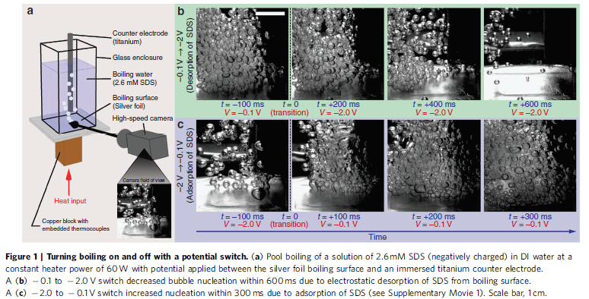
H. J. Cho, J. P. Mizerak and E. N. Wang, "Turning bubbles on and off during boiling using charged surfactants," Nat Commun, vol. 6, no. 8599, pp. 1-7, 2015. http://dx.doi.org/10.1038/ncomms9599.

Slide 3
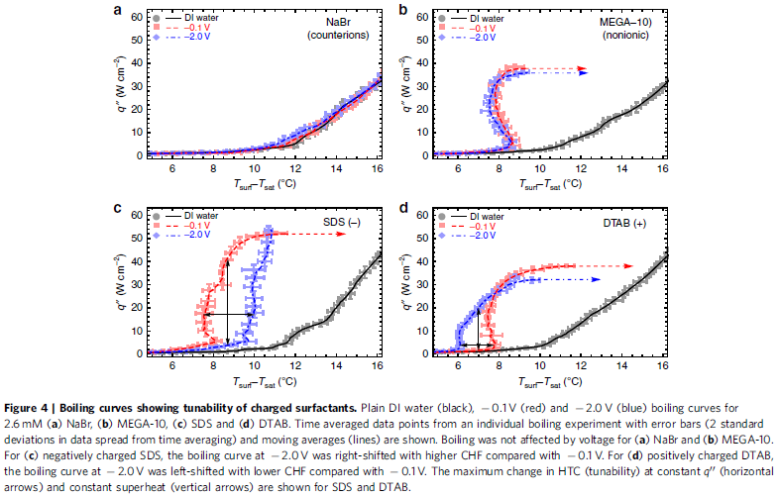
H. J. Cho, J. P. Mizerak and E. N. Wang, "Turning bubbles on and off during boiling using charged surfactants," Nat Commun, vol. 6, no. 8599, pp. 1-7, 2015. http://dx.doi.org/10.1038/ncomms9599.

Slide 4
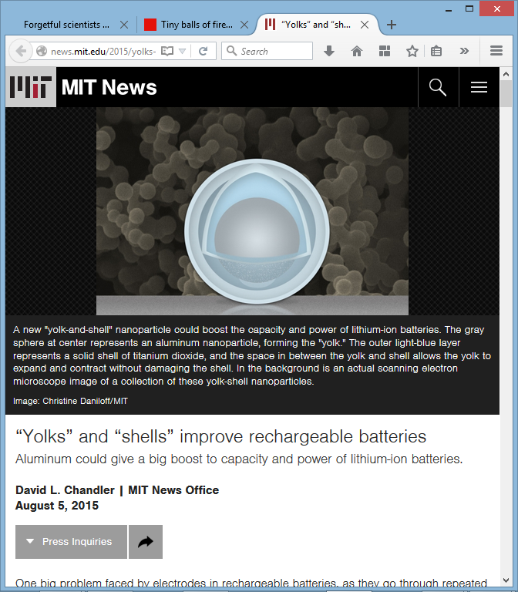
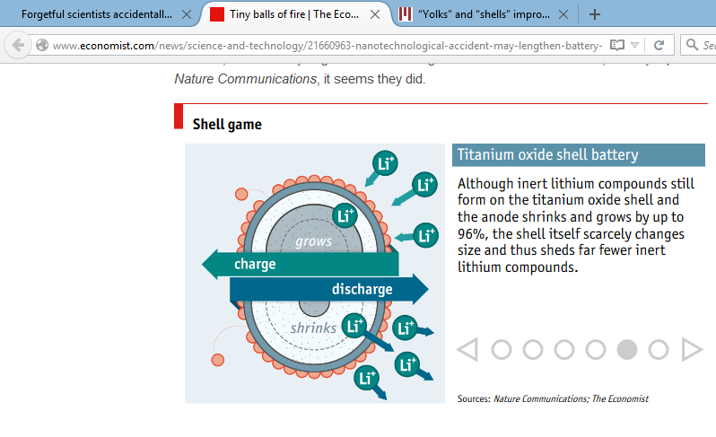
Fun news

Slide 5
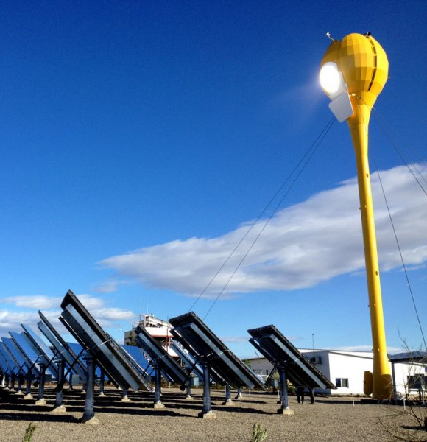
AORA Solar collaboration
Pinchas Doron
  AORA
Ellen Stechel
  Nathan Johnson
  Marcus Herrman
  Yulia Peet
  Clark Miller
  Perdo Peralta
  Pat Phelan
“Tulip”
~30 m
~100 kW_{e} + 170 kW_{th}
Brayton cycle (Ansaldo T100)
2 units deployed (Israel, Spain)
1 ready to break ground? (Here)
10? ordered (Ethiopia)
J. M. Duran, "AORA Solar's Tulip System: A hybrid solar thermal solution," 25 11 2013. [Online]. Available: http://www.iitj.ac.in/CSP/material/21dec/aora.pdf. [Accessed 02 11 2015].
Notes:
J. Alcauza, "AORA to build its first commercial CSP plant in Ethiopia," CSP-World, 3 Dec 2014. [Online]. Available: http://www.csp-world.com/news/20141203/001547/aora-build-its-first-commercial-csp-plant-ethiopia. [Accessed 28 Apr 2015].

Slide 6
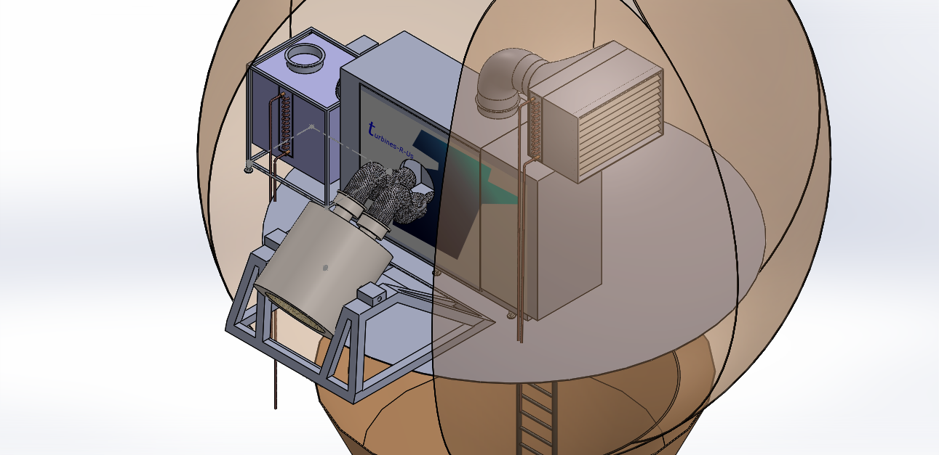
Close-up
Exhaust
Inlet filter and air cooling coil
Heat recovery heat exchanger
Turbine
Ambient Air
HTF
Receiver
Chilled water

Slide 7
AORA waste heat utilization
110 feet
(precooling)
BRAYTON TURBINE
POWER
270 °C Air
Heat
Exchanger
(TBD)
~100°C
(water)
Application
Load,
eg cooling
Cool air
Notes:
http://www.ises.org.il/71

Slide 8


Waste heat utilization team
Jon
Nick
Sami
Weston
Yuqian?
Andrew
Inactive
Randi
Turki
Gaurav

Slide 9
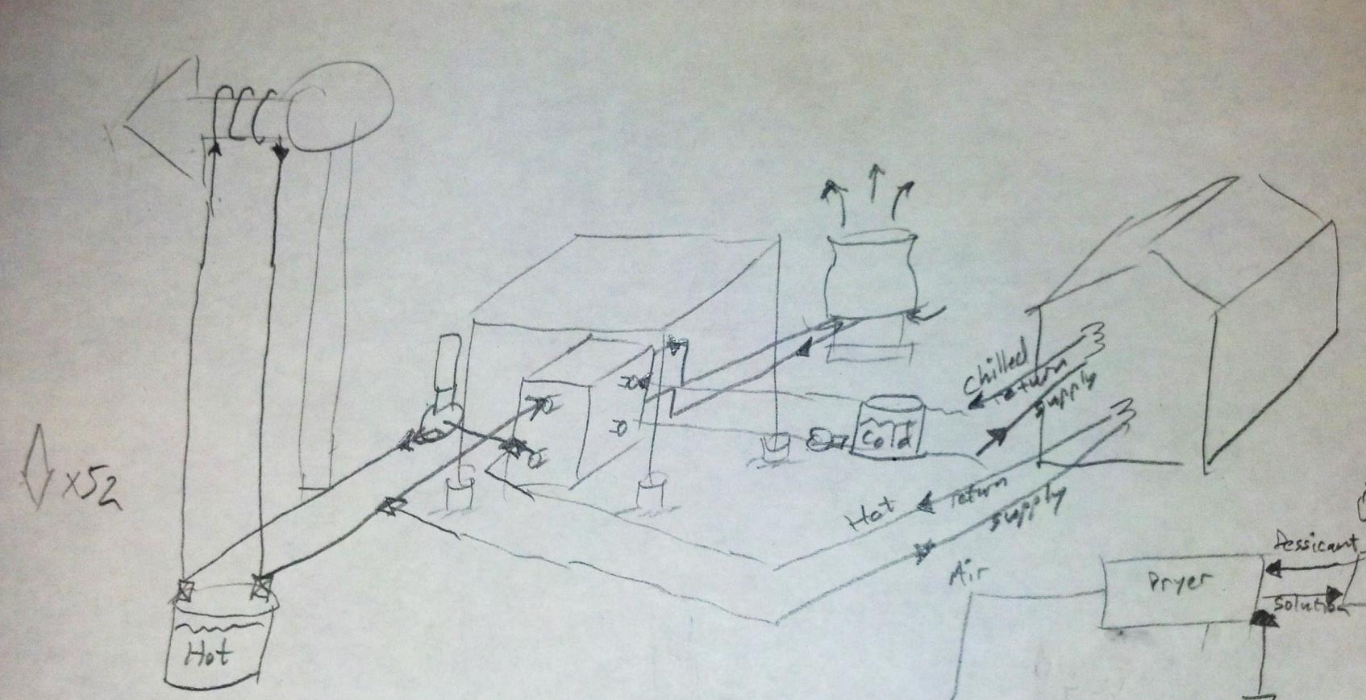
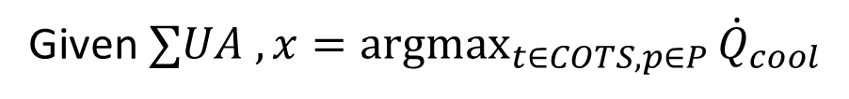
Nick’s dissertation Chapter 1
Given $∑UA , x=\underset{t∈COTS, p∈P}{argmax}{{\dot{Q}}_{cool}}$

Slide 10
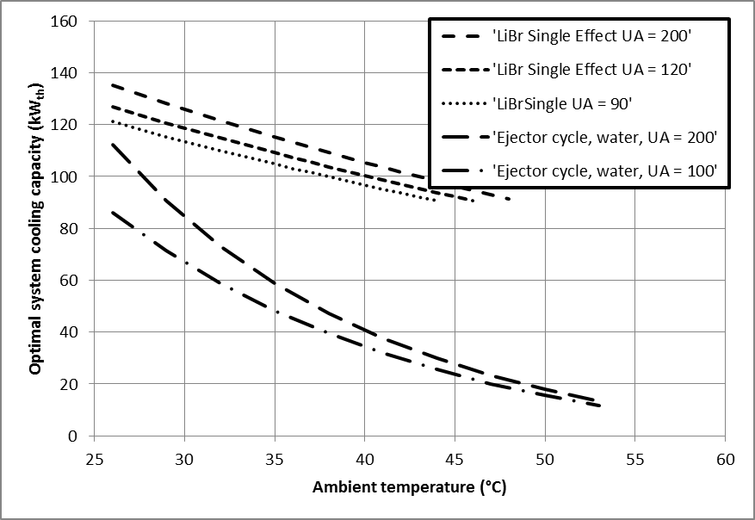
Cooling technologies compared that deliver 10 °C chilled water (per Tulip)
Simple LiBr cycle
crystallization limit
Notes:
This figure shows, for each given “ambient” temperature, the per Tulip cooling capacity of a chilling system of the given technology and size (in terms of UA = area * overall heat transfer coefficient product summed over external heat exchangers) optimized to run at that temperature. Cooling is delivered as 10 deg C chilled water. Additional technologies are to be modelled, and more detail added.
“Ambient” temperature in this model is just the temperature of whichever heat rejection fluid is entering the condenser heat exchangers. Other technologies to compare will include ammonia-water absorption cycles, adsorption cycles, two-stage ejector cycles. At present, the size is related to cost, but different heat exchangers (for heat recovery, heat input to chiller, condenser, and evaporator) will have different cost per unit UA. So eventual goal for a publishable paper is a plot where each curve is for a given cost of whole cooling system. Meanwhile we will finish designing and get quotes for near the capacity expected.

Slide 11
Nick’s dissertation Chapter 2
???

Slide 12
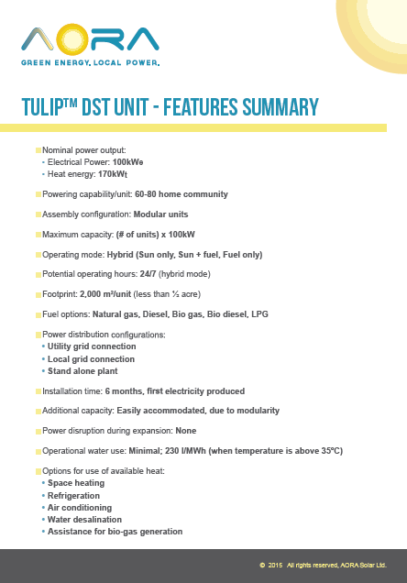
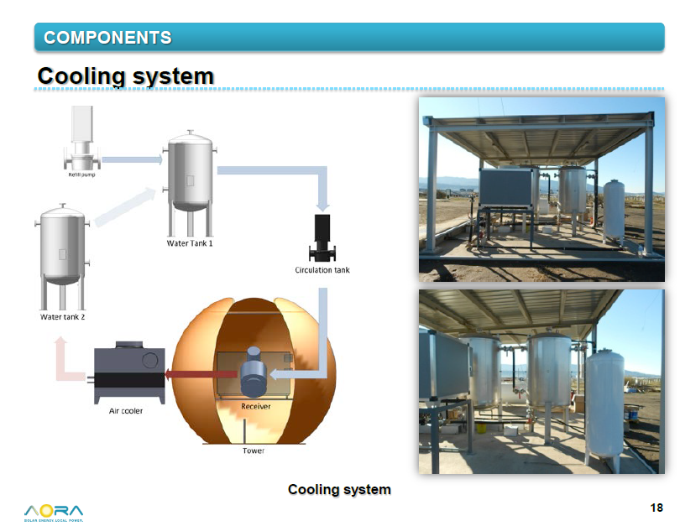
Existing spray cooling system
J. M. Duran, "AORA Solar's Tulip System: A hybrid solar thermal solution," 25 11 2013. [Online]. Available: http://www.iitj.ac.in/CSP/material/21dec/aora.pdf. [Accessed 02 11 2015].
AORA Solar Ltd., "Tulip Datasheet," 07 11 2012. [Online]. Available: http://aora-solar.com/wp-content/uploads/2012/01/DatasheetInfographic-MedRes.pdf. [Accessed 02 11 2015].

Slide 13
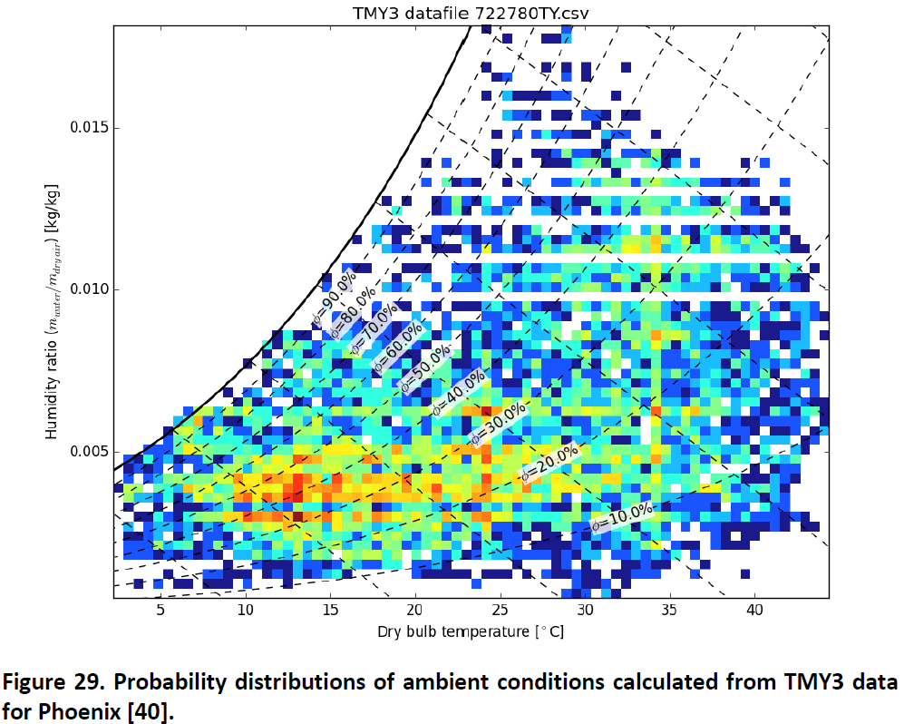

Heat rejection: evaporative technologies
$$↦$$

Slide 14

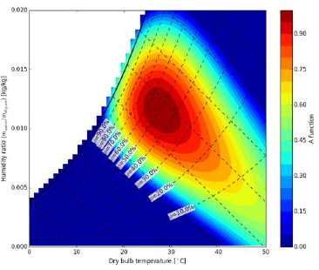
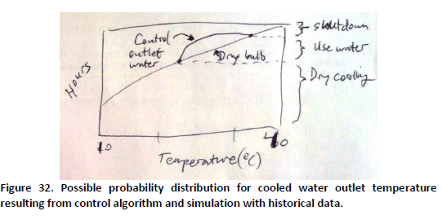


Heat rejection: evaporative technologies
$$×$$
$$↦$$

Slide 15
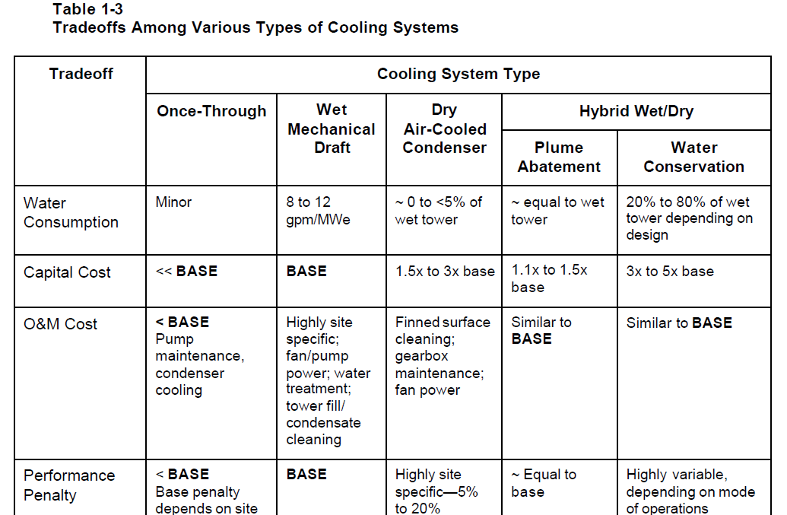
Heat rejection
J. S. Maulbetsch, "Comparison of Alternate Cooling Technologies for California Power Plants: Economic, Environmental and Other Tradeoffs: Consultant Report," EPRI, California Energy Commission PIER, Atherton, CA, 2002.

Slide 16
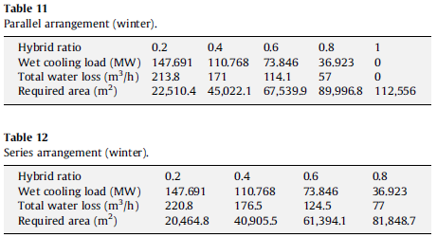
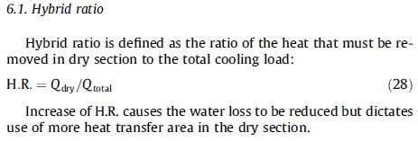
Heat rejection
E. Rezaei, S. Shafiei and A. Abdollahnezhad, "Reducing water consumption of an industrial plant cooling unit using hybrid cooling tower," Energy Conversion and Management, vol. 51, pp. 311-319, 2010. http://dx.doi.org/10.1016/j.enconman.2009.09.027.

Slide 17
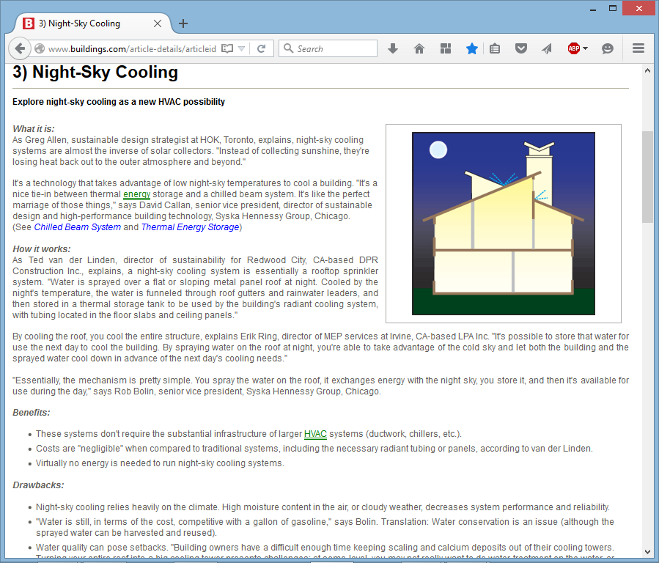
Skip this

Slide 18
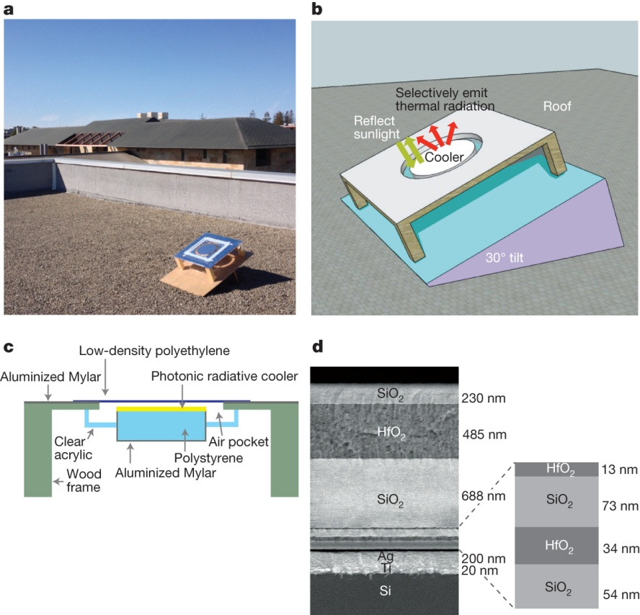
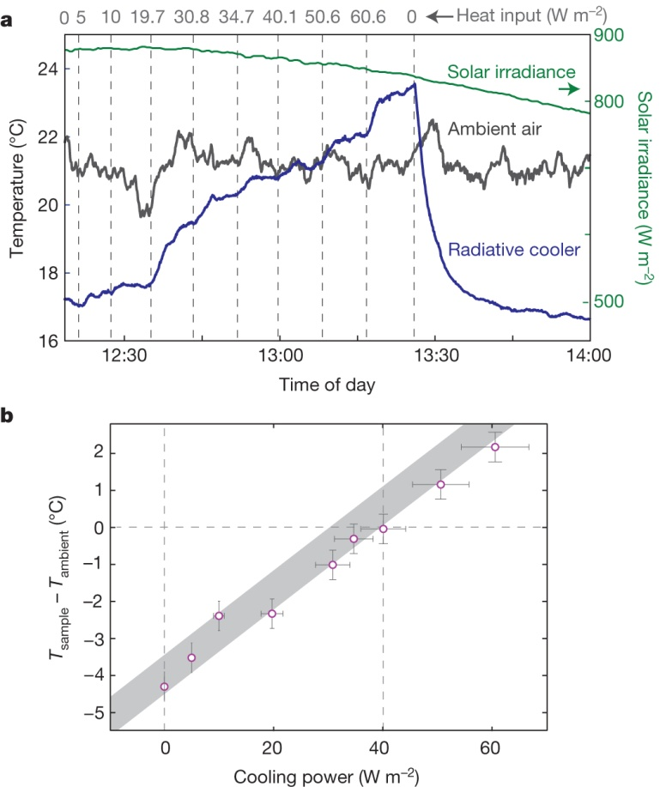

Rooftop apparatus and photonic radiative cooler.
Cooling power of photonic radiative cooler.
AP Raman et al. Nature 515, 540-544 (2014) doi:10.1038/nature13883

Slide 19
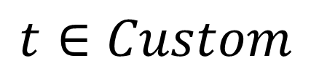
Nick’s dissertation Chapter 1
$$t∈Custom$$

Slide 20
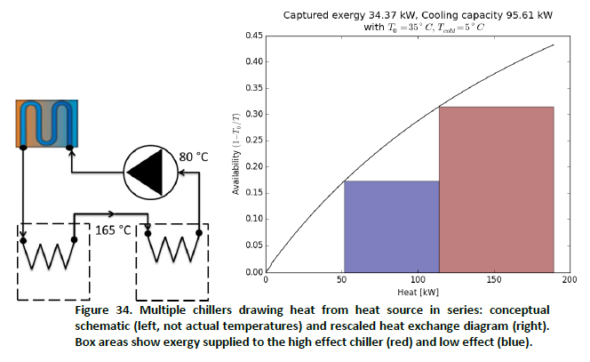
Multiple chillers
Assume: exergetic efficiency of chiller = 37 %
(calculated based on Thermax LiBr single & double effect)

Slide 21
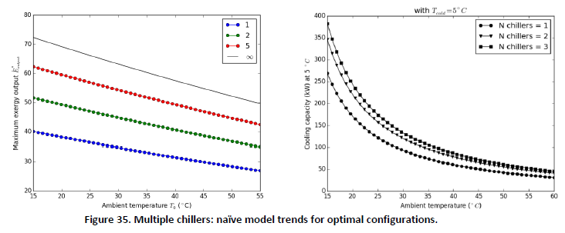
Multiple chillers: analytic result

Slide 22
High ambient temperature

Slide 23
Dynamic modelling users group?
Modelica: a dynamic modelling language
My application
  Open source model (eventually dynamic) for absorption chiller
  Requires: Open source library for properties (based on work from Spring, openACHP …)
Other applications
  Building controls optimization

Slide 24
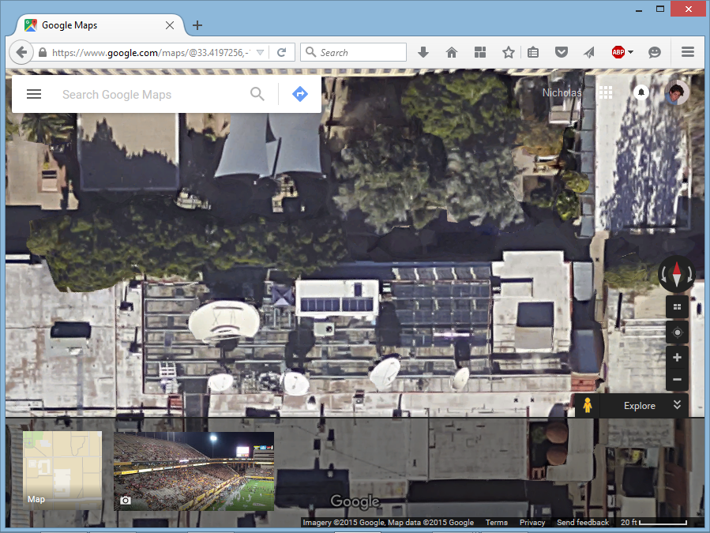
Solar tea?

