Slide 1
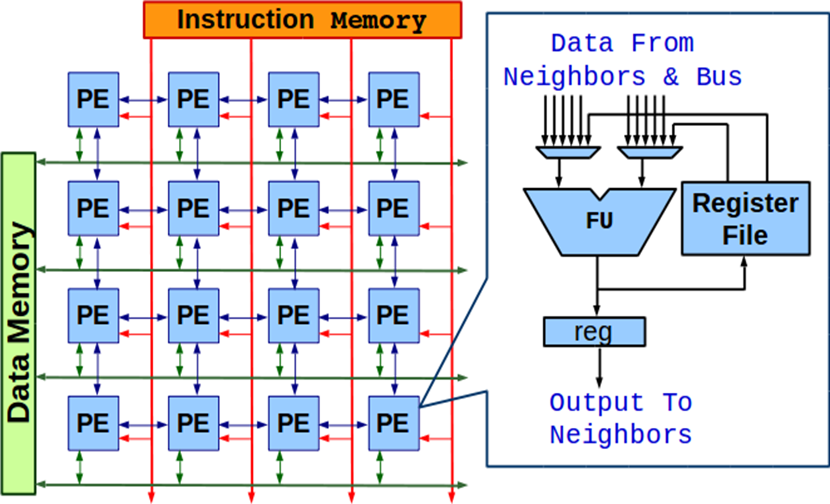
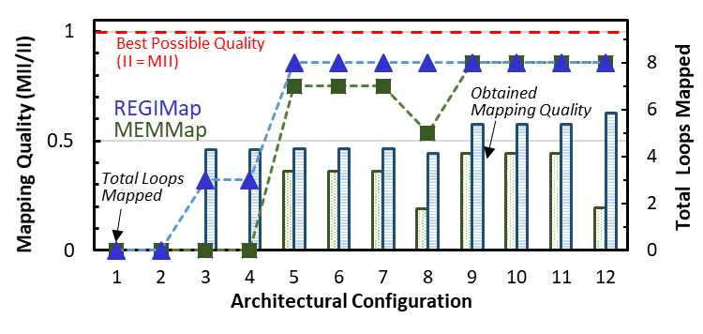
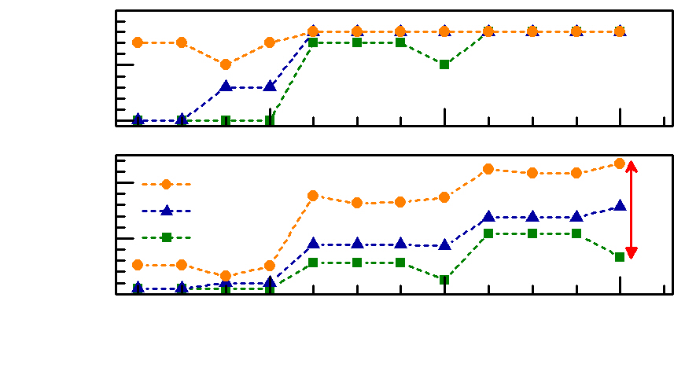
RAMP: Resource-Aware Mapping for CGRAs
Shail Dave, Mahesh Balasubramanian, Aviral Shrivastava
Compiler Microarchitecture Lab, Arizona State University
Coarse Grained Reconfigurable Arrays (CGRAs)
Performance Impact of Ad-Hoc Routing Strategies
Array of Processing Elements (PEs); each PE has ALU-like functional unit that works on an operation every cycle.
Power-efficiency of several 10s of GOps/Sec per Watt!
ADRES [HiPEAC ‘08]
HyCUBE [DAC ‘17]
A 4x4 CGRA with Local Register File and 2-D Mesh Interconnect
Mapping Loops on CGRAs
RAMP: Resource-Aware Mapping Technique
Modulo Schedule
time
- Iterative Modulo Scheduling [B. Rau, MICRO ‘94]
Software Pipelined Execution
Failure Analysis
B = 0;
for(i=0; i<1000; i++)
{
A = B - 4;
B = A + L;
C = A * 3
D = C + 7;
}
i=0
a:
1
a
1
1
a
1
Routing
Strategy
2
Re-Schedule
3
Place & Route
b:
b
c
2
2
b
c
c:
Partition Mapping Problem in 3 Sub-Problems
Systematically and Flexibly Explore Resources to Achieve Mapping, Adapting to the Application Needs
E.g. we can choose to first map the DDG with routing via registers. Then, for any unmapped data dependency, explore different routing options, per failure analysis.
d:
d
1
i=1
d
II = 2
Sample Loop
Data Dependency Graph (DDG)
3
a
Performance Critically Depends on the Obtained Mapping
Mapping Problem = Routing Problem
Routing is needed when the dependent operations are scheduled at a distant time, or operations cannot be mapped due to resource constraints.
A
Modulo Schedule DDG (Arch., II)
Generate Compatibility Graph CG
P&R (Find Maximal Clique of CG)
B
All Operations Mapped?
Yes
H
Done
Modified & rescheduled DDG
Challenges with Code Generation Heuristics Employing Ad-hoc Routing Strategies
C
No
For Each Unmapped Node v/Edge e
Exhaustive Resource Exploration
D
Failure Analysis
Ops Scheduled at Consequent Time?
F
Dependent Ops Scheduled Far?
E
Is pred(v) live-in?
DDG, Arch Description, Target II
Place & Route
Graph Modification
Spill to Mem
Route via PEs
and/or Reg.
Spill to distrib. RFs
Load Read-Only Data
Re- Compute
Route via PE
Change Schedule Time
Scheduling (IMS)
Mapping
Re-schedule
Routing in an ad-hoc manner
Place & Route
G
Select the Strategy that Uses Minimum Resources
Schedule (II=3)
time
P&R
Routing Data Dependency via PEs
Spilling to Distributed RFs
RAMP Improves CGRA’s Acceleration Capability by 2.13x
1
a
c
1
1
c
a
?
- EMS [H. Park et al., PACT ’08]
- EPIMap [M. Hamzeh et al., DAC ‘12]
Since a_{r} is not rescheduled, cannot route a → e
time
2
b
d
2
a_{r}
a
i
10
3
e
2
d
b
2
t
f
e^{i-1}
a
e^{i-2}
3
b
g
t+1
g
Total Loops Mapped
DDG
e
c
b
e^{i-1}
e^{i-2}
5
t+2
e_{rr}
e^{i-1}
c
e^{i-2}
Routing via Registers
Routing via Memory
d
t+3
d
e^{i-1}
e_{rw}
II = 5
0
REGIMap [M. Hamzeh al.,DAC ’13]
GraphMinor [L. Chen et al., TRETS ‘14] Cannot efficiently utilize distributed RFs to route e^{i-2} → a^{i}
MEMMap [S. Yin al., TVLSI ’16] Statically determine the dependencies routed via memory
≠ spill data to memory when required (unavailability of regs)
e
h
t+4
e
e^{i}
h
e^{i-1}
20
RAMP
e^{i-1}
Speedup
REGIMap
f
t+5
f
e^{i}
a
e^{i-1}
10
MEMMap
Experimental Setup
0
4
8
12
Architecture Configuration
Increase in
a
time
i
time
i
8 MiBench benchmarks (top performance-critical loops)
RAMP modeled using CCF Compilation & Simulation Framework Available at: https://github.com/cmlasu/ccf (LLVM 4.0 and gem5 as foundation)
CGRA modeled as a separate core coupled with ARM Cortex-like core
Evaluation over 12 architectural configurations
PEs connected in a 2D torus, perform fixed-point computations
CGRA accesses 4 kB data memory and 4 kB instruction memory
Configurations vary in terms of array size, PE functionality, registers etc.
Higher the Better
Resources
0.91
2
b
g
t
a
e^{i-1}
a
1
l_{b}
c
t+1
b
e^{i-1}
g
1
2
?
a
t+2
c
e^{i-1}
c
b
3
s_{a}
c
b
?
sha
bitcount
susan_ smooth
adpcm _enc
gsm_ short
gsm_ long
jpeg _enc
adpcm _dec
geo mean
d
t+3
d
e^{i-1}
d
e
d
e
s_{b}
Acknowledgements
e
h
t+4
?
e
e^{i}
h
f
4
f
t+5
e^{i-1}
g
5
f
l_{a}
This work was partially supported by funding from NSF grants CNS 1525855 and CCF 172346 - NSF/Intel joint research center for Computer Assisted Programming for Heterogeneous Architectures (CAPA).
i+1
a
f
6
g

