Slide 1
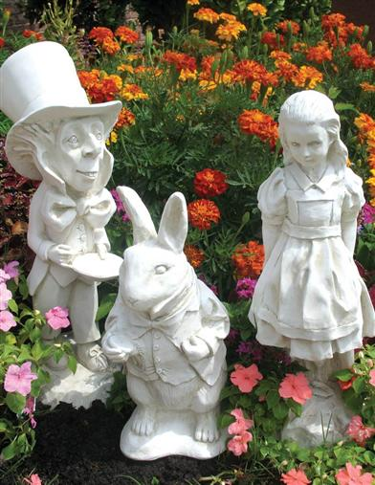
Alice’s Adventures in Wonderland and Through the Looking Glass by Lewis Carroll illustrated by John Tenniel
By Don Nilsen and
Alleen Nilsen

Slide 2
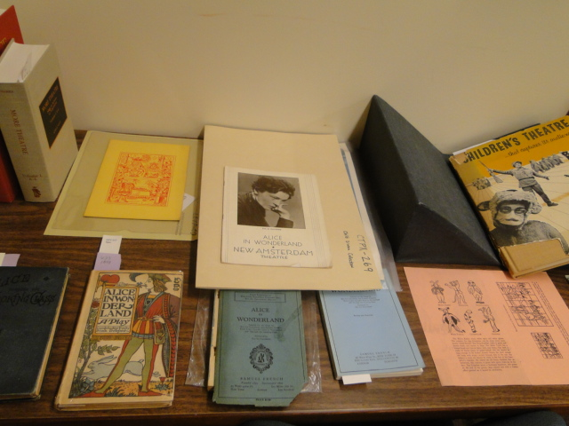
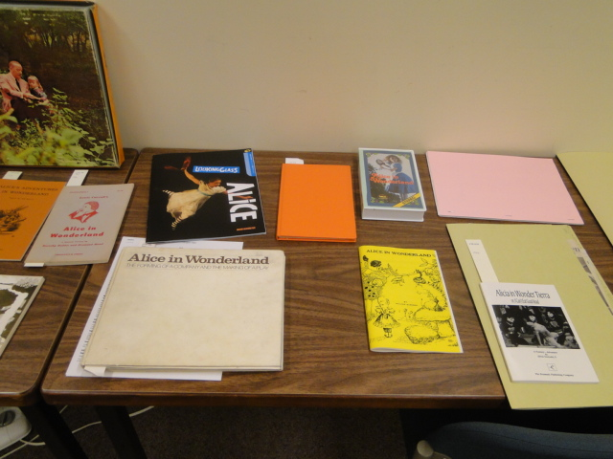
Here is just a part of ASU’s Alice in Wonderland Special Collections

Slide 3
ASU Library’s Alice in Wonderland Collection contains: :
Pop-up books
Latin versions
Scene changers
Fine Art interpretations
Alice in Wonderland in movies
Children’s Theatre
The original artwork by Lewis Carroll

Slide 5
ASU Emeritus College Symposium

Slide 6
List of Contributors to This Material
Per Aannestad Joseph Agius Carolynn Bramlett
Patricia Brick Fraser Brown Linda Coleman
Bernie DeKoven Stephanie DeLusé Henk Maarten de Jongste
Winifred Doane Jennifer Duvernay Anastasiya Fiadotava
Bruce Findlay Tony Forabosco Danuta Furszpaniak
Elizabeth Giudicessi Barbara Grapstein Ellen Johnson
Sally Kitch Katherine Krzys Kristen Larue
Mary Laws Beth Lessard Neal Lester
Donna Lillian Mariann Martin Kyle McMullan
Michael Meany Wendell Pace Daryl Peebles
Jae Pierce-Baba Don Presnell Alice Sheppard
R. F. Shangraw Mary Swaty Breezy Taggart
Joann Tongret William Verdini Heather Wincel
Marilyn Wurzberger

Slide 7
Here’s A recent cartoon from the Boston Herald.

Slide 8
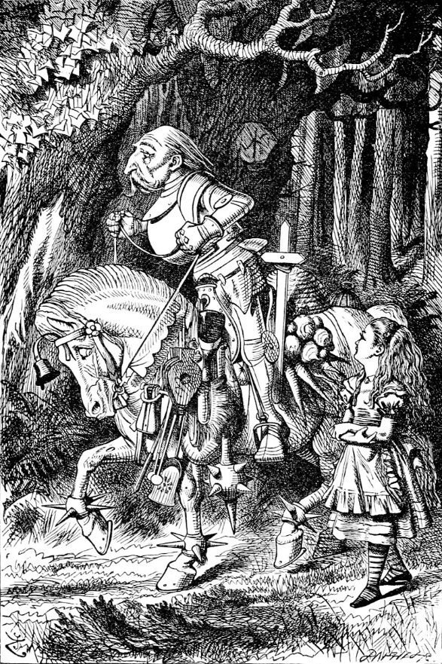
Alice in Wonderland revolves around a deck of cards, while Through the Looking Glass is based on Chess. Today, several video games are based on the Alice books.

Slide 9
Contemporary Authors Love Alice
For example, fairly new books include Lois McMaster Bujold’s Gentleman Jole and the Red Queen and Ngaio Marsh’s Off With His Head.
Douglas Adams’ The Restaurant at the End of the Universe has several allusions to Alice.

Slide 10
A Speech Pathologist’s Perspective:
Joseph Agius, a Speech Language Pathologist, pointed out that Lewis Carroll stuttered and so he surrounded himself with children who made him feel more at ease.
He especially enjoyed the company of a particular child named Alice.
If Lewis Carrol had not stuttered and if Lewis Carroll had not met Alice Liddell, Alice’s Adventures in Wonderland may never have been written.

Slide 11
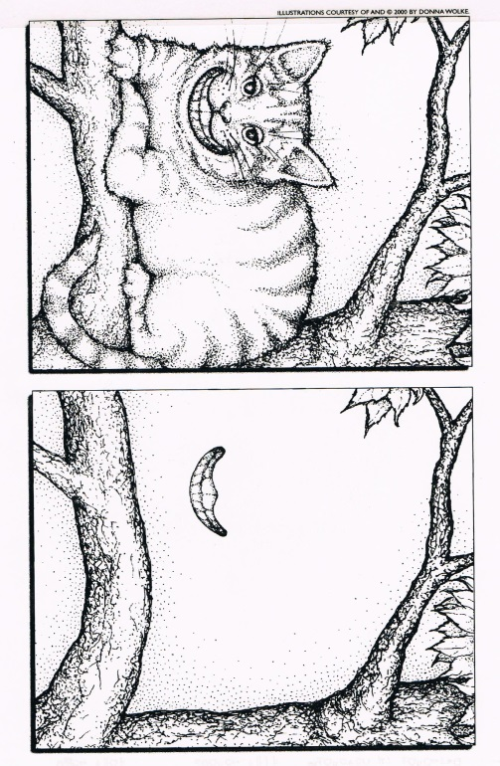
Black Holes, Stars and the Cheshire Cat’s Smile: An Astronomer’s Perspective
Per Aannestad, an astronomer at ASU, cites an article by John Archibald Wheeler .
Wheeler stated that when a star collapses to a black hole, there remains behind only the gravitational attraction of a disembodied mass.
This attraction of a disembodied mass is compared to the smile on the face of Lewis Carroll’s Cheshire cat that remains after the cat is no longer there.
Black Hole Cheshire Cat by Donna Wolke:
Curiouser and curiouser!

Slide 12
Still Alice: The Book and the Movie

Slide 13
Still Alice, the Movie
Still Alice earned Julianne Moore an academy award.
The loss of control and mental confusion in the movie is very much like the loss of control and mental confusion of Alice in Wonderland, and that of the drug-related pop culture allusions of the 1960s and 1970s.
However, the tone is different, because people engaging in drug use are seeking new feelings and experiences, while in Still Alice, the character is a professor of linguistics at Columbia University who is diagnosed with Alzheimer’s disease, and is doing all that she can to combat the complications of the condition.

Slide 14
Alice in Wonderland References in The Matrix:
https://www.youtube.com/watch?v=i_lNe4Y8yKQ&feature=youtu.be

Slide 15
Other Alices: Alice Cooper & Arlo Guthrie’s Alice’s Restaurant

Slide 16
The Matrix is filled with Alice allusions
MORPHEUS: I imagine that right now, you’re feeling a bit like Alice. Hmmm? Tumbling down the rabbit hole?
NEO: You could say that.
MORPHEUS: You take the blue pill, the story ends. You wake up in your bed and believe whatever you want to believe. You take the red pill, you stay in wonderland, and I show you how deep the rabbit hole goes.

Slide 17
Jasper Fforde’s Thursday Next—Literary Detective series makes several allusions to the Alice books.
For example, the Bellman, from Carroll’s “Hunting of the Snark” is a major character, while The Cheshire Cat is the head librarian.

Slide 18
Here’s the #3 Book on the New York Times August 14, 2015 Best Seller List of Non Fiction

Slide 19
Alice and her Friends in Central Park, New York

Slide 20
Shrooms in Downtown Tempe
The mushrooms in Alice in Wonderland are psychedelic.
The Caterpiller is sitting on top of one of these mushrooms while he’s smoking a Hookah.
This is one of the reasons that in the 1960s and 70s the Alice books were adopted by the drug culture.

Slide 21
White Rabbits in Downtown Tempe, Arizona

Slide 22
White Rabbit References at the ASU Emeritus College Symposium

Slide 23
The Royal Ballet in London is now featuring Alice in Wonderland. This scene is “Alice and the Knave of Hearts.”

Slide 24
Lincoln Center, New York: “Allice’s Adventures in Wonderland”

Slide 25
Peter and Alice: a Current London Play Starring Judi Dench as Alice
This play compares and contrasts Lewis Carroll’s relationships with young girls and J. M. Barrie’s relationships with young boys, and how these relationships influenced the writing of Peter Pan and Alice in Wonderland--and in turn, how the books influenced the children’s adult lives.

Slide 26
Alice: “Drink Me”
Jefferson Airplane: “The White Rabbit”:
This is part of why hippies in the 1960s associated Alice with drugs.
The song that advised listeners to “Go ask Alice when she’s 10 feet tall” also inspired the title for Go Ask Alice, a famous 1971 teen book by Beatrice Sparks. And of course the drawing of the caterpillar, smoking a hookah while sitting on top of a mushroom, also helped the idea.

Slide 27
Lewis Carroll Was a Master at Parody
G. W. Langford’s poem not only preached at parents, but threatened them with a reminder of the high mortality rate of young children: It went:
Speak gently to the little child?
Its love be sure to gain;
Teach it in accents soft and mild;
It may not long remain.
Lewis Carroll’s parody went:
Speak roughly to your little boy.
And beat him when he sneezes.
He only does it to annoy
Because he knows it teases.

Slide 28
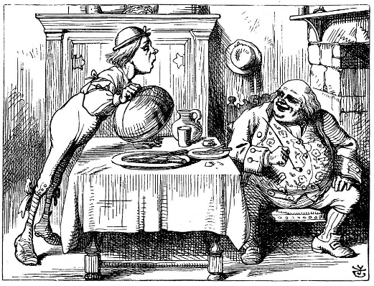
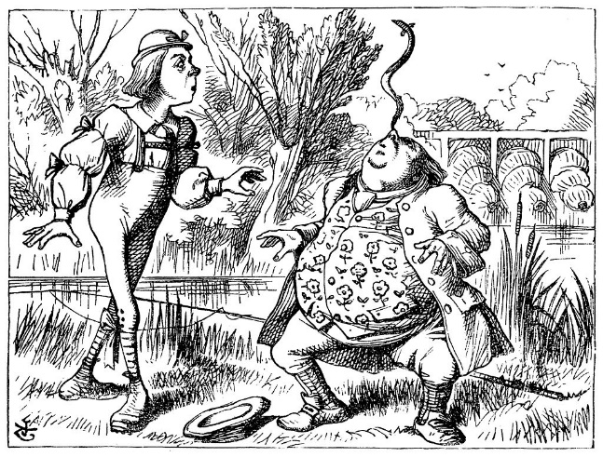
Teasing Father William
“You are old, Father William,” the young man said,
And your hair has become very white;
And yet you incessantly stand on your head—
Do you think, at your age, it is right?
“You are old,” said the youth, “As I mentioned before,
And have grown most uncommonly fat;
Yet you turned a back-somersault in at the door—
Pray, what is the reason for that?”

Slide 29
Gryphon, Mock Turtle and Alice
GRYPHON: Hello. Who are you?
ALICE: Alice
GRYPHON: Alice…a charming misnomer.
ALICE: And who are you?
GRYPHON: a Griffin! Part eagle, part lion—the best of each, I always say!

Slide 30
Humpty Dumpty and Alice and the Alice Band
The “Alice Band” originated around 1865, just after the publication of Tenniel’s drawings. Today it is becoming fashionable for men with long hair. We heard that in England it is still called an “Alice Band,” while in the U. S. it is more likely to be called a “Man Band.”

Slide 31
Humpty Dumpty While not creating Humpty Dumpty, Carroll made him famous.
Humpty Dumpty sat on a wall.
Humpty Dumpty had a great fall.
All the king’s horses
And all the king’s men
Couldn’t put Humpty Dumpty
Together again.
Hayden Library has over 100 listings in its card catalogue that include the phrase, “All the Kings’ Men.”

Slide 32
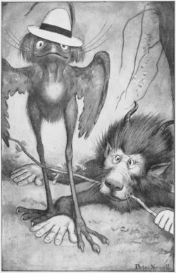
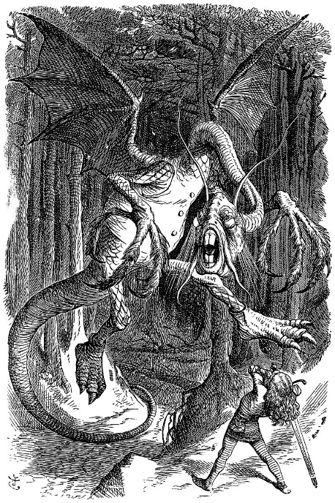
This site could help someone define the differences between content words and function words as illustrated in “Jabberwocky”
CONTENT WORDS: Nouns, Verbs, Adjectives and Adverbs ➔ NONSENSE WORDS
FUNCTION WORDS: Articles, Conjunctions, Auxiliary Verbs, Prepositions, Pronouns
➔ REAL WORDS
‘Twas brillig, and the slithy toves
Did gyre and gimble in the wabe:
All mimsy were the borogoves,
And the mome raths outgabe
Beware the Jabberwock, my son!
The jaws that bite, the claws that catch!
Beware the Jubjub bird, and shun
The frumious Bandersnatch?

Slide 33
The man who sent us this picture of the Jabberwock Inn in Monterey, California, invited us to meet him there for “a good jabber.” We mentioned this in one of our senior citizen classes, and a woman said that when she was a teenager, the adults complained that her generation talked “only jabberwock and jive.” She was surprised to learn where they got the term.

Slide 34
King and Queen of Hearts
Lewis Carroll may be partially responsible for the reputation of today’s lawyers and courts, because of the way he made fun of the Royal Court, e.g.
“Verdict first; Evidence second.”
“Don’t be nervous, or I’ll have you executed on the spot.”
“Off with their heads.”

Slide 35
Mad Hatter: Hatters in the 1800s suffered from mercury poisoning because they kept contaminated pins in their mouths.
In our query note, we asked if someone hadn’t yet referred to Donald Trump as a Mad Hatter.
A smart woman responded, “Oh, no. The Hatter is much too kind and likable. Donald Trump has to be the Red Queen.”

Slide 36
Mad Hatter’s Tea Party and New York Tea Party

Slide 37
Walt Disney World’s Spinning Tea Cups

Slide 38
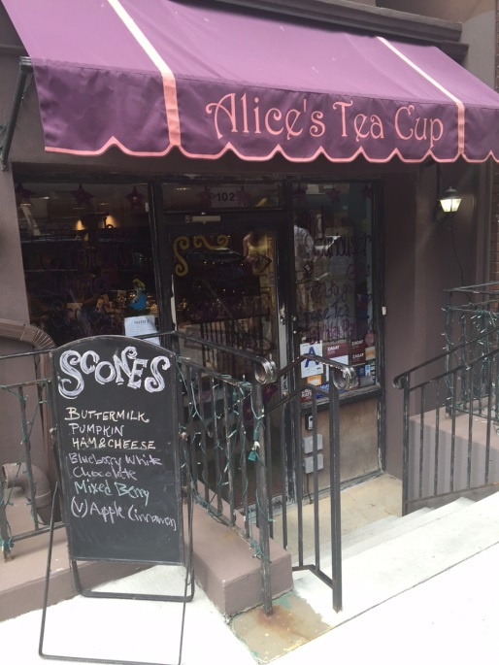
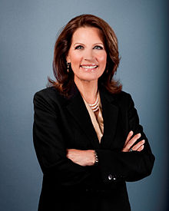
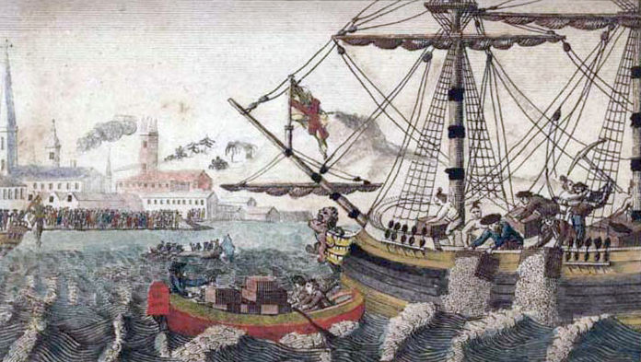
Other Tea Parties

Slide 39
March Hare
Spring is the rutting season for rabbits.
So the March Hare is to be excused for his rudeness.
MARCH HARE: Then you should say what you mean.
ALICE: I do…, at least I mean what I say, that’s the same thing, you know.
MARCH HARE: Not the same thing a bit! Why, you might just as well say that “I see what I eat” is the same thing as “I eat what I see!”

Slide 40
Mock Turtle, Gryphon, and Alice
The Mock Turtle first took “Reeling and Writhing”.
And then came the Classical Master, who was an old crab. He taught “Laughing and Grief.”

Slide 41
The Mouse’s Tale/Tail
MOUSE: Mine is a long and a sad tale.
ALICE: It is a long tail, certainly, but why do you call it sad?
And she kept on puzzling about it while the mouse was speaking, so that her idea of the tale was something like this:

Slide 42
The Mouse’s Tale Original and Salvador Dali’s

Slide 43
Puns and Linguistic Parodies in Alice in Wonderland
Reading and Writing ➔ Reeling and Writhing
Latin and Greek ➔ Laughing and Grief
Addition, Subtraction, Multiplication, and Division ➔
Ambition, Distraction, Uglification and Derision
Drawing, Sketching and Painting in Oils ➔
Drawling, Stretching, and Fainting in Coils
Take care of the pence, and the pounds will take care of themselves ➔
Take care of the sense, and the sounds will take care of themselves

Slide 44
Lewis Carroll was a master at parodying poems of his day:
Twinkle, twinkle, Little Star, How I wonder where you are ➔ Twinkle, twinkle, Little Bat, how I wonder where you’re at.
With most of his parodies, Carroll was protesting the didacticism and the sentimentality imposed on Victorian children by their parents.

Slide 45
Isaac Watts’ original is about bees and their industriousness , while Lewis Carroll’s Parody is about crocodiles
Isaac Watts’ original:
How doth the little busy bee
Improve each shining hour
And gather honey all the day
From every opening flower!
Lewis Carroll’s parody:
How doth the little crocodile
Improve his shining tail
And pour the waters of the Nile
On every golden scale!

Slide 46
Tweedledum and Tweedledee and Bob Dylan’s “Tweedle Dee & Tweedle Dum”
Who hasn’t thought of Tweedledum and Tweedledee as we listen to the presidential debates?
http://www.bobdylan.com/us/songs/tweedle-dee-tweedle-dum

Slide 47
WHITE QUEEN: Can you do addition? What’s one and one and one and one and one and one and one and one and one and one?
ALICE: I don’t know. I lost count.
ALICE: One can’t believe impossible things.
WHITE QUEEN: When I was younger, I always did it for half an hour a day. Why, sometimes I’ve believed as many as six impossible things before breakfast.
Through the Looking Glass

Slide 48
Tim Burton’s Alice in Wonderland: Johnny Depp as the Mad Hatter, Mia Wasikowska as Alice, and Helena Bonham Carter as the Red Queen.

Slide 49
The Sesquicentennial of Lewis Carroll’s Alice in Wonderland
Lewis Carroll’s Biography as It Relates to Alice in Wonderland:
https://www.youtube.com/watch?v=Irlpvtwu1Rs

