Slide 1
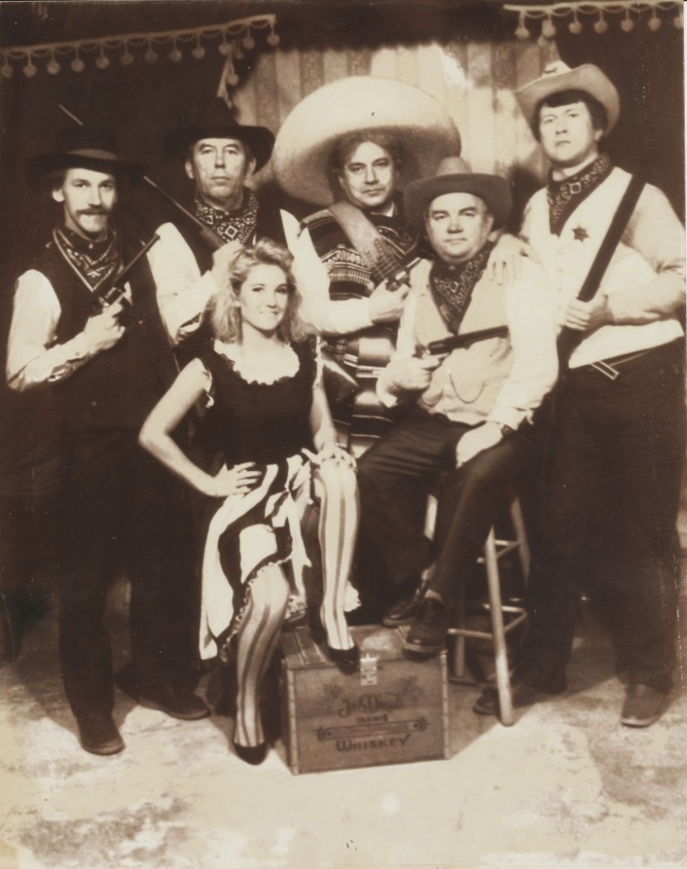
The History of the International Society for Humor Studies
By Don L. F. Nilsen, and
Alleen Pace Nilsen

Slide 2
International Humor Conferences Before and During the WHIM Conferences (WHIM: World Humor and Irony Membership)
Tony Chapman and Hugh Foote convened an International Humor Conference in Cardiff, Wales.
Harvey Mindess and Joy Turek convened an International Humor Conference in Los Angeles, California.
Amy Carrell convened a humor seminar in Edmond, Oklahoma.
Ann Marie Guilmette convened an international humor conference in St. Catherines, Ontario, Canada.
Salvatore Attardo convened an international humor conference in Youngstown, Ohio.
Desmond MacHale convened an international humor conference in Cork, Ireland.
Larry Mintz, Rufus Browning and Herb Cummings convened an International Humor Conference in Washington, D.C.
Judith Stora Sander and Nelly Feuerhahn have convened CORHUM humor conferences throughout France.

Slide 3
Larry Mintz convened another International Humor Conference in Washington, D.C. Art Buchwald, Mark Russell, Jeff McNelly and Bob Orben were on the panel.
The Library of Congress convened a Seminar of Humor Scholars in Washington, D.C.
Avner Ziv convened a number of international humor conferences in Tel Aviv, Israel.
Christian Hempleman and Owen Lynch convened a number of humor conferences in Dallas, Texas.
The Association of Applied and Therapeutic Humor (AATH) convened a number of international humor conferences.
Willibald Ruch has convened 16 international humor summer schools in different countries, including England, Estonia, Finland, Germany, Northern Ireland, Russia, Scotland, Spain, and Switzerland.

Slide 4
Two Newspaper Articles about Scholars at Humor Conferences Note The Two Snoozing Academics on the left.

Slide 5
1981: Art Buchwald Comes to the A.S.U. Campus
In 1981, Art Buchwald came to the ASU Campus.
He said that Humor Conferences are difficult because the audience will expect to be kept in stitches during the entire conference.
Since we can’t (and shouldn’t) do this, we decided to make our conferences scholarly.
And tried to laugh as little as possible.

Slide 6
1982 Flyer
This is a flyer to establish the dates of our conference: April 1st of Every Year.
We kept this tradition for seven years,
Six years at Arizona State University, and one year at Purdue University.

Slide 7
1982: Two Early News Stories

Slide 8
1983: The Proceedings of the 1982 WHIM Conference The Theme of this Conference was “Linguistic Humor and Language Play”
We named ourselves WHIM—World Humor and Irony Membership.
We called our proceedings WHIMSY—World Humor and Irony Membership Serial Yearbook.
Rather than publishing “abstracts,” we published “concretes,” excerpting the most insightful comments from each paper.
These “concretes” were about three pages single spaced in length.

Slide 9
1983: Larry Wilde MC-ed the 1983 Joke Telling Competition 1984: The second WHIMSY proceedings were published. The theme was “Humor and Metaphor”

Slide 10
1984: The Theme of Our 3rd Conference was “Contemporary Humor” We received a Gift from the House of Humor and Satire in Gabrovo, Bulgaria

Slide 11
Miss Peach: An Original Mel Lazarus Drawing: Presented to the Nilsens at an ISHS Conference

Slide 12
1985: Here is a News Story and a 1985 WHIM Flyer

Slide 13
1986: We were featured on the A.S.U. directory front cover. The theme of our fourth WHIM conference was “Humor across the Disciplines.”

Slide 14
1986: Sydney Harris Drew a WHIM Cartoon in the Wall Street Journal and James Boren drew a “whimsical” cartoon of a “humor professor.”

Slide 15
1986: The theme of our fifth WHIM conference was “American Humor.”
Gene Valentine, who did all of our WHIMSY covers used the Statue-of-Liberty Symbolism to Reinforce the Conference Theme.

Slide 16
1987: Alleen and Don Nilsen were invited to the House of Humor and Satire in Gabrovo, Bulgaria.
Here are two Gabrovo icons. The first is for a half cup of coffee.
The second cup is for someone with a mustache. The coins one show a cat with no tail.
Two of these icons stress the “stinginess” of Gabrovo citizens.
The reason the cat has no tail is so when it comes into the house the owner can close the door sooner.
The Statue of Racho Kabacho, the founder of Gabrovo is in the middle of the river, because the land is cheaper there.

Slide 17
1987: Alleen Nilsen got in trouble for talking about Evan Mecham, Arizona’s soon-to-be-impeached governor. The theme of the sixth WHIM conference was “International Humor”

Slide 18
1987: A Soviet Delegation came to the WHIM conference in Tempe, Arizona
They thought they were coming to “Tampa” instead of “Tempe,” and were surprised to see American desert instead of American water.
When they visited Arizona’s “Rawhide City,” they dressed up as American Cowboys.
They had their picture taken with the frontier bar maid.

Slide 19
1987: Representatives from Russia’s Pravda and Krokodil Attended Our Sixth WHIM Conference
Therefore, America’s C.I.A. also had to attend.
The first day they wore suits.
The second day they wore Hawaiian shirts.
The third day, Paul Krasner asked them to stand up so that we could give them a round of applause.

Slide 20
1988: The WHIM Conference Moved to Purdue University, where Victor Raskin and Shaun Hughes were the Conveners. 1989: We went overseas—to Laie, Hawaii
Here we decided to start going international, so…
1989 in Laie, Hawaii (Margaret Baker & Jesse Crisler)
It was here that we decided to change our name to ISHS: International Society for Humor Studies, because the other name was “too whimsical.”
Because more than half of our membership were U.S., we also decided to alternate between U.S. and non-U.S. venues.

Slide 21
1990: in Sheffield, England
Here are some Nilsen pictures from the 1990 ISHS conference in Sheffield, England.

Slide 22
1993: in Luxembourg
Here are some Nilsen pictures from the 1993 ISHS conference in Luxembourg.

Slide 23
1994: Ithaca, New York
Here is an embroidery given to the Nilsens at the 1994 ISHS conference in Ithaca, New York.

Slide 24
1998: Bergen, Norway
Here is a Norwegian troll bought by the Nilsens at the 1998 ISHS conference in Bergen, Norway.

Slide 25
1999: Oakland, California
Here are some Nilsen pictures from the 1999 ISHS conference in Oakland, California.

Slide 26
2000: Osaka, Japan
Here are some Nilsen pictures from the 2000 ISHS conference in Osaka, Japan.

Slide 27
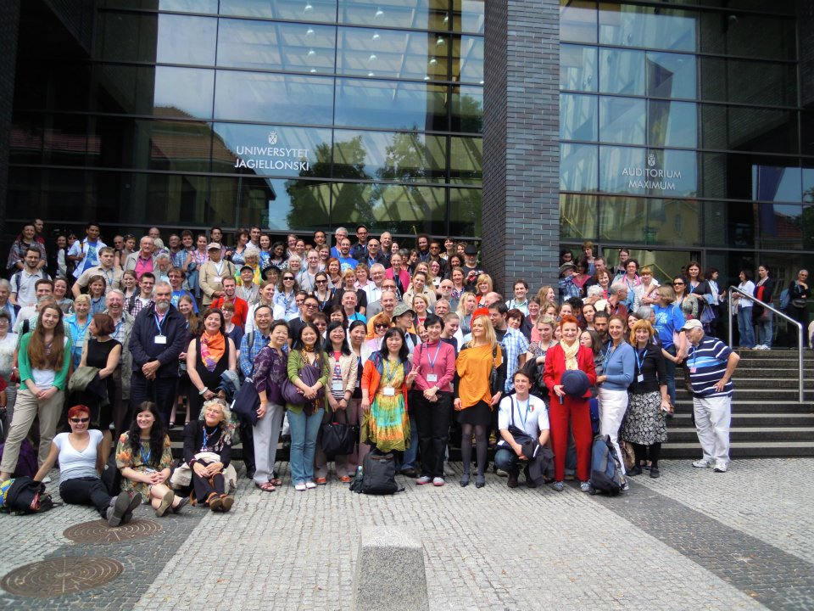
2012 in Kraków, Poland Uniwersytet Jagiellonski

Slide 28
1990 in Sheffield, England (Mark Glazer)
1991 in St. Catharines, Canada (Ann-Marie Guilmette)
1992 in Paris, France (Judith Stora-Sandor & Nelly Feuerhahn)
1993 in Luxembourg (Larry Sherman)
1994 in Ithaca, New York (Mary Ann Rishel)
1995 in Birmingham, England (George Paton)
1996 in Sydney, Australia (Jessica Milner Davis & John McCallum)
1997 in Edmond, Oklahoma (Amy Carrell)
1998 in Bergen, Norway (Sven Svebak)
1999 in Oakland, California (Martin Lampert)
2000 in Osaka, Japan (Hiroshi Inoue & Goh Abe)
2001 in College Park, Maryland (Larry Mintz

Slide 29
2002 in Forli, Italy (Delia Chiaro)
2003 in Chicago, Illinois (Judith Kaplan-Weinger & Richard Hallett)
2004 in Dijon, France (Lorene Birden)
2005 in Youngstown, Ohio (Salvatore Attardo)
2006 in Copenhagen, Denmark (Martin Führ)
2007 in Newport, Rhode Island (Margaret Mathias)
2008 in Alcalá de Henares, Spain (Juan Garcia Cerrada, Carmen Valero-Garces & Begona Carbelo Baquero
2009 Long Beach, California (Amy Bippus)
2010 Hong Kong (Xiaodong Yue)
2011 Boston, Massachusetts (Patrice Oppliger)
2012 Kraków, Poland (Wladyslaw Chlopicki)
2013 Williamsburg, Virginia (Larry Ventis

Slide 30
2014 in Utrecht, The Netherlands (Sibe Doosje)
2015 in Oakland, California (Martin Lampert)
2016 in Dublin, Ireland (Eric Weitz)

