Slide 1
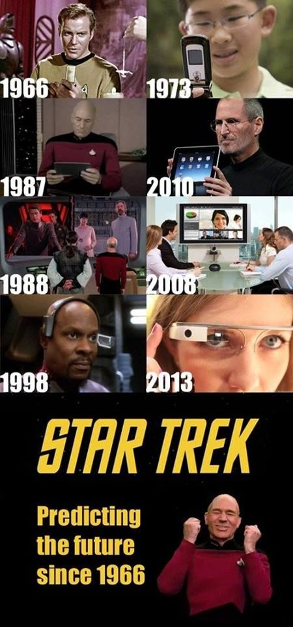
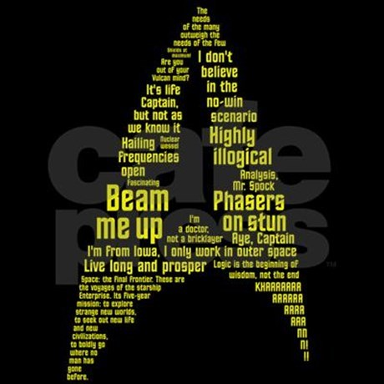
Star Trek: An Alphabetical Listing of Characters and Races
by Don & Alleen Nilsen

Slide 2
The Humor of Star Trek Images
Incongruity and Incongruity-Resolution is one of the most recurring themes in humor theory.
All of the Alien species in Star Trek are almost human, but not quite. They might have antlers, or pig snouts, or furrowed foreheads, or big brains, or they might even be part human and part machine.
And they might be green, or blue with white hair, or have other deviations from human appearances.
And the behaviors of Aliens, like their appearances, are both human and non human.
They are incongruous (non-human), but their incongruity is close enough to being human that we can easily identify with them.
Star Trek Aliens are like “funny” humans.
But their “funniness” should not hide the fact that they can be super-logical, super-objective, super-sexual or super-dangerous. Even these hyperbolic attributes can be a bit humorous.

Slide 3
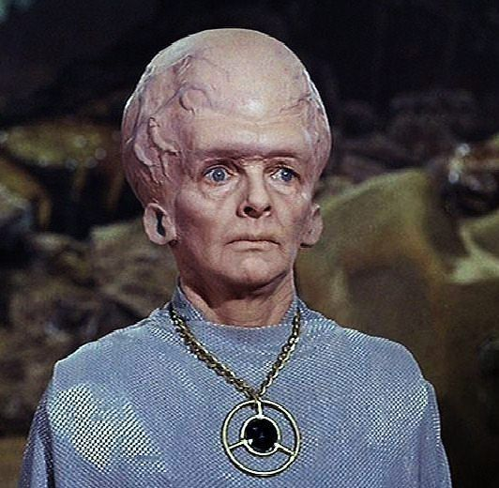
Five Alien Races: Can you name them?

Slide 4
Space, the final frontier. These are the voyages of the Starship Enterprise.
Its five-year mission:
To explore strange new worlds,
To seek out new life and new civilization,
To boldly go where no man has gone before.

Slide 5
Leit Motifs
Analysis, Mr. Spock.
Are you out of your Vulcan mind?
Beam me up, Scotty.
Hailing frequencies open.
Highly illogical.
I’m a doctor, not a bricklayer.
I’m from Iowa. I only work in outer space.
It’s life, Captain, but not as we know it.
Khaaaaaaaaaaaaaaaaaaaaaaaan!
Live long and prosper.
Logic is the beginning of wisdom, not the end.
The needs of the many outweigh the needs of the few.
Phasers on stun.

Slide 6
In 1964, Gene Roddenberry wrote a proposal for a science-fiction series.
The proposal was influenced both by Jonathan Swift’s Gulliver’s Travels and by the popularity of TV Westerns.
Roddenberry’s series was to be both a morality tale and an adventure story, and it was to be named Wagon Train to the Stars. The name was later changed to Star Trek based on the earlier pioneer “trekkers.” Star Trek fans are now called Trekkies, or Trekkers.
The original Star Trek featured the galactic adventures of Captain James T. Kirk and the crew of the starship Enterprise as they explored the “United Federation of Planets” during the 23rd century.

Slide 7
Star Trek was designed to take on such controversies as war and peace, personal loyalty, authoritarianism, imperialism, class warfare, racism, religion, human rights sexism, and the intergalactic role of economics and technology.
William Shatner said that science fiction is like religion in that it tries to explain the inexplicable.
In Star Trek, technology and diversity are valued rather than feared, and people work together for the greater good.

Slide 8
Six Iterations of Star Trek:
The Original Series: 1966-1969
The next Generation: 1987-1994
Deep Space Nine: 1993-1999
Voyager: 1995-2001
Enterprise: 2001-2016
Discovery: Will premier in January of 2017-

Slide 9
Movies Related to The Original Series
Star Trek--The Movie: 1979
The Wrath of Khan: 1982
The Search for Spock: 1984
The Voyage Home: 1986
The Final Frontier: 1989
The Undiscovered Country: 1991
Generations: 1994
First Contact: 1996
Insurrection: 1998
Memesis: 2002

Slide 10
Star Trek Prequel Movies
Star Trek: 2009
Into Darkness: 2013
Beyond: 2016

Slide 11
Andorians Andorians have antennas, blue skin, and white hair.

Slide 12
(Cy)Borgs (Cy)Borgs are part machine and part human. They have a “hive” mentality.

Slide 13
(Cy)Borg Queen Susanna Thompson

Slide 14
Cardassians Cardassians believe in expansion of the Federation.

Slide 15
Pavel Chekov Anton Yelchin & Walter Koenig Chief Engineer of the Starship Enterprise

Slide 16
Beverly Crusher Gates McFadden, Chief Medical Officer of the Starship Enterprise

Slide 17
Data Brent Spiner Helmsman of the Starship Enterprise

Slide 18
Gul Dukak (A Cardassian)

Slide 19
Ferengi Armin Shimerman

Slide 20
Jayla Sofia Boutella

Slide 21
Keenser Deep Roy

Slide 22
Khan Ricardo Montalban & Benedict Cumberbatch

Slide 23
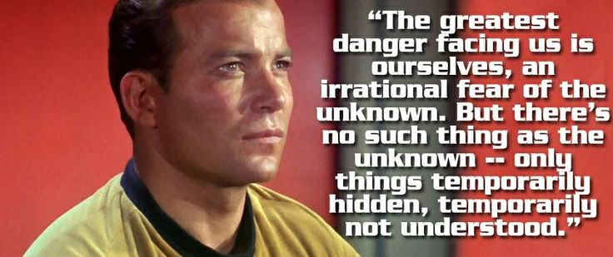
James T. Kirk William Shatner & Chris Pine Captain of the Starship Enterprise

Slide 24
Klingons The Klingons are belligerent warriors.

Slide 25
Krall Idris Elba Krall was the captain of the Starship Franklin. When it crashed into a planet, Krall and his crew felt that they were abandoned by the Federation.

Slide 26
Geordi La Forge LeVar Burton, Chief Engineer of the Starship Enterprise Geordi is blind so he must wear special “glasses.”

Slide 27
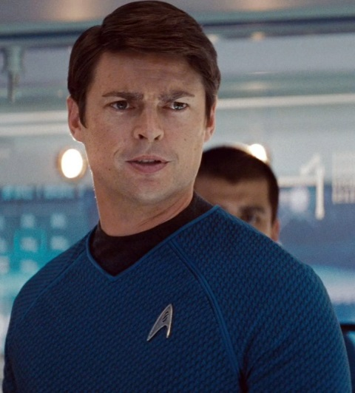
Leonard McCoy (Bones) DeForest Kelley & Karl Urban Chief Medical Officer of the Starship Enterprise

Slide 28
Orions The green-skinned Orion humanoid women seem to be slaves, but in truth, their dancing girations have a powerful influence over human males.

Slide 29
Captain John Luc Picard Patrick Stewart

Slide 30
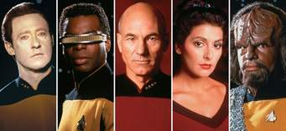
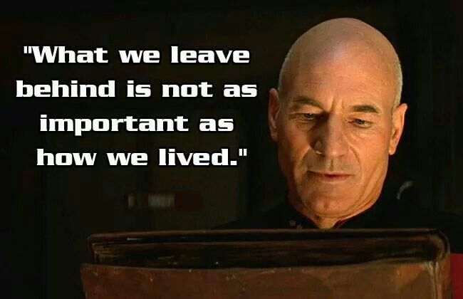
Captain John Luc Picard’s Crew

Slide 31
Q John DeLancie

Slide 32
Quark Armin Shimerman

Slide 33
William Riker Jonathan Frakes 1st Officer of the Starship Enterprise

Slide 34
Romulans The Romulans are a splinter group that broke off from the Vulcans. Unlike the other Vulcans, the Romulans refuse to suppress their emotions.

Slide 35
Romulans with Helmets They are from the “Roman Republic” in Outer Space

Slide 36
Saavik (a Vulcan) Kirstie Alllie & Robin Curtis)

Slide 37
Scotty (Montgomery Scott) James Doohan & Simon Pegg Chief Engineer of the Starship Enterprise

Slide 38
Seven of Nine

Slide 39
Spock Leonard Nemoy & Zachary Quinto

Slide 40
.

Slide 41
Shin Hand Sign

Slide 42
Species 8472 Species 8472 communicate telepathically. The Borgs want to assimilate them, but they are immune to the Borg’s attempts to do so.

Slide 43
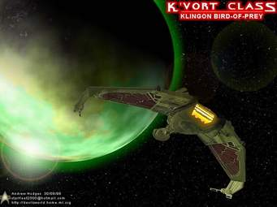
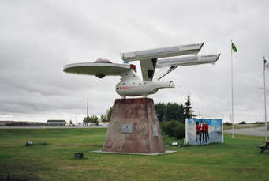
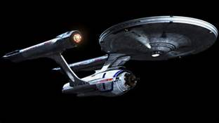
Star Ships: Romulan, Klingon, Vulcan & the Starship Enterprise

Slide 44
Hikaru Sulu George Takei & John Cho Helmsman of the Starship Enterprise

Slide 45
Tellarites The Tellarites are pig-snouted and are very argumentative (pig headed)

Slide 46
Tribbles Tribbles are fun, but there are too many of them.

Slide 47
Deanna Troi Marina Sirtis Communications & Counselor of the Starship Enterprise

Slide 48
Nyota Uhura Michelle Nichols & Zoe Saldana Communications & Counselor of the Starship Enterprise

Slide 49
Vulcans The Vulcans have learned to control their emotions because of their violent past.

Slide 50
Worf Michael Dorn Chief Engineer of the Starship Enterprise

Slide 51
What have you learned?

