Slide 1
Inferring User Activities from
IoT Device Events in Smart Homes:
Challenges and Opportunities
Xuanli Lin, Yinxin Wan, Kuai Xu, Feng Wang, Guoliang Xue
Arizona State University
Presentation at IC3N’2022

Slide 2
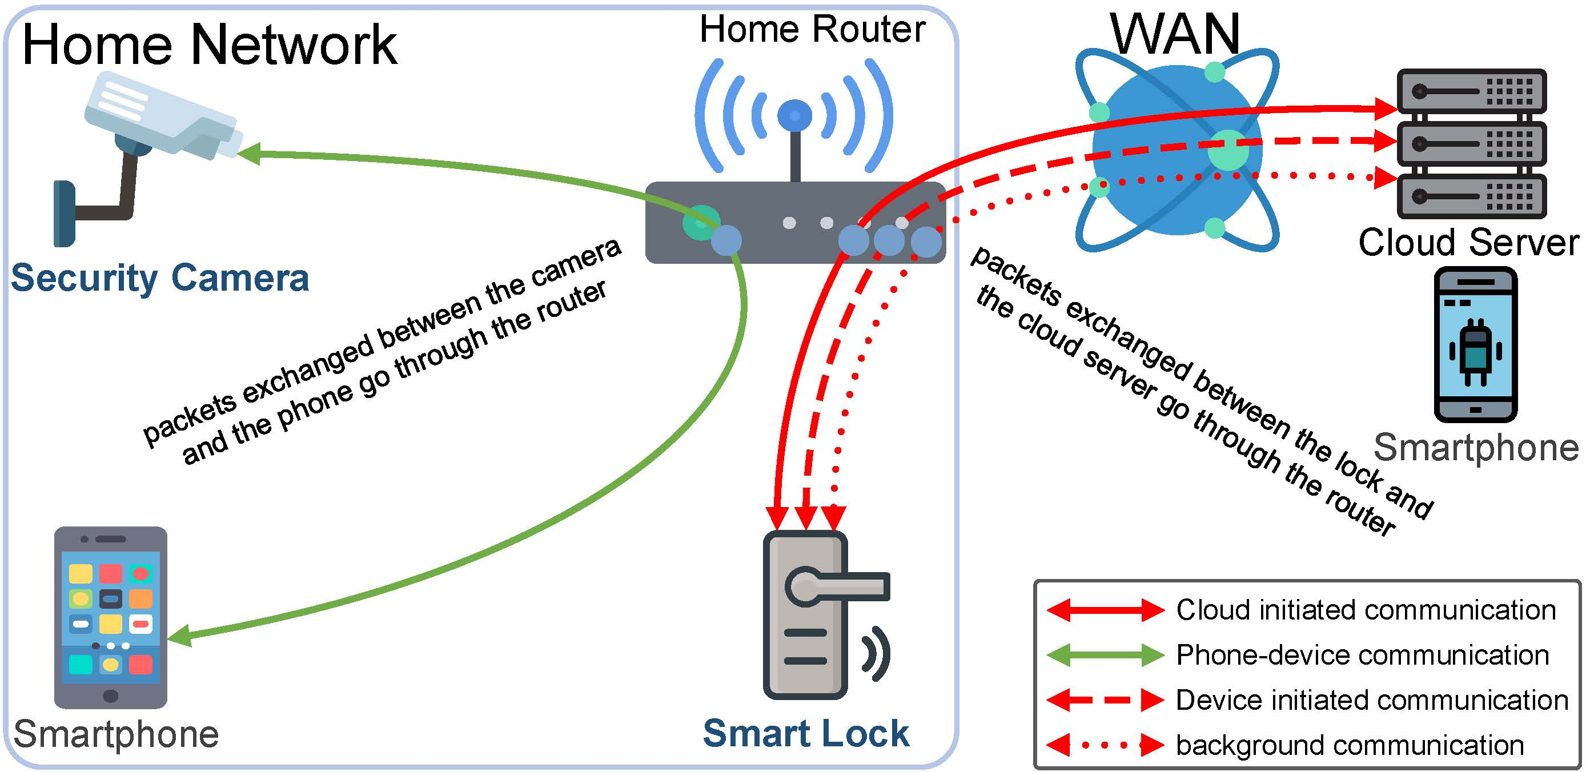
WHAT Do We Have from a Networking Perspective?
Dialogues are going on, many can be captured at the home router
Notes:
Smartphone talking to the cloud server (for August lock) via the app.
The cloud server talks with the lock, going through the home router.
When we use the smartphone to view the security camera, the traffic goes through the home router.

Slide 3
WHAT Do We Have from a Networking Perspective?
22:54:00.750 IP 44.230.166.103.443 > 192.168.1.122.49156: Flags [P.], seq 187180:187593, ack 289324, win 65535, length 413
22:54:00.758 IP 192.168.1.122.49156 > 44.230.166.103.443: Flags [P.], seq 289324:289929, ack 187593, win 12684, length 605
22:54:01.004 IP 44.230.166.103.443 > 192.168.1.122.49156: Flags [P.], seq 187593:188006, ack 289929, win 65535, length 413
22:54:01.012 IP 192.168.1.122.49156 > 44.230.166.103.443: Flags [P.], seq 289929:290534, ack 188006, win 14000, length 605
22:54:02.176 IP 44.230.166.103.443 > 192.168.1.122.49156: Flags [P.], seq 188006:188419, ack 290534, win 65535, length 413
22:54:02.183 IP 192.168.1.122.49156 > 44.230.166.103.443: Flags [P.], seq 290534:291139, ack 188419, win 13643, length 605
22:54:02.420 IP 44.230.166.103.443 > 192.168.1.122.49156: Flags [P.], seq 188419:188832, ack 291139, win 65535, length 413
22:54:02.428 IP 192.168.1.122.49156 > 44.230.166.103.443: Flags [P.], seq 291139:291744, ack 188832, win 13286, length 605
Eight sequenced TCP/IP packets captured during a locking event
Software like tcpdump can capture packets that are sent and received by devices in the local network
Ordered sequences of TCP packets can be observed when an IoT device is in operation
Important information can be obtained from these packets: time, sender, receiver, packet size, etc.
Notes:
(Note: 44.230.166.103 address is the cloud server of August smart lock, and 192.168.1.122 is the August smart lock)
Here we can see a sequence of 8 TCP/IP packets sent and received by a smart lock when someone locks it over internet.
In fact, using software like tcpdump, we can observe similar sequences for many other device events and for different IoT devices.
Looking at this capture, we can find information such as the time the packet was sent, source and destination addresses, and the size of the packets in bytes.
It turns out that this information would be very useful to infer device events.

Slide 4
IoT Device Events and Their Signatures
Each IoT device has a known set of device events
Example 1: Ring Video Doorbell
  stream on
  stream off
  ringing
  motion detection
Example 2: August Lock Pro
  app opening
  WiFi (un)locking
  bluetooth (un)locking
  manual (un)locking
  autolocking
Each device event generates a sequence of network packets, which is called the signature of the corresponding device event (Ping-Pong, IoTAthena)
Notes:
Examples of device events.

Slide 5
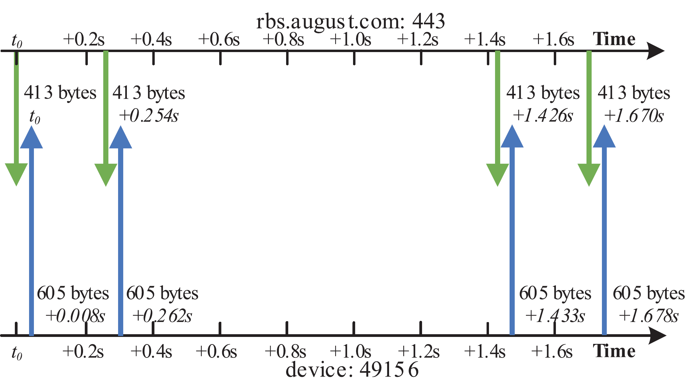
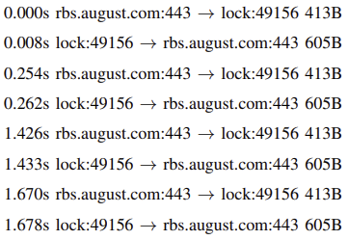
IoT Device Events and Their Signatures
When certain IoT device event occurs, we can observe unique network traffic signature from the IoT device
Network traffic signature when a smart lock (un)locks
Notes:
Signatures of device events.
IoTAthena added “inter-packet intervals” to distinguish more device events.

Slide 6
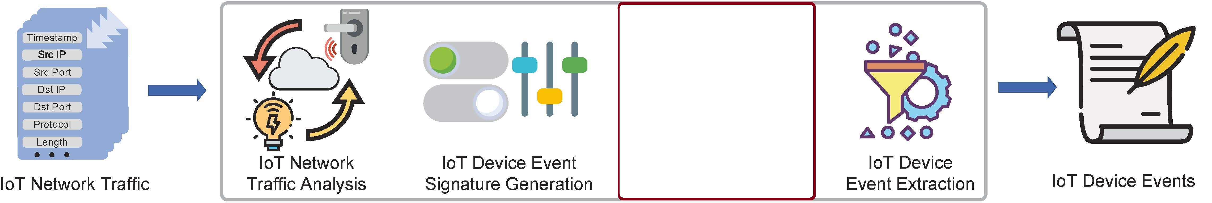
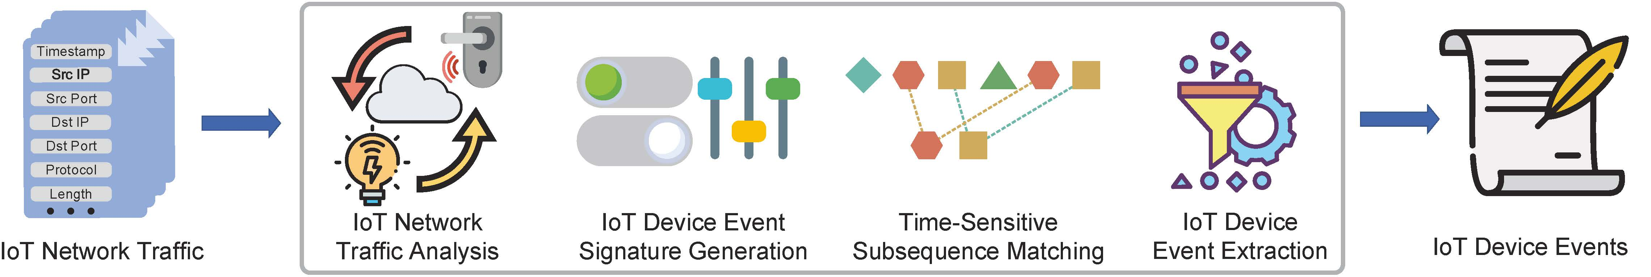
From TCP Packets To Device Events
Ping-Pong (Trimanananda et. al, NDSS’2019)
IoTAthena (Wan et. al, TWC’2022)
Notes:
Using the signatures, we can unveil device events from the sequence of network packets.
First studied by Ping-Pong (Trimananda et. al, 2019), then by IoTAthena (Wan et. al, 2022).

Slide 7
User Activities and Their Signatures
Doorbell Motion Detection
Spotlight On
Doorbell Ringing
Spotlight Off
Someone enters the property, rings the doorbell, and leaves (night)
Notes:
Besides device events, we can infer user activities from network traffic.

Slide 8
From Device Events To User Activities
IoTMosaic (Wan et. al, INFOCOM’2022)
E2AP (Xue et. al, JSAC, in press)
Notes:
These were first studied in IoTMosaic, then improved in E2AP.

Slide 9
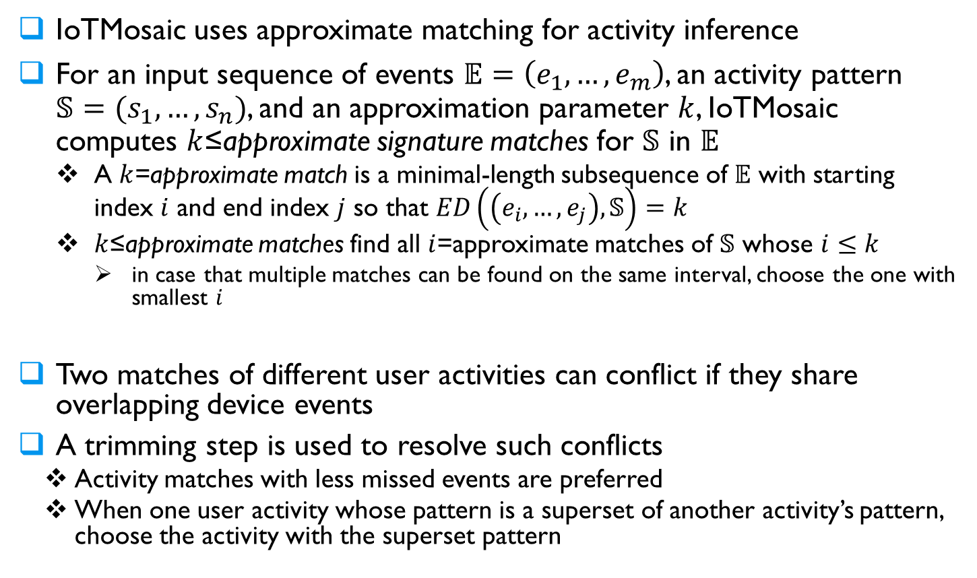
IoTMosaic
IoTMosaic uses approximate matching for activity inference
For an input sequence of events $𝔼=\left(e_{1},…,e_{m}\right)$, an activity pattern $𝕊=(s_{1},…,s_{n})$, and an approximation parameter $k$, IoTMosaic computes $k$≤approximate signature matches for $𝕊$ in $𝔼$
  A $k$=approximate match is a minimal-length subsequence of $𝔼$ with starting index $i$ and end index $j$ so that $ED\left(\left(e_{i},…,e_{j}\right),𝕊\right)=k$
  $k$≤approximate matches find all $i$=approximate matches of $𝕊$ whose $i≤k$
    in case that multiple matches can be found on the same interval, choose the one with smallest $i$
Two matches of different user activities can conflict if they share overlapping device events
A trimming step is used to resolve such conflicts
  Activity matches with less missed events are preferred
  When one user activity whose pattern is a superset of another activity’s pattern, choose the activity with the superset pattern

Slide 10
E2AP: device Events to user Activity Patterns
The E2AP framework dynamically assigns a weight for a full/partial match of a signature.
For given weight assignment, it computes a sequence of compatible user activity-patterns that maximizes the total weight.
The loss function of a weight assignment is the edit distance of the network traffic with the concatenation of patterns of the inferred sequence of activity-patterns.
E2AP computes the optimal weight assignment by minimizing the loss function.
Since it learns the optimal weight, rather than giving higher priority for exact matches, E2AP outperforms IoTMosaic, especially when there are missing device events.

Slide 11
References
R. Trimananda, J. Varmarken, A. Markopoulou, and B. Demsky, “Ping-Pong: Packet-level signatures for smart home device events”, NDSS’2019.
Y. Wan, K. Xu, F. Wang, G. Xue, “IoTAthena: Unveiling IoT device activities from network traffic”, TWC, 2022.
Y. Wan, K. Xu, F. Wang, G. Xue, “IoTMosaic: Inferring user activities from IoT network traffic in smart homes”, INFOCOM’2022.
G. Xue, Y. Wan, X. Lin, K. Xu, F. Wang, “An effective machine learning based algorithm for inferring user activities from IoT device events”, JSAC, in press.
https://www.public.asu.edu/~gxue1/

