Slide 1
Propagation of Trust and Distrust
Guha et al (WWW 2004)

Slide 2
What is the need?
Growing economic motivation to spread information & DISINFORMATION.
Open standards and low barrier to publication on the Web.
Unscrupulous exploitations of social aspect of the Web.
E.g. fake recommendations, link spamming, etc.

Slide 3
Benefits
A reason to believe
Well-trusted may command greater influence
Positive pressure on the evolving social constructs

Slide 4
What to expect…
Absolute or relative trust scores?
Is distrust as important as trust?
Does a trust score of ‘0’ translates to distrust or no opinion?
Should distrust be modeled as negative trust?
How about symmetry, transitivity?
Extremely sparse data
Notes:
Sensitive to outliers, semantics of 0 trust
Markov chain – what do negative probabilities mean
Principal eigenvector need not be real in negative trust matrix

Slide 5
Basic Idea
T: Trust D: Distrust B: Belief
B = T, or B = T – D
Atomic Propagation
a
b
Transpose Trust
(B^{T})
a
b
c
c
Direct Propagation
(B)
c
a
c
a
b
Co-Citation
(B^{T}B)
Trust Coupling
(BB^{T})
d
b
d
Notes:
Propagation of trust and distrust can be defined in terms of matrix operations.
Conclusion is reached based on single argument.

Slide 6
Basic Idea
C_{B,α} = α₁B + α₂B^{T}B + α₃B^{T} + α₄BB^{T}
Propagation of Trust/Distrust
Trust Only: B = T, P^{(k)} = C_{B,α}^{k}
One Step Distrust: B = T, P^{(k)} = C_{B, α}^{k} (T – D)
Propagated Distrust: B = T – D, P^{(k)} = C_{B,α}^{k}
Iterative Propagation
Eigenvalue Propagation (EIG): F = P^{(K)}
Weighted Linear Combination (WLC): F =
Rounding: binarizing the trust values
Transitivity of Distrust
Notes:
When a user distrusts someone they also discount all the judgments made by that person.
Both trust and distrust propagate together, and can be treated as two ends of a continuum.
On Transitivity of distrust (Multiplicative: enemy of enemy is your friend) (Additive: enemy of enemy is your worst enemy)

Slide 7
Experiments
Epinions “web-of-trust” dataset
131,829 nodes; 841,372 edges
Labels: 85.29% Trust (+1.0), 14.71% Distrust (-1.0)
3⁴ = 81 experimental schemes
Propagation of trust/distrust (3 cases): T, T1D, T-D
Iteration method (3 cases): EIG; WLC γ=0.5, γ=0.9
Rounding (3 cases): Global , Local, Majority
Atomic Propagation (3 cases): Direct only (α=e₁), Co-citation only (α=e₂), Combined (α={0.4,0.4,0.1,0.1})
Test strategy: An edge is masked, 81 schemes predict
3250 randomly masked edges
Є=fractions of incorrect predictions made by the scheme
Є_{s}=fractions of incorrect predictions made by the scheme on a balanced test set (498 trust & distrust edges each).

Slide 8
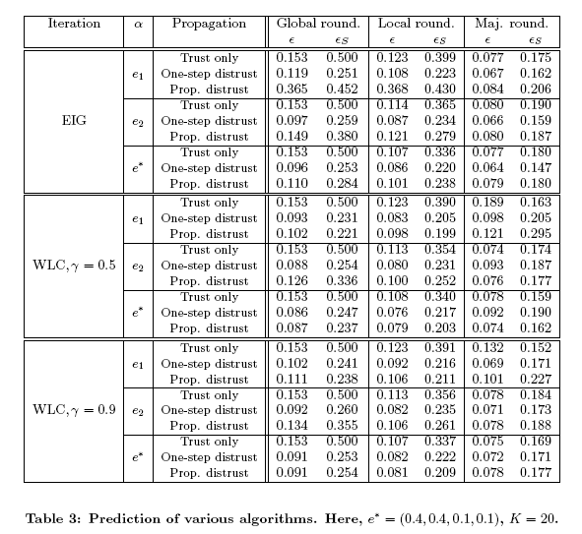
Results

