Slide 1
Relational Learning, and Structured Output
Lei Tang
May.04, 2007

Slide 2
Relational Learning
Typical Classification task: IID assumption
Relational Learning: instances are interrelated.
Some Examples:
Hypertext Classification
Identifying topics in scientific literature.
Prediction of Movie Box Sales

Slide 3
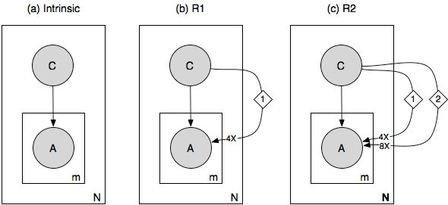
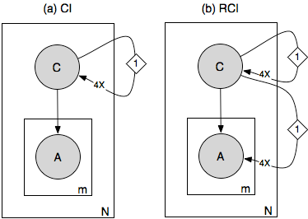
Strategies for relational learning
How to use the link information?
Make it flat, several models (Jens-etal04, kdd)

Slide 4
Ensemble Method
Consider relational learning as datasets with heterogonous attributes.
Another strategy is to build classifier on each type of attribute and do the ensemble learning.

Slide 5
Iterative Strategy for Prediction
For prediction, the class labels are unknown for the neighbors of the test data.
So, iteratively predict until converge. (Nevi-Jens00, AAAI; Li-Geto03, ICML)
This like label propagation in semi-supervised learning.
Baseline models:
Use only attributes
Use only link information (This actually works pretty well on most benchmark datasets used in literature)

Slide 6
Interdependent & Structured Output
The output space is not a “flat” list of labels, but some structure.
E.g. Multi-label/class classification, Hierarchical Classification

Slide 8
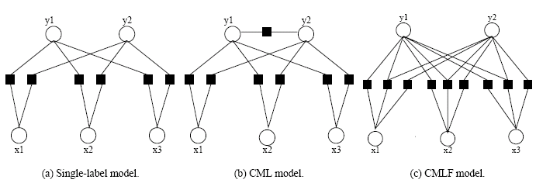
Collective Multi-label Classification
Takes into consideration of interrelations between labels rather than instances.

Slide 9
Multi-task Learning
Perform PCA in the output space to find out principal dimensions.

Slide 10
Large-Margin Methods
Use Joint Feature Map.

Slide 11
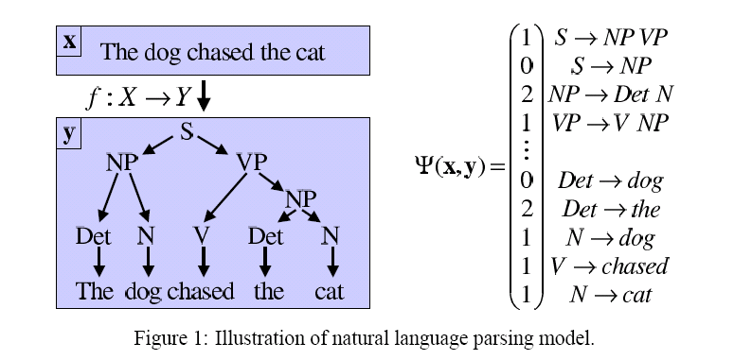

Slide 12
Discussions
Interdependent features (graphical model)
Interdependent instances (not well studied yet)
Interdependent classes (The future)

