Slide 1
Cohesive Subgroups Chapter 7
Feb 20, 2009

Slide 2
Definition of subgroups
Definition of sub-groups: “Cohesive subgroups are subsets of actors among whom there are relatively strong, direct, intense, frequent or positive ties. It formalizes the strong social groups based on the social network properties ”
Discussion in this chapter is dedicated to one-mode networks. So, it
One mode networks: focus is on properties of pair-wise ties
Two mode networks: focus is on ties among actors through
Joint membership in collectivities.
Although the literature contains numerous ways to conceptualize the idea of subgroup, there are four general properties:
The mutuality of ties
The closeness of reachability of subgroup members
The frequency of ties among members
The relative frequency of ties among subgroup members compared to non-members

Slide 3
Subgroups Based on Complete Mutuality
“Cliquish” subgroups (Festinger and Luce and Perry)
Cohesive subgroups in directional dichotomous relations would be characterized by sets of people among whom all friendship choices were mutual.
Definition of a Clique
A clique in a graph is a maximal complete subgraph of three or more nodes, all of which are adjacent to each other, and there are no other nodes that are also adjacent to all of the members of the clique.
Considerations
Strict
Unstable (a single edge will prevent a subgraph from being a clique)
Sparse networks do not have cliques
Small cliques can only be found and a lot overlaps
No internal differentiation among actors within a clique
Notes:
2

Slide 4
Subgroups Based on Complete Mutuality
2
7
Example
Cliques: {1,2,3},{1,3,5}, and {3,4,5,6}
3
1
4
5
6
Notes:
3

Slide 5
Subgroups Based on Reachability and Diameter
Hypothesis: social processes occur through intermediaries . E.g. information diffusion
n-cliques
An n-clique is a maximal subgraph in which the largest geodesic distance between any two nodes is no greater than n.
n = 1 -> clique
n-clans
An n-clan is an n-clique, in which the geodesic distance, d(i,j), between all nodes in the subgraph is no greater than n for paths within the subgraph
All n-clans are n-cliques or subgraph of n-cliques
n-clubs
An n-club is defined as a maximal subgraph of diameter n. They are usually hard to find
Notes:
4

Slide 6
Subgroups Based on Reachability and Diameter
1
Example
2-cliques:
{1,2,3,4,5} {2,3,4,5,6}
2-clans:
{2,3,4,5,6}
2-clubs:
{1,2,3,4} {1,2,3,5}
{2,3,4,5,6}
2
3
4
5
6
Notes:
5

Slide 7
Nodal degrees: from the problem of vulnerability
nodes should be adjacent to relatively numerous other subgroup nodes
K-plexes: each node in the subgraph may be lacking ties to no more than K subgraph members (it includes reflexes)
K=1 clique
If K < (g(s) + 2)/2 , then the diameter is <= 2
K-Cores: specifies the minimum number of links
d
a
b
c
Vulnerable 2-clique – 1 lost tie causes it to disintegrate

Slide 8
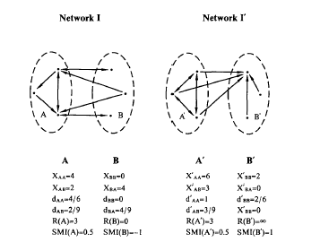
Comparing within to outside subgroup ties
cohesive subgroups should be relatively cohesive within compared to outside
LS sets: ties concept – more inside than outside
A set of nodes S in a social network is an LS set if each of its proper subsets has more ties to its complement within S than to outside of S
Lambda Set: Connectivity concept.
Should be hard to disconnect by removal of edges.
Lambda(i,j): The number of edges that must be removed from the graph in order to leave no path between any two nodes.
Lambda(i,j) > Lambda(k,l) where i,j,k belong to the subgroup and k does not

Slide 9
Measures of Subgroup Cohesion
A measure of degree to which strong ties are within rather than outside is given by the ratio:
The numerator is the average
strength of the ties within and the
denominator is the average
strength from subgroup members
to outsiders
Notes:
8

Slide 10
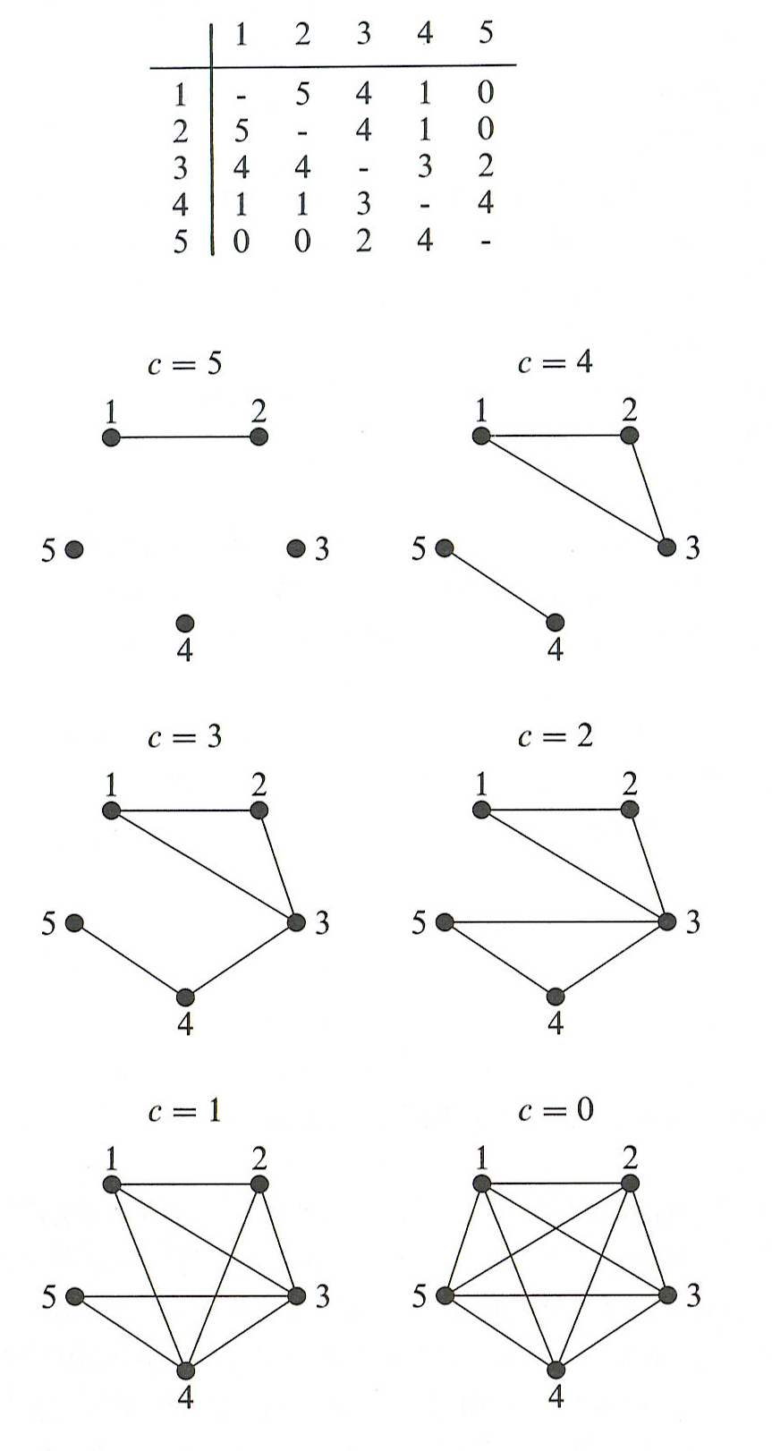
Dealing With Value and Direction
Directional relations: symmetrize the relations
weakly connected n-clique.
unilateral connected n-clique,
strongly connected n-clique
recursively connected n-clique.
Recursive relationship, semi-path
Valued relations : Define cut-off values and then dichotomize. Question: What strength = connection?
Example: Choosing a level for dichotomization

Slide 11
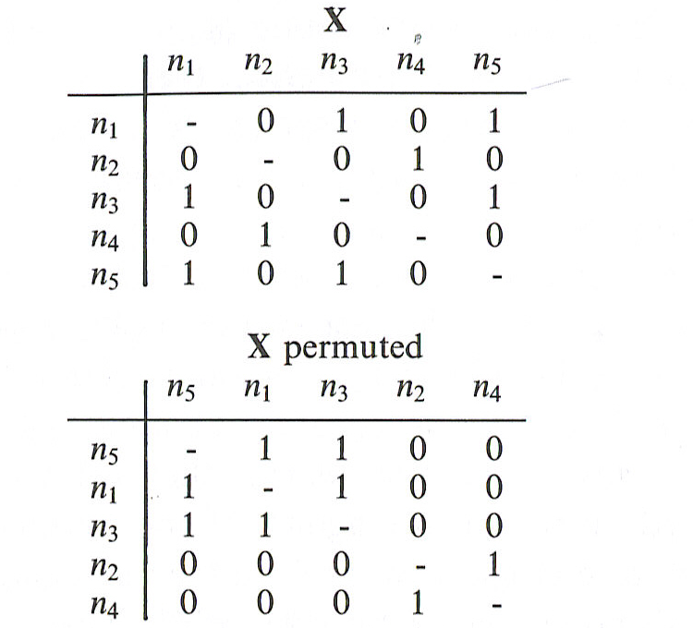
Other Approaches – Permutations & Visualization
Permutation
Multi Dimensional Approach (Clustering Analysis, Factor Analysis: Caldeira (1988)

